Slide 1
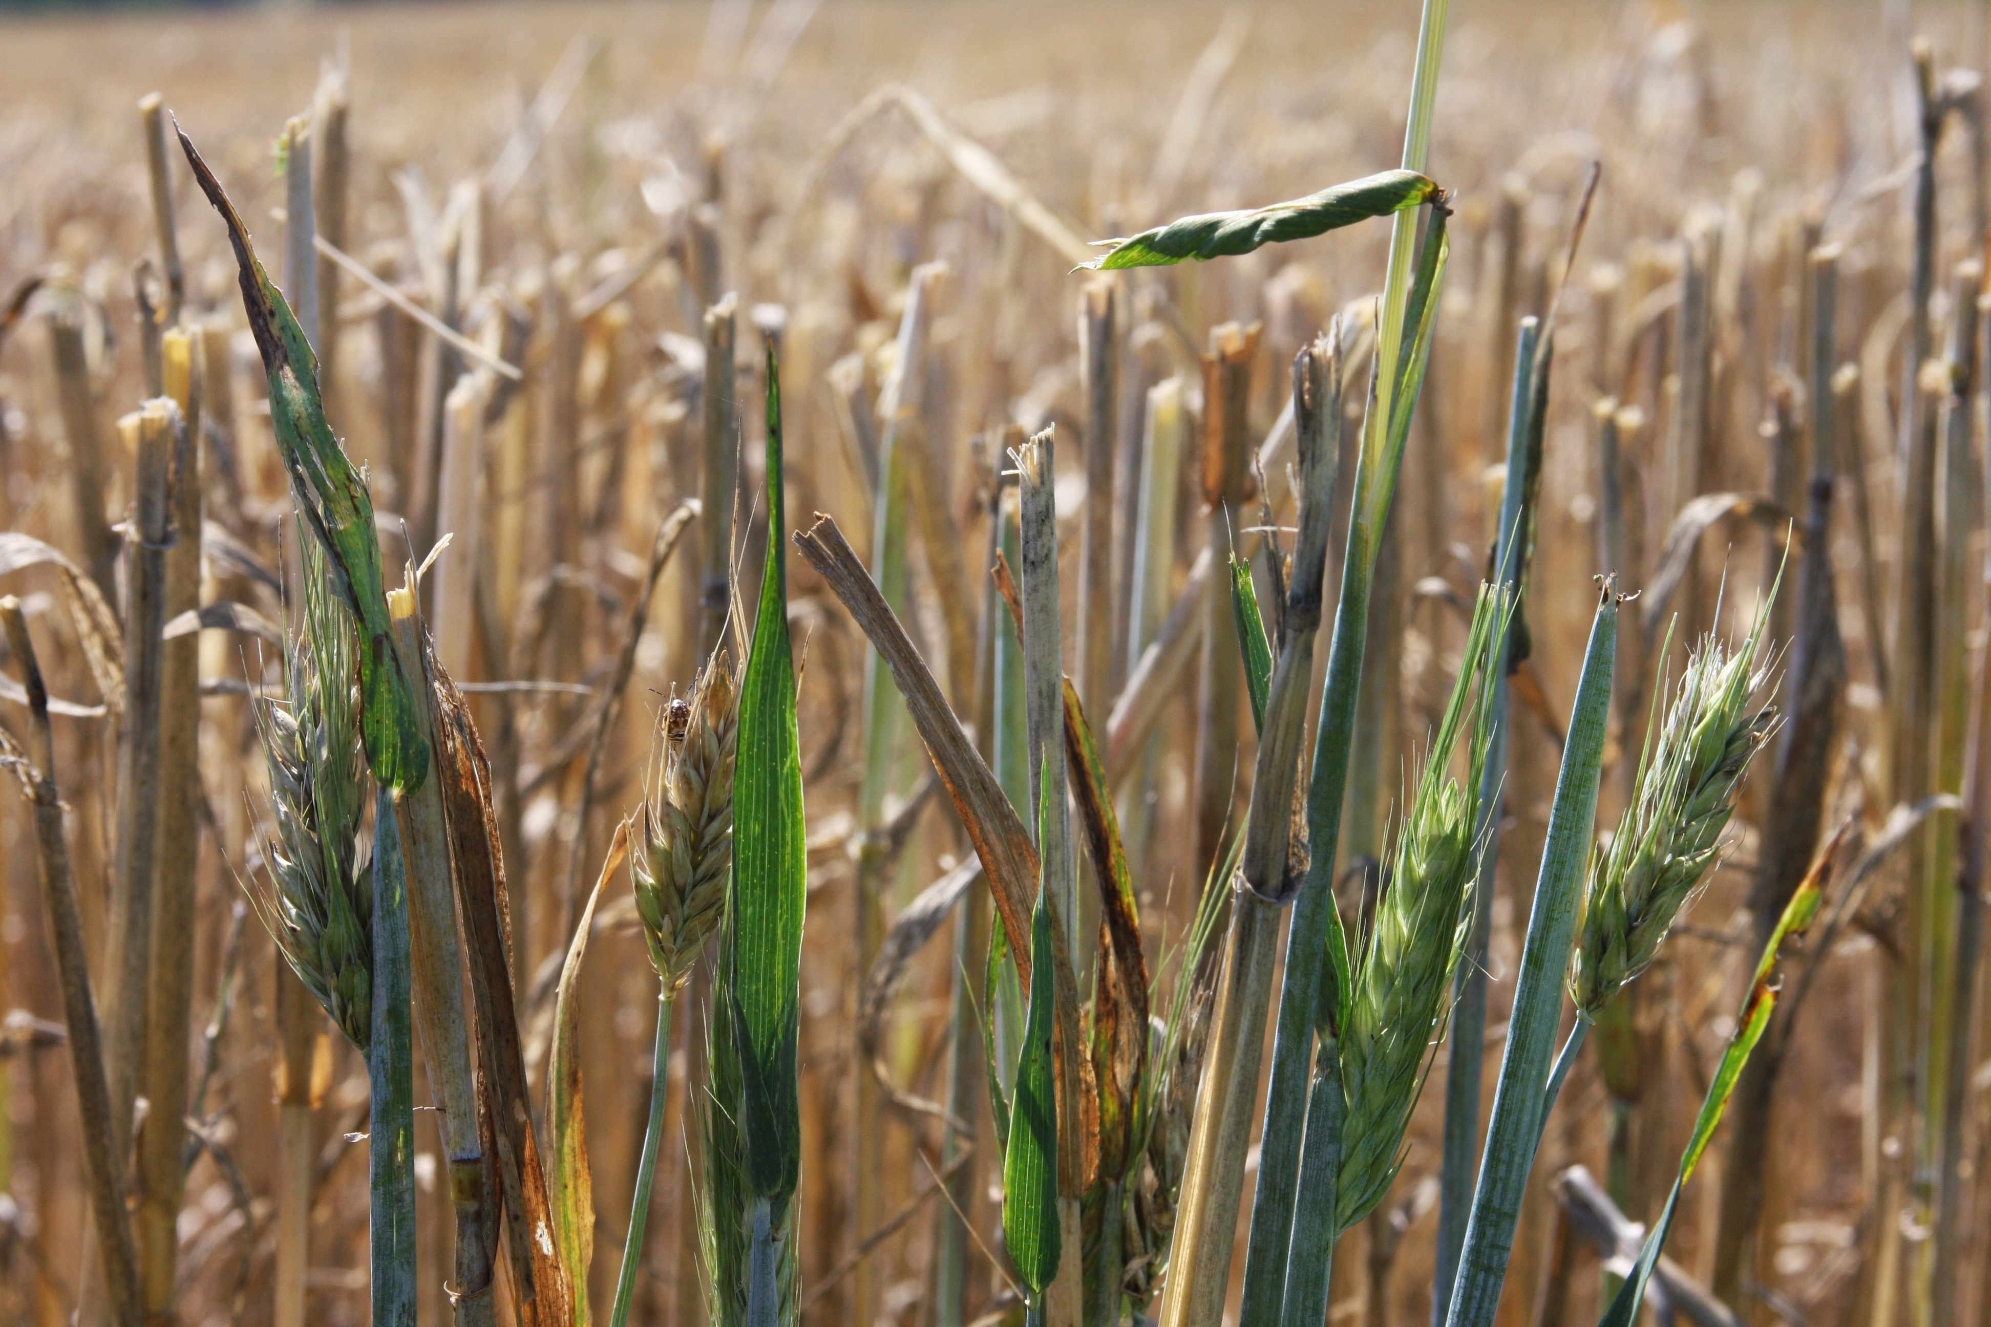
Should I consider Whole-Farm Revenue Protection (WFRP) for my farm operation?
Rod M. Rejesus
Professor and Extension Specialist
Dept. of Ag. and Resource Economics
NC State University

Slide 2
Goals for Today
WFRP Overview
How it came about?
Features of WFRP
NC Experience with WFRP
Take-Home Message(s)

Slide 3
Introduction
2014 Farm Bill required development of a whole farm crop insurance policy (Title XI, Sec. 11022)
Resulted in Whole-Farm Revenue Protection (WFRP)
Primarily because specialty, organic, and diversified crop farmers have historically been underserved
Specialty crops: fruits, nuts, vegetables, and some field crops (including sweet potatoes)
Notes:
NOTE: Markey Penetration and Particpation for traditional commodity crops (corn, soybeans, wheat): on average 89%

Slide 4
Notes:
Source: 2017 RMA study “The Risk Management Safety Net: Market Penetration and Market Potential”

Slide 5
Notes:
Source: 2017 RMA study “The Risk Management Safety Net: Market Penetration and Market Potential”

Slide 6
Introduction
WFRP meant to expand and improve upon prior whole-farm revenue programs:
AGR and AGR-Lite
AGR & AGR-Lite have been lightly used since its introduction in 1999
In NC, only 3 AGR-Lite policies in each year from 2012 to 2014
Started offering WFRP in 2015 (as a pilot)
Now available in all states

Slide 7
What does WFRP cover?
Revenue from all commodities produced on the farm:
Including animal and animal products
Commodities purchased for resale (up to 50% of total)
Excluding timber, forest products, & animals for sport, show or pets
Replant costs for annual commodities
With approval from insurance company
Notes:
ESSENTIALLY: All farm revenue is insured together under one policy. Individual commodity losses are not considered, it is the overall farm revenue that determines losses
Replant costs for annual commodities. Actual cost up to a maximum of 20% of expected revenue for the crop. Record of replant costs required. Insurance company has approval authority. Payable after loss of 20% of the crop or 20 acres.

Slide 8
Main Features of WFRP
All farm revenue is insured together under one policy
Individual commodity losses are not considered, it is the overall farm revenue that determines losses
Coverage levels available: 50% to 85%
In 5% increments
Diversification requirement at 80% and 85% coverage: at least 3 commodities (commodity count)
No catastrophic coverage level for WFRP

Slide 9
Main Features of WFRP
Costs for ‘market readiness operations’ may be left in the approved revenue
Minimum required to make commodity market ready
On farm, in-field or close proximity to field
No added-value costs may be included
Historic revenue can be adjusted to reflect farm expansion (i.e., indexing process)
Allows for 35% growth over historic average (with insurance company approval)
Notes:
- Expanded coverage to allow incidental processing expenses needed to bring commodity to market. Washing, trimming, and packing/packaging costs
- Growth adjustment increases insurable revenue. Growth may be due to higher yielding varieties, additional acres, planting patterns, etc. An indexing process automatically adjusts the historic revenue to reflect farm growth. Farmers can “opt out” of this if they want, Not required (but may be a good idea).

Slide 10
Main Features of WFRP
Can still purchase other Federal crop insurance policies covering individual commodities
Must be at buy-up coverage levels
Any indemnities from these individual policies will count as revenue earned under WFRP
May reduce WFRP premium subsidy

Slide 11
Main Features of WFRP
Premium subsidies are available & depends on farm diversification
Farms with 2 or more “commodities” (commodity count) receive whole-farm premium subsidy
Farms with 1 “commodity” receive basic premium subsidy

Slide 12
WFRP Premium Subsidy
Coverage Level | 50% | 55% | 60% | 65% | 70% | 75% | 80% | 85%
Qualifying Commodity Count: 1 | 67% | 64% | 64% | 59% | 59% | 55% | N/A | N/A
Qualifying Commodity Count: 2 | 80% | 80% | 80% | 80% | 80% | 80% | N/A | N/A
Qualifying Commodity Count: 3 or more | 80% | 80% | 80% | 80% | 80% | 80% | 71% | 56%
WFRP subsidy - % total premium paid by government
Line 1 – Basic Subsidy
Lines 2 & 3 – Whole-Farm Subsidy

Slide 13
Main Features of WFRP
The extent of diversification matters for WFRP
Number of commodities produced are counted toward the diversification requirement in WFRP
Each commodity must provide a certain percentage of the expected farm revenue to be counted
Commodities providing small amounts of revenue may be grouped to meet the qualification
Diversification measure determines:
Eligibility for WFRP, eligibility for the 80% and 85% coverage levels, and premium/premium subsidies
Notes:
Eligibility for WFRP – for example if have farm have commodities that are insurable using individual policies must have at least 2 “commodities”

Slide 14
Premium Example
WFRP Premium Calculators
Quick Estimate from RMA Website
https://ewebapp.rma.usda.gov/apps/costestimator/Estimates/QuickEstimate.aspx
Cornell Ag-Analytics WFRP Premium Calculator
https://ag-analytics.org/CropInsurance/WFRPCalculator
Gives an idea of how much WFRP will cost you!
Notes:
Go through an example here!!!!

Slide 15
Premium Example
Notes:
At this point go to ag analytics website?

Slide 16
WFRP Qualification Limits
WFRP available in every county in the US
But there are limits:
Only covers up to $8.5 million of revenue
Only producers with up to $1 million in expected revenue from: (a) animals & animal products, and (b) greenhouse/nursery may qualify
Notes:
Implication – if greater than 10 million need to break up in to different entitites
This table shows the maximum approved revenue for each of the coverage levels. The expected revenue from each farm cannot exceed $1 million from animal products or greenhouse/nursery and may not exceed $1 million from each of these commodities.

Slide 17
Main Features of WFRP
How is insured revenue determined?
WFRP insured revenue (or liability amount) is the lower of:
Your current year’s expected revenue (as determined by your farm plan) at the selected coverage level, or
Your historic revenue adjusted for growth at the selected coverage level
Notes:
Farm plan – intended farm operation report

Slide 18
Main Features of WFRP
What causes a loss payment under WFRP?
Natural causes of loss and decline in market price during the insurance year
When revenue-to-count for the insurance year is lower than insured revenue, a loss payment will be made
Note: Taxes must be filed for the insurance (loss) year before any claim can be made (e.g., 2017 insurance year requires 2017 year farm taxes to be filed)
Notes:
All natural causes of loss and a decline in the market price will trigger a loss payment. Taxes for the loss year must be filed before a claim can be made. If the revenue to count is lower than the insured revenue, a loss payment will be made. However, unlike simple crop policies, like grain corn, when undisputed claims can be received in as little as 30 days, Whole Farm payments are certain to arrive after taxes are filed, or a considerable time after the actual crop loss.
Last bullet: Although must notify agent immediately if there is loss event (even if likely get paid next year!).

Slide 19
Other WFRP Facts & Features
WFRP only covers revenue ‘produced’ in the insurance year
A commodity not harvested or sold will not count as revenue
A commodity grown last year and sold this year will not be covered
For commodities that grow each year, like cattle, only the growth for the insurance year counts
Example: Calves worth $800 at beginning of the year and to be sold at $2000, the value insured will be $1200
Inventory and Accounts Receivable are used to get to the ‘produced’ amounts
Prices used to value commodities need to meet policy guidelines
Notes:
Beginning and ending inventory will be required in order to determine the value of the commodities harvested and not sold and commodities grown last year and sold this year. For commodities that grow each year, like cattle, only the growth for the insurance year counts. For example, calves worth $800 at the beginning of the year and sold at $2000 at the end of the year can be insured only for the $1200 they increased in revenue-measured value. Any prices used to value commodities that exceed the expected value guidelines in the policy will be reviewed and approved by the underwriting staff.

Slide 20
What will my agent need?
Five years of farm tax forms (Schedule F)
For 2018, from 2012-2016
Need to know if you are:
Calendar year tax filer
Fiscal year filer (and your fiscal year)
What you plan to produce for insured year
To complete Intended Farm Operation Report
Other information as applicable
Such as supporting records, organic certification, etc.
Notes:
The five years of farm tax forms are required for the first year. In the following years, only the most recent tax form will be needed in order to update the 5 year average. Information about what you plan to produce during the insured year is very important. Your completed Whole Farm History Report and your Intended Farm Operation Report must be completed before sales closing the date. Supporting records includes sales records. Sales records for each commodity may be required if a claim is filed.
NOTE: Producers physically unable to farm for one year of the 5-year history may qualify with 4 historic years of taxes if they have been farming also the previous year

Slide 21
Timeline
Sales Closing Date: Feb. 28 for NC producers
For calendar year and early fiscal filers
Intended Farm Operation Report is completed
Late fiscal filers: Nov 20
Revised Farm Operation Report (like acreage report) due
July 15 for calendar year and early fiscal filers
Late fiscal filer: last day of the month in which your fiscal year begins, but no later than October 31
Notes:
You may purchase Whole Farm right up to March 15, however, in light of the preparation needed, contacting a crop insurance agent far in advance of this date is highly recommended. You also need to file an intended farm operation plan or commodity report. This is a list of intended crops for the year. The Revised Farm Operation Report updates your Intended Commodity Report in the event that you did not grow all the commodities and amounts that were intended.
Early Fiscal Filers (Jan-July fiscal years)
Fiscal year means a period of 12 consecutive months used for accounting and tax purposes, and ending on the last day of the twelfth month as long as the twelfth month is not December.
Early fiscal year filer means an insured that files taxes with a fiscal year that begins prior to August 1 of the insurance year.
Late fiscal year filer means an insured with a fiscal year that begins August 1 or later in the insurance year.

Slide 22
Timeline
Billing Dates:
Calendar year and early fiscal filers: Aug 15
Late fiscal filers: Dec 20
Final Farm Operation Report (where actual production and revenue information provided):
Due when:
A claim is submitted for indemnity, or
By next year’s sales closing date (if no claim)
If not provided, limited to 65% coverage next year
Notes:
Early Fiscal Filers (Jan-July fiscal years)
The Final Farm Operation Report includes the actual production and revenue information by commodity.

Slide 23
What farms benefit from WFRP?
Attractive option for:
Diversified farms (especially those with specialty crops)
Farms with integrated grain & livestock systems
Single commodity farms not insurable by other RMA policies
Organic crop producers (who grow crops without adequate organic price elections for insurance)
Farms that sell to direct markets, local markets, specialty markets
Notes:
Lat two byullets – because of WFRP covering revenue and actual prices received from these markets! Actual prices received are taken into account.

Slide 24
WFRP Experience in NC
Year | Policies Sold | Liability | Total Premium | Subsidy | Indemnity | Loss Ratio
2015 | 23 | 24,420,238 | 1,759,835 | 1,351,511 | 969,441 | 0.55
2016 | 61 | 87,934,030 | 5,290,762 | 3,997,604 | 8,552,678 | 1.62
2017 | 103 | 162,119,181 | 8,887,121 | 6,617,003 | 125,617 | 0.01
Steadily increasing participation over the last three years
Recall, only 3 AGR-Lite policies sold each year from 2012-2014
Notes:
Recall: Prior to 2015 only 3 AGR-Lite policies sold for the whole state

Slide 25
Top 5 WFRP Counties in 2016
County | Policies Sold | Liability | Total Prem. | Subsidy | Indemnity | Loss Ratio
Nash | 8 | 20.36M | 1,055,741 | 826,108 | 2,060,331 | 1.95
Edgecombe | 6 | 18.23M | 654,434 | 487,695 | 1,444,258 | 2.21
Sampson | 6 | 11.45M | 867,774 | 663,529 | 440,495 | 1.66
Harnett | 6 | 7.38M | 396,521 | 274,174 | 182,465 | 1.11
Wayne | 6 | 2.97M | 195,618 | 146,891 | 108,986 | 0.93
In 2016, 19 NC counties had WFRP
In 2015, only 13 NC counties have WFRP
Notes:
Recall: Prior to 2015 only 3 AGR-Lite policies sold for the whole state

Slide 26
Top 5 WFRP Counties in 2017
County | Policies Sold | Liability | Total Prem. | Subsidy | Indemnity | Loss Ratio
Johnston | 15 | 15.17M | 576,903 | 459,129 | 74,895 | 0.13
Nash | 12 | 32.21M | 1,748,073 | 1,322,544 | 17,812 | 0.01
Sampson | 10 | 17.84M | 1,329,555 | 969,583 | - | -
Duplin | 9 | 7.77M | 556,389 | 437,001 | - | -
Edgecombe | 7 | 22.90M | 795,079 | 581,893 | 28,092 | 0.03
In 2017, 28 NC counties had WFRP
Notes:
Recall: Prior to 2015 only 3 AGR-Lite policies sold for the whole state

Slide 27
2016 WFRP Experience in NC
Coverage Level | Policies Sold | Liability | Total Premium | Subsidy | Indemnity | Loss Ratio
55% | 2 | 589,047 | 77,581 | 50,807 | 230,523 | 2.97
65% | 2 | 1,927,887 | 185,320 | 125,419 | 14,316 | 0.08
75% | 36 | 48,519,227 | 3,241,345 | 2,580,982 | 2,547,367 | 0.78
80% | 15 | 33,994,238 | 1,586,009 | 1,128,112 | 5,109,622 | 3.22
85% | 6 | 2,903,631 | 200,507 | 112,284 | 650,850 | 3.25
NC farmers who bought WFRP in2016 mostly insured at 75% coverage level
Same pattern in 2015 and 2017
Notes:
NOTE: Geographically in 2016 --- Most WFRP insured – 5+ in each county -- Edgecombe, Harnett, Johnston, Nash (8), Sampson, and Wayne Counties
2017 – Duplin included (9), som other counties > 10 – Johnston, Nash, Sampson

Slide 28
Issues/Concerns with WFRP
Diversified farms already have low revenue risk
Do not experience significant revenue variation
Some do not experience revenue drops below 85%
WFRP may not be a good option in this case
Premiums perceived to be “high”
Premium is a function of county, commodities grown, % revenue for each commodity, commodity count
Need adjustments over time to better reflect risk experience?

Slide 29
Issues/Concerns with WFRP
Policy complexity & paperwork requirement
Agents sometimes not familiar and not willing to service this policy
Perceived underwriting risk – not sure exactly what losses are to be covered
Qualification requirements
Revenue Limits
Availability of tax records (< 5 years)

Slide 30
WFRP not for you?
If individual commodities insurable through RMA, then individual policies still an option (e.g., Yield Protection and Revenue Protection)
If not insurable through RMA, then may consider Non-insured Crop Disaster Assistance Program (NAP) through FSA
2014 Farm Bill authorized higher coverage levels: 50-65% in 5% increments at 100% of price
Made it “crop-insurance-like”

Slide 31
Take Home Message(s)
WFRP has potential to be an attractive risk management option for diversified operations
At least call your agent to explore this option
Increasing participation in NC
Issues with program complexity & paperwork requirements that one needs to work through
Consider interactions with individual crop insurance policies, NAP, and/or commodity programs

Slide 32
Thank you!
Questions?
Contact: Rod M. Rejesus, NC State University
Tel No. (919)513-4605
Email: rod_rejesus@ncsu.edu
Website:
NCSU Ag. Policy, Risk Mgt., & Crop Insurance Resources
https://ag-econ.ncsu.edu/agricultural-policy-risk-management-and-crop-insurance-resources/

