Slide 1


Customer and Market Segmentation

Slide 2
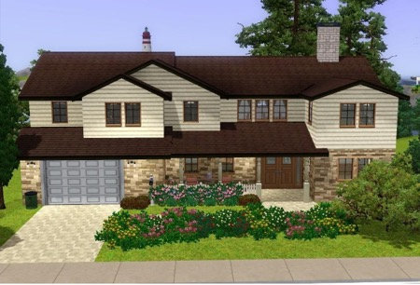
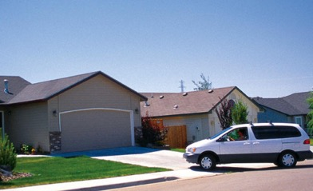
Customer Needs & Customer Identity
Customer Problem
What kind of siding to put on my home
What benefits do customers seek?
How much are they WTP for these benefits?
Will they pay more for benefits above those offered by current producers?
Segment Identification
Factors differentiating each segment
Demographics – income, home value, location
Usage behaviors – installation, repair, maintenance
Psychographics – activities, interests, opinions, leisure
Segment B
Segment A
Source: Roger J. Best, Market Based Management
Notes:
When segmenting a market, it is best to start with customer needs and then determine which demographics influence those needs. The market segmentation process should begin with the benefits that customers are seeking in order to solve a particular customer problem. Because different customers seek different solutions for the same problem, our first challenge is to identify and understand the various customer needs that drive product consideration and preferences. After we have grouped customers into needs-based segments, we can then ask, “What are the demographics, usage behaviors, and psychographics that distinguish one group of customers from another?” Knowing the factors that differentiate one segment from another helps us identify the segments. Here we can see how we might divide the market for home siding into two segments that have different needs: a price-sensitive segment and a quality-conscious segment. Needs-based segmentation provides the basic guidelines for product positioning strategies and marketing communications. With the market properly segmented, we can now develop specific segment value propositions that will attract new customers and retain existing ones.

Slide 3
These questions don’t work because they are Organization-centric
Questions we can ask when thinking about our customers.
What can we sell customers?
How can we reach customers most efficiently?
What relationships do we need to establish with customers?
How can we make money from our customers?

Slide 4
Instead, we should ask these and shift to be more Customer-centric.
What jobs do our customers need to get done and how can we help?
What are our customers aspirations and how can we help them live up to them?
How do our customers prefer to be addressed?
How do we, as a business, best fit into their routines?
What relationship do our customers expect us to establish with them?
For what value are customers truly willing to pay?

Slide 5
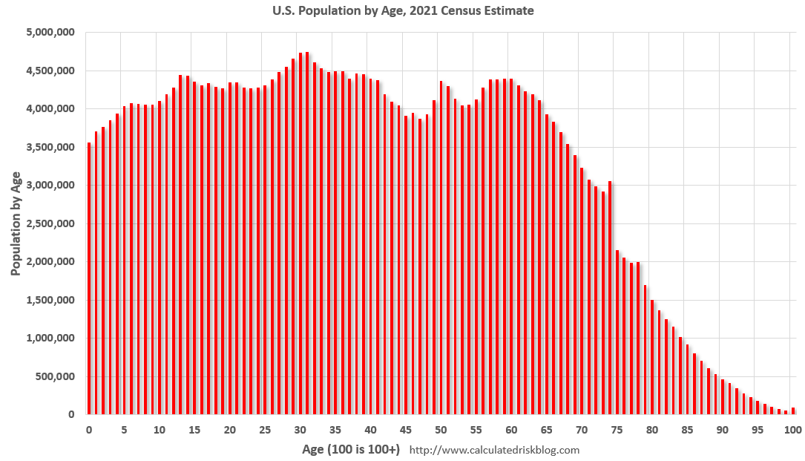
U.S. Population by Age and Generational Groups (2021)
Generations Defined by Age in 2021
Gen Alpha
27.9M
Gen Z
68.6 M
Millennials
72.2M
Gen X
65.8 M
Boomers
71.7 M
Silent
19.1 M
Present Age: 0-8 9-26 25-40 41-56 57-75 76-100+
Birth Date: 2013+ 1997-2012 1981-1996 1965-1980 1946-1964 1928-1945
Source: US Census Bureau, 2021 Projected Population by Single Age, released June 2020 based on 2010 data. Generations defined by Pew Research Group.

Slide 6
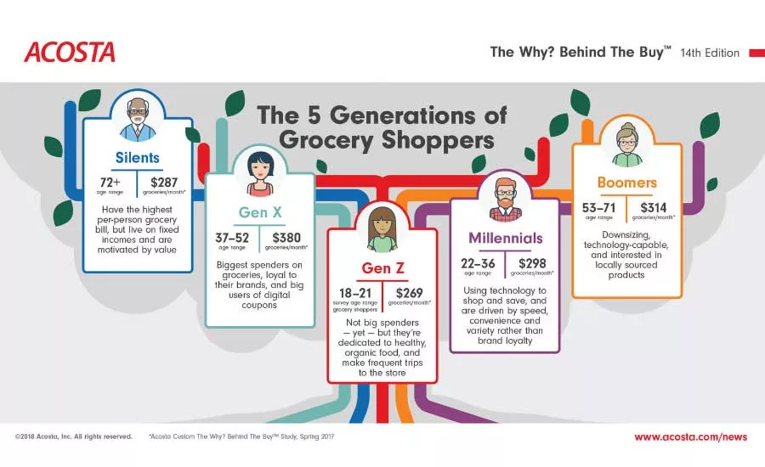
Generational Differences Matter
76+
$287
Have the highest per person grocery bill but live on fixed incomes and are motivated by value
57-75
$314
41-56
$380
Downsizing, technology-capable, and interested in locally sourced products
Biggest spenders on groceries, loyal to brands, and big users of digital coupons
25-40
$298
18-24
$269
Use tech to shop and save, driven by speed, variety, and convenience, rather than brand loyalty
Not big spenders yet, but dedicated to healthy food, and make frequent trips to the store

Slide 7




What drives customer needs?
Consumer Market Customer Needs
Demographic Influences
Lifestyle
Influences
Usage
Behaviors
Age
Income
Marital status
Education
Occupation
Attitudes
Values
Activities
Interests
Political views
Quantity
Time of use
Personality
Social
Frequency of use
Source: Roger J. Best, Market Based Management
Notes:
Three primary forces shape the needs of consumers. Needs and preferences often shift as a person moves demographically from one life situation to another. Changes in income, occupation, and educational level all contribute to a changing set of customer needs for a variety of products. Lifestyle forces created by differences in values, attitudes, and interests also contribute to differences in customer needs. Two consumers who are demographically the same may differ significantly in their attitudes and value orientations. A consumer with strong environmental values is likely to prefer a different car than a demographically identical person whose values are focused on fun, enjoyment, and personal gratification. A third major force in shaping customer needs is usage behavior. How the product is used, when it is used, and how much it is used are all forces that shape customer needs for a great many products.

Slide 8
What drives business customer needs?
Business-to-Business
Customer Needs
Firm Demographics
Company Culture
Usage Behaviors
Number of employees
Sales Volume
Number of Locations
Years in business
Financial situation
Business sophistication
Growth orientation
Innovativeness
Technology
Decision making
Application
Quantity
Time of purchase
Frequency of purchase
Users
Source: Roger J. Best, Market Based Management
Notes:
Three primary forces shape the needs of consumers. Needs and preferences often shift as a person moves demographically from one life situation to another. Changes in income, occupation, and educational level all contribute to a changing set of customer needs for a variety of products. Lifestyle forces created by differences in values, attitudes, and interests also contribute to differences in customer needs. Two consumers who are demographically the same may differ significantly in their attitudes and value orientations. A consumer with strong environmental values is likely to prefer a different car than a demographically identical person whose values are focused on fun, enjoyment, and personal gratification. A third major force in shaping customer needs is usage behavior. How the product is used, when it is used, and how much it is used are all forces that shape customer needs for a great many products.

Slide 9




Customer Segmentation
The process of dividing a customer base into smaller groups or segments based on shared characteristics such as lifestyle influences, usage behaviors, and demographics.

Slide 10
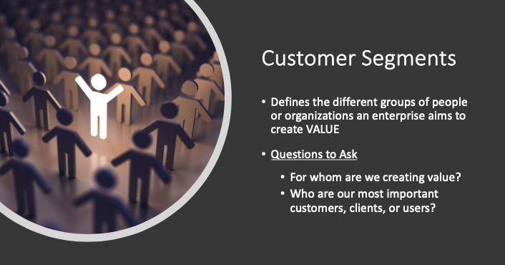
Source: StrategyzerAG

Slide 11
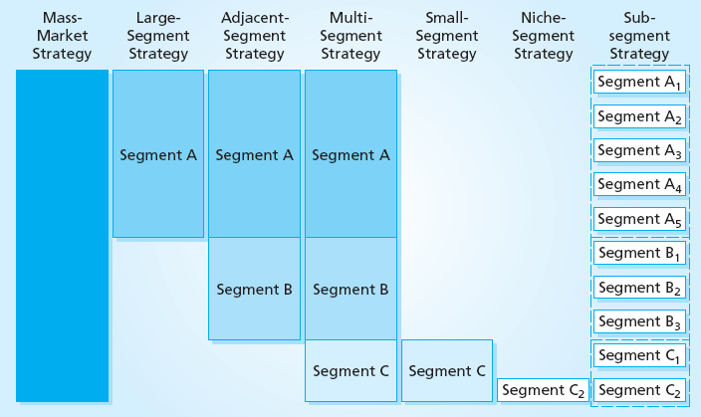
Segmentation Strategies
Mass- Market Strategy
Large- Segment Strategy
Adjacent- Segment Strategy
Multi-Segment Strategy
Small-Segment Strategy
Niche-Market Strategy
Sub-Segment Strategy
Source: Roger J. Best, Market Based Management
Notes:
When differences in customer needs are small or demographics are not distinctive, a business may elect to use a mass-market strategy. This strategy presents a generic value proposition that is built around the core customer need and the business’s generic positioning strategy.
When a market is segmented and marketing resources are limited, a business could elect to pursue a large-segment strategy. Unlike a mass-market strategy, a large-segment strategy addresses one set of core customer needs.
Businesses quite often find that they have pursued a single-segment focus but have reached the point of full market penetration. When this is the case, an adjacent-segment strategy offers an attractive opportunity for market growth.
Although a market may offer opportunities in several segments, a business with limited resources and certain capabilities may elect to compete in the small segment. The smallest segment, represented by segment C above, is often ignored by large competitors, who may use mass-market or large-segment strategies.
A niche within a segment, is another strategy that uses a highly refined marketing effort directed at an overlooked small group of target customers with unique needs, demographics, lifestyle or usage behaviors.

Slide 12
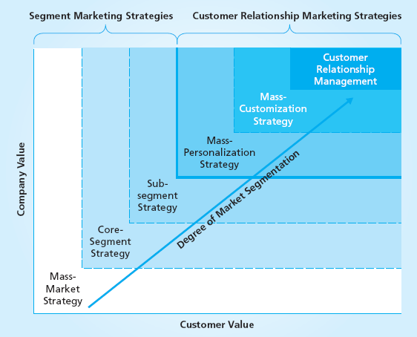
Customer Relationship Marketing
There are three levels of
Customer Relationship Marketing
Mass Personalization
Mass Customization
Customer Relationship
Management
Source: Roger J. Best, Market Based Management
Notes:
Many businesses work hard to acquire new customers, but this is where the effort to promote good customer relations often stops. By contrast, customer relationship marketing is more focused on what happens after a customer is acquired. The goal of customer relationship marketing is to develop a long-term customer relationship that benefits both the customer and the company. As the potential for greater company value and customer value increases, the company gains an opportunity to extend its market segmentation to individual customers. As shown here , customer relationship marketing includes three different strategies for three different groups of customers as determined by company value and customer value. Customer relationship marketing is often called customer relationship management, but these two terms have distinct meanings:
■ Customer relationship marketing (CRM) is a range of one-on-one relationship marketing programs based on the level of company and customer value.
■ Customer relationship management is a high-level CRM program for developing ongoing individualized relationships with certain customers when both company and customer value are high enough to warrant this level of marketing effort.

Slide 13
Four Steps Critical to the Success of Customer Relationship Management
Qualify
Qualify current customers for customer relationship management based on attractive levels of potential customer and company value
Understand
Understand individual customer needs, product preferences, and usage behaviors
Create
Create individualized customer solutions based on the customer’s unique needs and establish customer touch points that will serve to build and sustain the relationship
Track
Track customer experiences and all aspects of customer satisfaction to ensure that high levels of customer satisfaction and customer loyalty are achieved
Source: Roger J. Best, Market Based Management

Slide 14


What defines a customer segment?
Do their needs require and justify a distinct offer?
Are they reached through separate distribution channels?
Do they require different types of relationships?
Do they have substantially different profitability levels?
Are they willing to pay for different aspects of the offer?
Source: StrategyzerAG

Slide 15
Exercise
Individually consider who the Brown’s current customer segments are – 1 min
01
Brainstorm the Brown’s customer segments in your group – 2 min
02
List or use post-its to demarcate each segment on the BMC – 7 min
03

