Slide 1
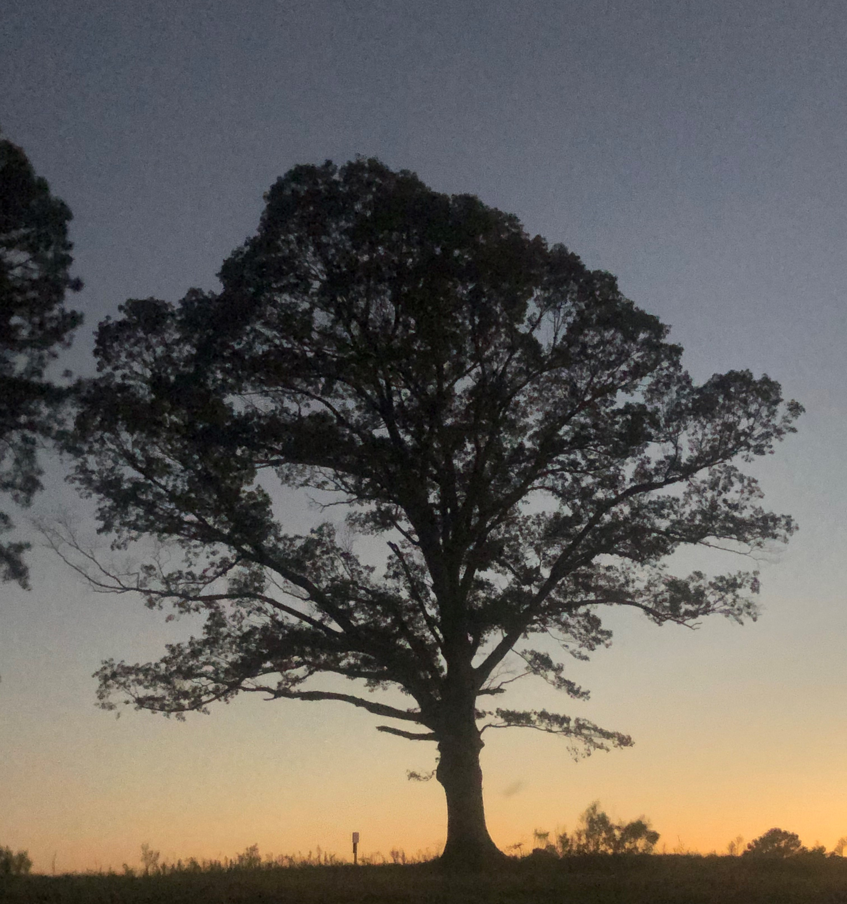
Developing Next Gen Leaders
David Mayo mayod@ecu.edu

Slide 2
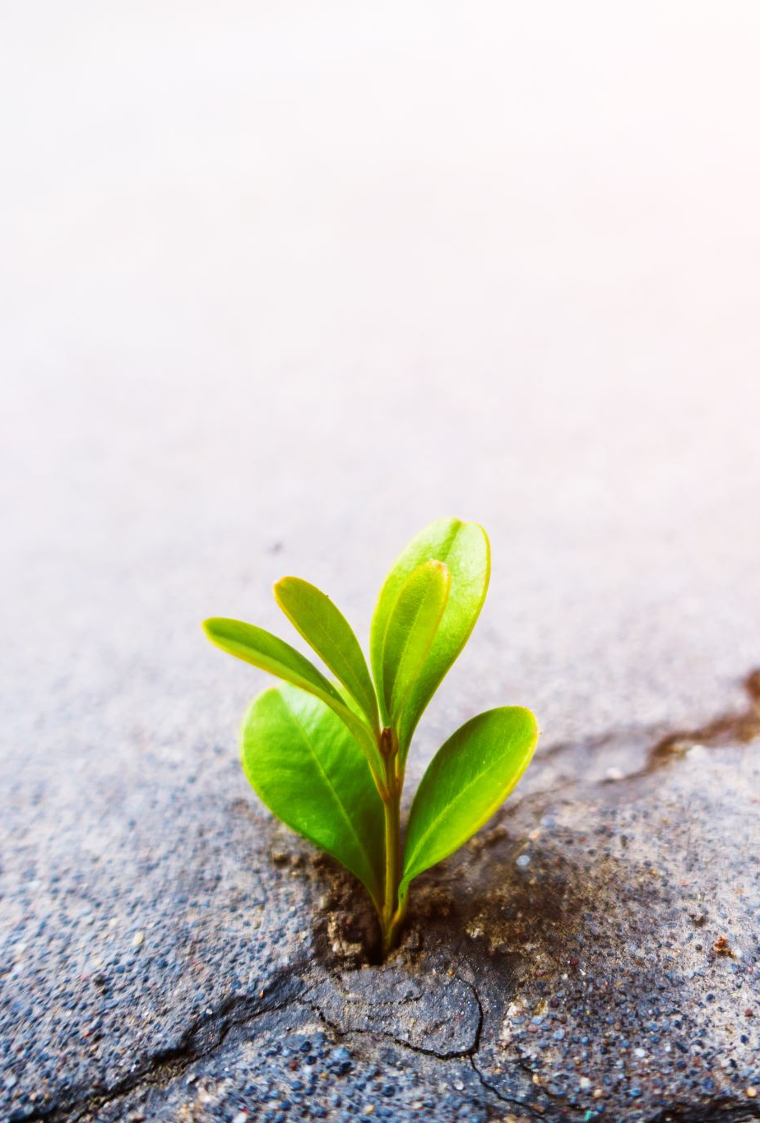
Agenda
Understand the importance of family farm transition
Note best practices for generational leadership development
Assess Farm Succession Readiness

Slide 3
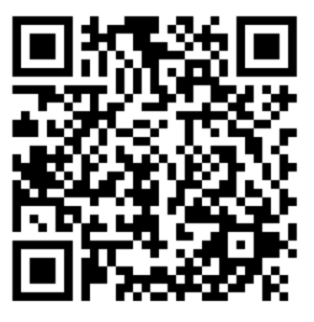

Slide 4
What percentage have a transition plan?
A: fewer than 10%
B: 20%
C: 37%
D: more than 70%

Slide 6
What percentage of people believe succession planning is important?
A: 20%
B: 67%
C: 90%
D: 98%

Slide 8

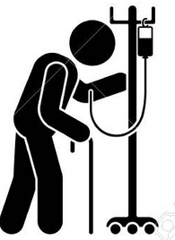

So Big Surprise…
Second Generation 30%
Third 12%
Fourth 3%

Slide 9

We all know that farmers are aging…
Farmers over 65 outnumber farmers under 35 by 5 to 1

Slide 10
In the next 20 years what percentage of US farmland will change hands?
A: 70%
B: 60%
C: 50%
D: 30%

Slide 11
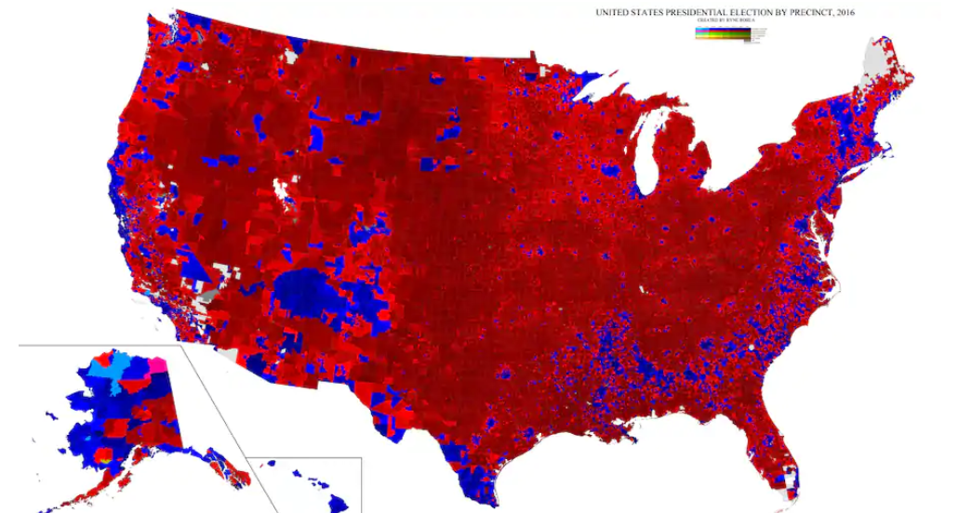
About 70% of the land area will change hands. 77% of that land will go to relatives.

Slide 12
Family farms tend ____% of farmland in the US.
A: more than 93
B: 90
C: 85
C: less than 60

Slide 13
Family farms tend ____% of farmland in the US.
A: more than 93
B: 90
C: 85
C: less than 60

Slide 14
Last one… Farmers with a college education
A: are almost twice as likely to have a succession plan
B: are 40% more likely to have a succession plan
C: are 10% more likely to have a succession plan
D: are 10% less likely to have a succession plan

Slide 15
Last one… Farmers with a college education
A: are almost twice as likely to have a succession plan
B: are 40% more likely to have a succession plan
C: are 10% more likely to have a succession plan
D: are 10% less likely to have a succession plan

Slide 16
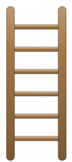
The Agricultural Ladder
Full Ownership
Mortgage Operator
Tenant
Wage Labor
Doing chores
W.J. Spillman 1919

Slide 17
A New Ladder
Chores
Wage Labor
Managerial Responsibility
Leadership Development Training
Organizational Decision Making
Organizational Leadership
Successor Mentorship

Slide 18
Map the ladder at Brown Family Farm
Current position in the Family Farm
Name(s):
Current position in the Family Farm
Name(s):
Chores
Wage Labor
Managerial Responsibility
Leadership Development Training
Organizational Decision Making
Organizational Leadership
Successor Mentorship
Current position in the Family Farm
Name(s):
Current position in the Family Farm
Name(s):
Current position in the Family Farm
Name(s):
Current position in the Family Farm
Name(s):
Steps to move to next level
Step(s):
Current position in the Family Farm
Name(s):
Steps to move to next level
Step(s):
Steps to move to next level
Step(s):
Steps to move to next level
Step(s):
Steps to move to next level
Step(s):
Steps to move to next level
Step(s):
Steps to move to next level
Step(s):

Slide 19
Steps to move to next level
Step(s):
Steps to move to next level
Step(s):
Steps to move to next level
Step(s):

Slide 20
Steps to move to next level
Step(s):
Steps to move to next level
Step(s):
Steps to move to next level
Step(s):

