Slide 1

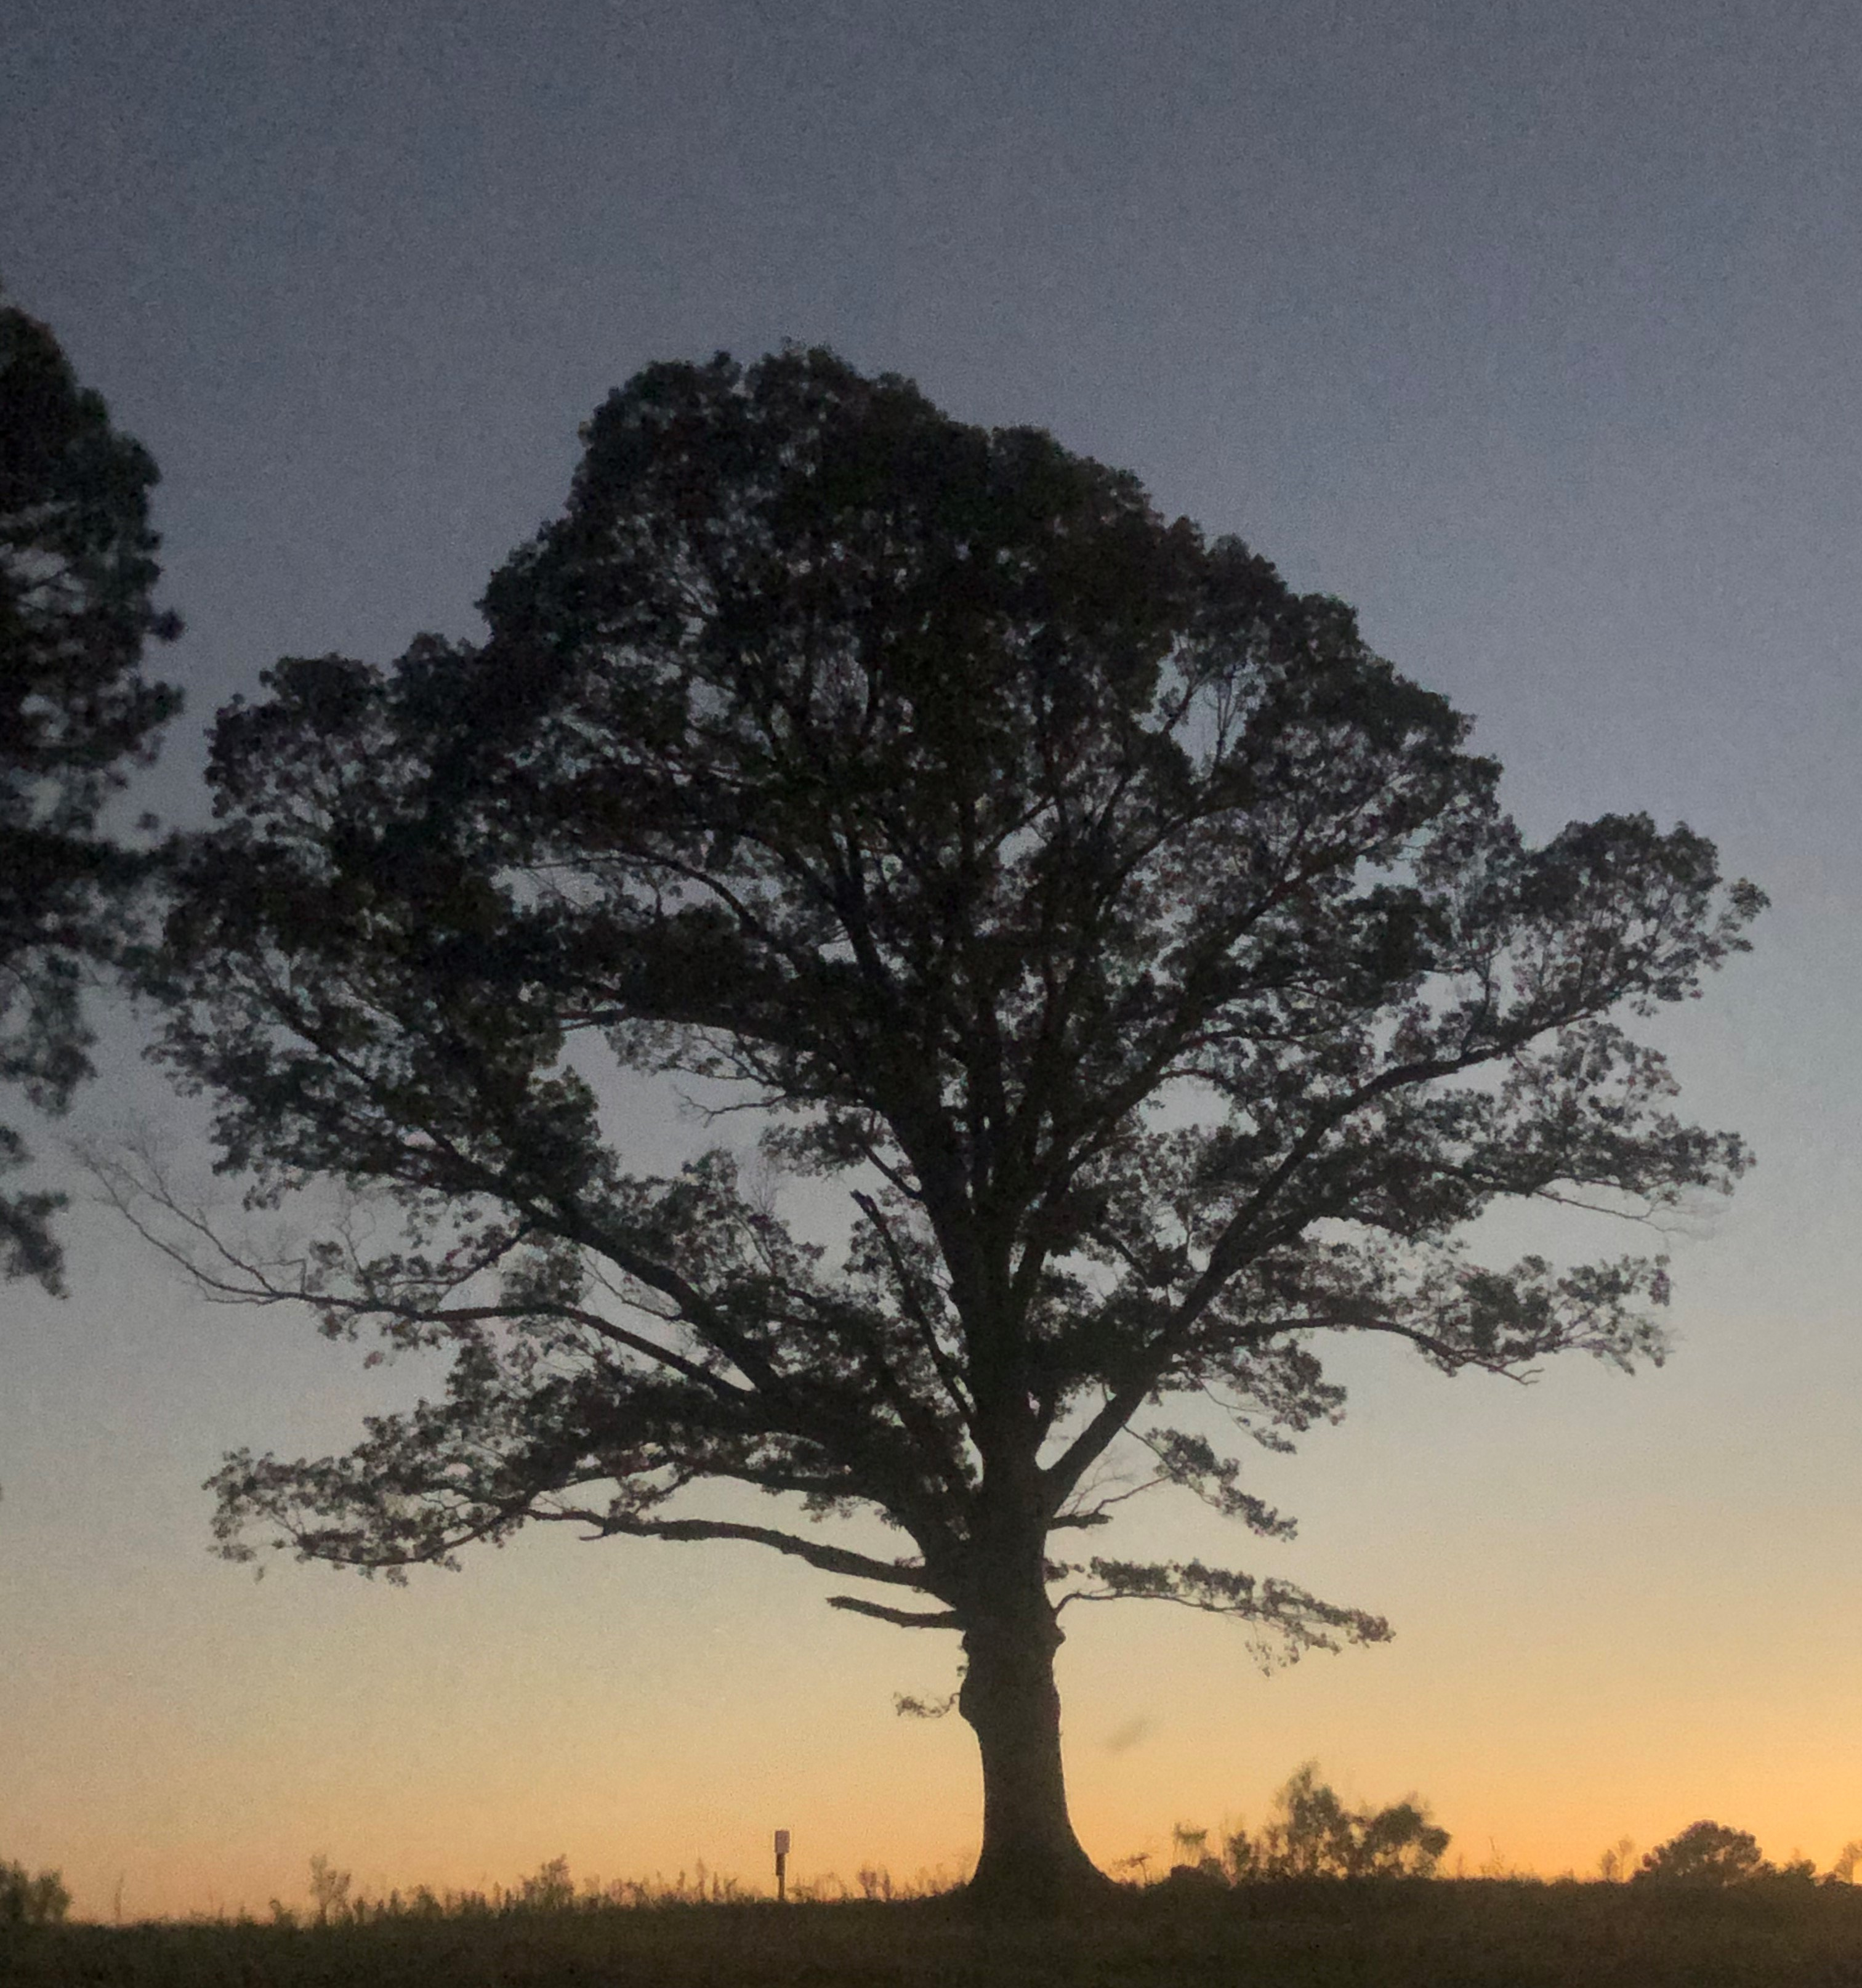
Leadership Succession
David Mayo mayod@ecu.edu

Slide 2
The Benefit
Higher organizational performance (6% on average in the US across multiple metrics)
Long-term wealth retention and generation for the family
Lower risk
Higher levels of innovation
Broader context in which to approach and execute major decisions or react to sudden events and family changes
Piece of mind, free up bandwidth for life enjoyment

Slide 3
When should this process start?
NOW!
  Actually, you have started it today for BFF
  Goal is to continue and sustain the process
Shorter Time = Increased Risk
  Each day that passes, you are one day closer to your ultimate disposition of property and responsibility (Time and Risk are inversely related)
  As time gets shorter and family older, major events become more frequent (marriage, kids, divorce, financial reversals, disability, death), all have bearing on your business succession and property disposition plans
Leadership development will take years and intentional planning to create qualified successors
  Basic training on how to operate the farm
  Managerial training
  External training
  More experience opportunities making longer term decisions
In a sense, executing transfer of management equity (business succession planning), and planning for property disposition (estate planning) should keep pace with (and becomes its own reward for) successor’s leadership path

Slide 4
Think about control vs ownership separately
Ownership may be a birthright- most wealth of family farms is tied to the farm transferring ownership and financial interest is appropriate
Control of the farm is earned- decision making is given based on competence
Voting and non-voting stock should be used as incentive based on development milestones
Many farmers work well past average retirement age for other businesses; this could leave later generations with no interest in the businesses where they have worked 30+ years

Slide 5
Earning shares (or partnership interest)
Voting Shares
Performance based
  Meeting training goals
  Exceeding job position metrics
  Position advancement
Non-Voting
Performance based
Tenure based
Avoiding estate tax
To give a mechanism to deliver financial interest

Slide 6
Earning shares- Write some specific examples that could work on BFF
Voting Shares
Non-Voting

Slide 7







Timeline
G2 Birth
G1 35 Years
G2 10 years
G1 45 years
G2 17 years
G1 52 years
G2 22 years
G1 57 years
G2 25 years
G1 60 years
G2 30 years
G1 65 years
G2 35 years
G1 70 years

Slide 8

Children are born; gen one 35 years from retirement
  Leadership development- begin college savings
  Legal prepare a will and plan for transition due to death, purchase life insurance
    Plan guardianship and testamentary trust in event of both parent die
    Prelim review of business organization (LLC and land relationship)

Slide 9
What Steps if Any Should be Taken at BFF for This Generation

Slide 10
Children are ten years old; gen one is 25 years from retirement
  Focus on planning to fund retirement, financial strategies could include savings/401k, asset sale to the next generation, leasing assets to the farm after retirement or any combination.
  Expose children to chores, work, and family values through storytelling (remember the ladder)

Slide 11
What Steps if Any Should be Taken at BFF for This Generation

Slide 12
Children are 16-18 years old; gen one is 17-19 years from retirement
  Create formal guidelines for leadership succession and speak with children. This may include career experience off the farm, formal college education, or leadership development programs. This process outlines what a successful leader will need for the farm.
  As property acquired through purchase and inheritance, advance estate plan with a revocable trust

Slide 13
A skills map will need to be created for successors to gain control-CEO example
Core Leadership and Strategy
Defining Mission
Financial Management and Decision Making
Strategy Creation
Business Modeling
Market Forecasting
Building Culture
Management Skills
Goal setting
Running meetings
Conflict management
Managing managers
Inspiring change

Slide 14
3. Legal, Risk, and Compliance
4. Core Business Skills and Knowledge
5. Innovation Management

Slide 15
What Steps if Any Should be Taken at BFF for This Generation

Slide 16
Children are 22; gen one is 14 years from retirement
  Map farming tasks that must be learned and create a plan to train in all key aspects
  Continue advancing estate plan as acquire property (make decisions regarding specific dispositions of assets through revocable trust); advance business organization planning to manage risk (protect asset classes – land, machinery, personal assets), ensure LLC operating agreements have buy sell language

Slide 17
Some Pathways
Require formal education- undergraduate degree in Agriculture or related field or MBA
Require experience off the farm- Management level position in agribusiness, responsible for managing at least 5 individuals.
Require executive education- Complete entire EFM and Leadership programs
Require certain responsibilities and outcomes for each position on the farm- to be responsible for crop mix, you must first learn, futures, crop rotations, labor availability, and field preparation. (These will probably be the most extensive requirements for promotion and progression)
Serve in leadership of professional organizations

Slide 18
What Steps if Any Should be Taken at BFF for This Generation

Slide 19
Children are 25; gen one is 10 years from retirement
  Increase managerial responsibility, transition children to primary managers of employees
  Consider transferring (by gift) equity in business operation (under operating agreement restrictions); make adjustments to trust by amendment as property acquired
  Evaluate balance of liquidity and business/land assets, and consider fair distribution of assets among children on and off the farm (i.e. insurance increase?)

Slide 20
What Steps if Any Should be Taken at BFF for This Generation

Slide 21
Children are 30; gen one is 5 years away from retirement
  Transition strategic decision making for the farm
  Transition legal ownership of operation; execute and record options for farm successor to purchase land
  Begin to execute financial plan for gen one retirement

Slide 22
Full Job Description $60,000/yr
The Organic Farmer Manager-California fulfills the primary task of managing projects. This position reports to the Research Director and the Farm Director.
ESSENTIAL DUTIES AND RESPONSIBILITIES- Conduct day-to-day farm operations in relationship to crop and livestock production. Field responsibilities include but are not limited to; field preparation, planting, harvesting, cultivating, pest management, maintaining equipment, directing employees, etc.
Coordinate the management of farm with technical staff.
Operate equipment in a safe and efficient manner and effectively teach equipment operation and maintenance to staff.
Document field operations to satisfy organic certification requirements, research data collection needs, reporting, and accounting needs.
Ensure all federal, state and local regulations are met.
Complete and follow Good Agricultural Practices (GAP) implemented by the U.S. Department of Agriculture (USDA) when and where appropriate.
Plan a growing schedule and meet with research partners frequently to ensure high quality research.
Educate and train temporary staff and interns to carry out the day-to-day activities of the managed operation.
Assist Communications and Research team.
Ensuring seeds, fertilizers, pesticides, and other supplies are regularly restocked.
Handling the marketing and sale of products produced on the farm.
Collaborating with senior staff to prepare budgets and financial reports.
Building professional networks and keeping abreast of developments in agricultural science.
Familiarity with California cash crops growing practices and irrigation systems.
Must be detail-oriented, well organized, and able to work independently and in a safe manner.

Slide 23
Qualifications:
Must be able and willing to work in all types of weather, be able to lift 50 pounds or more, have good communications skills – (both written and verbal), and be flexible in hours as farm work can be unpredictable
Must have a bachelor’s degree and/or 5 years of experience in organic horticultural or agronomic crop production.
Minimal travel required.
Willingness to provide input, explore new tasks, try new or different approaches and openness to new ideas.

Slide 24
What will the job description of the leader of BFF look like?
Full Job Description
ESSENTIAL DUTIES AND RESPONSIBILITIES
Qualifications

Slide 25
What Other Steps if Any Should be Taken at BFF for This Generation

Slide 26
Children are 35; gen one is at retirement age
  Majority control is transferred to gen two, gen one continues to transition into a trusted mentor role
  Begin planning for gen three succession
  Continue advancing estate plan

Slide 27
What Steps if Any Should be Taken at BFF for This Generation

Slide 28

Each situation is unique
Some have already waited too long to plan, now what?
Children are born and owners want to retire at different ages.
The next generation isn’t ready.
Gen one can’t financially afford to retire.
Early death or other unplanned event
Gen two changes their mind, no longer interested

Slide 29
What Steps if Any Should be Taken at BFF for This Generation

Slide 30
Perception
Reality
Generational transfer is rife with conflict
Their generation just doesn’t understand
My attorney is handling all of our succession planning
We must go through the succession pains to see any gains
If done properly and fairly there will be less conflict
Each generation brings a unique perspective that can enhance success
There are multiple aspects of succession, some questions are legal and some of the most important questions have to be solved internally
If successors are being developed, there are gains from the start

