Slide 1
Impacts of a Rapidly Rising AEWR on the Fruit and Vegetable Sector
Blake Brown, PhD
Hugh C. Kiger Professor Emeritus
NC State University

Slide 2
NC Chamber
NC Growers Association
GA Fruit and Vegetable Growers Association
Michigan Asparagus Growers
NC Farm Bureau
AgCarolina Farm Credit
NC Sweetpotato Commission

Slide 3
What are the impacts of increased farm worker wages in the produce industry on:
Consumers
US produce industry output
Affiliated industries
Employment
Imports and exports

Slide 4


 | National Average AEWR
2012 | $ 10.36
2013 | $ 10.80
2014 | $ 11.10
2015 | $ 11.29
2016 | $ 11.74
2017 | $ 12.20
2018 | $ 12.47
2019 | $ 13.25
2020 | $ 13.99
2021 | $ 14.62
2022 | $ 15.56
2023 | $ 16.62
2024 | $ 17.55
Source: National Council of Agricultural Employers

Slide 6
What would the 2022 AEWR have been if the AEWR had only incorporated cost of living increases?
The national average AEWR in 2022 would have been $12.77, 17.93% lower than its 2022 level of $15.56

Slide 7
Vegetables Wages Decrease 17.9% | % Change | Actual 2022 Level | Change | Predicted 2022 Level
Demand for US Grown Fresh Vegetables | 2.44% | 29,730 | 725 | 30,455
US Fresh Vegetable Exports | 3.83% | 2,547 | 98 | 2,645
Fresh Vegetable Imports | -2.67% | 17,750 | (474) | 17,276
Total US Demand for Fresh Vegetables | 0.53% | 47,480 | 251 | 47,731
Price Index of Fresh Vegetables in US | -1.28% | 366 | (5) | 361
Quantity supplied U.S. Fresh Vegetables | 2.55% | 32,277 | 823 | 33,100
Farm Labor Employment | 6.71% | 138,569 | 9,297 | 147,866
Quantities are in millions of lbs

Slide 8
Fruit Wages decrease 17.9% | % Change | Actual 2022 Levels | Change | Predicted 2022 Level
Demand for US Grown Fresh Fruit | 2.61% | 15,211 | 397 | 15,608
US Fresh Fruit Exports | 3.22% | 3,734 | 120 | 3,854
Fresh Fruit Imports | -1.68% | 17,209 | (290) | 16,919
Total US Demand for Fresh Fruit | 0.33% | 32,420 | 108 | 32,527
Price Index of Fresh Fruit in US | -1.07% | 173 | (2) | 171
Quantity supplied U.S. Fresh Fruit | 2.73% | 18,944 | 518 | 19,462
Farm Labor Employment | 7.19% | 138,010 | 9,924 | 147,934
Quantities are in millions of lbs

Slide 9
Overview of Total Economic Impacts
Impact | Employment | Labor Income | Value Added | Output
Direct | 22,853 | ($531,434,487) | $79,288,259 | $584,256,643
Indirect | 4,087 | $242,819,183 | $394,687,073 | $734,174,972
Induced | -1,195 | ($79,649,884) | ($149,796,075) | ($245,861,811)
Totals | 25,744 | ($368,265,188) | $324,179,256 | $1,072,569,804

Slide 10
Industries by Impact: Top Ten
Industry | Impact on Output
Vegetable and melon farming | $310,341,075
Fruit farming | $291,131,876
Support activities for agriculture and forestry | $119,478,054
Other real estate | $64,966,701
Pesticide and other agricultural chemical manufacturing | $59,481,557
Wholesale - Other nondurable goods merchant wholesalers | $48,481,629
Nitrogenous fertilizer manufacturing | $19,734,565
Petroleum refineries | $16,978,075
Insurance carriers, except direct life | $14,607,989
Insurance agencies, brokerages, and related activities | $10,227,947

Slide 11
Economic impacts of a 17.93% decrease in 2022 domestic farm labor wage rates and AEWR: Change in Farm Labor Employment by State

Slide 12
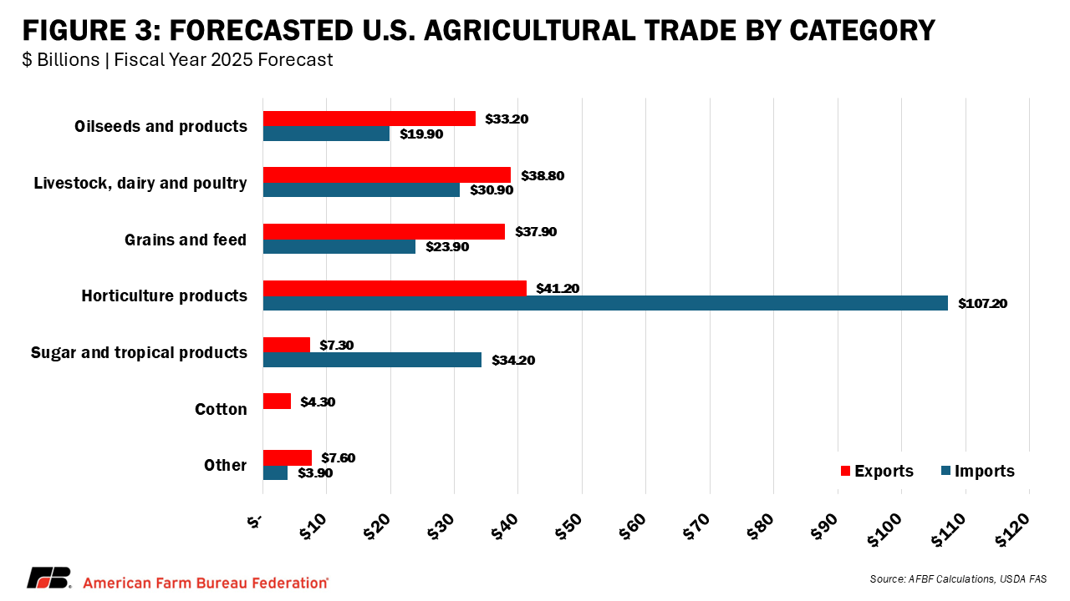
“U.S. Heading to Record Ag Trade Deficit”
Faith Parum, American Farm Bureau. June 20, 2025

Slide 13
In a nutshell, a lower AEWR would…
Increase consumption of fresh produce
Lower produce price
  Part of the labor cost savings are passed through to consumers
  Part of savings are captured by producers leading to larger production
Decrease imports and increase exports of fresh produce
Increase the quantity and value of US fresh produce production
Increase employment in the farm sector; particularly H-2A workers.
Increase output in affiliated industries
Increase the value of output in many states; particularly big produce states like California

