Slide 1
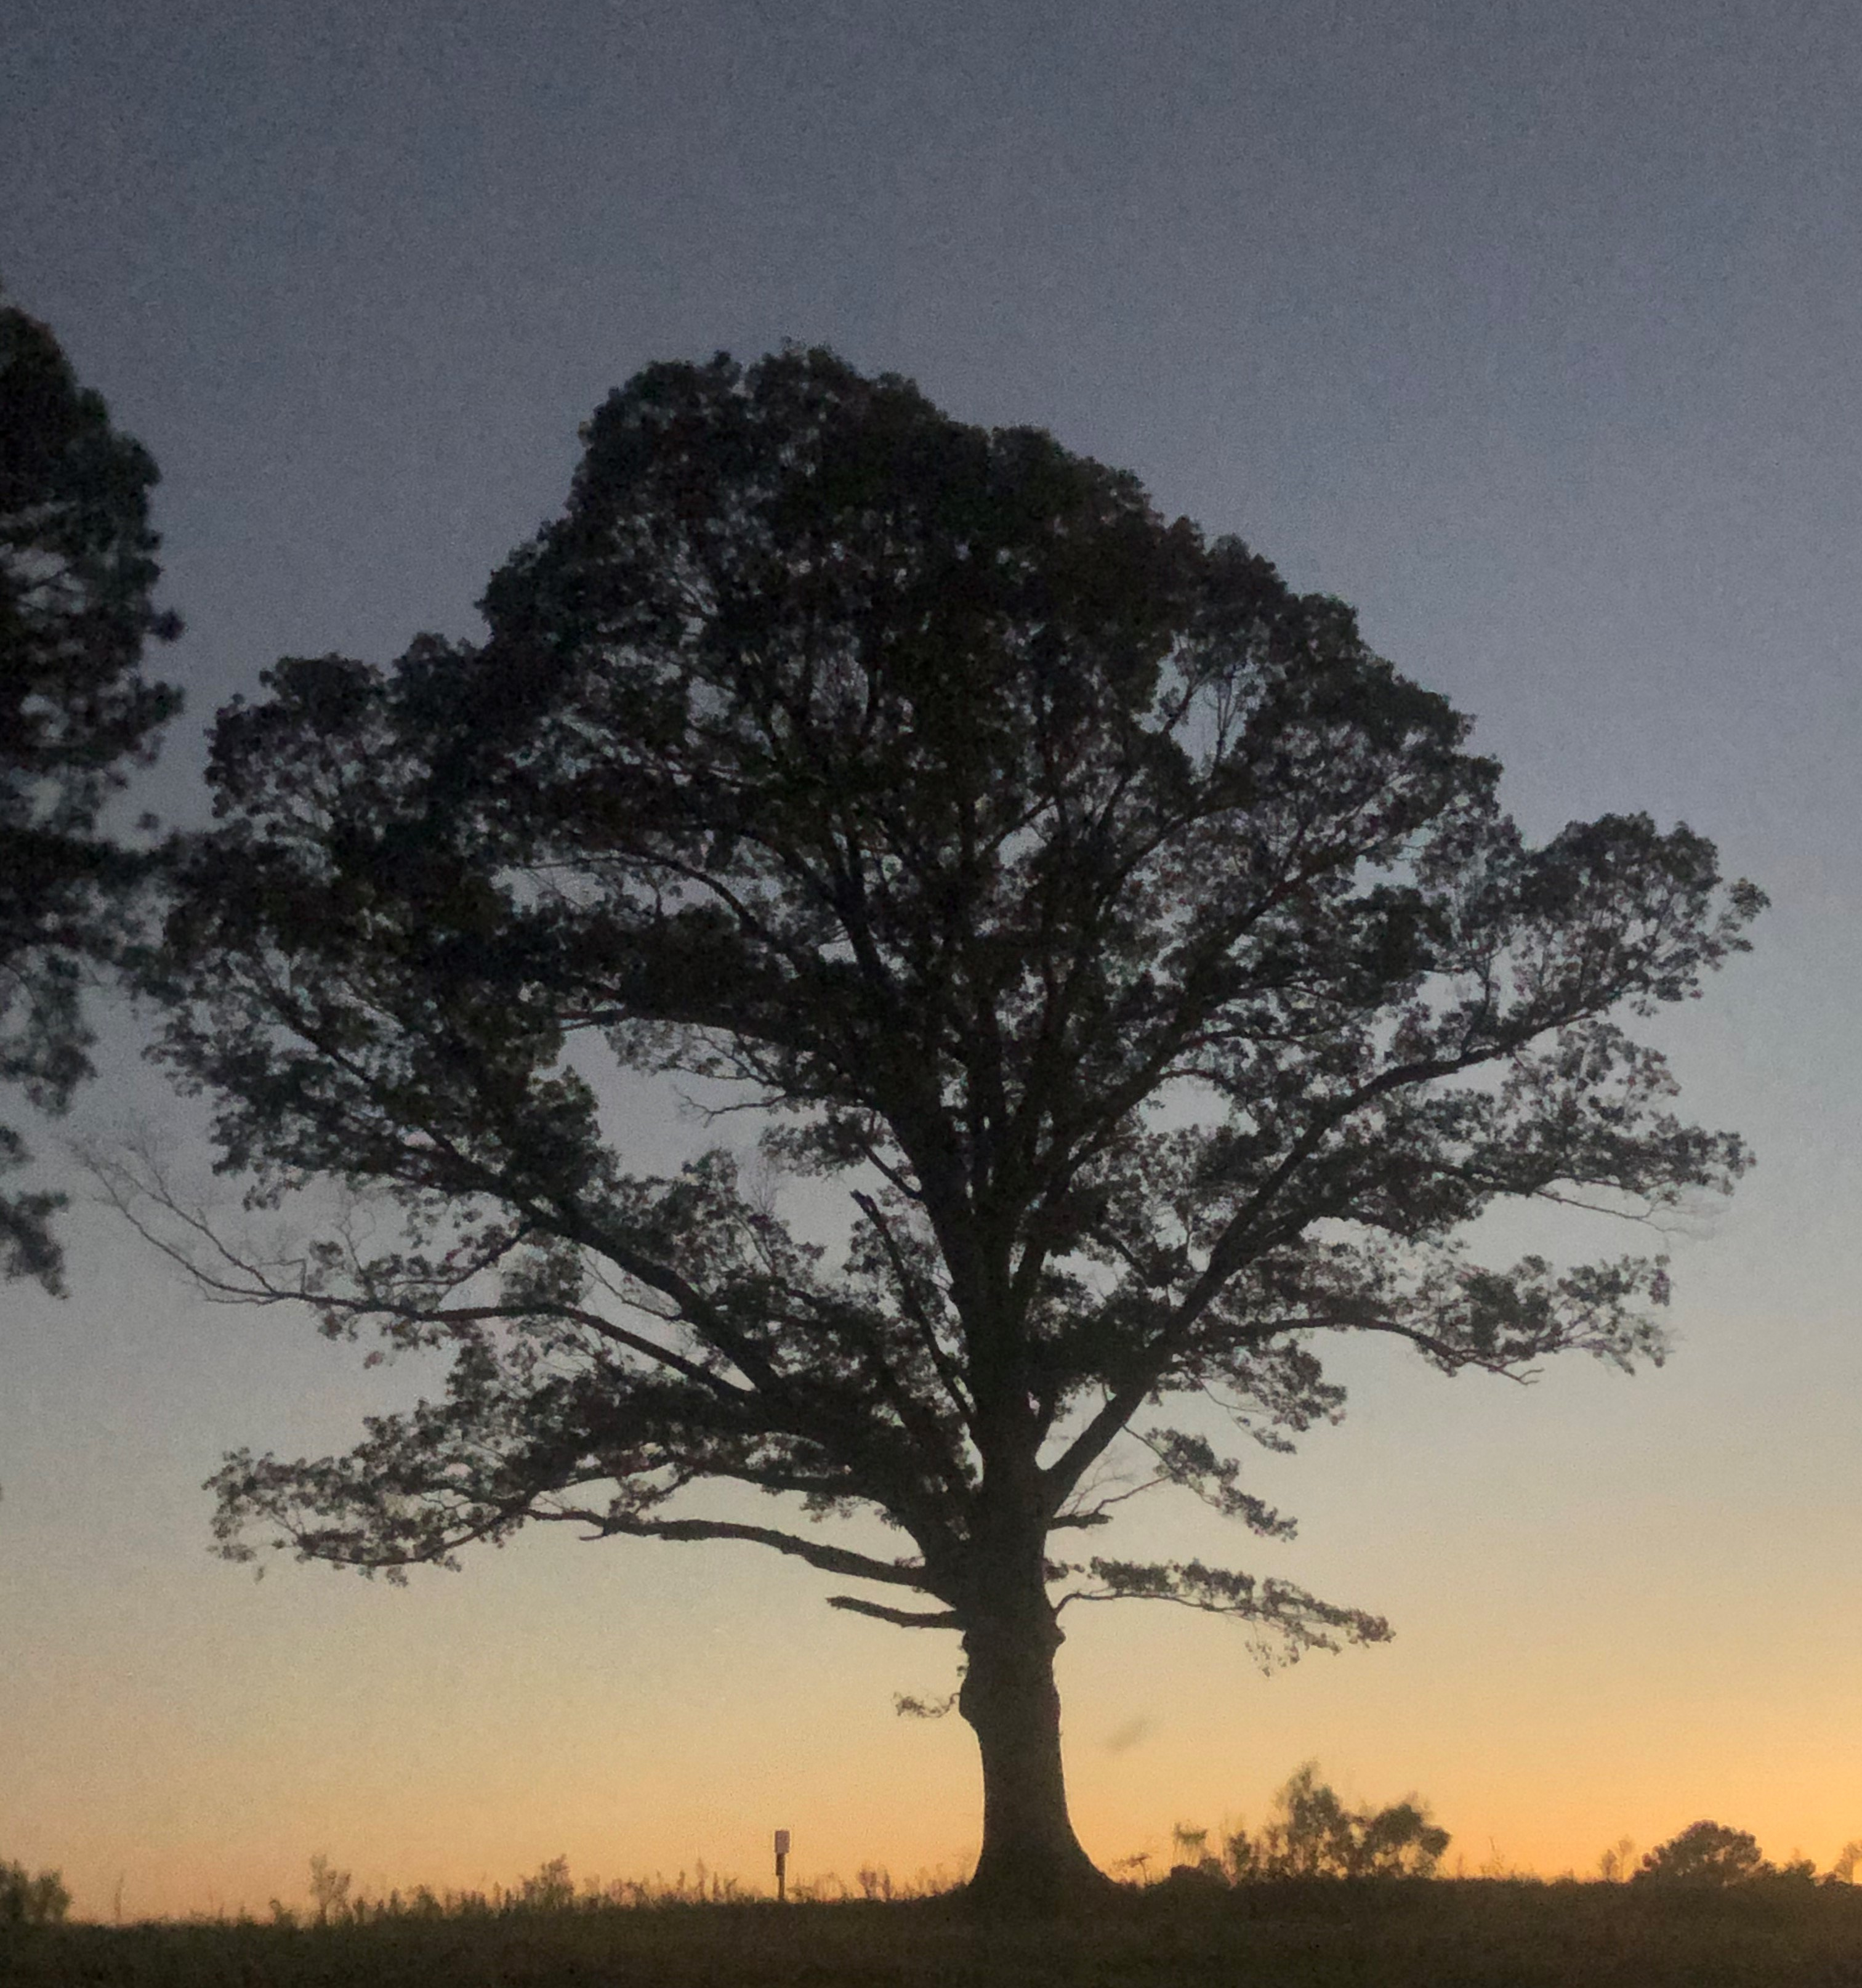
Blue Ocean Strategy
David Mayo mayod@ecu.edu

Slide 2
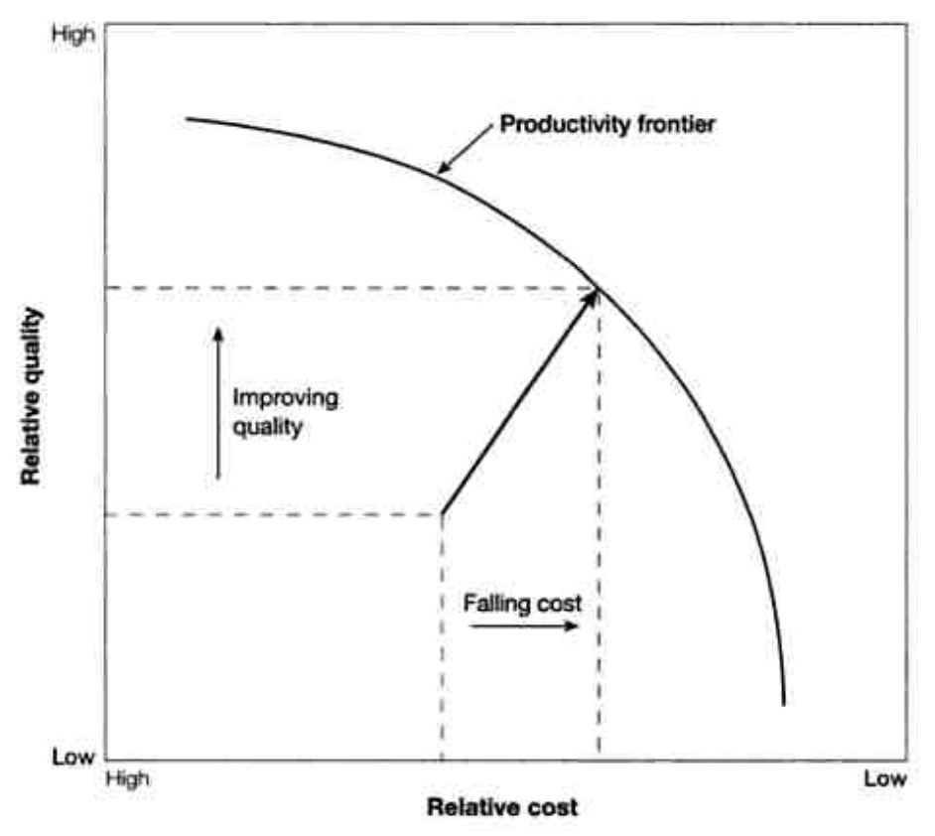
Traditional Strategy

Slide 3
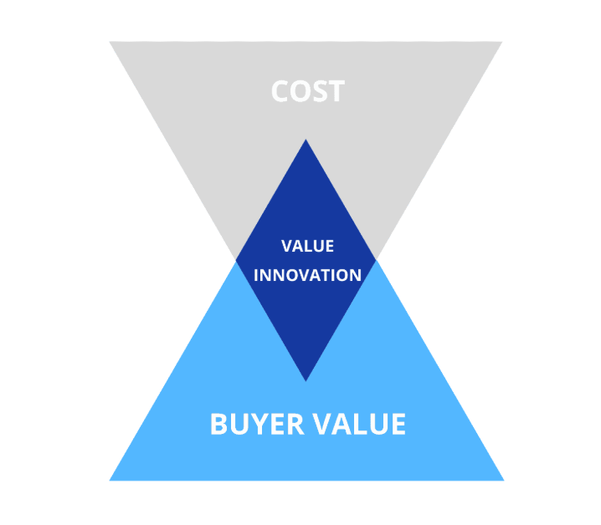
Blue Ocean Strategy

Slide 4
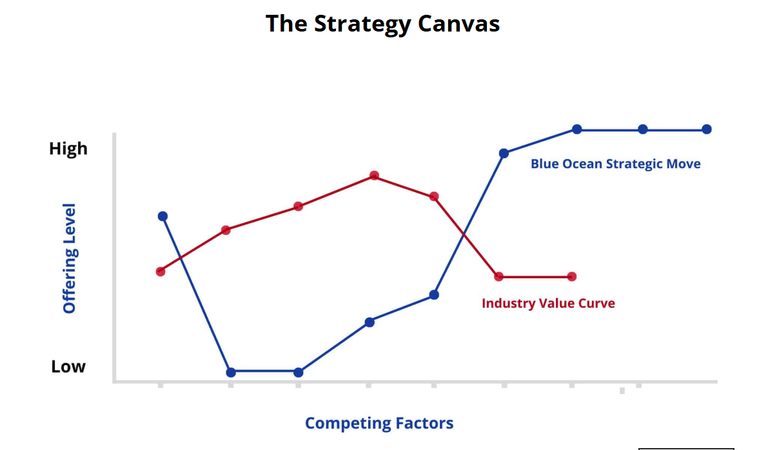

Slide 5
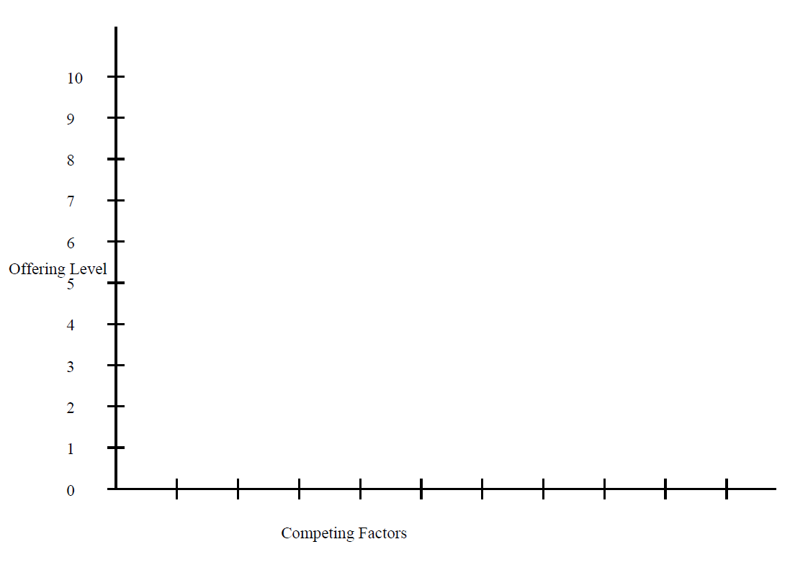
Strategy Canvas- Band

Slide 6
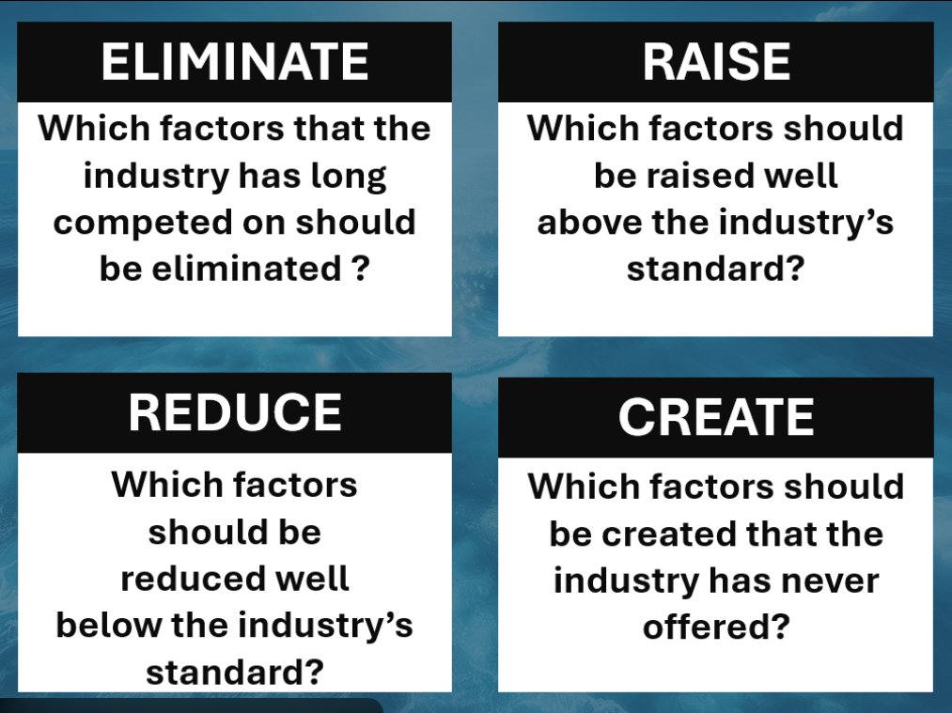

Slide 7
The Dying Band
A small, rural school in Montana has struggled for years to maintain its band program. In most schools about 10% of students enroll in band as an elective. The school has total enrollment of around 110 students in high school. They have consistently had 10-15 students enrolled in band; they have average to above average enrollment for their size. But it’s tough to watch a concert recital with 25 people in attendance. One year the drummer was sick; the whole band was off beat and the whole concert was a disaster. Mr. Smith the band director is passionate about music, but he has a lot on his plate. In addition to teaching band he also teaches two sections of History, a section of Literature, and he coaches their struggling soccer team. Recently the principle had to bring some bad news…
Principal: Mr. Smith I want to talk with you about something that I’ve been putting off for a couple of years.
Mr. Smith: Ok. If this is about the soccer team, I know we haven’t won a game in two years, but we are barely fielding….
Principal: No, no that’s not it. It’s about the band… We have a few big problems; our students just can’t afford the instruments that they need. We had three requests this year for financial help with instruments; we just don’t have a budget to cover a $1,000 tuba. I understand how important the band is to you and to the students that participate, but attendance is just too low to justify having the band. We are ok with the budget for this year and next, but if band enrollment doesn’t go up we are going to have to remove band as an elective.
Mr. Smith: But learning music is important to the student’s development. I can’t imagine the student experience here without a band.
Principal: I hate this as much as you do, but if something doesn’t change we are going to have to cut band.
Mr. Smith walked out and new he had to come up with a plan. There are more activities for students to choose form than ever before. The e-sports team was growing like crazy, maybe students just want to be online now instead of doing school activities?
Help Mr. Smith create a strategy canvas and develop a new Blue Ocean Strategy for the band.

Slide 8
Strategy Canvas- New Band

Slide 9
Strategy Canvas- Brown Family Farm

Slide 10
Strategy Canvas- New Brown Family Farm

Slide 11
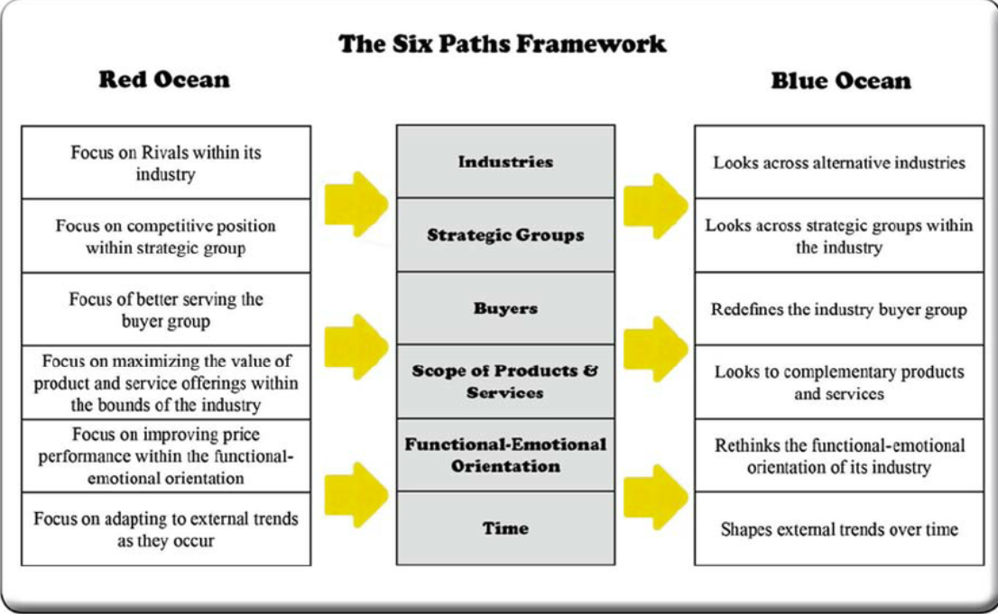

Slide 12
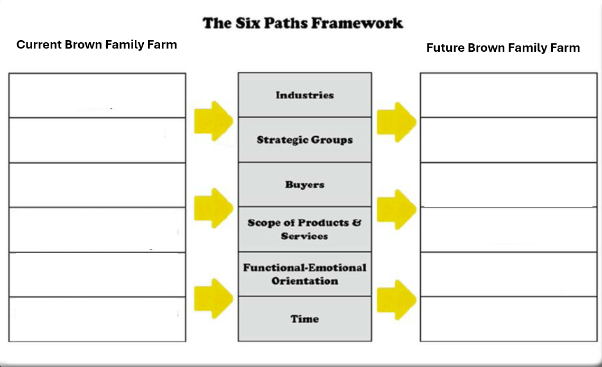

Slide 13
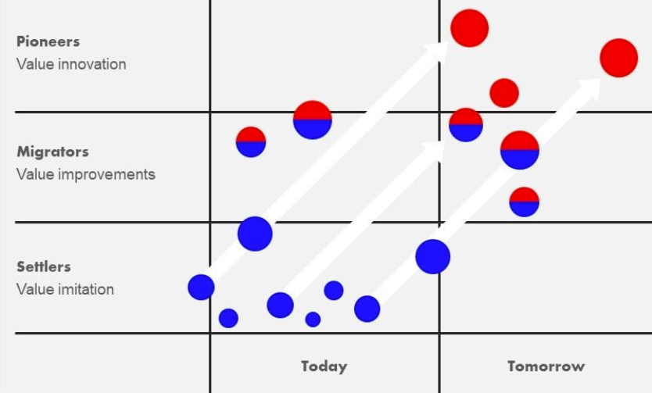

Slide 14
