Slide 1
Risk Management Toolkit Overview and Approach

Slide 2
Approach This approach can be used for any project, initiation or ongoing business operations to assess risk.
1.Risk Management Strategy & Plan
2.Risk Identification
3.Risk Assessment
4.Risk Prioritization
5.Risk Mitigation
6.Risk Closure and Issue Escalation
7. Issue Management
Summary of the corporate and business strategy
Risk appetite
Risk management capability maturity model
Risk management mission, vision and strategic objectives
Risk management KPIs, targets and initiatives
Roadmap to reach our strategic objectives
Risk management team and budget
Governance structure
Guiding principles
Framework to manage risk
Risk types and examples
Tools to identify risks
Simple risk log in Powerpoint
Comprehensive risk log in Excel
Probability of the risk happening
Potential impact of the risk
Risk value
3-by-3 risk prioritization matrix in PowerPoint and Excel
5-by-5 risk prioritization matrix in PowerPoint and Excel
Response options
Examples
Actions, deadlines, and responsibilities
Dashboard
Risk closure
Issue escalation
Simple issue log in PowerPoint
Comprehensive issue log in Excel

Slide 3
By multiplying the “Probability” dimension by the “Impact” dimension, we will get our “Risk Value”
Probability
Impact
Risk Value
What is the probability of the risk happening
What is the potential impact of the risk
The risk value will help you prioritize your risks
X
=

Slide 4
To assess the probability of a risk happening, we can use a 3-level or 5-level rating depending on our needs
Probability 3-level rating
Probability Scale
Definition
3.Likely
Over 60% chances of happening
2.Possible
Between 20% and 60% chance of happening
1.Unlikely
Less than 20% chance of happening

Slide 5
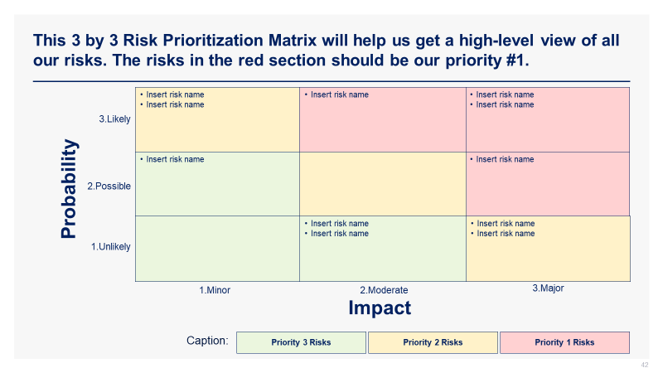
Rick Prioritization Matrix

Slide 6
Simple risk log 3-level rating
Low priority (risk value is 1, 2, or 3)
Medium priority (risk value is 6)
High priority (risk value is 9)
Risk # | Risk Title | Risk Description | Impact (1=Minor; 2=Moderate; 3=Major) | Probability (1=Unlikely; 2=Possible; 3=Likely) | Risk Value (Impact X Probability) | Mitigation Strategy | Assigned To
1 | Lower website speed | Improving the resolution of our images will increase the size of our images, which may lower our website page loading time | 3 | 3 | 9 | Find the sweet spot between quality images and page loading time | Donald
2 | High oil price | A strong increase in oil price would create a high pressure on our profit margins | 1 | 2 | 2 | Buy more oil than we need to build up our stock while the price of oil is at an affordable price | Ralph
3 | Insert your risk title | Insert your risk description | 2 | 3 | 6
4 | Insert your risk title | Insert your risk description | Rate from 1 to 3 | Rate from 1 to 3
5 | Insert your risk title | Insert your risk description | Rate from 1 to 3 | Rate from 1 to 3
6 | Insert your risk title | Insert your risk description | Rate from 1 to 3 | Rate from 1 to 3
7 | Insert your risk title | Insert your risk description | Rate from 1 to 3 | Rate from 1 to 3

