Slide 2
Do I need to Listen Better?

Slide 3
Learning Outcomes
Understanding what it means to listen
Why is listening important
Recognize and overcome barriers to effective listening
Identify and practice behaviors that promote effective listening.

Slide 4
Listening Better

Slide 5
50%
Notes:
Listening is a part of everyday life. We spend more time listening than speaking. Yet research shows we have a substantial room for improvmene.t
50%: That is how much of the message we retain immediately after hearing it. This session is designed to help you increase the awareness of what it takes to be a better listener.

Slide 6
Listening Vs Hearing
Notes:
What the difference? Ask for input?
Many view listening as a simple action rather than as a skill that takes effort to practice and hone. Listening is the foundational skill that influences our communication and guides our actions.
Forgot a name after introductions? Why?

Slide 7
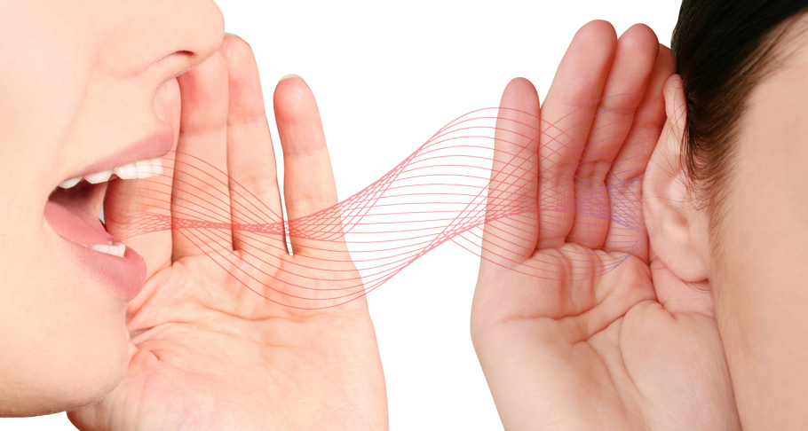
Effective Listening
“Occurs when there is a high degree of correspondence between the sender’s original message and the listener’s re-creation of that message.”
Notes:
Listeners place an active role in the process—they are responsible for recreating the speaker’s message and making sure that their interpretation aligns closely with the original message

Slide 8
Roadblocks to Listening
List Internal and External Barriers

Slide 9
Notes:
Poll Title: Do not modify the notes in this section to avoid tampering with the Poll Everywhere activity. More info at polleverywhere.com/support Roadblocks to listening. One word or Connected*Words https://www.polleverywhere.com/free_text_polls/KJLOXy0PGyW4nk3UTPLfU

Slide 10
Barriers
External
Noise
Visual Distractions
Physical setting
Objects
The Speaker
Internal
Anxiety
Self-Centeredness
Close-minded
Mental laziness
Boredom
Sense of superiority
Cognitive Dissonance
Impatience
Emotional reaction
Notes:
Cognitive—hearing what only the listener expects to hear or to mold the message to personal beliefs

Slide 11
Role Play
Use the Role Play in Handout: Page 2 and 3
Pairs: One person is speaker, one is the listener
Each of you take turns.

Slide 12
Survey Says??

Slide 13
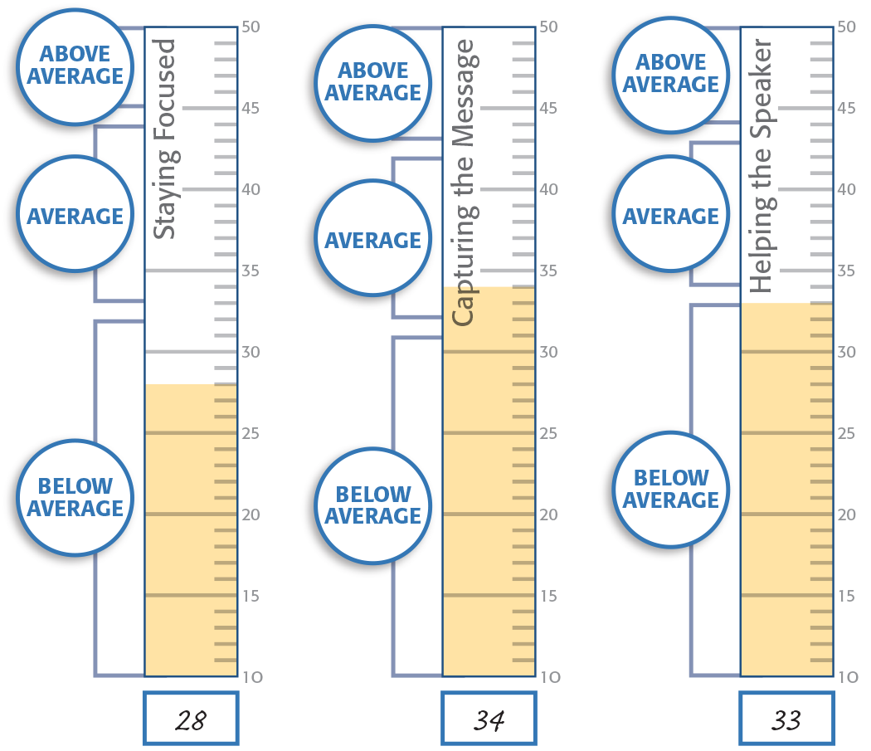
Charting Your Results: Page 4
Shade each column up to your subtotal s
Page 3core.

Slide 14
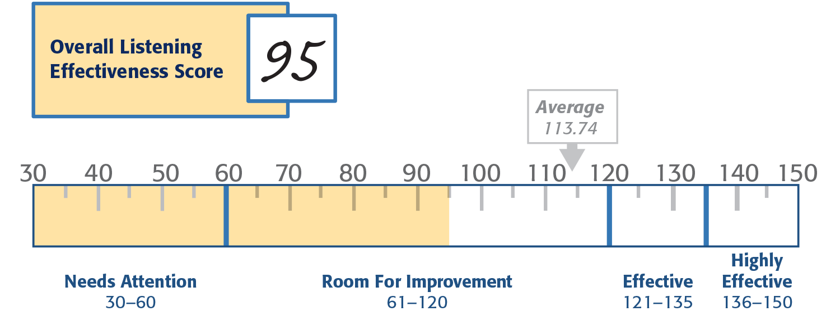
Charting Your Results Page 5
Shade up to your total score on the scale.

Slide 15
Listening involves invisible and visible behaviors.

Slide 16
Let’s Name them

Slide 17
Notes:
Poll Title: Do not modify the notes in this section to avoid tampering with the Poll Everywhere activity. More info at polleverywhere.com/support Roadblocks to listening. One word or Connected*Words https://www.polleverywhere.com/free_text_polls/KJLOXy0PGyW4nk3UTPLfU

Slide 18
The Listening Model

Slide 19
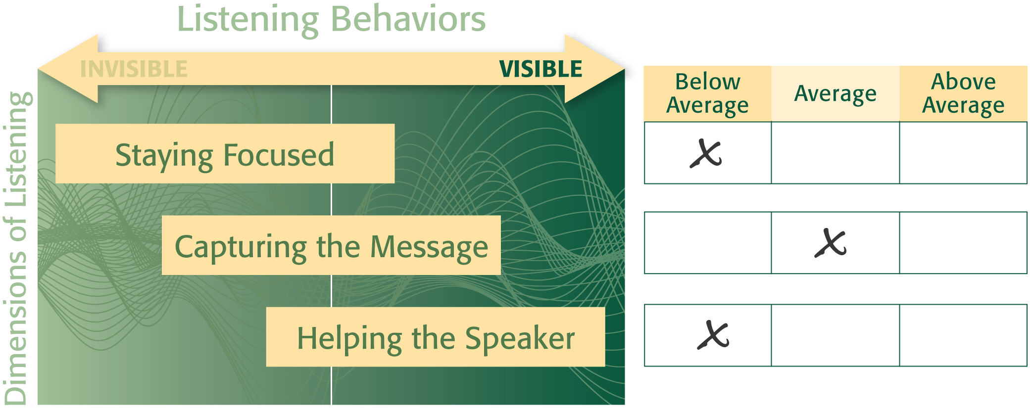
Score Ranges Page 6
Indicate the range for your score in each Dimension.

Slide 20
Review your Scores
Page 7-9
Interpret your scores on the summary pages. Take note of behaviors associated with your score.

Slide 21
Exploring Behaviors:
What behaviors would help a listener succeed?
Notes:
We will examine ways to improve our listening in each dimension of equation in order to be a better listener.
Activity: Divide into 3 groups. Ask each group to list behaviors that promote effective listening in each dimension. Internal and External behaviors.
Staying Focused
Capturing the message
Helping the Speaker

Slide 22
Listening Rate vs. Speaking Rate
450 words/minute
125–175 words/minute
Notes:
As humans we think much faster than we talk. Instead of using the extra time to process, our minds tend to wander.

Slide 23
What can we do to stay focused?
Notes:
Page 64 in manual

Slide 24
Staying Focused
Prepare
Monitor
Correct
Notes:
Prepare: clear your mind of other things
Monitor—recognize when your concentration has slipped
Correct: Refocus on the conversation

Slide 25
What can we do to Capture the Message?
Notes:
Page 65 in manual

Slide 26
Capturing the Message
Be open-minded
Think
Clarify
Confirm
Notes:
Open minded: Be neutral—leave your agenda and biases out of it
Think: Try to make sense of what the speaker is saying. Extract the main ideas. What are you learning?
Clarify: Ask questions to seek info or clarity
Confirm Summarize the points.

Slide 27
What can we do to Help the Speaker?
Notes:
Page 65 in manual

Slide 28
Helping the Speaker
Screen
Refrain
Respond
Assist
Notes:
Stop yourself from interrupting changing subject finishing sentences or interjecting
Steer clear of distracting non verbal actions
Respond with verbal support and encouragement.
Provide the speaker with support and non verbal encouragement. Body language goes a long way.

Slide 29
Nightmare Meeting Page 10
Groups of 4
Review the scenario and respond to the questions.
7 minutes

Slide 30
Nightmare Meeting
What barriers are present?
How could you remove them?
What techniques could help the listeners?

Slide 31
Development Planning Page 11
Create a plan to put what you’ve learned into practice.

Slide 32
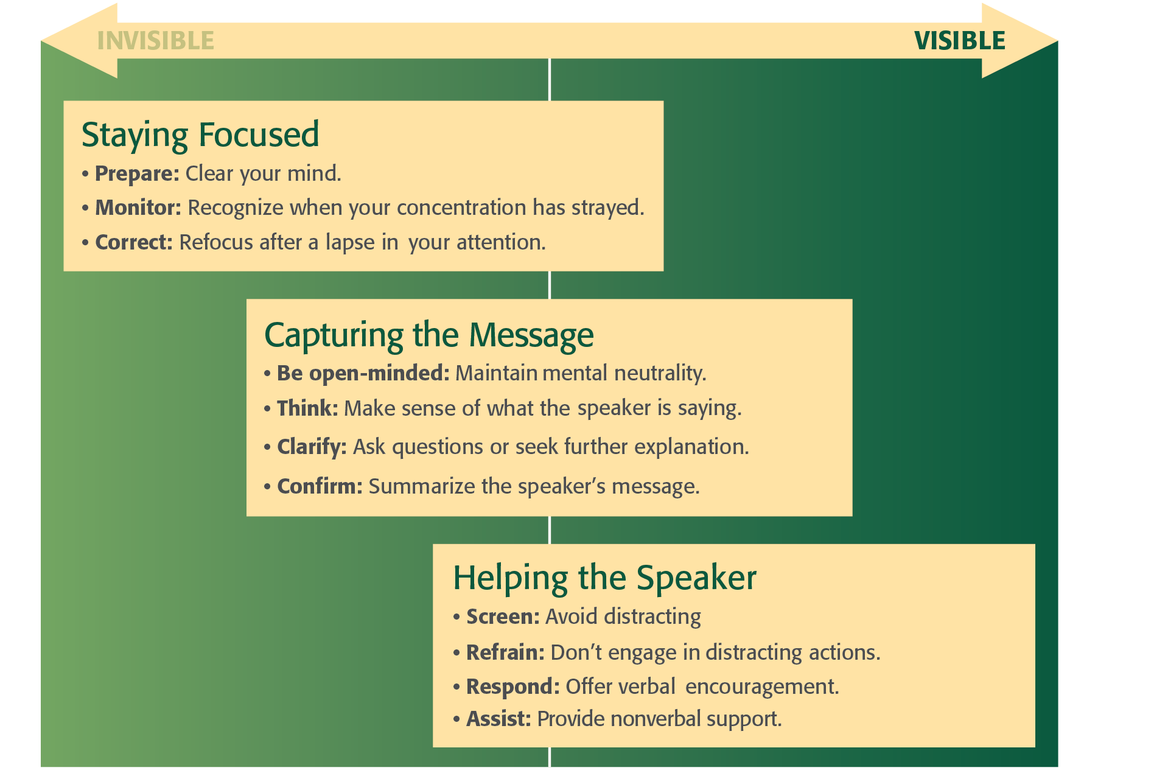
Key Learning Points

Slide 33
Key Learning Points

