Slide 1

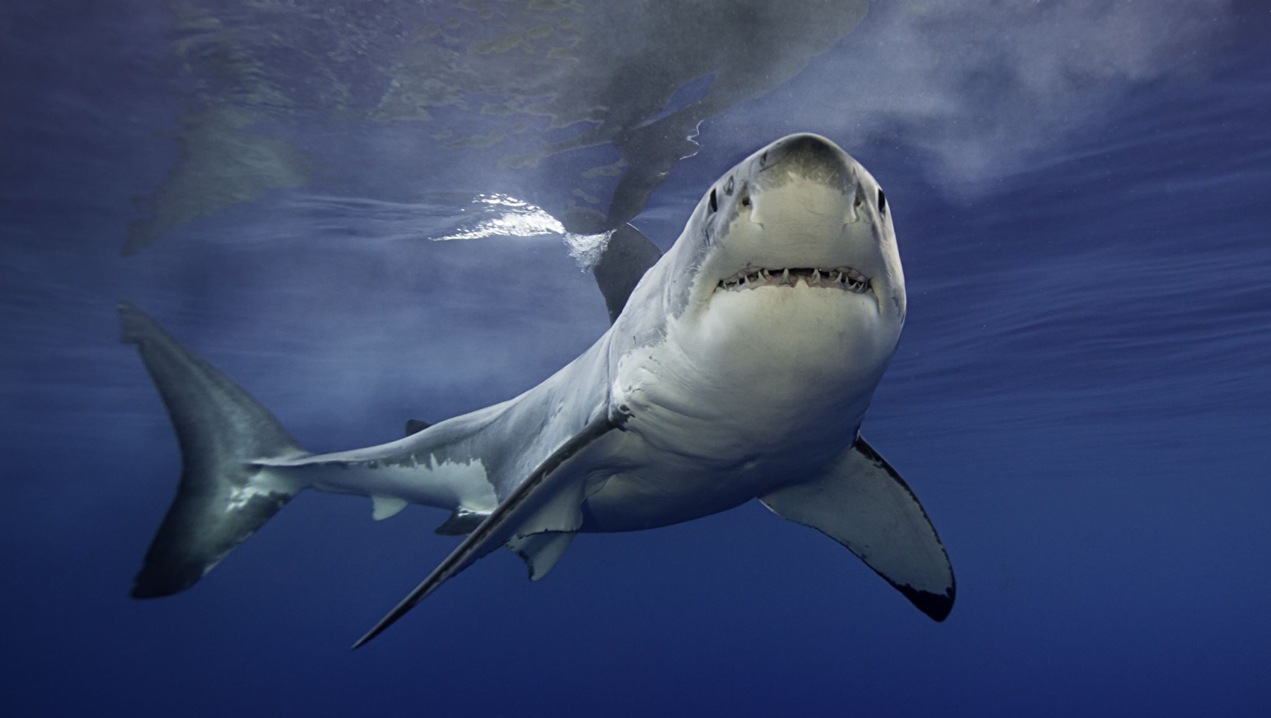
Shark Tank
The Business Model Canvas and the New Brown Family Farm

Slide 2
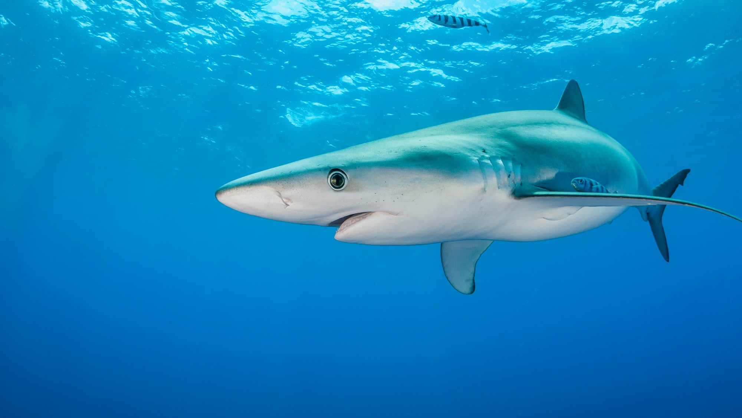
The Challenge
Create the NEW Brown Family Farm
Include all NINE building blocks of the Business Model Canvas
Don’t forget the people

Slide 3
The NEW Brown Family Farm Business Model
Business Model Canvas
Program Insights
Economic Viability
Innovation and Creativity

Slide 4

Details
Each team will have 15-20 min to present with 5 min for questions
Judges will score based on rubric criteria

Slide 5


The Rubric
 | 1 | 2 | 3 | 4
 | Not at all | Very Little | Some- what | To a Great Extent
The Customer(s) are clearly identified
The Value Proposition addresses the pains & gains of customers
The products and services satisfy the jobs to be done?
The team included insights learned from the program:
Strategy & Innovation
Human Resources
Financial Management - Economics
Succession Planning
To what extent was the change presented from current to future state of the BFF?
Is this a business you would consider investing in?
How well thought out were the changes needed in:
Channels and Relationships?
Key Activities and Resources?
Were partnerships considered and choices explained?
Is the incremental revenue proposed enough to support changes?
Is the business model financially viable?
Did they demonstrate thoughtful changes or adjustments to:
Succession plan
Job responsibilities & Goals
Policies and practices
Plan for leadership changes and/or staffing levels
TOTAL

Slide 6
SWOT Analysis - A Great Place to Start
Leverage the Brown’s STRENGTHS
Address their WEAKNESSES
Explore/ evaluate OPPORTUNITIES
Disrupt and innovate to overcome THREATS
Strengths
Weaknesses
Land
Multiple crops
Custom packing
Technology
Global gap certified
Established contracts
New skills
Don’t know the customer
Price taker
Lack of succession plan/retirement
Manual processes
Lower labor productivity
Packing operations management
Product waste
Opportunities
Threats
Move up value chain, go direct to end customer (grocery, restaurant, consumer, etc.)
Niche products
Beef cattle
Expand use of land
Innovation
Partnerships
Climate change
Consumer health focus
Labor competition/scarcity
Energy costs
Disease/bugs
Higher input costs
Legislation, policies, regulations

Slide 7
Who will help you? Key Partners | How do you do it? Key Activities | What do you do? Value Propositions | How do you interact? Customer Relationships | Who do you help? Customer Segments
 | What do you need? Key Resources |  | How do you reach them? Channels
What will it cost? Cost Structure | How much will you make? Revenue Streams

Slide 8
Make Tough Decisions
Tradeoffs
“The main impediment to action is the forlorn hope that certain painful choices or actions can be avoided - that the long list of hoped-for ‘priorities’ can all be achieved.”
- Richard Rumelt

Slide 9
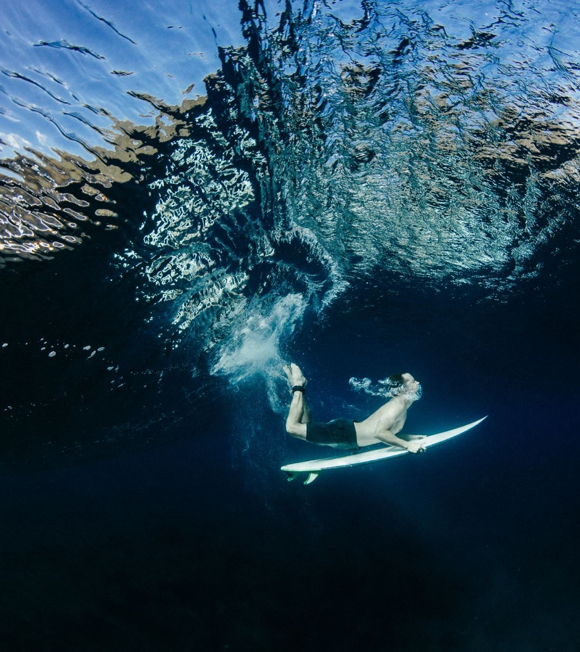
Resources are FINITE
“Strategy is a natural consequence of scarce vital resources and the struggle for survival.”
- Sir Lawrence Freedman

Slide 10
Take Time to understand your customers and be clear on your Value Propositions

Slide 11
Design the Future Brown Family Farm
Considerations:
Things to do:
Use what you’ve learned in EFM
You have FINITE resources – Tradeoffs will be required
New businesses require FUNDING SOLUTIONS
Be innovative
Brainstorm potential growth AND reduction opportunities using POST-ITS
Utilize the Business Model Canvas to assess the impact on current operations
Complete the financial analysis/ updates to support your new business
Address the HR Challenges

Slide 12
Customer Segments
Who are your most important customers?
Value Propositions
What problem are you solving or need are you fulfilling?
Channels
Which channels do you use for sales, communication, and distribution?
Customer Relationships
What are they like for each customer segment?
Revenue Streams
What are customers willing to pay for and how?
Key Resources
List the assets required to deliver your value proposition.
Key Activities
What activities are critical to delivering value?
Key Partnerships
Who do you rely on for resources or activities?
Cost Structure
Which resources and activities are the most expensive?

