Slide 1


Overview of the Business Model Canvas
Key elements for strategic business planning explained
Notes:
---

Slide 2
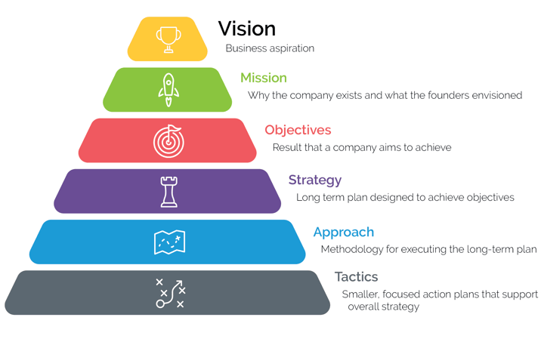
The Business Model
Source: The 6 Elements of Effective Strategic Design, Dan Overgaag, Spur Reply Consulting
Notes:
The approach guides your organization on how to execute the strategic planning framework effectively.

Slide 3
Business Model Definition
A business model describes the rationale of how an organization creates, delivers, and captures VALUE.
Source: Strategyzer

Slide 4
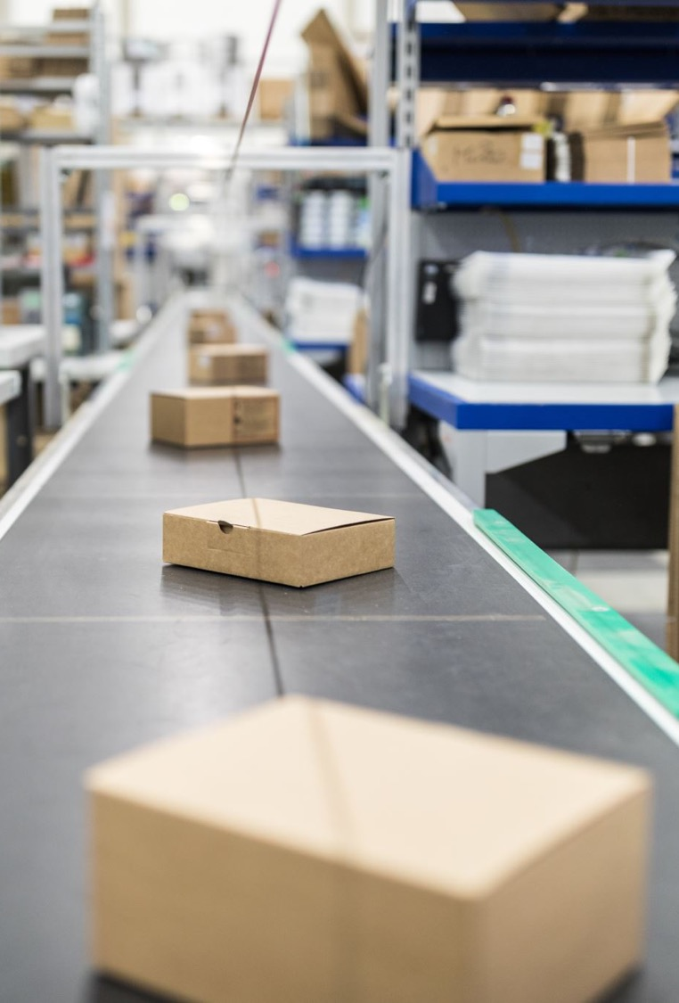
In other words, a business model is …
Everything it takes to make some thing: design, raw materials, manufacturing, labor and so on.
Everything it takes to sell that thing: marketing, distribution, delivering a service, and processing a sale.
How and what the customer pays: pricing strategy, payment methods, payment timing, and so on.

Slide 5

What is the Business Model Canvas?
Strategic tool that visualizes and simplifies business models on one page.
Breaks down a business into NINE building blocks like customers, value propositions, key partners, costs, and revenues.
Notes:
The Business Model Canvas (BMC) is a strategic management tool designed to help organizations visualize, design, and innovate their business models in a structured and simplified way. Developed by Alexander Osterwalder, the BMC breaks down a business into nine essential building blocks, providing a holistic view of how a company creates, delivers, and captures value. Unlike traditional business plans, which can be lengthy and complex, the BMC offers a one-page framework that fosters clarity and collaboration among stakeholders. It is widely used by startups to validate ideas, by established companies to innovate, and by consultants to analyze and optimize business strategies. The canvas encourages iterative thinking, enabling teams to quickly test assumptions and adapt to changing market conditions. Its visual nature makes it an excellent tool for workshops, brainstorming sessions, and strategic planning meetings. By focusing on key components such as customers, value propositions, and revenue streams, the BMC ensures that businesses align their operations with market needs and profitability goals. Ultimately, the BMC serves as a dynamic blueprint that evolves with the business, supporting agility and informed decision-making in competitive environments.

Slide 6
Key Partners 1 2 3 4 5 | Key Activities A B C | Value Propositions VP1 VP2 VP3 VP4 VP5 | Customer Relationships A B C | Customer Segments 1 2 3 4 5
 | Key Resources A B C |  | Channels A B C
Cost Structure A B C | Revenue Streams A B C

Slide 7
Organization-centric Questions
What can we sell customers?
How can we reach customers most efficiently?
What relationships do we need to establish with customers?
How can we make money from our customers?

Slide 8
Customer- centric
Questions
What jobs do our customers need to get done and how can we help?
What are our customers aspirations and how can we help them live up to them?
How do our customers prefer to be addressed?
How do we, as a business, best fit into their routines?
What relationships do our customers expect us to establish with them?
For what value are customers truly willing to pay?

Slide 9
Customer Segments
For whom are we creating value?
Who are our most important customers, clients, or users?
Examples:
Mass Market
Niche Market
Segmented
Diversified
Multi-sided Platform
Distinct CS Tests:
Do their needs require and justify a distinct offer?
Are they reached through separate distribution channels?
Do they require different types of relationships?
Do they have substantially different profitability's?
Are they willing to pay for different aspects of the offer?
Key Resources
What Key Resources do our VP require?
Our Distribution Channels?
Our Customer Relationships?
Revenue Streams?
Types of Resources:
Physical
Intellectual (brand, patents, copyrights, data)
Human
Financial
Operational
Key Partners
Who are our Key Partners?
Who are our key suppliers?
Which Key Resources are we acquiring from partners?
Which Key Activities do partners perform?
Types:
Strategic Alliance between non-competitors
Coopetition – strategic relationship between competitors
Joint ventures to develop new business
Buyer-supplier relationships to assure reliable supply
Motivations for partnerships:
Optimization and economy
Reduction of risk and uncertainty
Acquisition of resources and activities.
Customer Channels
Through which Channels do our CS want to be reached?
How are we reaching them now?
How are our Channels integrated?
Which work best?
Most cost efficient?
Channel Phases:
Awareness
Evaluation
Purchase
Delivery
After Sales
Value Proposition
What value do we deliver to the customer?
What do you offer your customer to create gains?
Which one of our customer’s problems are we helping to solve?
Which customer needs are we satisfying or pains relieving?
What bundles of products/services are we offering each CS to help gets job done?
Characteristics:
Newness Price
Performance Cost reduction
Customization Risk reduction
“Getting the job done” Accessibility
Design Convenience/usability
Brand/Status
Who are our Key Partners?
Who are our key suppliers?
Which Key Resources are we acquiring from partners?
Which Key Activities do partners perform?
Types:
Strategic Alliance between non-competitors
Coopetition – strategic relationship between competitors
Joint ventures to develop new business
Buyer-supplier relationships to assure reliable supply
Motivations for partnerships:
Optimization and economy
Reduction of risk and uncertainty
Acquisition of resources and activities.
What Key Activities do our VP require?
Our Distribution Channels?
Customer relationships?
Revenue Streams?
Categories:
Production
Problem Solving
Platform/Network
What value do we deliver to the customer?
What do you offer your customer to create gains?
Which one of our customer’s problems are we helping to solve?
Which customer needs are we satisfying or pains relieving?
What bundles of products/services are we offering each CS to help gets job done?
Characteristics:
Newness
Performance
Customization
“Getting the job done”
Design
Brand/Status
Price
Cost reduction
Risk reduction
Accessibility
Convenience/usability
What type of relationship does each of our CS expect?
Which ones have we established?
Which do we want to establish?
Which ones work?
How are they integrated with the rest of the business model?
Examples: personal assistance, dedicated personal assistance, self-service, automated services, communities, co-creation
For whom are we creating value?
Who are our most important customers, clients, or users?
Examples:
Mass Market
Niche Market
Segmented
Diversified
Multi-sided Platform
Distinct CS Tests:
Do their needs require and justify a distinct offer?
Are they reached through separate distribution channels?
Do they require different types of relationships?
Do they have substantially different profitability's?
Are they willing to pay for different aspects of the offer?
Revenue Streams
For what value are our customers willing to pay?
For what do they currently pay?
How are they currently paying?
How would they prefer to pay?
How much does each Revenue Stream contribute to overall revenues?
Cost Structure
What are the most important costs inherent in our business model?
Which Key Resources are most expensive?
Which Key Activities are most expensive?
What Key Resources do our VP require?
Our Distribution Channels?
Our Customer Relationships?
Revenue Streams?
Types of Resources:
Physical
Intellectual (brand, patents, copyrights, data)
Human
Financial
Operational
Through which Channels do our CS want to be reached?
How are we reaching them now?
How are our Channels integrated?
Which work best?
Most cost efficient?
Channel Phases:
Awareness
Evaluation
Purchase
Delivery
After Sales
Customer Relationships
What type of relationship does each of our CS expect?
Which ones have we established?
Which do we want to establish?
Which ones work?
How are they integrated with the rest of the business model?
Examples: personal assistance, dedicated personal assistance, self-service, automated services, communities, co-creation
Key Activities
What Key Activities do our VP require?
Our Distribution Channels?
Customer relationships?
Revenue Streams?
Categories:
Production
Problem Solving
Platform/Network
What are the most important costs inherent in our business model?
Which Key Resources are most expensive?
Which Key Activities are most expensive?
For what value are our customers willing to pay?
For what do they currently pay?
How are they currently paying?
How would they prefer to pay?
How much does each Revenue Stream contribute to overall revenues?

Slide 10
Who are our Key Partners?
Who are our key suppliers?
Which Key Resources are we acquiring from partners?
Which Key Activities do partners perform?
Types:
Strategic Alliance between non-competitors
Coopetition – strategic relationship between competitors
Joint ventures to develop new business
Buyer-supplier relationships to assure reliable supply
Motivations for partnerships:
Optimization and economy
Reduction of risk and uncertainty
Acquisition of resources and activities.
What Key Activities do our VP require?
Our Distribution Channels?
Customer relationships?
Revenue Streams?
Categories:
Production
Problem Solving
Platform/Network
What value do we deliver to the customer?
What do you offer your customer to create gains?
Which one of our customer’s problems are we helping to solve?
Which customer needs are we satisfying or pains relieving?
What bundles of products/services are we offering each CS to help gets job done?
Characteristics:
Newness
Performance
Customization
“Getting the job done”
Design
Brand/Status
Price
Cost reduction
Risk reduction
Accessibility
Convenience/usability
What type of relationship does each of our CS expect?
Which ones have we established?
Which do we want to establish?
Which ones work?
How are they integrated with the rest of the business model?
Examples: personal assistance, dedicated personal assistance, self-service, automated services, communities, co-creation
For whom are we creating value?
Who are our most important customers, clients, or users?
Examples:
Mass Market
Niche Market
Segmented
Diversified
Multi-sided Platform
Distinct CS Tests:
Do their needs require and justify a distinct offer?
Are they reached through separate distribution channels?
Do they require different types of relationships?
Do they have substantially different profitability's?
Are they willing to pay for different aspects of the offer?
What Key Resources do our VP require?
Our Distribution Channels?
Our Customer Relationships?
Revenue Streams?
Types of Resources:
Physical
Intellectual (brand, patents, copyrights, data)
Human
Financial
Operational
Through which Channels do our CS want to be reached?
How are we reaching them now?
How are our Channels integrated?
Which work best?
Most cost efficient?
Channel Phases:
Awareness
Evaluation
Purchase
Delivery
After Sales
What are the most important costs inherent in our business model?
Which Key Resources are most expensive?
Which Key Activities are most expensive?
For what value are our customers willing to pay?
For what do they currently pay?
How are they currently paying?
How would they prefer to pay?
How much does each Revenue Stream contribute to overall revenues?

Slide 11
Customer Segments
Define different groups of people or organizations your business aims to serve. Who are your most important customers?
Value Propositions
Describe the unique value you deliver to your customers. What problem are you solving or need are you fulfilling?
Channels
How you deliver value proposition to customers. Which channels do you use for sales, communication, and distribution?
Customer Relationships
Outline relationships with each customer segment. Is it personal, automated, self-service, or community-based?
Revenue Streams
Identify how your business earns money from each customer segment. What are customers willing to pay for and how?
Key Resources
List the assets required to deliver your value proposition. These can be physical, intellectual, human, or financial.
Key Activities
Define important actions your business must take to operate successfully. What activities are critical to delivering value?
Key Partnerships
Identify the network of suppliers and partners that help you succeed. Who do you rely on for resources or activities?
Cost Structure
Describe all costs involved in operating your business model. Which resources and activities are the most expensive?

Slide 12
Key Partners 1 2 3 | Key Activities A B C | Value Propositions VP1 VP2 VP3 VP4 VP5 | Customer Relationships A B C | Customer Segments 1 2 3
 | Key Resources A B C |  | Channels A B C
Efficiency
VALUE
Deliver Value
Create Value
Capture Value
Cost Structure A B C | Revenue Streams A B C

Slide 13


Slide 14

Key Partners 1 2 3 | Key Activities A B C | Value Propositions VP1 VP2 VP3 VP4 VP5 | Customer Relationships A B C | Customer Segments 1 2 3
 | Key Resources A B C |  | Channels A B C
Cost Structure A B C | Revenue Streams A B C

Slide 15

Exercise
Review
In your groups, review the customer segments and value propositions of a rudimentary BFF Business Model Canvas
Create
Distill the information you read from the case study and have learned this week.
Create post-its to capture additional ideas for customer segments.
Use
Use different colored post-its to align the customer segment and value propositions.

