Slide 1



Leading
Through
Change
By: Sharon Justice

Slide 2

What you need:
Your participant guide:
Print it and follow along

Slide 3

Session Objectives
  Understand Change Styles
  Recognize how Styles work through change
  Recognize styles of others
  Explore how style affects Leadership
  Explore Leading others through change

Slide 4
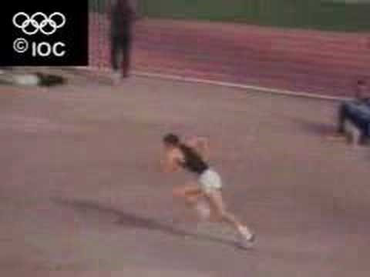

Slide 5

Change

Slide 6

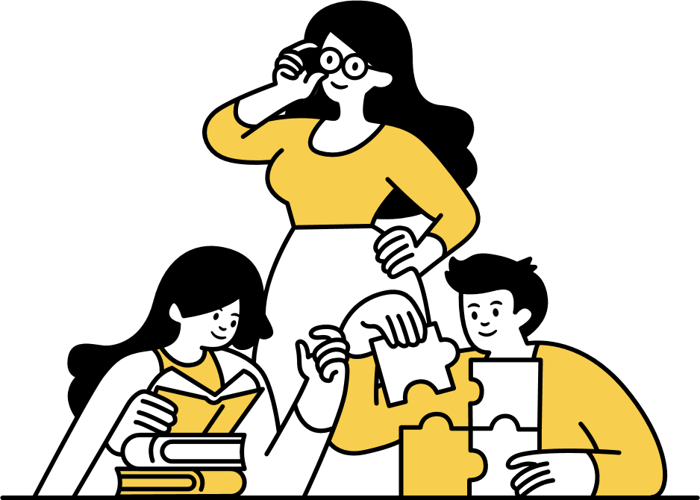
Activity
Follow the instructions as they are given to you by the facilitator
Page 2 Change Style Report
Notes:
Ask participants to write for 3 minutes their response to, “How does change typically effect you?”
- 90 seconds into exercise, ask students to write with their other hand.
- Upon completion, ask participants to write a discovery statement on 3x5 card about change based on this activity.
2.Ask participants to draw their experience of change. What does change look like to you?
- 90 seconds into exercise, ask students to close their eyes and continue to draw.
- Upon completion, ask participants to write a discovery statement on a 3x5 card about change.
3.Ask participants to get out of their seats and walk out of the room backwards, out through one door, down the hall to some predetermined position and back into the room and into their seats. Ask them to do this slowly and deliberately, at half their normal walking speed, being very conscious of their body and their movements. 3:28-3:30
Write discovery statement on 3x5 card about change.
- Upon completion, ask participants to write a discovery statement on a 3x5 card about change.
Debrief/Facilitator Notes: Have participants share their discovery statements. Help students uncover their habitual patterns in dealing with change. Here are some questions that may help.
- How did these changes make you feel about yourself? Other participants, the staff?
- Did you ask for help when you were going through stress caused by changes?
- What thoughts came up as you experienced these changes?
- Do you feel that you were able to adapt quickly or more slowly to the changes that you were asked to make?
- Were your responses to these exercises typical of how you respond to change?
- What worked for you? What didn’t?

Slide 7

Your Change
What is a change that is planned or has already begun?
  What concerns you most about this change?
  What is your role in the change?
  Who will you have to help navigate through the change?
  Name the people that are impacted as a result of this change within your workplace.
  What are some of their reactions to the change (or if it isn’t announced yet, what do you anticipate their reaction to be?)

Slide 8
Change Processing Style
Page 4 Change Style Report
CPS Does:
  Offer an explanation of preferred style for initiating & dealing with change
  Describe three change style preferences…more personality influenced than situation influenced
  Create an appreciation for change-style diversity
CPS Does Not:
  Present a right or wrong, “better” or “worse” change style
  Measure competence in initiating & managing change
  Limit individuals to predetermined responses to change
Notes:
9

Slide 9
Change in your organization?
Page 4 Change Style Report
Rate of Change
1
5
10
Occasional Constant
Notes:
10

Slide 10
Change in your organization?
Page 4 Change Style Report
Rate of Change
1
5
10
Occasional Constant
Intensity of Change
1
5
10
Intensity of Change
Fine-Tune Radical
Notes:
11

Slide 11

Change
What’s driving your changes?
Notes:
12

Slide 12

Change
What’s driving the changes?
What are your obstacles?
Notes:
13

Slide 13

Current Change
  What is a recent change you have faced.
  How did you respond?
  How long did it take you to change?

Slide 14

Two Dimensions of Change
Page 5 Change Style Report
Structural
Psychological
Notes:
15

Slide 15

Two Dimensions of Change
Structural Event
  New job
  New boss
  Reengineering
  New Technology
  Merger/Acquisition
  New systems
  Revised job
  Personal

Slide 16
Two Dimensions of Change
Structural Event
  New job
  New boss
  Reengineering
  New Technology
  Merger/Acquisition
  New systems
  Revised job
  Personal
Psychological Response
The process we go through to adjust to the new situation (fear, excitement, anxiety, suspense disappointment)
“Emotions”

Slide 17


Try This
  Find a pen or pencil and a piece of paper.
  Quickly sign your name the way you typically sign a check or other document.
  Move your pen or pencil to your other hand and sign your name again.

Slide 18

Change Processing Style
©2003 Discovery Learning, Inc. All Rights Reserved.

Slide 19
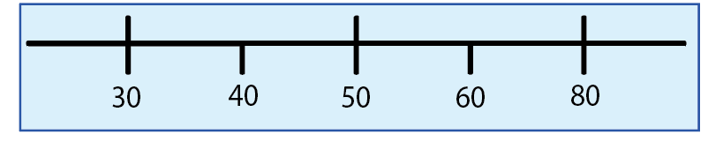
CPS CONTINUUM
Page 5 Change Style Report
Trailblazer
Bridge Builder
Guardian
Notes:
There are three styles that make up the CSI.
The results of your CSI will place you on a continuum ranging from the Conserver style to an Originator style with the Pragmatist style occupying the middle of the continuum
The closer to the end of the continuum, the stronger the preference for a conserver or originator approach to change

Slide 20

Take the Survey!

Slide 21
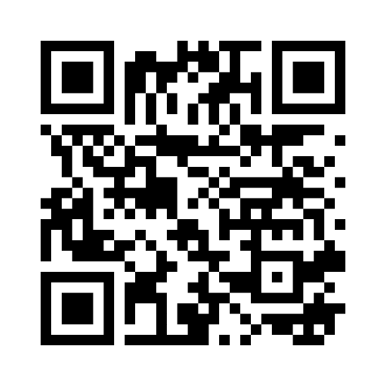
SCAN THE QR CODE TO TAKE THE CHANGE STYLE ASSESSMENT

Slide 22
Open your Survey Results!

Slide 23

CHANGE STYLE PREFERENCE
Page 8- 10 Change Style Report
GUARDIAN
Accept the structure
Prefer change that is incremental
BRIDGE BUILDER
Explore the structure
Prefer change that is
functional
TRAILBLAZER
Challenge the structure
Prefer change that is expansive

Slide 24
Place yourself on the continuum
Page 5 – Change Style Report
Trailblazer
Bridge Builder
Guardian

Slide 25

CHARACTERISTICS
Page 8- 10 Change Style Report
When facing change GUARDIANS
  Generally appear deliberate, disciplined, and organized
  Prefer change that maintains current structure
  May operate from conventional assumptions
  Enjoy predictability
  May appear cautious and inflexible
  May focus on details and the routine
  Honor tradition and established practice

Slide 26

CHARACTERISTICS
Page 8- 10 Change Style Report
When facing change TRAILBLAZERS
  May appear unorganized, undisciplined, unconventional and spontaneous
  Prefer change that challenges current structure
  Will likely challenge accepted assumptions
  Enjoy risk and uncertainty
  May be impractical and miss important details
  May appear as visionary and systemic in their thinking
  Can treat accepted policies and procedures with little regard

Slide 27

CHARACTERISTICS
Page 8- 10 Change Style Report
When facing change BRIDGE BUILDERS
  May appear practical, agreeable, flexible
  Prefer change that emphasizes workable outcomes
  Are more focused on results than structure
  Operate as mediators and catalyst for understanding
  Are open to both sides of an argument
  May take more of a middle-of-the-road approach
  Appear more team-oriented

Slide 28
Review Your Style
Page 5 Change Style Report
Trailblazer
Bridge Builder
Guardian
Style Guide
Trailblazer 10 Bridge Builder 11 Guardian 12
Notes:
Talking Points
The three styles I have described are to some degree artificially de=discrete profiles on a continuum that is not really as discrete when you apply it to every person in reality. The transition from one style to the next is gradual at best and has “gray” areas where description and behaviours definition are less predictable. There is not a clean break from one style preference to another!
Over 35,000 people have completed the CSI and it is found in the general population - 25% who complete the CSI score as a Conserver; 50% are Pragmatists and 25% are Originators

Slide 29


For Reflection
What do we need to know about working effectively with you?
What frustrates you about working with other styles?
What tips would you offer to work together more effectively?

Slide 30

PERCEPTIONS
Page 11 Change Style Report
TRAILBLAZERS see GUARDIANS as:
      Dogmatic
      Bureaucratic
      Yielding to authority
      Having their head in the sand
      Preferring the status quo
      Lacking new ideas

Slide 31
PERCEPTIONS
Page 11 Change Style Report
GUARDIANS see TRAILBLAZERS as:
      Divisive
      Impulsive
      Lacking appreciation of tested ways of getting things done
      Starting but not finishing projects
      Not interested in follow through
      Wanting change for the sake of change
      Not understanding how things get done

Slide 32
PERCEPTIONS
Page 11 Change Style Report
BRIDGE BUILDERS can be perceived by strong GUARDIANS and TRAILBLAZERS as
      Compromising
      Mediating
      Indecisive
      Easily influenced
      Noncommittal
      Hiding behind team needs

Slide 33

COLLABORATION
GUARDIANS BRIDGE BUILDERS TRAILBLAZERS
Prefer to keep
current structure
smoothly
Focus on relationships
Encourage building
on what is already
working
Prefer balanced
inquiry
Focus on shared
objectives
Encourage looking
at the current
circumstances
Prefer to challenge
accepted structure
Focus
on the task
Encourage
exploring
new responsibiliies

Slide 34

Your Team
Identify the styles of your team, workgroup or committee?
  Do you have all styles?
  Are you missing a style?
  How do you work together?
  Can you see the styles in action?

Slide 35

Style Summary
Guardians
CONTRIBUTIONS TO THE ORGANIZATION
  Get things done on schedule
  Work well within organizational structure
  Attend to detail and factual information
  Demonstrate strong follow-through skills
  Encourage and adhere to routine
  Respect rules and authority
  Handle day-to-day operation efficiently
LEADERSHIP STYLE
  Lead through reliable, stable, and consistent behavior
  Reward following the rules while getting the job done
  Attend to practical organizational needs
  Expect organizational policies, procedures and rules to
  be followed
  Promote the traditional values of the organization

Slide 36
Style Summary
Guardians
  PREFERRED WORK ENVIRONMENT
  Secure
  Steady and consistent pace rewarded
  Time and space for reflection
  Stable, structured, orderly, and predictable
  Group oriented problem solving and decision making
  POTENTIAL PITFALLS
  May be rigid in thought and action
  May discourage innovation by promoting existing rules, policies and regulations
  May not see beyond the present details to understand the broader, strategic context
  May delay completion of tasks because of perfectionism
  May delay action by reflecting too long on a situation
  May appear unyielding and set in their ways
  May overly focus on small details and inconsistencies

Slide 37
Style Summary
Bridge Builders
  CONTRIBUTIONS TO THE ORGANIZATION
  Willing to address the needs of the organization as they arise
  Get things done in spite of the rules, not because of them
  Negotiate and encourage cooperation and compromise to get problems solved
  Take a realistic and practical approach
  Draw people together around a common purpose
  Organize ideas into action plans
  Have short- and long-range perspectives
  Promote practical organizational structure
  LEADERSHIP STYLE
  Facilitate problem solving among people
  Use and adapt past experiences to solve current problems
  Build cooperation rather than expecting it
  Use a facilitative approach in managing people and projects
  Encourage the organization to have congruence between values
  and actions

Slide 38
Style Summary
Bridge Builders
  PREFERRED WORK ENVIRONMENT
  Flexible and adaptable
  Harmonious and participative atmosphere
  Action-oriented, productive people who focus on the situation
  at hand
  Hands-on experiences encouraged
  Adaptive structure that is responsive to the needs of the moment
  POTENTIAL PITFALLS
  May appear indecisive and undirected
  May not promote ideas and priorities enough
  May try to please too many people at the same time
  May appear noncommittal
  May be easily influenced
  May negotiate compromise that is too “middle of the road”

Slide 39
Style Summary
Trailblazers
CONTRIBUTIONS TO THE ORGANIZATION
  Understand complex problems
  Bring strong conceptual and design skills
  Push the organization to understand the system as a whole
  Support and encourage risk-taking behavior
  Provide future-oriented insights and vision for the organization
  Serve as catalysts for change
  Initiate new ideas, projects, and activities
LEADERSHIP STYLE
  Catalysts for systemic change
  Energetic and enthusiastic
  Provide long-range vision to the organization
  Conceptualize and build new models
  Constantly reorganize the whole system
  Like to be in charge of the start-up phase
  Prefer unique leadership roles to conventional roles
  Manage more than one task at the same time

Slide 40
Style Summary
Trailblazers
  PREFERRED WORK ENVIRONMENT
  Working independently on models to solve complex problems
  Change and risk oriented
  Non-bureaucratic, unconstrained by rules and policy
  Idea oriented and intellectually challenging
  Focus on long-range, strategic planning
  Multiple tasks to work on simultaneously
  POTENTIAL PITFALLS
  May not adjust their vision to the facts, logic, and practical constraints of the situation
  May become lost in theory, ignoring or forgetting current realities
  May over extend themselves
  May not adapt well to policies and procedures
  May appear unyielding and discourage others from challenging them
  May ignore the impact of their ideas on the system and other people
  May move on to new ideas or projects without completing those
  already started
  May overlook relevant details

Slide 41

Questions for Assessing Situational Appropriateness of Change Style
Page 12 Change Style Report
  How many solutions have been tried already?
  How critical is time?
  How limited are resources?
  How critical is the situation?
  How long has the team worked together?
  Are politics playing a part in the situation or decision?
  Who is requesting the change?
  Is the client a conserver, a pragmatist, or an originator?
  In what stage of development is the project?
  Is the project of a short- or long-term nature?
  Has the competition changed?
  Are you facing deregulation?

Slide 42


Increasing Flexibility
Page 12 Change Style Report
  Step Back
  Solicit Feedback
  Make effort to understand
  Find another view point
  Imagine
Preference Capacity
Notes:
Conservers:
Effective Toyata TPS
Ineffective: wort nightmare bureaucrat
Pragmatists: Effective find common ground
Ineffective perceived as wishy washy
Research: more team oriented and mediating than either of the others
Originators: Effective: Apple 3M Google
Ineffective: Innovation death spiral Lots of ideas, never enough time to work them through. Flavor of the month
45

Slide 43
Suggestions for Increasing Flexibility and Avoiding Style Traps
Page 12 Change Style Report
Guardians
  Consider at least three alternatives before making a decision.
  Remember to pay attention to the wider ramifications of problems in addition to present realities.
  Think of the “big picture” consequences of actions. Ask others to explain them if necessary.
  Find an originator you respect and ask his or her perspective.
  Specify a time frame in which the decision will be made or the action taken.
  When time is critical, identify no more than three or four criteria for deciding who should be included in framing your decision.
  Develop tools and strategies for exploring and understanding system oriented issues.
  Find someone who is willing to play devil’s advocate with your proposed solutions/ideas.
  Write a list of advantages for taking more of an originator-type approach in a given situation.
  Write a description of a desired future outcome in positive and global terms.

Slide 44
Suggestions for Increasing Flexibility and Avoiding Style Traps
Page 12 Change Style Report
Bridge Builders
  Specify a period of time in which to consider alternatives prior to committing to a solution.
  Imagine the consequences of your decision on someone for whom you care.
  When dealing with strong conservers or originators, ask exploratory questions about emotional responses to a situation, for example, How do you feel about this? How would you like things to be?
  Identify a person you suspect to be a strong conserver and a person you believe to be a strong originator and solicit their opinions.
  Identify decision criteria and apply the criteria to each possible solution.
  Identify specific questions to ask conservers and originators.

Slide 45
Suggestions for Increasing Flexibility and Avoiding Style Traps
Page 12 Change Style Report
Trailblazers
  Wait a day before taking action.
  Find someone you suspect of being a conserver and ask for his or her perspective.
  Identify and try to understand at least five facts related to the situation, problem, or decision.
  Explore and understand what is already working in the current situation.
  Learn to give up on an impractical idea.
  Attempt to clearly understand the impact of the decision or action on at least two other people.
  Find someone who is willing to play devil’s advocate on a given topic or decision.
  Write a list of advantages for taking more of a conserver-type approach.
  Make a list of relevant facts and details.
  Learn to screen activities rather than attempting all that is initially appealing.

Slide 46
In Summary
  There is no right or wrong style
  We all have opportunities to be more aware
  We can use style to increase effectiveness

Slide 47

Leading Through Transitions
Notes:
If you want to lead people somewhere new, you have to meet them where they are
Expect that many people are not as far along as you would hope
Predictable stages people go through in responding to a change event…describes how people go through a transition
The thinking is that once the event occurs, there are four stages that people typically go through: Acknowledging, Reacting, Investigating, and Implementing, these four stages describe some of the behaviors and emotions that people go through and have at each stage.
In addition to the stages, people tend to transition during a change from a past orientation – what was to a future orientation – what can be. They also at certain stages tend to be more in a cognitive domain and need information, verses at other stages (2 and 3) tend to be characterized more by feelings and emotion and need support

Slide 48

Change Process - Transition
@#%! happens
Notes:
Discovery Learning © 2008
51
The thinking is that once the event occurs, there are four stages that people typically go through: Acknowledging, Reacting, Investigating, and Implementing, these four stages describe some of the behaviors and emotions that people go through and have at each stage.
In addition to the stages, people tend to transition during a change from a past orientation – what was to a future orientation – what can be. They also at certain stages tend to be more in a cognitive domain and need information, verses at other stages (2 and 3) tend to be characterized more by feelings and emotion and need support

Slide 49
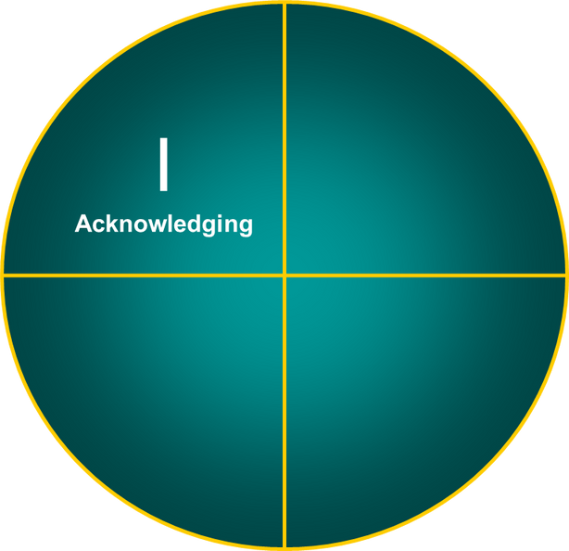
Change Process - Transition
Page 2 – Leading Others Through Change Handout
@#%! happens
Notes:
Discovery Learning © 2008
52
Let’s look at each stage and what you may typically see at each stage:
Stage 1: Acknowledging – this stage people are shocked and may feel threatened. Often this is the stage where people need to overcome some level of denial. They may deny that a change has happened.

Slide 50
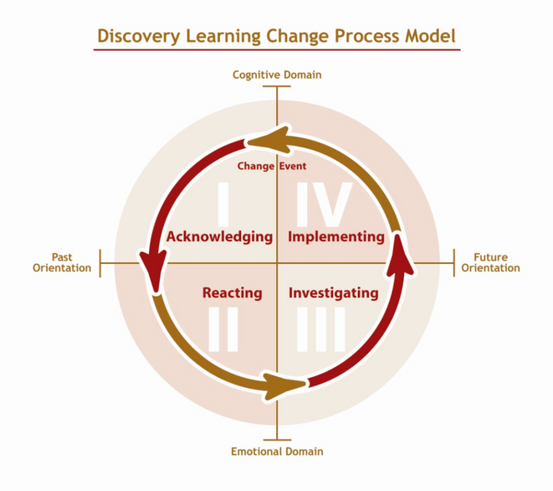

Change Process - Transition
Beginning state:
Comfort &
Control
What People Often Think
  I’m secure
  I’m in control
  I’m satisfied
  I’m doing fine
  I’m being recognized
  I’m working hard
  Hey, everything’s cool
Stage I: Acknowledging
Notes:
53

Slide 51
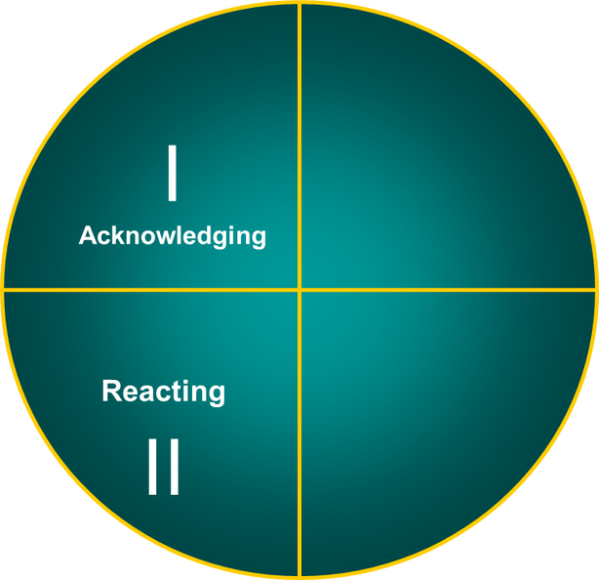
Change Process - Transition
Page 3 – Leading Others Through Change Handout
@#%! happens
Notes:
Discovery Learning © 2008
54
.
Stage 2: Reacting – This is the stage where people start to feel the change and they begin to react and respond – some of the reactions you often see at this stage can be anger, depression, withdrawal. This can be so even when people are excited about a new opportunity that a change represents as most change has some period of loss.
Stage 3: Investigating – This is the stage of exploring and creating. People show interest at this stage in new options and possibilities. They begin to explore the benefits of moving on. This is where support for and encouragement is needed as people shift their attention from the past to the future and show increasing excitement and enthusiasm.
Stage 4: Implementing – This is the stage where people are implementing new ideas that support the change. You will see people at this stage establish new routines for getting things done, their comfort with change engenders more flexibility, creativity and risk taking. People start to view the change as the way we do things around here.
While there are predictable stages in a change as described by this model – what is not predictable is the rate and way people move through them. Some people may move faster than others, some may get stuck in spots, and others may go forward only to revert back to a stage before moving on again.
There are some things you can do at various stages to help people along these stages.

Slide 52

Change Process - Transition
Beginning state:
Fear, anger, & resistance
What People Often Feel
I’m anxious
I’m not in control
I’m angry and upset
I’m worried about…
I’m not appreciated
I’m frustrated
Hey, everything’s in chaos
Stage II: Reacting

Slide 53
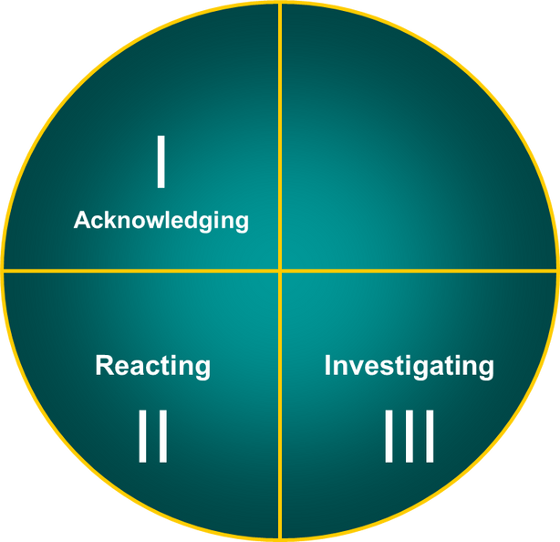
Change Process - Transition
Page 4 – Leading Others Through Change Handout
@#%! happens
Notes:
Discovery Learning © 2008
56
Stage 3: Investigating – This is the stage of exploring and creating. People show interest at this stage in new options and possibilities. They begin to explore the benefits of moving on. This is where support for and encouragement is needed as people shift their attention from the past to the future and show increasing excitement and enthusiasm.

Slide 54

Change Process - Transition
What People Often Feel
I’m challenged
I’m hopeful
I’m encouraged
I’m searching for….
I’m excited
Hey, progress is being made
Beginning
state:
Openness to inquiry & possibilities
Stage III: Investigating
Notes:
57

Slide 55
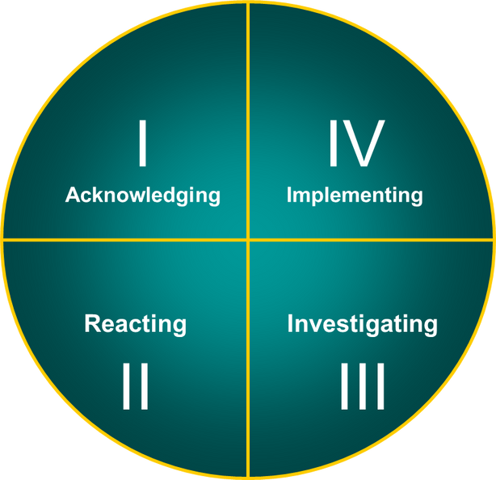
Change Process - Transition
Page 5 – Leading Others Through Change Handout
@#%! happens
I
Acknowledging
IV
Implementing
Reacting
II
Investigating
III
Notes:
Discovery Learning © 2008
58
Stage 4: Implementing – This is the stage where people are implementing new ideas that support the change. You will see people at this stage establish new routines for getting things done, their comfort with change engenders more flexibility, creativity and risk taking. People start to view the change as the way we do things around here.

Slide 56

Change Process - Transition
Beginning
state:
Readiness to learn & accommodate
What People Often Think
I’m encouraged
I’m confident
I’m satisfied
I’m energized
Hey, I made it!
Stage IV: Implementing

Slide 57
There is a predictable way to move through a change
Page 6 – Leading Others Through Change Handout
Stuck
Fast
2 forward, 1 back
What’s not predictable is the rate people move

Slide 58
There is a predictable way to move through a change
Cognitive Domain
I
Acknowledging
IV
Implementing
Past Orientation
Reacting
II
Investigating
III
Future Orientation
Emotional Domain
Notes:
Discovery Learning © 2008
61
While there are predictable stages in a change as described by this model – what is not predictable is the rate and way people move through them. Some people may move faster than others, some may get stuck in spots, and others may go forward only to revert back to a stage before moving on again.
There are some things you can do at various stages to help people along these stages.

Slide 59
Leadership Imperatives
Page 6 – Leading Others Through Change Handout
Give Information
Give Reinforcement
I
Acknowledging
IV
Implementing
Reacting
II
Investigating
III
Give
Support
Give Encouragement
Notes:
Discovery Learning © 2008
62
Talking Points
Stage 1: Acknowledging – some things you can do in stage 1 is give information and repeat it as people do not always absorb it the first time. Give visible support and assist with support networks. What you should try and avoid at this stage is – hutting people over the head with the truth, and pushing for acknowledgement and this may serve to intensify denial.
Stage 2: Reacting – In stage two it is best to lead by listening, acknowledging the feelings of those in resistance, give people time to adjust (if possible) provide facts, be empathetic and identify areas of stability – what is not changing that helps to create a sense of stability. Something you should avoid – arguing, providing reasons they should not feel the way they do, convince them it is good for them, push them towards investigation (this can get them to revert back to stage1)
Stage 3: Investigating – The leadership imperative in stage three is encouragement, create opportunities to explore new possibilities and reward it. Often participation problem solving and decision making is effective at this stage. Help to outline the pros and cons of the new possibilities under investigation. Things you may want to avoid doing as a leader of change at this stage with people are: pushing choices, rushing them, punishing mistakes will shut down creativity and risk taking. And try to avoid overestimating or misrepresenting future options.
Stage 4: Implementing – The leadership imperative in stage 4 is reinforcement – some of the best things you can do are: clarify desired outcomes so people know what success looks like. Reward effective performance, support risk taking and innovation, encourage communication and get out of the way. Some things you will want to avoid doing – micro managing, controlling choices, punishing mistakes that are a part of the learning process, change the ground rules in the middle of execution and limit participation.

Slide 60
The Traps
Page 7 – Leading Others Through Change Handout
Trailblazers
Divergent thinkers – tend to bypass Reacting
Comfortable with options and possibilities
Reluctant to leave
Investigating for Implementing
Guardians
Bridge Builders
Convergent thinkers
Asking lots of detailed questions about consequences of change
Want acknowledgement of concerns before moving to investigating
Slow down Trailblazers
Pull along Guardians
Wanting 100% buy-in
Notes:
As we overlay CSI into this model we can see very clear roles that each of the styles plan in moving a team through the transition

Slide 61



Leadership DO’s and DON’Ts – Acknowledging
Page 8 – Leading Others Through Change Handout
  Give visible support
  Provide information clearly, honestly, compassionately, and consistently
  Provide facts
  Assist with support networks
  Link to business drivers
  Hit people over the head with the truth
  Push for acknowledgement (this intensifies denial)
GIVE INFORMATION
Notes:
Change Implementation
Discovery Learning © 2008
64

Slide 62

Leadership DOs and DON’Ts - Reacting
Page 8 – Leading Others Through Change Handout
  Listen, ask questions
  Acknowledge the feelings of those in resistance
  Provide time (as the situation allows)
  Provides facts
  Be empathetic
  Identify areas of stability
  Argue
  Provide reasons why they should not feel the way they feel
  Convince them this is good for them
  Push exploration that results in denial
GIVE SUPPORT
Notes:
Change Implementation
Discovery Learning © 2006
65

Slide 63

Leadership DO’s and DON’Ts - Investigating
Page 8 – Leading Others Through Change Handout
  Create opportunities to explore new possibilities
  Reward exploration
  Use participative decision making
  Outline pros and cons of new possibilities
  Push choices
  Rush choices
  Punish mistakes
  Overestimate or misrepresent future options
GIVE ENCOURAGEMENT
Notes:
Change Implementation
Discovery Learning © 2006
66

Slide 64

Leadership DO’s and DON’Ts -Implementing
Page 8 – Leading Others Through Change Handout
  Clarify desired outcomes
  Reward effective performance
  Support risk taking and innovation
  Encourage communication
  Get out of the way
  Micro-manage
  Control choices
  Limit participation
GIVE REINFORCEMENT
Notes:
Change Implementation
Discovery Learning © 2006
67

Slide 65
Communicating Change
Page 8 – Leading Others Through Change Handout
Guardians | Bridge Builders | Trailblazers
Know the details. Don’t start by presenting the big picture. Pick one angle and build from there. Present a minimum of information and ask what else is needed. Let them guide you with what they need to know. Ask about anticipated obstacles. | Speak in terms of outcomes. Talk about the consequences. Ask for recommendations. Talk about timelines. Ask who’s input is needed. | Think in the future. Ask what they would like to see happen. Ask for ideas. Ask what’s effective in the current system (status quo) that they would not want to change. Talk about the connection between the change and future effectiveness. Give details as they are requested.

Slide 66

Exercise
Using the change case, answer the questions in the provided worksheet.
Page 9 – Leading Others Through Change Handout

Slide 67

  Who are the characters and what CPS styles do you see?
Debrief
Sue
Guardian
Jane
Bridge Builder
Kathy
Trailblazer

Slide 68
Debrief
The Rest of the case:

Slide 69

Individual
Exercise
Using the worksheet and the change you identified at the start, answer the questions in the provided worksheet.
Page 11 – Leading Others Through Change Handout

Slide 70

  "Things are the way they are because they got that way"
Laws of Organizational Change

Slide 71
  "Unless things change, they are likely to stay the same"
Laws of Organizational Change

Slide 72
  "Change would be easy if it weren’t for the people"
Laws of Organizational Change

Slide 73
  "People don’t resist change, they resist being changed"
Laws of Organizational Change

Slide 74
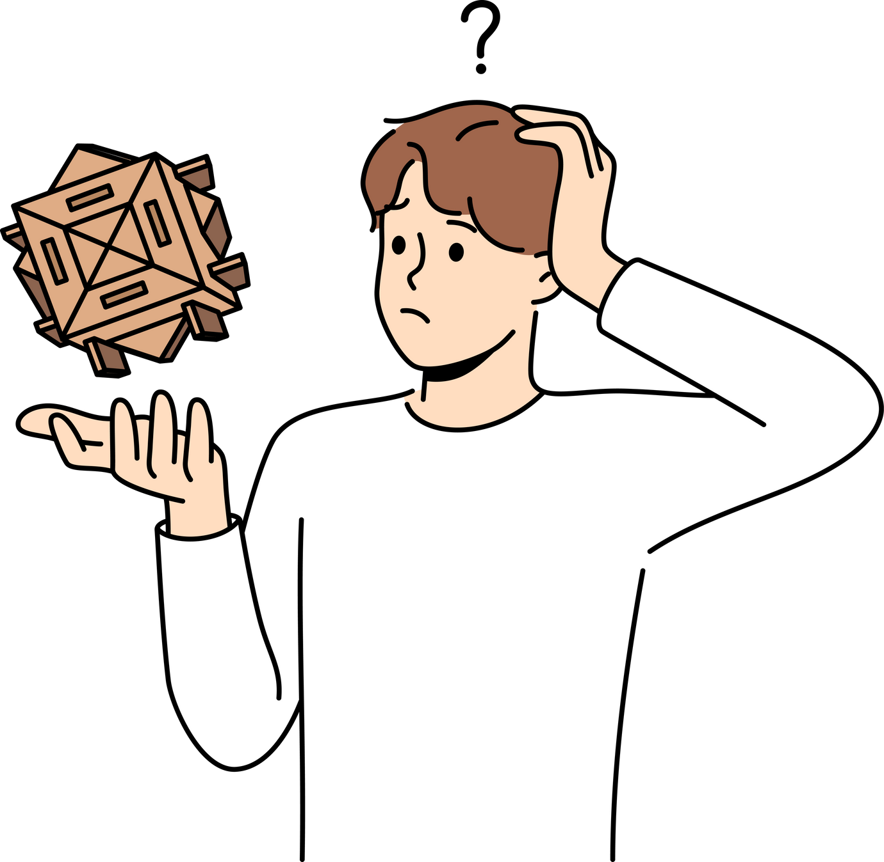
What makes leading change so difficult?

Slide 75

What are 2 things that have resonated with you that you commit to trying?

Slide 76
“It is not the strongest of the species that survives, nor the most intelligent that survives. It is the one that is most adaptable to change”

Slide 77


Want to Learn More?
Sharon Justice
www.justiceleadership.com

