Slide 1
Jobs-To-Be-Done (JTBD)
Framework

Slide 2
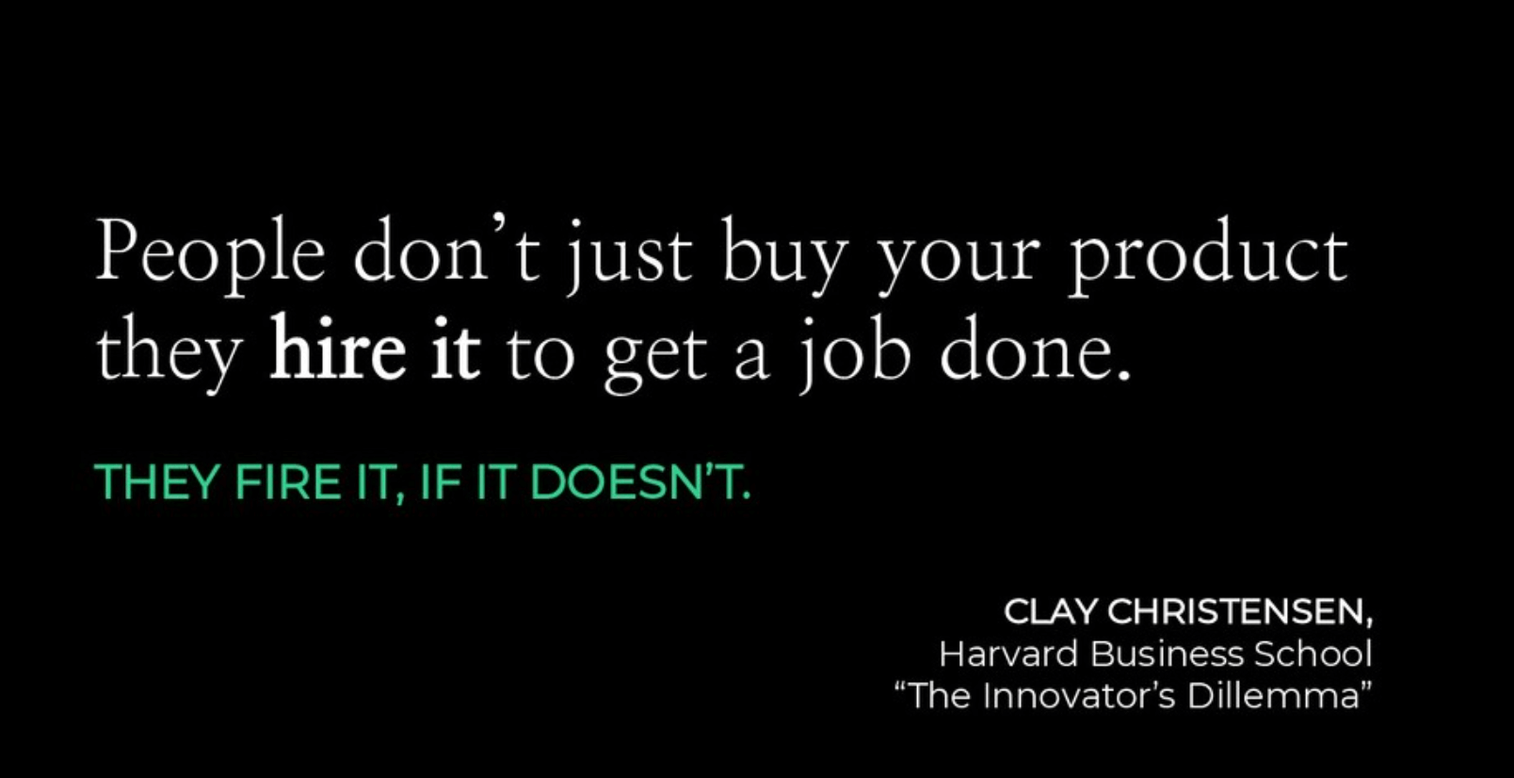
They fire it, if it doesn’t.
- Clayton Christensen,

Slide 3
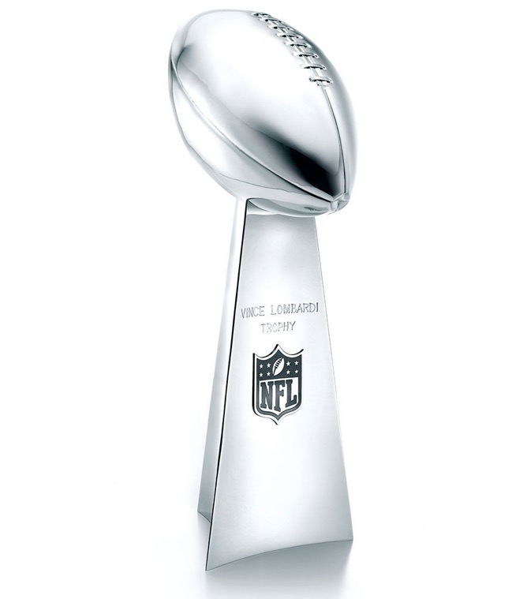
2025 Super Bowl Advertisements
Ad campaign 1
What customer Jobs-To-Be-Done
does it communicate?

Slide 4
2025 Super Bowl Advertisements
Ad campaign 2
What customer Jobs-To-Be-Done
does it communicate?

Slide 5


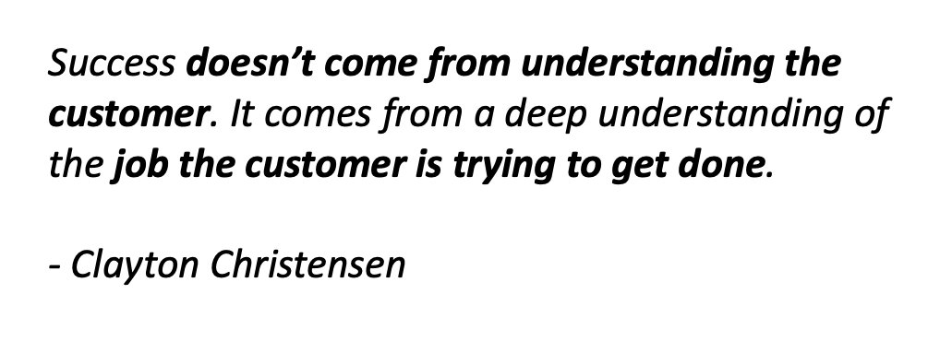

Slide 6
If I had asked my customers what they wanted, they would have told me, ‘a faster horse.’
- Henry Ford

Slide 7
The Value Proposition is the Heart of the Business Model Canvas and we start with JTBD

Slide 8
Customer Jobs
Things customers are trying to get done in their work or life
Help me …
Help me avoid …
I need to …

Slide 9
There are three types of Customer Jobs
Functional Jobs | Personal/ Emotional Jobs | Social Jobs
Complete a specific task or solve a specific problem | Customers seek a specific emotional state such as feeling satisfied or secure. | Make me look good, elevate my status, or help me gain power. Describes how customers want to be seen by others.

Slide 10
Exercise
What jobs do the BFF customers have to do?
Use the trigger questions
Brainstorm using post-its before trying to complete the sheet
– 6 min
Consolidate your ideas to complete the worksheet
- 4 min

Slide 11
Customer Pains
Negative emotions, undesired costs/situations, and risks the customer experiences (or could experience) before, during, or after getting the job done
Obstacles
Risks
Undesired outcomes

Slide 12
Exercise
What pains do the BFF customers have?
Use the trigger questions
Brainstorm using post-its before trying to complete the sheet
– 6 min
Consolidate your ideas to complete the worksheet
- 4 min

Slide 13
Customer Gains
Outcomes and benefits your customers want. Some gains are required, expected, or desired by customers, and some would surprise them.
Required gains
Expected gains
Desired gains
Unexpected gains

Slide 14
Exercise
What gains do the BFF customers want?
Use the trigger questions
Brainstorm using post-its before trying to complete the sheet
– 6 min
Consolidate your ideas to complete the worksheet
- 4 min

