Slide 1
Welcome
Third Edition

Slide 2
Reflection
Think of a situation where you missed an opportunity because of a lack of communication. What communication skills in particular could have alleviated the problem?
Take some time now to share your thoughts.

Slide 3
Learning Objectives
1. Understand how communication impacts our relationships with others.
2. Learn about the different types of communication.
3. Identify personal communication style.
4. Understand the four communication styles.
5. Discover a quick way to identify the styles of others.
6. Understand how to use style to improve communication.

Slide 4
What Causes Stress on the Farm?

Slide 5
What is Communication?
Write a definition in your groups
Notes:
The dictionary defines communication as, “the imparting or interchange of thoughts, opinions, or information by speech, writing, or signs.”
It is also defined as, “means of sending messages, orders, etc., including telephone, telegraph, radio, and television,” and in biology as an, “activity by one organism that changes or has the potential to change the behavior of other organisms.”
The effectiveness of your communication can have many different effects on your life, including items such as:
• Level of stress
• Relationships with others
• Level of satisfaction with your life
• Productivity
• Ability to meet your goals and achieve your dreams
• Ability to solve problems

Slide 6
What is Communication?
Interchange of thoughts
Speech
Writing
Signs
Notes:
The dictionary defines communication as, “the imparting or interchange of thoughts, opinions, or information by speech, writing, or signs.”
It is also defined as, “means of sending messages, orders, etc., including telephone, telegraph, radio, and television,” and in biology as an, “activity by one organism that changes or has the potential to change the behavior of other organisms.”
The effectiveness of your communication can have many different effects on your life, including items such as:
• Level of stress
• Relationships with others
• Level of satisfaction with your life
• Productivity
• Ability to meet your goals and achieve your dreams
• Ability to solve problems

Slide 7
How Do We Communicate?
Verbal
This is what you are saying.
Paraverbal
This is how you say it
Non-Verbal
Gestures and body language
Notes:
We communicate in three major ways:
Spoken: There are two components to spoken communication.
Verbal: This is what you are saying.
Paraverbal: This means how you say it – your tone, speed, pitch, and volume.
Non-Verbal: These are the gestures and body language that accompany your words. Some examples: arms folded across your chest, tracing circles in the air, tapping your feet, or having a hunched-over posture.
Written: Communication can also take place via fax, e-mail, or written word.

Slide 8
How Do We Communicate?
Verbal
Paraverbal
Non-Verbal
7%
93%
Notes:
We communicate in three major ways:
Spoken: There are two components to spoken communication.
Verbal: This is what you are saying.
Paraverbal: This means how you say it – your tone, speed, pitch, and volume.
Non-Verbal: These are the gestures and body language that accompany your words. Some examples: arms folded across your chest, tracing circles in the air, tapping your feet, or having a hunched-over posture.
Written: Communication can also take place via fax, e-mail, or written word.

Slide 9
Paraverbal Communication Skills
Many attempts to communicate are nullified by saying too much.
Robert Greenleaf
Voice Influcection video
Notes:
Many attempts to communicate are nullified by saying too much.
Robert Greenleaf
Have you ever heard the saying, “It’s not what you say, it’s how you say it”? It’s true! Try saying these three sentences out loud, placing the emphasis on the underlined word.
“I didn’t say you were wrong.” (Implying it wasn’t me)
“I didn’t say you were wrong.” (Implying I communicated it in another way)
“I didn’t say you were wrong.” (Implying I said something else)
Now, let’s look at the three parts of paraverbal communication; which is the message told through the pitch, tone, and speed of our words when we communicate.

Slide 10
Other Factors in Communication
Method
Mass
Audience
Notes:
Other communication factors that we need to consider.
Method: The method in which the communicator shares his or her message is important as it has an effect on the message itself. Communication methods include person-to-person, telephone, e-mail, fax, radio, public presentation, television broadcast, and many more!
Mass: The number of people receiving the message.
Audience: The person or people receiving the message affect the message, too. Their understanding of the topic and the way in which they receive the message can affect how it is interpreted and understood.

Slide 11
Understanding Communication Barriers
When you come right down to it, how many people speak the same language even when they speak the same language?
Russell Hoban
Notes:
On the surface, communication seems pretty simple. I talk, you listen. You send me an e-mail, I read it. Larry King makes a TV show, we watch it.
Like most things in life, however, communication is far more complicated than it seems. Let’s look at some of the most common barriers and how to reduce their impact on communication.

Slide 12
Group Activity
Create a list of barriers that get in the way of our communication

Slide 13
Why is Communication Style Important?
Benefits:
Improves your interaction and relationships with others
Helps Others Interpret Your Behavior
Influences Your Success

Slide 14
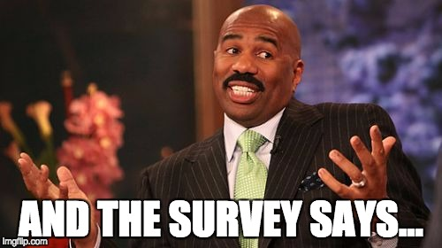
The Surveys

Slide 15
Your Communication Style Profile
Which color cards did you choose?

Slide 16
Why is Communication Style Important?
Benefits:
Improves your interaction and relationships with others
Helps Others Interpret Your Behavior
Influences Your Success
Notes:
Benefits:
Improves your interaction and relationships with others
Understanding communication style makes it easier to understand the behavior of others.
Helps Others Interpret Your Behavior
It’s easier for others to understand you when they know your communication style.
Influences Your Success
Understanding communication style allows you to choose professions that are best suited to your style. It also enables you to be more flexible in any situation.

Slide 17
Completing What’s My Communication Style?
Read each statement carefully.
Choose the statement ending that most closely reflects the way you communicate.
Sometimes you will find that more than one statement describes you. In that case, choose the one that most closely represents your style of communicating.
Put an “X” in the box next to the letter you have chosen on the Response Form.

Slide 18
Scoring What’s My Communication Style?
Step1: Slip a pencil or pen between the Response Form and the Scoring Form to separate the pages.
Step 2: Count the number of times you marked each style shape and place the resulting totals in the corresponding Communication Style Totals shapes. The sum of the scores for the four styles should total 24.
Step 3: Copy the Communication Style Totals into the corresponding style shapes on the chart labeled “Your Communication Style Profile.”

Slide 19
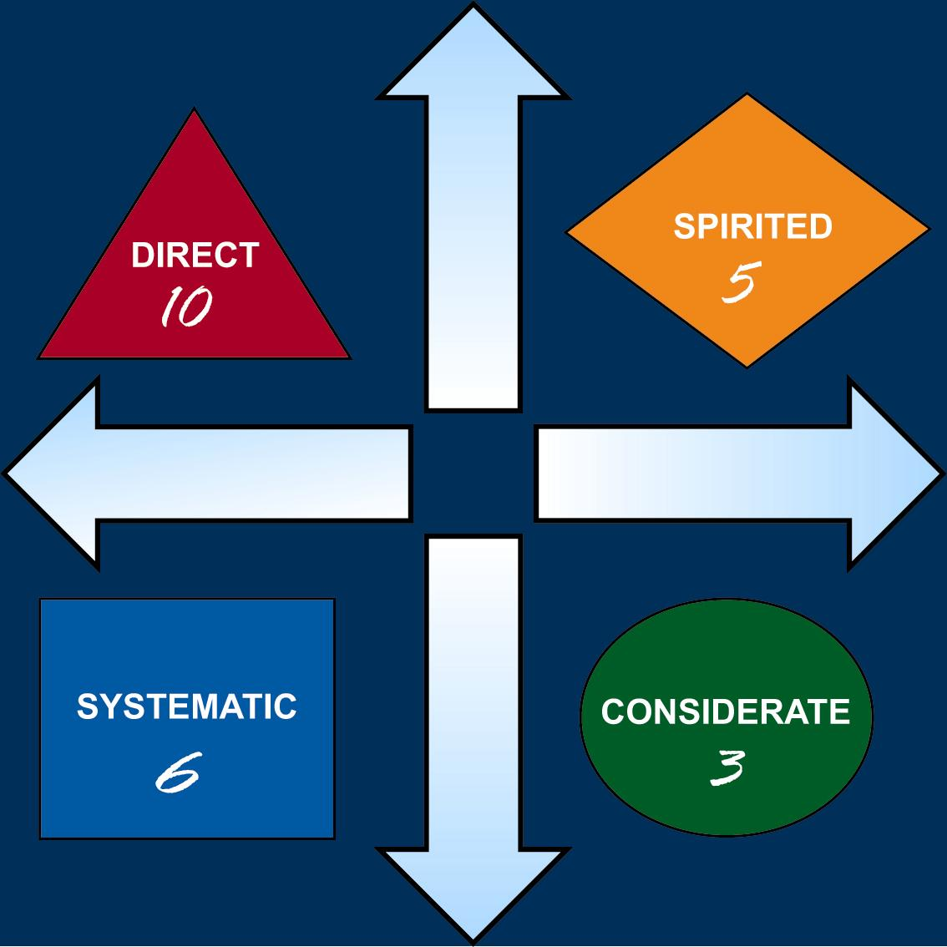
Your Communication Style Profile

Slide 20
Two Dimensions of Communication
Assertiveness
The effort that a person makes to influence or control the thoughts of others
Expressiveness
The effort that a person makes to control emotions and feelings when relating to others

Slide 21
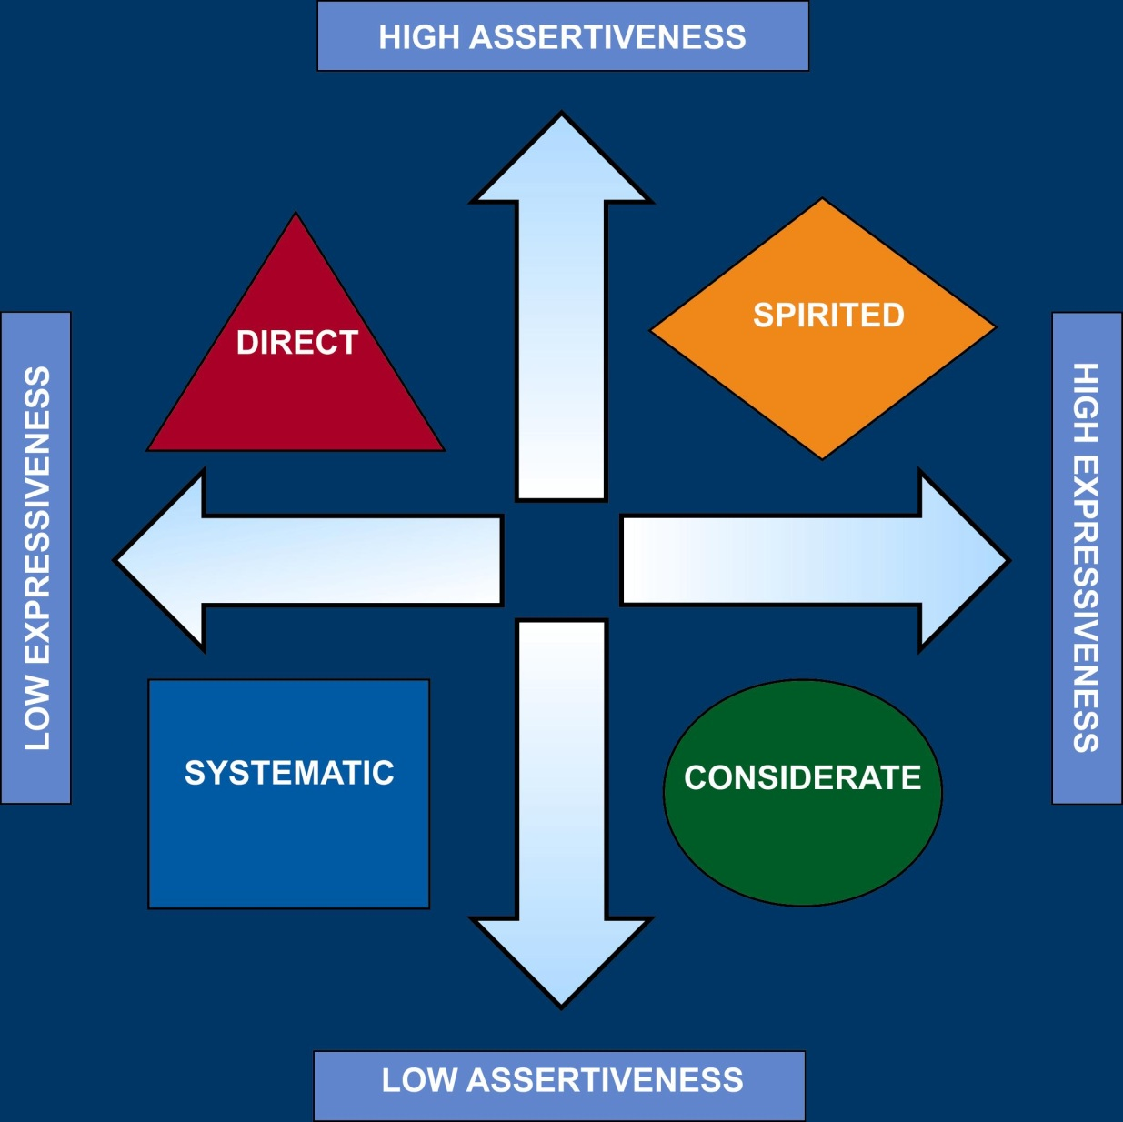
Style Model

Slide 22
Review your profile results

Slide 23
Four Types of Communication
Verbal
Paraverbal
Body Language
Personal Space

Slide 24
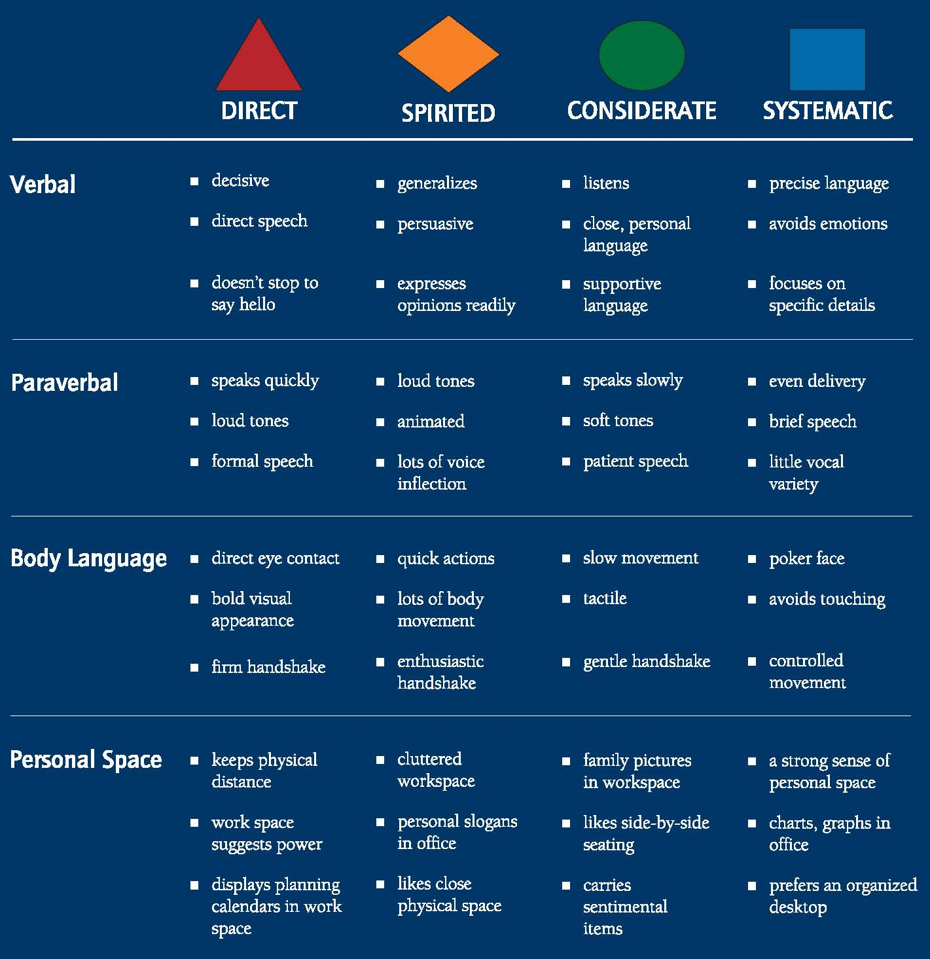
Open Page 4 in your student workbook

Slide 25
Let’s Play the Card Game
Gather in Groups of 3 or 4

Slide 26
Communication Style Strengths
Benefits of knowing the strengths of your style enables you to:
Draw on them when needed.
Find situations that are best suited to you.
Anticipate the behavior of others.
Adapt your style to respond to others appropriately.

Slide 27
Gather in Groups by Style
Using page 6 and your own experience
Make a list of your strengths as a communicator

Slide 28
Direct Style Strengths
Gets to the bottom line
Speaks forcefully
Maintains eye contact
Presents position strongly
Prefers to be in control
Tends to be decisive
Thrives on competition
Likes to take risks

Slide 29
Spirited Style Strengths
Likes to be persuasive
Tends to be a good storyteller
Focuses on the big picture
Uses motivational speech
Works at a fast pace
Builds strong alliances
Generates enthusiasm
Prefers to be with other people

Slide 30
Considerate Style Strengths
Listens well
Is a good counselor
Uses supportive language
Builds trust
Values relationships
Enjoys being part of a team
Cares for others
Tends to be reliable and steady

Slide 31
Systematic Style Strengths
Presents precisely
Seeks information
Speaks efficiently
Has a well-organized work space
Makes decisions based on facts
Excels at problem solving
Prefers clear guidelines
Works independently

Slide 32
Communication Style Trouble Spots
Benefits of knowing the potential trouble spots of your style enables you to:
Avoid situations that are not suited to your style.
Anticipate the behavior of others.
Adapt your style to respond to others appropriately.

Slide 33
Gather in Groups by Style
Use page 7 and your own experience
Make a list of your trouble spots

Slide 34
Direct Style Trouble Spots
Is a poor listener
Is impatient with others
Does not heed advice
Likes to argue
Likes to compete
Discounts feelings
Overlooks details
Tends to be a workaholic

Slide 35
Spirited Style Trouble Spots
Does not hear details
Tends to exaggerate
Generalizes
Can be overdramatic
Responds poorly to criticism
Glosses over details
Tends to miss deadlines
Does not manage time efficiently

Slide 36
Considerate Style Trouble Spots
Avoids conflict
Gives in easily
Keeps opinions to oneself
Overemphasizes feelings
Prefers what is comfortable
Allows own needs to linger
Resists change
Tells others what they want to hear

Slide 37
Systematic Style Trouble Spots
Focuses too much on details
Fears personal disclosure
Can be terse
Uses little variety in vocal tones
Puts accuracy ahead of feelings
Tends to be impersonal
Delays decision making
Does not take risks

Slide 38
How to Identify Other People’s Styles
Observe their behavior
Look for verbal, paraverbal, body language, and personal space clues
Gauge their level of assertiveness
Gauge their level of expressiveness

Slide 39
How to Speed Read Style Pg 8

Slide 40
The Brown Family
What communication Styles doe they each bring to the family?
Which Family members are going to have challenges getting on the same page?

Slide 41
Carol bursts through the door every day with a story to tell, or some catchy phrase or joke. She makes sure that she speaks to everyone on the way to her work area, often not picking up on the clues that not everyone is as morning cheerful as she is! Carol finally gets to her workspace and starts to buckle down at work, but tends to get distracted often by emails, folks walking by, or random thoughts and ideas that seem to always pop up. At times she feels the frustration of her co workers when she misses a deadline or two. But she feels that is to be expected in a workplace as busy as hers.

Slide 42
John is focused when he gets to work. He likes to head straight to his office, fire up his computer and start banging out email responses with the tasks for the day shared to his team. A few quick bullet points should be all that everyone needs to know what the major deliverables are for the day.
Today he is frustrated that he has a calendar full of meetings, most of which he thinks could be accomplished by a quick email. Maybe he can push the meetings quickly so they only take about 20 minutes instead of the full hour. He’s hoping he can do a few things during the meetings so he decides to take his laptop along

Slide 43
Candace is headed into the office for another busy week. As long as she can get in about an hour before Carol arrives she can get off to a good start. She shakes her head thinking that Sarah must not have as much to do on her list, because she insists on walking through the office and taking about an hour to greet everyone and check in before she can start her day. Candace just doesn’t understand why she takes up so much time just fliting around the office. She thinks, “I’ve got work to do, and I need to stay focused. On top of that, a full day of meetings means she is away from her desk for most of the day. She just hopes John doesn’t demand she make a snap decision about the new software purchase. She hasn’t yet seen any of the system specs or documentation and she needs time to review.

Slide 44
Sam is looking forward to the week. It’s the last week of the month, so it is time to plan the social event to celebrate birthdays. It’s always a fun time to see everyone and to catch up.
This past week was especially difficult at work. John pushed for some decisions quickly and it made a few people frustrated and before Sam knew it, he was in the middle of trying to help everyone get along. That meant he took on a few extra tasks to calm the feelings of others, Carol constantly missed her deadlines and he pitched in to help, and he didn’t finish his own work until late Saturday afternoon. He hopes that doesn’t happen this week, but it seems he can never quite get to his own work on time as so many people come to him for help, and he finds he would rather help them get it done than to say no.

Slide 45
Speed Read a Style
Go back to the situation in which you missed an opportunity to communicate:
Using page 8:
What is their style?
What is your style?
What are some of the things causing the disconnect?
What can you try differently next time.

Slide 46
Interacting with the Direct Style
Focus on their goals and objectives
Keep your relationship businesslike
Argue facts, not personal feelings
Be well organized in your presentations
Ask questions directly
Speak at a relatively fast pace

Slide 47
Interacting with the Spirited Style
Focus on opinions and inspiring ideas
Be supportive of their ideas
Don’t hurry the discussion
Engage in brainstorming
Be entertaining and upbeat
Allow them to share their ideas freely

Slide 48
Interacting with the Considerate Style
Focus on your relationship
Be supportive of their feelings
Make sure you understand their needs
Be informal
Maintain a relaxed pace
Give them time to build trust in you

Slide 49
Interacting with the Systematic Style
Focus on facts, not opinions
Be precise in your presentations
Be thorough and organized
Avoid gimmicks
Provide data when possible
Allow time for analysis

Slide 50
Applying What You’ve Learned Pg 10
1. What are the positive aspects of your communication style?
2. List some examples of how your strengths have benefited you in your communication at work.
3. What can you do to strengthen these characteristics? What can you do to develop new strengths?

Slide 51
Applying What You’ve Learned
4. What are some of the aspects of your dominant style that may be potential trouble spots?
5. What can you do to control or avoid those potential trouble spots?
6. Which communication styles do you communicate with most effectively?

Slide 52
Applying What You’ve Learned
7. Which communication styles do you communicate with least effectively?
8. What specific challenges do you face in your everyday interactions?
9. What can you do to overcome these challenges now that you understand the importance of communication style?

Slide 53
Review
Discussed how communication impacts our relationships with others
Learned about the four types of communication
Identified your personal communication style
Reviewed the HRDQ Style Model and the four communication styles
Practiced quick techniques to identify the styles of others
Learned how to “flex” our style when communicating with others
Discussed how to use style to improve communication
Established a plan to apply what we’ve learned.

Slide 54
Action Plan
Pick 1 person
Speed read their style
What works well between you?
What needs to be improved?
What are 2 things you can do to flex your style with this person

