Slide 1
U.S. Agriculture Update
Blake Brown, PhD
Hugh C Kiger Professor Emeritus
NC State University

Slide 2
Input Costs:
What about 2023?

Slide 3
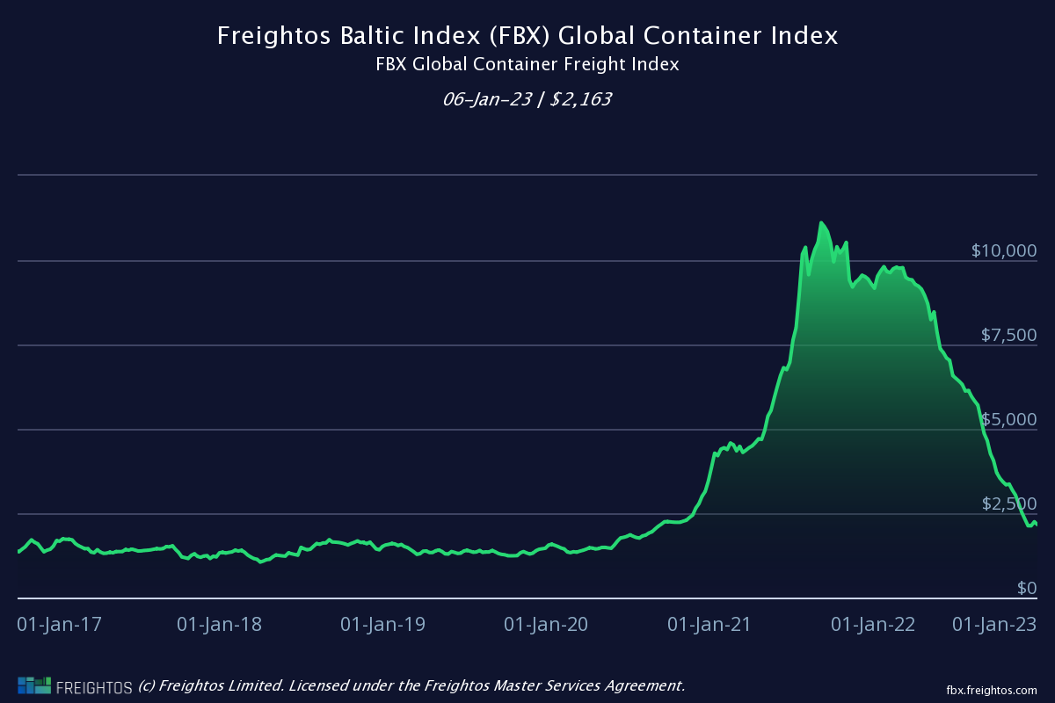

Slide 4
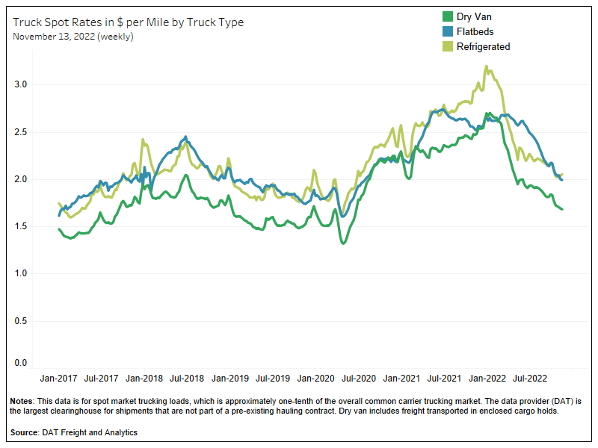

Slide 5
Fertilizer

Slide 6
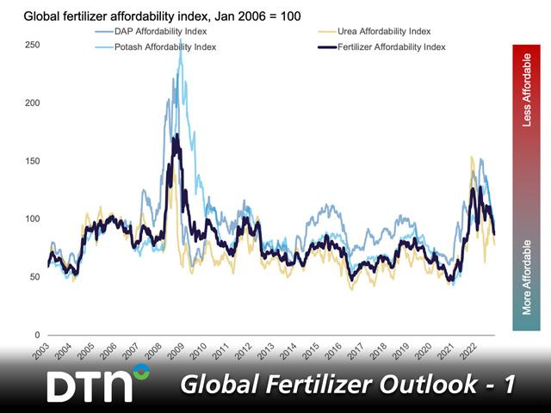

Slide 7
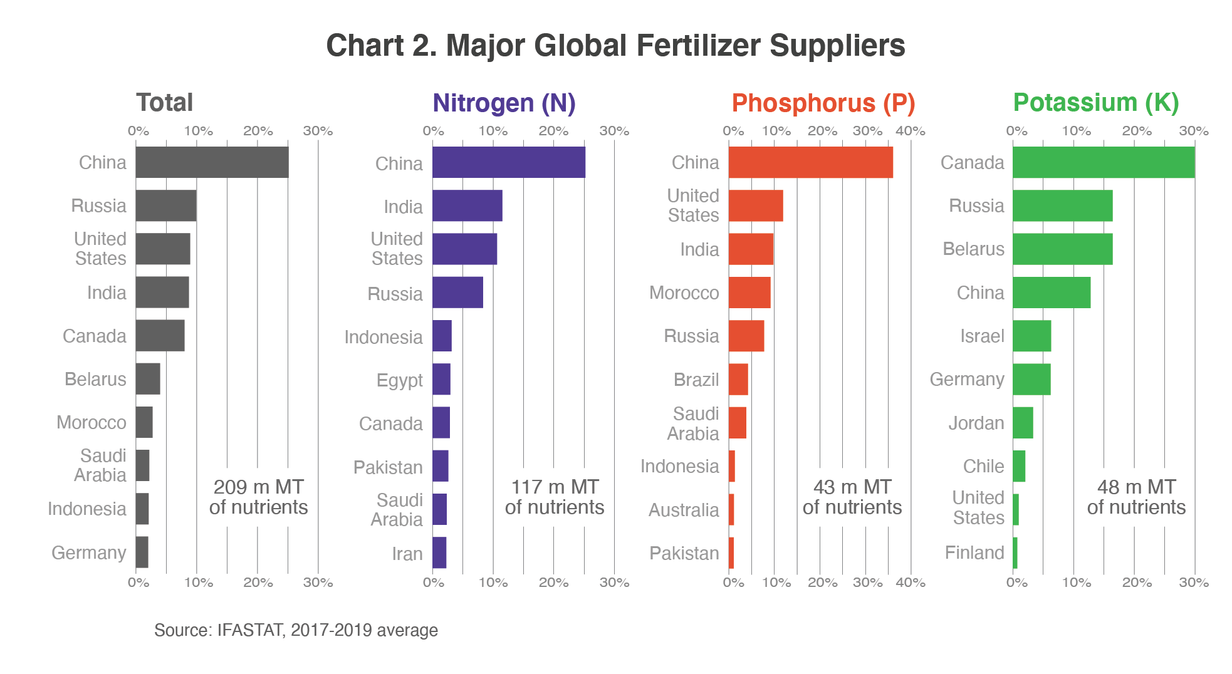

Slide 8






Potential balance of nitrogen, phosphorus and potassium in 2022 by region (1000 metric tons)
Source: FAO. 2019. World fertilizer trends and outlook to 2022. Rome.

Slide 9
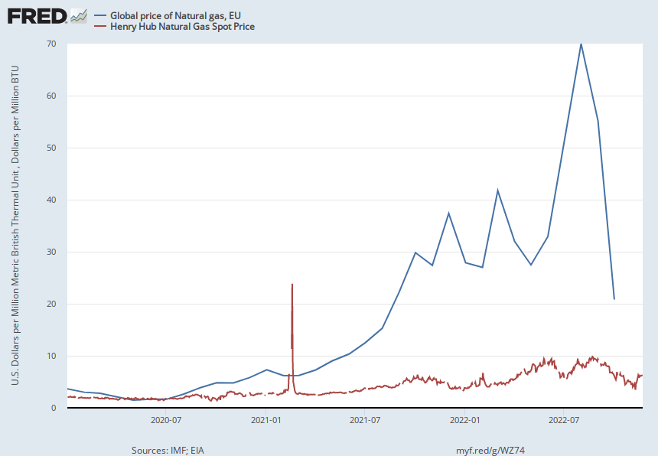
“Natural-Gas Prices Continue Free Fall” WSJ Jan 3, 2023
Notes:
Source:
International Monetary Fund
Release:
Primary Commodity Prices
Units:
U.S. Dollars per Million Metric British Thermal Unit, Not Seasonally Adjusted
Frequency:
Monthly
Value represents the benchmark prices which are representative of the global market. They are determined by the largest exporter of a given commodity. Prices are period averages in nominal U.S. dollars.Copyright © 2016, International Monetary Fund. Reprinted with permission. Complete terms of use and contact details are available at http://www.imf.org/external/terms.htm.
International Monetary Fund,
Global price of Natural gas, EU [PNGASEUUSDM],
retrieved from FRED,
Federal Reserve Bank of St. Louis;
https://fred.stlouisfed.org/series/PNGASEUUSDM,
November 29, 2022.
Source:
U.S. Energy Information Administration
Release:
Natural Gas Spot and Futures Prices (NYMEX)
Units:
Dollars per Million BTU, Not Seasonally Adjusted
Frequency:
Daily
More information about this series can be found at http://www.eia.gov/dnav/ng/TblDefs/ng_pri_fut_tbldef2.asp
U.S. Energy Information Administration,
Henry Hub Natural Gas Spot Price [DHHNGSP],
retrieved from FRED,
Federal Reserve Bank of St. Louis;
https://fred.stlouisfed.org/series/DHHNGSP,
November 29, 2022.

Slide 10
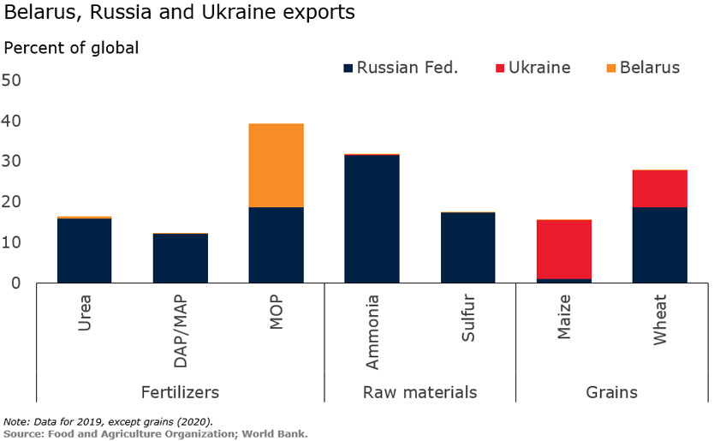


Slide 11
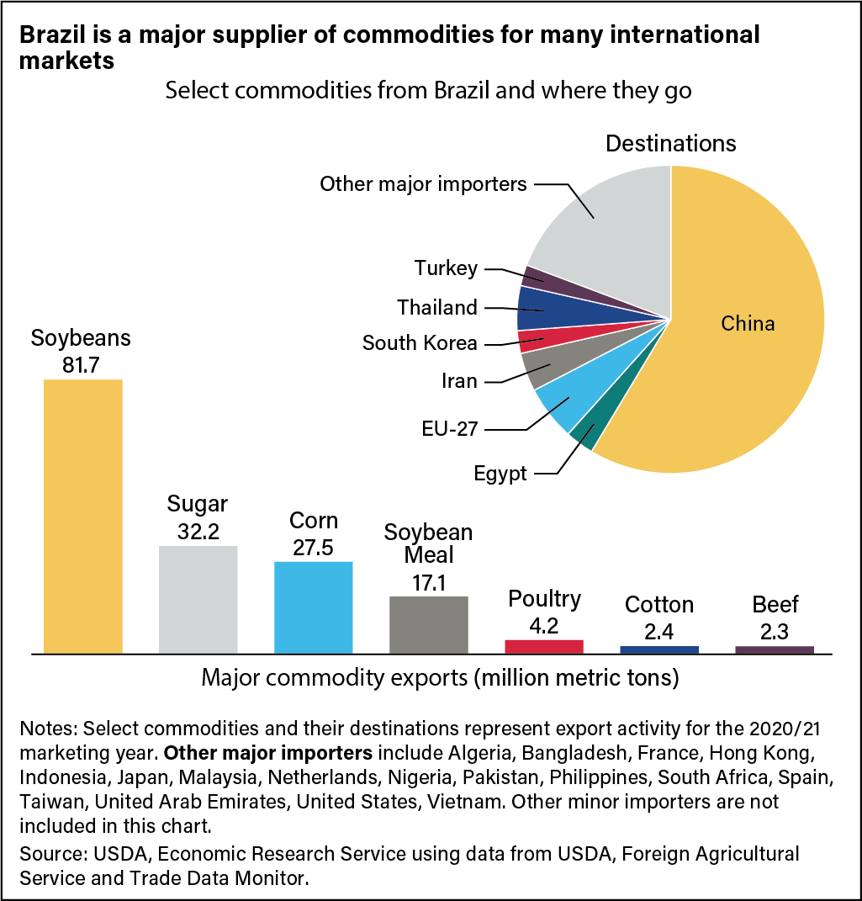

Slide 12
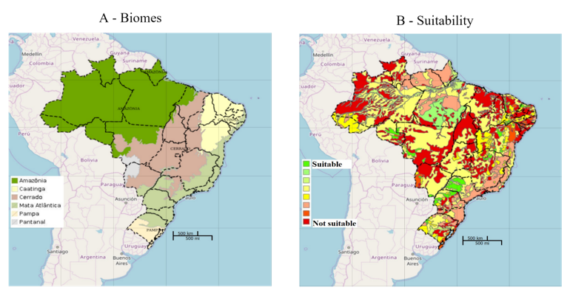
Brazil’s Land & Suitability for Farming
63.5 million hectares in crop production of 410 million hectares of potential arable land. FAO

Slide 13
“Good News for Food, Bad News for War: Brazil Buys Russian Fertilizer”
New York Times May 8, 2022

Slide 14
Trade

Slide 15
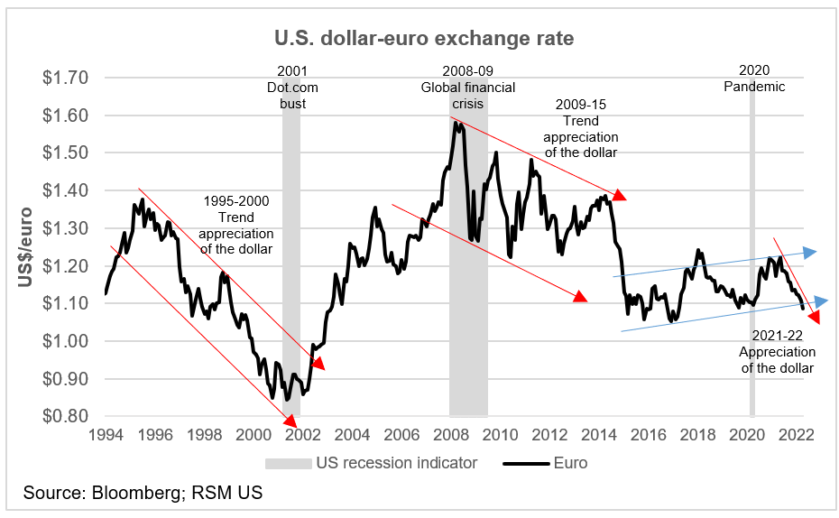

Slide 16
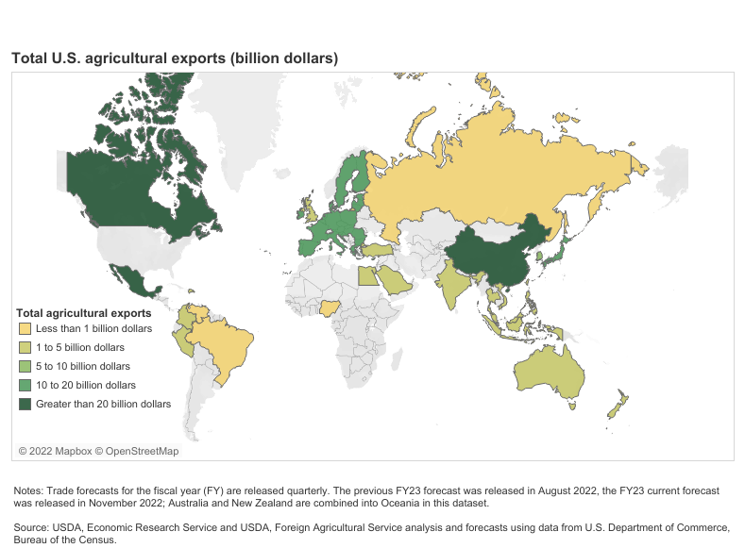

Slide 17
China Policy
US-China relations will remain strained
- “China Is National Security Threat No. 1
Resisting Beijing’s attempt to reshape and dominate the world is the challenge of our generation. “ Opinion WSJ 12-3-20 John Ratcliffe, Former Director of National Intelligence
  “Biden’s National Security Council Sharpens Focus on China” Foreign Policy 2-18-21
Will US remove tariffs on China imports?
  “Biden administration to maintain China tariffs while review continues” Reuters 9-2-22

Slide 18
The 2023 Farm Bill:
Republicans control the House: traditional farm bill
Administration: climate change oriented farm bill

Slide 19
Labor

Slide 20
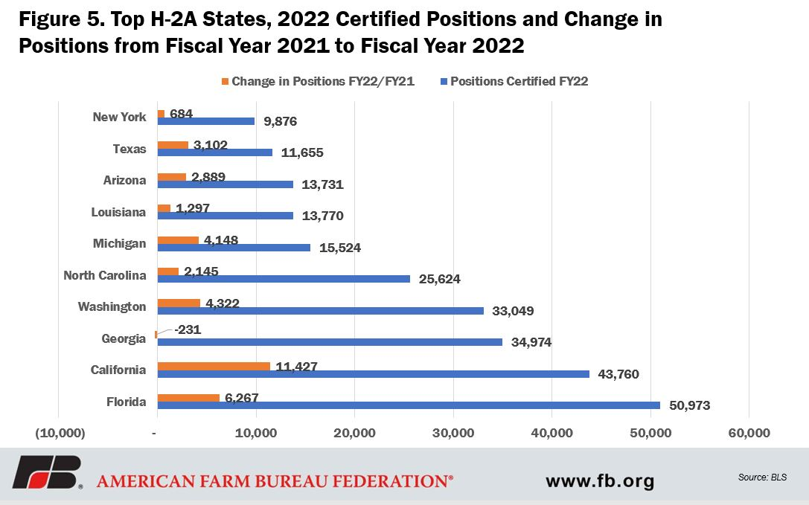
20212AEWR 2023 AEWR
NC: $14.16 NC: $14.91

Slide 21
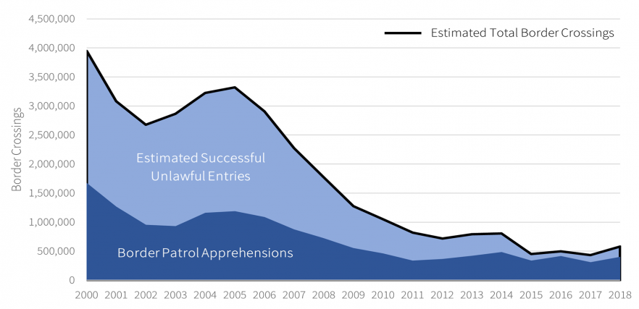
Border Crossings from Mexico
Source: “Rising Border Encounters in 2021: An Overview and Analysis” American Immigration Council | July 2021

Slide 22
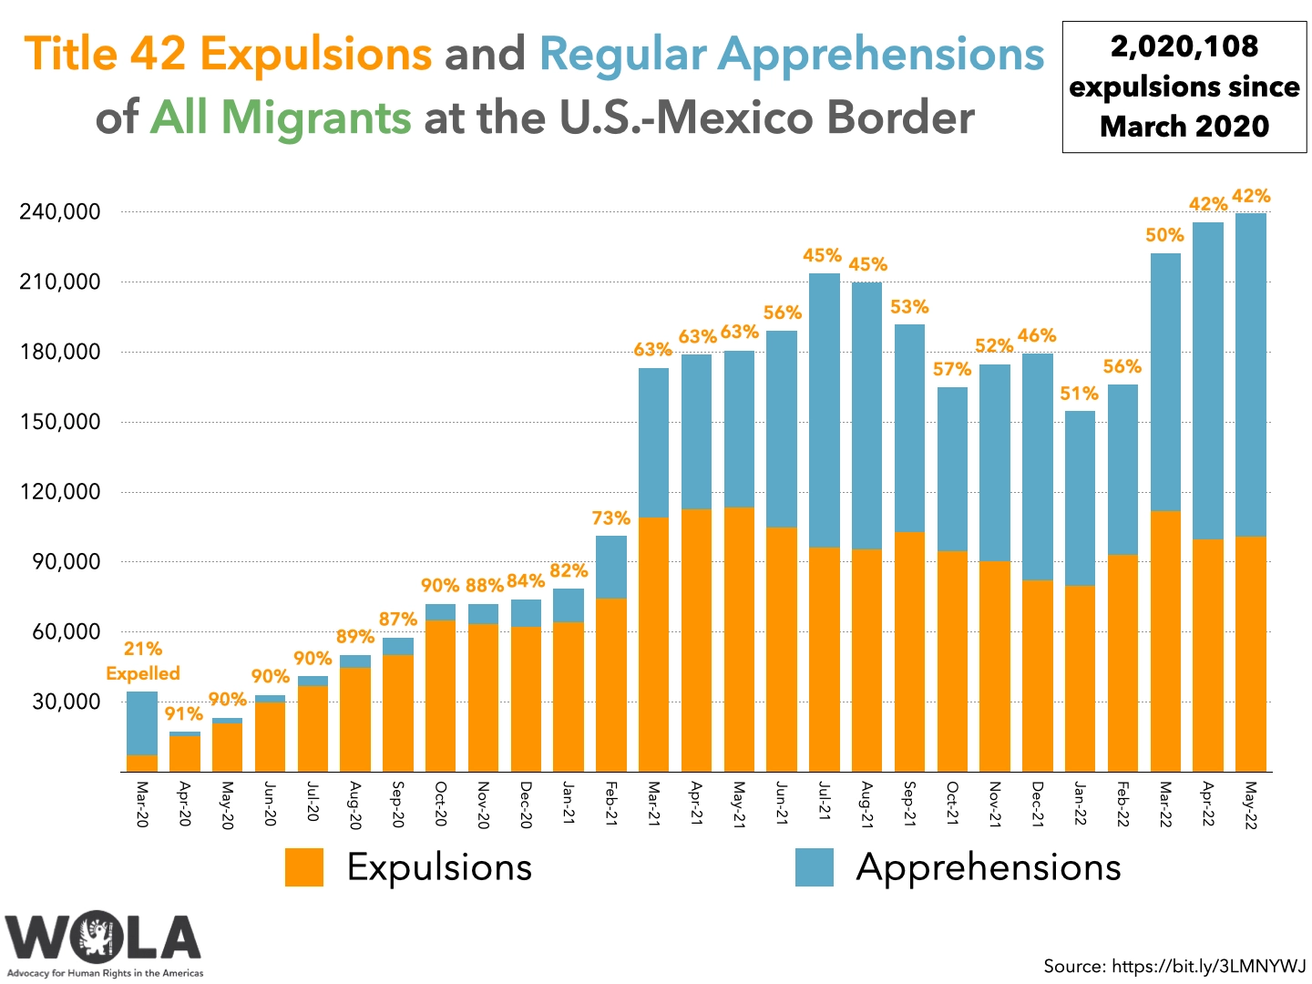

Slide 23
Take-Aways
Pandemic related supply issues are getting better
  Lower shipping and trucking costs
Phosphate & Potash cost should decline…some
Nitrogen costs may remain high…but there is some hope European plants may produce N again
Interest rates…high
Trade: unfavorable exchange rates BUT this could improve as Fed slows interest rate increases
Exports to China volatile and subject to political climate between US and China
Labor: 2023 AEWR $14.91

