Slide 1
SWOT Analysis in Business
One of the Foundation Stones of the Strategic Plan

Slide 2
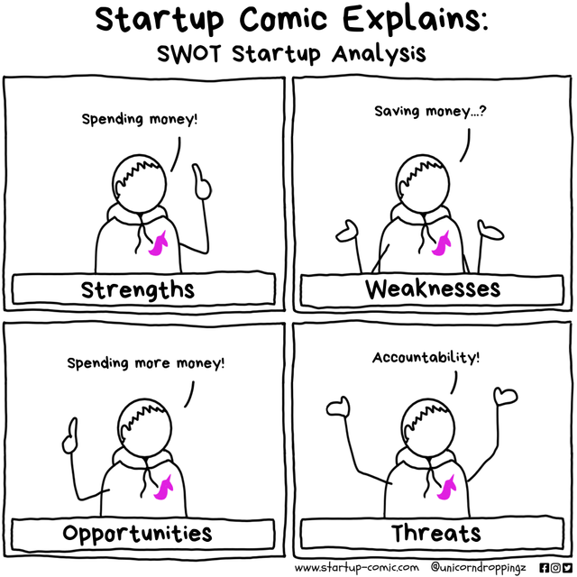

Slide 3

What is SWOT Analysis?
One of the foundation stones for the strategic plan:
Helps you understand your competitive position
Supports decision‑making and strategy development
Assess internal/external factors and current/future potential

Slide 4

Strengths
Internal
Advantages specific to your business
Unique resources or capabilities
Strong brand reputation
Skilled workforce
What are your strengths in terms of customers, employees, operational efficiencies (include financial), infrastructure (include intellectual property), partners?

Slide 5

Weaknesses
Internal
Limitations specific to your business
Skill or resource gaps
Inefficient processes
Areas needing improvement
What are your weaknesses in terms of customers, employees, operational efficiencies (include financial), infrastructure (include intellectual property), partners?

Slide 6

Threats
External
Challenges to your business
Competitor actions (market share)
Regulatory/policy changes
Economic downturns
What is happening that may harm your profits, production, supply chain, relationships with customers, partners?

Slide 7

Opportunities
External
Factors that support growth
Emerging markets
Technological advancements
Strategic partnerships
How can we improve customer and partner relationships, gain efficiency/profitability, create new products, enter new markets?

Slide 8
Helpful
Harmful
Strengths
Weaknesses
What do we do best?
In what areas do we receive the most complaints?
Internal
Opportunities
Threats
What opportunities are available to you?
What trends, conditions, or competitors pose a threat to us?
External

Slide 9

Kroger SWOT Analysis
Strengths
Weaknesses
Extensive product range and services
Strong brand positioning and customer loyalty
Strategic partnerships and collaborations
Focus on personalized customer experience
Focus on middle to upper-class income earners
Limited international presence
Vulnerability to cybersecurity threats
Limited product control in third-party vendors
Opportunities
Threats
Building strategic partnerships and branding opportunities
Expanding and enhancing small-format stores
Leveraging loyalty programs
Investing in e-commerce capabilities
Expanding private label brands
Intense competition
Shifting consumer preference to online shopping/delivery
Economic downturns and reduced consumer spending
Regulatory challenges
Supply chain disruptions

Slide 10


SWOT Analysis – Class Exercise
Strengths
Weaknesses
Strong brand identity and value
Extended global reach/distribution system
Customer loyalty
Dominant market share
Strategic partnerships (include alcohol)
Capitalizing on huge social media potential
Expansion through acquisitions
Product diversification
Overdependence on third party technology providers
Cherished Coke products discontinued
Dependence on US market for soft drinks
Opportunities
Threats
Consumers prefer healthier alternatives
Emerging markets
Consumers demanding packaged water
Lawsuits
Increasing health conscientiousness
MAHA and the new food pyramid recommendations
Direct and indirect competition
Economic uncertainty
Environmentally destructive packaging

Slide 11

Application to BFF
Look at the SWOT handout and question prompts. Fill out the worksheet individually – 5 min
Brainstorm (with your group) the INTERNAL Strengths and Weaknesses of the Brown Family Farm – 5 min
Brainstorm (with your group) the EXTERNAL Threats and Opportunities of the Brown Family Farm – 5 min
Highlight the top SWOTs among your group and be prepared to share with everyone. – 5 min

Slide 12
BFF SWOT Analysis
Leverage the Brown’s STRENGTHS
Address their WEAKNESSES
Explore/evaluate OPPORTUNITIES
Disrupt and innovate to overcome THREATS
Strengths
Weaknesses
Land
Multiple crops
Custom packing
Technology
Global gap certified
Established contracts
New skills
Don’t know the customer
Price taker
Lack of succession plan- retirement
Manual processes
Lower labor productivity
Packing operations management
Product waste
Opportunities
Threats
Move up value chain, go direct to end customer (grocery, restaurant, consumer, etc.)
Niche products
Expand use of land
Innovation
Industry trends
Partnerships
Climate change
Consumer health focus
Labor competition/scarcity
Energy costs
Disease/bugs
Higher input costs
Legislation, policies, regulations

