Slide 1
Environmental SCAn and Risk Assessment
2023 Executive Farm Management Program
January 10, 2023

Slide 2
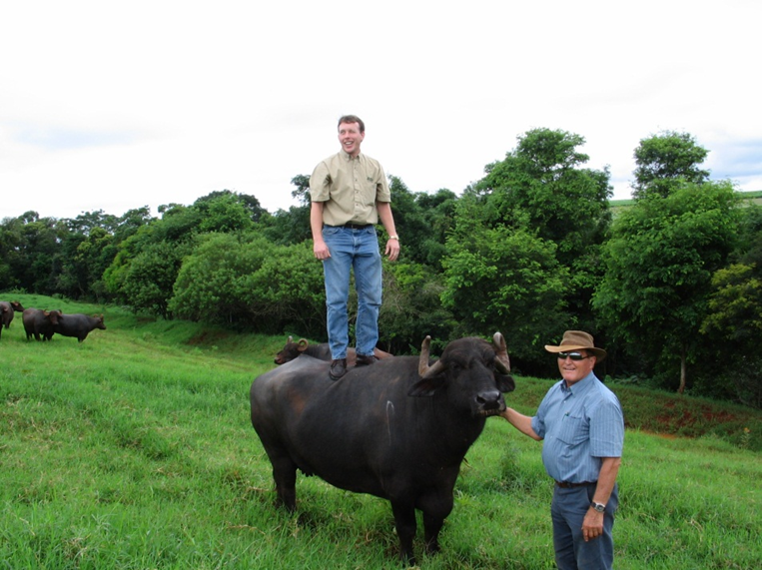
Risk Assessment?

Slide 3
What is Risk?
The chance of loss or an unfavorable outcome associated with an action.
The possibility of something bad happening.
Uncertainty is not knowing what will happen in the future.
The greater the uncertainty, the greater the risk.

Slide 4
http://extensionrme.org/pubs/IntroductionToRiskManagement.pdf

Slide 5
Five Primary Sources of Risk
Production risk
Market risk
Financial risk
Legal or institutional risk, and
People or personal risk.

Slide 6
Production Risk
Any production related activity or event that has a range of possible outcomes is a production risk.
The major sources of production risks:
  Weather & climate changes,
  Pests & diseases,
  Technology,
  Genetics,
  Machinery efficiency,
  Quality of inputs.
  Fire, wind, theft, and other casualties are also sources of production risk.
Notes:
What are some management strategies?
Growers have three choices in dealing successfully with production risks.
1) They can control or minimize risk through management practices by doing a better job of what they currently do.
2) They can reduce production variability by making changes such as diversifying, integrating, applying new technology, etc.
3) They can transfer production risk to someone else through contracting, purchasing insurance, etc.

Slide 7
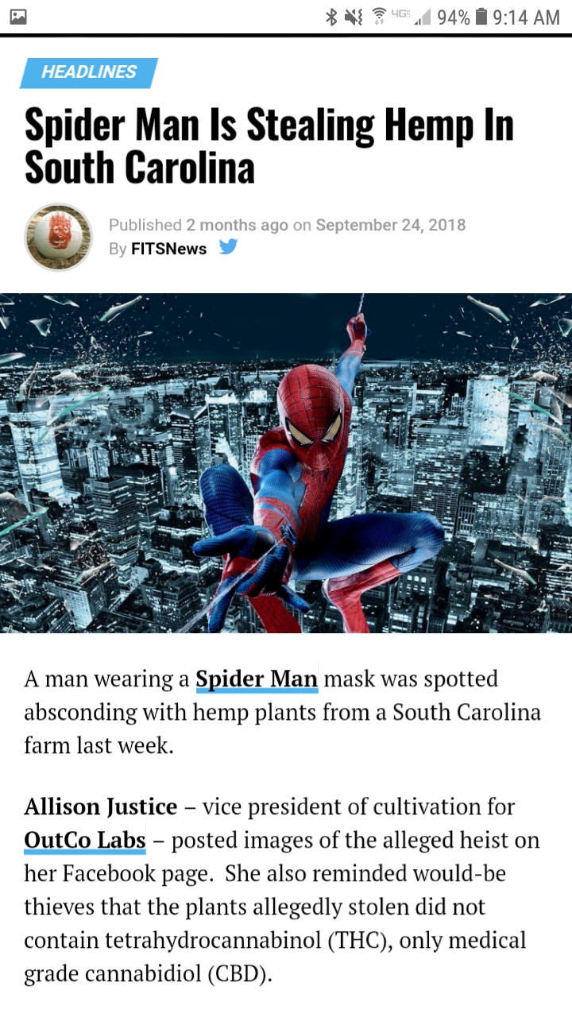
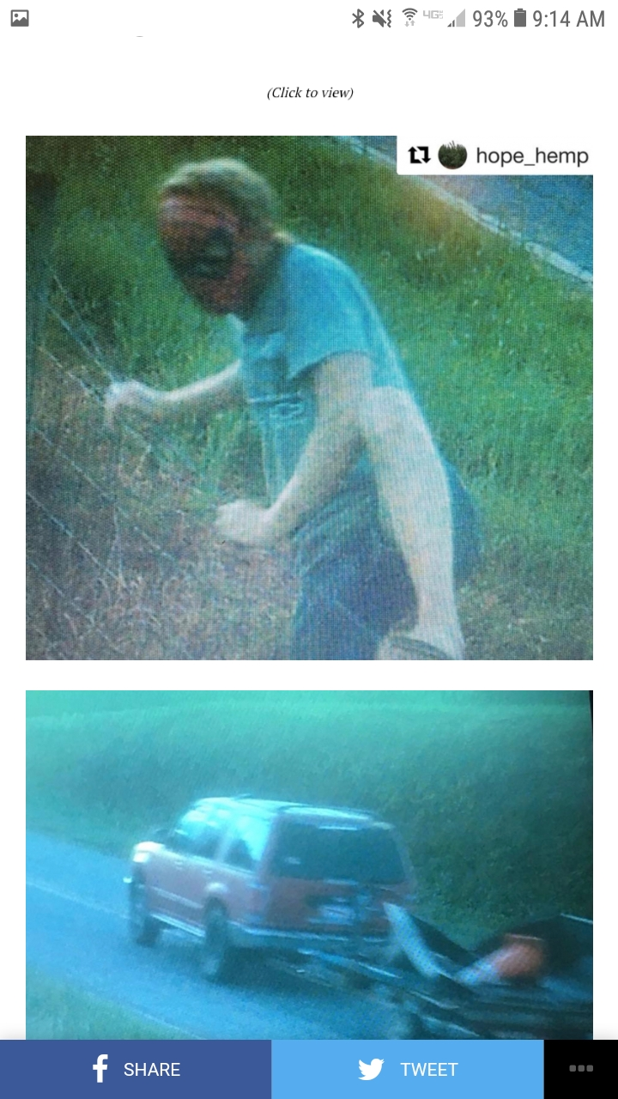

Slide 8
Marketing Risks
Marketing risk is any market related activity or event that leads to the variability of prices farmers receive for their products or pay for production inputs.
Access to markets is also a marketing risk.
Notes:
What are some management strategies?
Written Marketing Plan
Forward pricing marketing tools
Revenue insurance
Advisors
Storage
Branding
Marketing channels

Slide 9
Financial Risks
Financial risk encompasses those risks that threaten the financial health of the business and has four basic components:
1) The cost and availability of capital;
2) The ability to meet cash flow needs in a timely manner;
3) The ability to maintain and grow equity;
4) The ability to absorb short-term financial shocks.
Notes:
What are some management strategies? Interest rate, liquidity, solvency, repayment capacity, profitability
Written business plan cash flow budget, current ratio, working capital/gross income ratio
Cost of production by enterprise working capital
Breakeven prices operating profit margin, family living, off-farm living
Financial ratio trend analysis
Advisory team
Off-farm income

Slide 10
Legal Risks
The legal issues most commonly associated with agriculture fall into five broad categories:
1) Contractual arrangements,
2) Business organization,
3) Laws and regulations,
4) Tort liability, and
5) Public policy and attitudes.
Notes:
Management Strategies?
Insurance
Entity structure
Training and compliance with gov’t regulations
Exposure to risk

Slide 11
People Risk
People are both a source of business risk and an important part of the strategy for dealing with risk.
At its core, human risk management is the ability to keep all people who are involved in the business safe, satisfied and productive.
People risk can be summarized into four main categories:
1) Human health and well-being;
2) Family and business relationships;
3) Employee management; and,
4) Transition planning.
Notes:
Management Strategies
Major medical and disability insurance
Life insurance
Mission, goals and objectives with family, management team, employees, advisory team
Evaluate risk exposure
Safety training

Slide 12
Environmental Scan
Do a scan of the risks and how uncertain those risks.
  Market Forces: Key customer issues in your arena, such as growing or shrinking segments; customer switching costs; changing jobs, pains, and gains; and more.
  Key Trends : Key trends shaping your arena, such as technology innovations; regulatory constraints; social trends; and more.
  Industry Forces: Key actors in your space, such as competitors; rising value chain actors; new or fading technology providers; and more.
  Macroeconomic Forces: Macro trends, such as global market conditions; access to resources; high or low commodities prices; and more
What can you do to manage those risks?

Slide 13
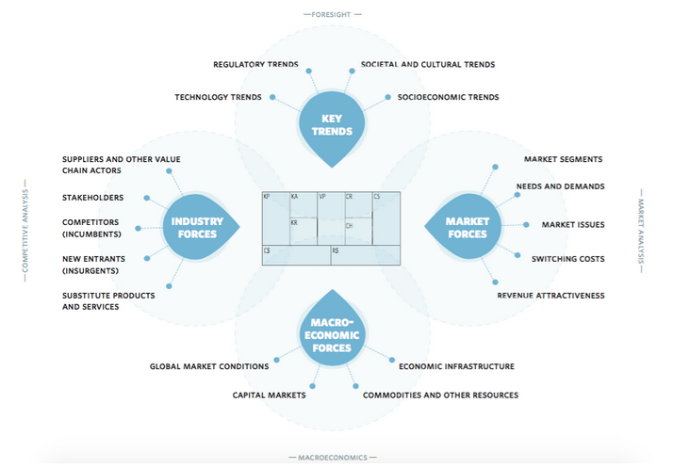
Source: Strategyzer blog post by Nabila Amarsy, October 15, 2015
https://www.strategyzer.com/blog/posts/2015/10/14/how-to-scan-through-your-environments-disruptive-threats-and-opportunities

Slide 14
Agricultural Disruptors
What are some potential disruptors for your farm operation and/or industry?
What is the probability of happening?
What is the potential impact on the operation?

Slide 15
Environmental, Social & Governance
ESG Concept
  Investing
  Consumer Preferences
  Value Proposition
What are some ESG issues that can influence or disrupt risk management plans?

Slide 16
U.S. Cotton Trust Protocol Joins Sustainable Apparel Coalition
MEMPHIS, TENN (April 7, 2021) – The U.S. Cotton Trust Protocol announces membership in the Sustainable Apparel Coalition (SAC), a global, industry-wide nonprofit of over 250 members working to reduce environmental impact and promote social justice throughout the global value chain. The Trust Protocol joins leading apparel, footwear, and textile brands, retailers, manufacturers, sourcing agents, service providers, trade associations, nonprofits/NGOs, and academic institutions in a shared vision of an industry that gives more than it takes – to the planet and its people.
Source: National Cotton Council, https://www.cotton.org/news/releases/2021/prsac.cfm

Slide 17
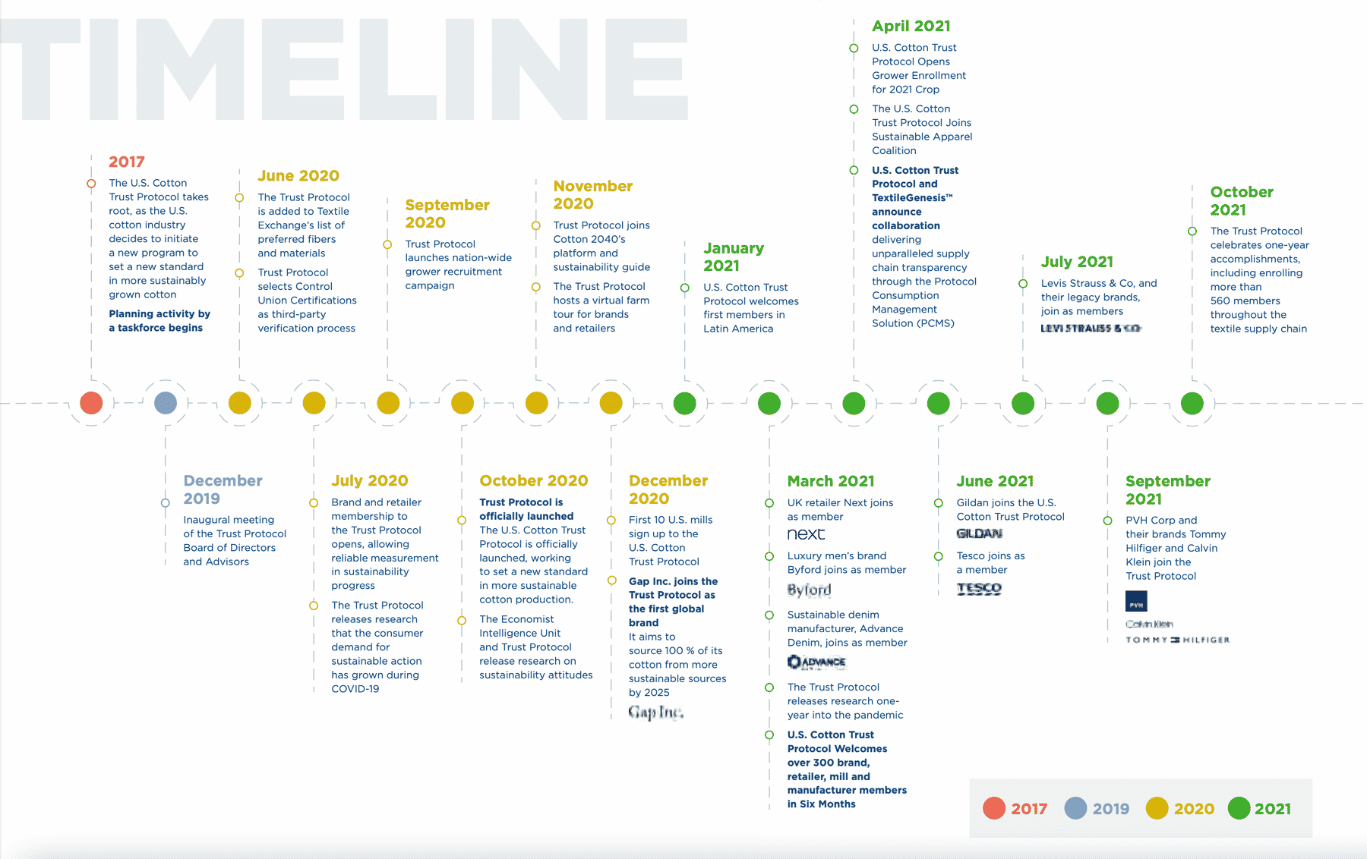

Slide 18
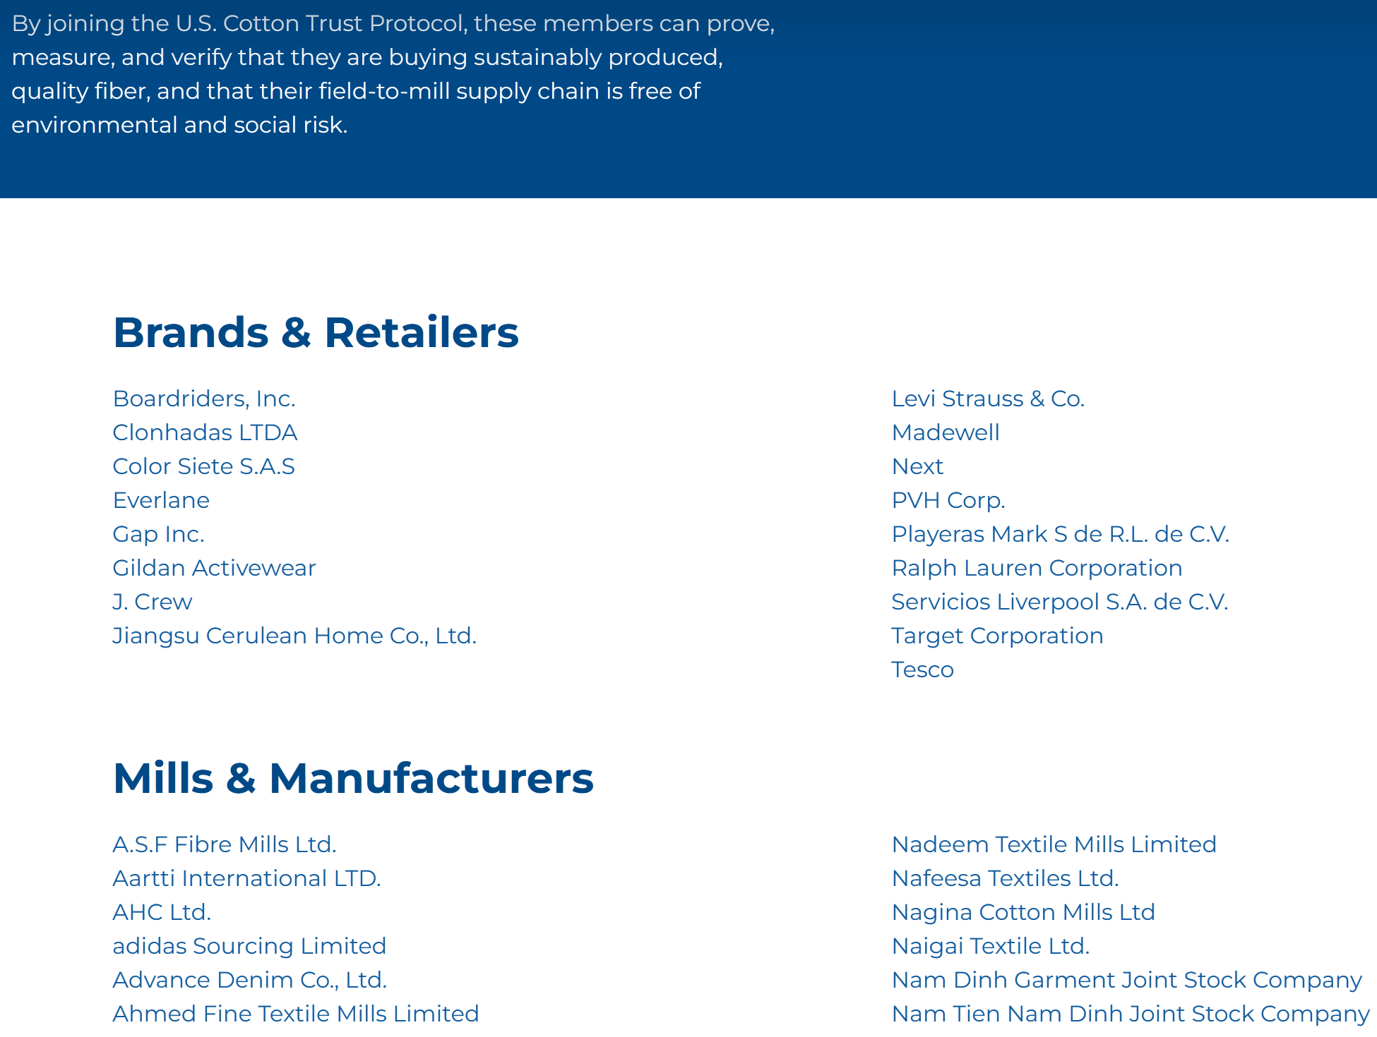

Slide 19
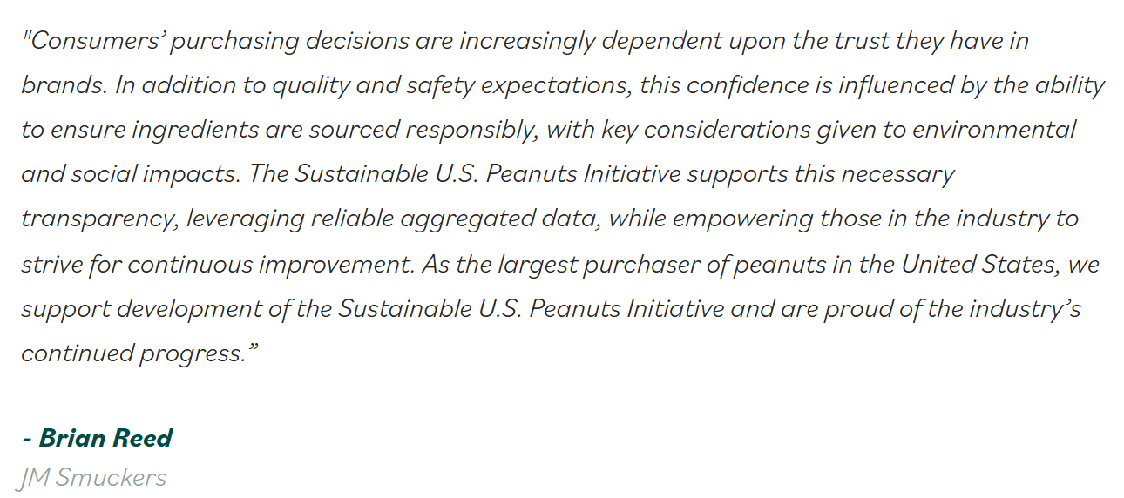
SUSTAINABLE U.S. PEANUTS
“U.S. Peanuts should – and must – be part of a sustainable future”
https://sustainableuspeanuts.org/

Slide 20
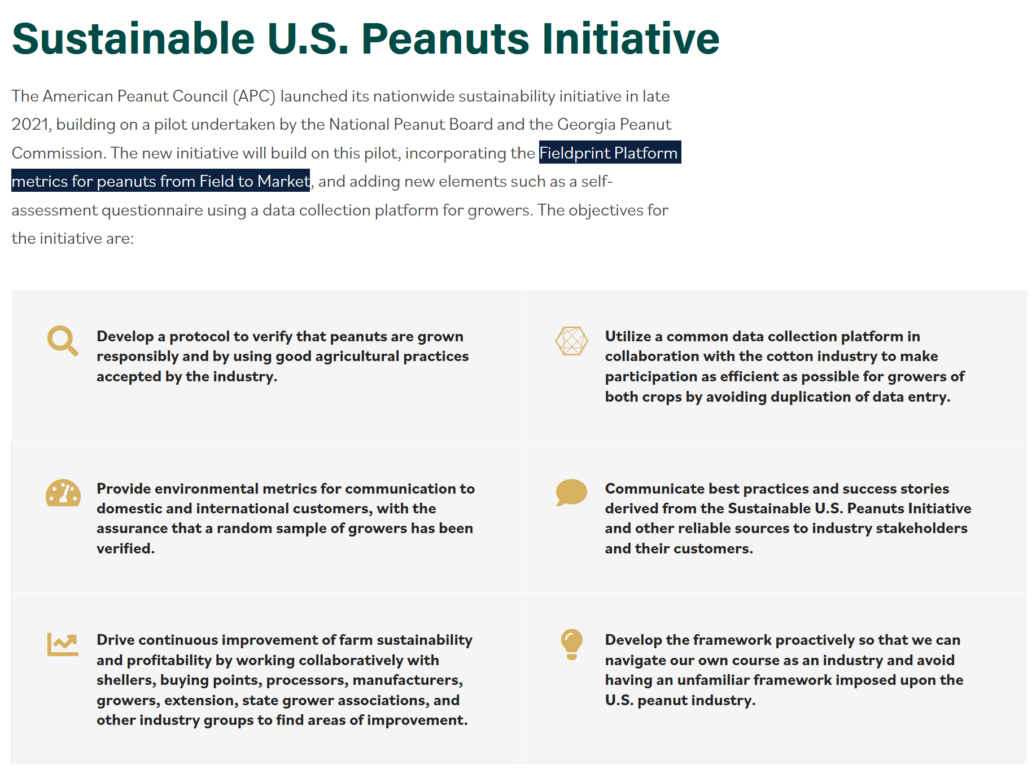

Slide 21

