Slide 1

Strategic Planning
Introduction and Overview

Slide 2
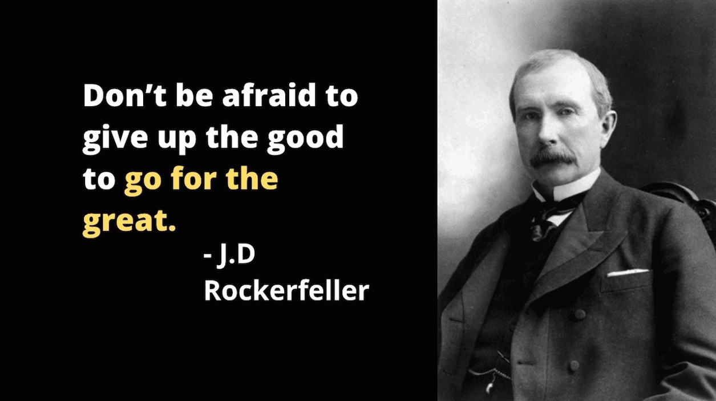

Slide 3
What is strategic planning?
Strategic planning is the process of defining an organization’s direction, priorities, and actions to achieve long-term success. It helps leaders set goals, allocate resources efficiently, and measure progress to ensure alignment with their mission and vision.
-Balanced Scorecard Institute

Slide 4
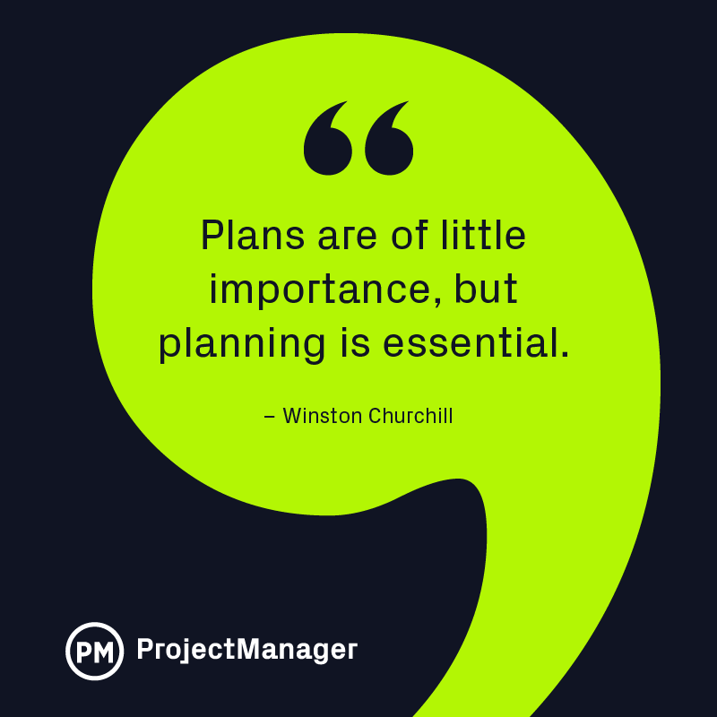
The process is just as important as the product.
Along the way, you want to Involve more than top management.

Slide 5
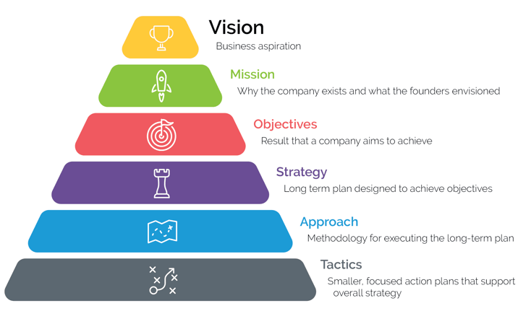
The Six Elements of Effective Strategic Planning
Source: Dan Overgaag,
Spur Reply Consulting

Slide 6
“To begin with the end in mind means to start with a clear understanding of your destination. It means to know where you’re going so that you better understand where you are now and so that the steps you take are always in the right direction.”
- Stephen R. Covey, The 7 Habits of Highly Effective People

Slide 7

Begin with the end in mind, but how do you get there?
You can use a GPS to navigate through the process
Goals
Priorities
Strategies

Slide 8
Goals & Priorities
Begin with the Vision and Mission
Vision: Answers what do you aspire for your business. Where do you dream to be?
Mission: Answers why you have this vision and how you plan to achieve it. Why and how you plan to get there?

Slide 9
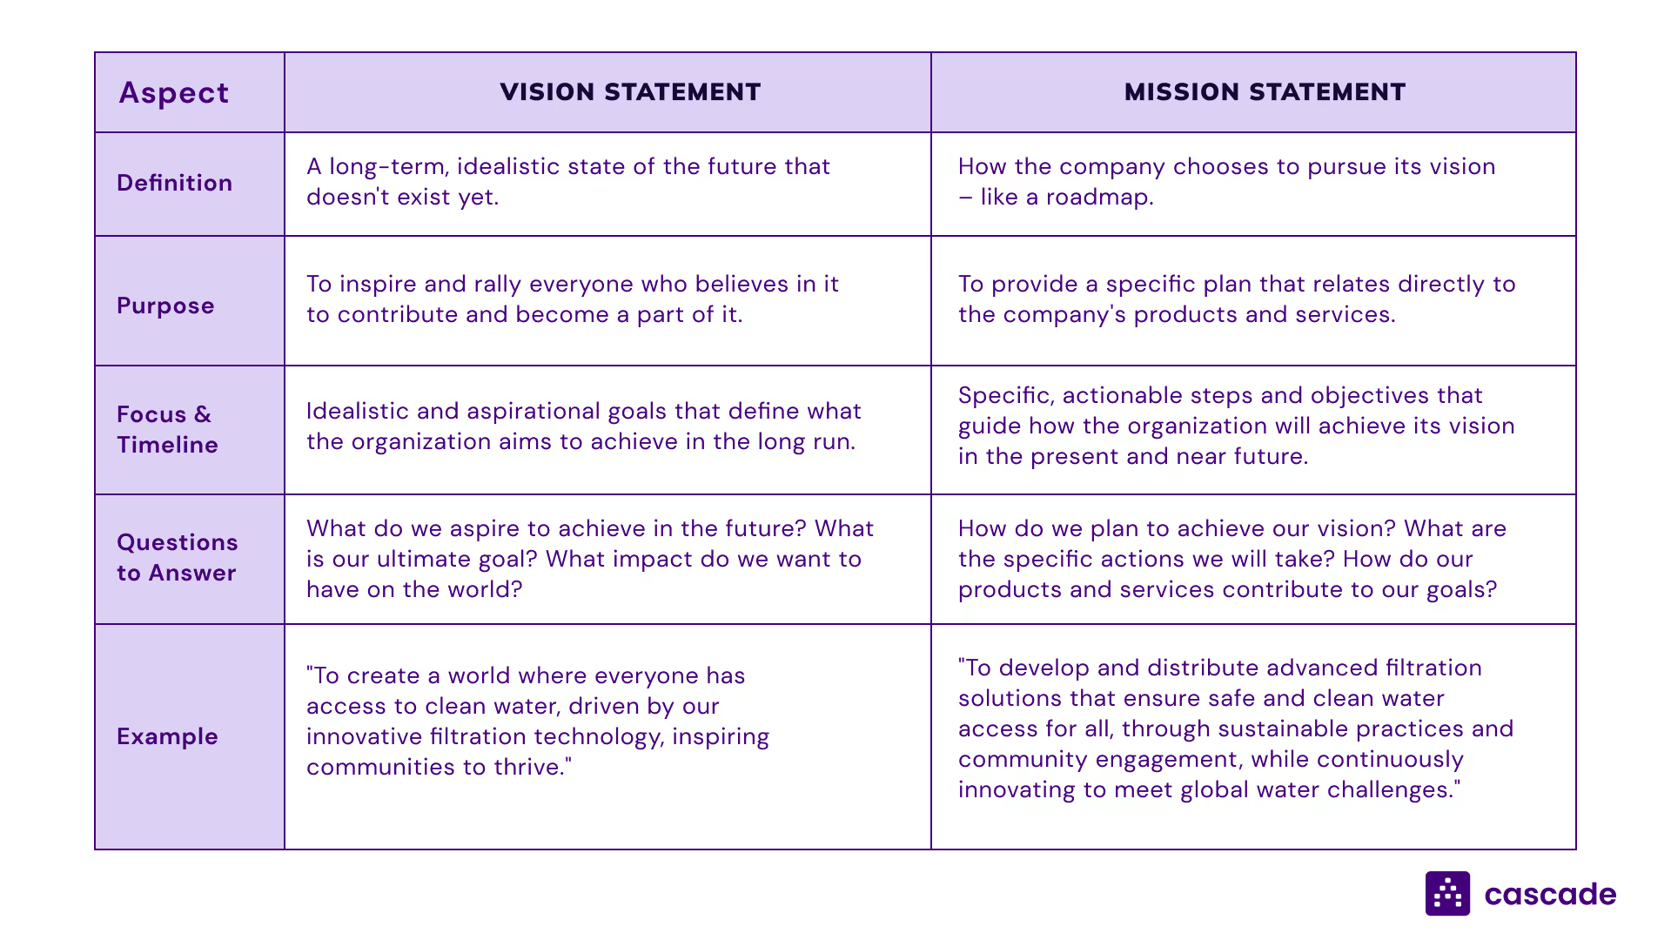

Slide 10



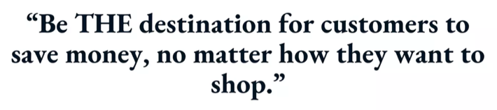



“We feed the world like family.”
We conduct business essential to life. Running for the people who trust us and the planet that sustains us, we create intelligent connected machines that enable lives to leap forward.
“The premier purveyor of the finest coffee in the world, inspiring, and nurturing the human spirit
– one person, one cup and one neighborhood at a time.”
“Engage, delight and inspire consumers by building brands they love and leading in growing categories. Our Vision is our long-term direction that guides business priorities and aligns our organization.”
Example Vision Statements
To enrich the lives of those who produce and those who consume, ensuring progress for generations to come.

Slide 11
“We feed the world like family.”
We conduct business essential to life. Running for the people who trust us and the planet that sustains us, we create intelligent connected machines that enable lives to leap forward.
“The premier purveyor of the finest coffee in the world, inspiring, and nurturing the human spirit
– one person, one cup and one neighborhood at a time.”
“Engage, delight and inspire consumers by building brands they love and leading in growing categories. Our Vision is our long-term direction that guides business priorities and aligns our organization.”
What mission statements would go along with these?
To enrich the lives of those who produce and those who consume, ensuring progress for generations to come.

Slide 12
Objectives also fall under the goals & priorities of GPS
Source: The 6 Elements of Effective Strategic Design, Dan Overgaag, Spur Reply Consulting

Slide 13

Objectives
Specific results you plan to achieve within a specific time frame
Clear
Measurable
Supported by strategic initiatives throughout the business
Source: The 6 Elements of Effective Strategic Design, Dan Overgaag, Spur Reply Consulting

Slide 14
The final 3 tiers fall under the Strategy of our GPS
Source: The 6 Elements of Effective Strategic Design, Dan Overgaag, Spur Reply Consulting

Slide 15
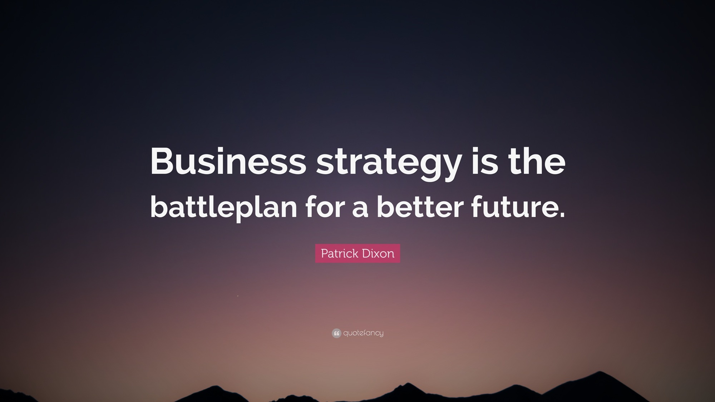
Notes:
Your strategic planning strategy is a long-term plan that enables you to achieve your organization’s objectives.
An effective strategy brings together vision and execution. Strategies are much more specific than an organization’s vision, mission, and objectives. They are typically only shared within an organization and ideally built around an organization’s needs and market context. Strategies should map long-term plans to objectives and actionable steps, foster innovative thinking, as well as anticipate and mitigate potential pitfalls.
Strategic plans often look out 3-5 years, and there may be a separate plan for each objective within the organization.

Slide 16
Examples of Business Strategies
Cross-sell more products
Superior customer service
Technologically advanced
Excel at customer retention/loyalty
Be the low-cost provider
McDonald’s, Dunkin’ Donuts
Chick-fil-A, Ritz Carlton
Apple, Tesla
Sephora, Starbucks, Circle K Convenience Stores
Walmart, Dollar General

Slide 17
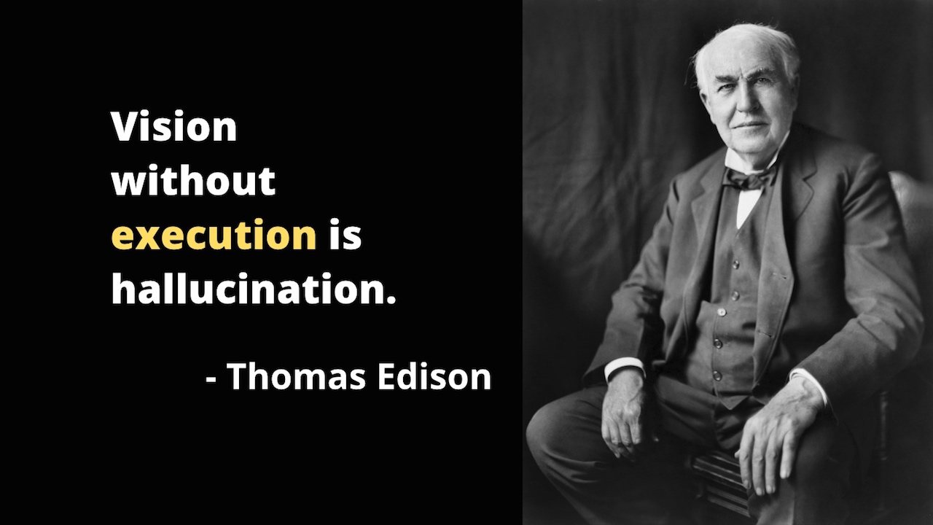

Slide 18
Approach
Provides the framework for strategic planning and methodology to execute strategy
Answers key questions that determine tactics
This is The Business Model
Source: The 6 Elements of Effective Strategic Design, Dan Overgaag, Spur Reply Consulting
Notes:
The approach guides your organization on how to execute the strategic planning framework effectively.

Slide 19
Business Model Definition
A business model describes the rationale of how an organization creates, delivers, and captures VALUE.
Source: Strategyzer

Slide 20

Value
How can we solve customer problems and satisfy their needs?

Slide 21
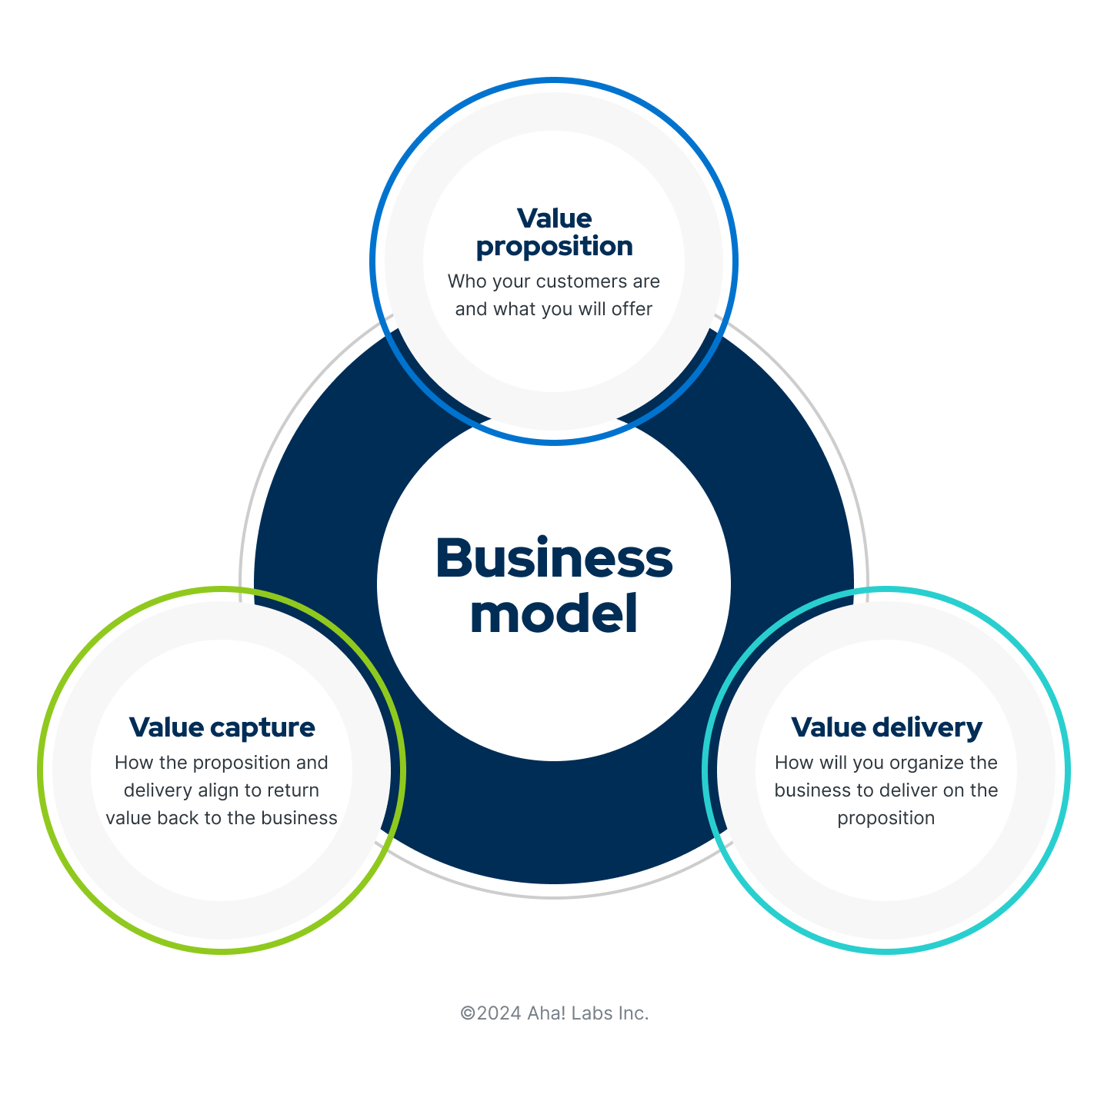
There are three core components to the business model that are linked to value.

Slide 22
Tactics
Focused initiatives and projects that enable execution of the strategic plan.
How you make it all happen.
Include tracking and evaluation of progress.
Source: The 6 Elements of Effective Strategic Design, Dan Overgaag, Spur Reply Consulting
Notes:
Successful strategic planning incorporates tactics, including clear resource allocation and progress monitoring. Allocating resources strategically, including financial, employee, and technological resources, is essential for effectively carrying out a strategic plan. Establishing robust systems and processes for evaluation allows organizations to track progress, quickly identify deviations, and make timely adjustments as needed. This iterative approach ensures that the strategic plan remains relevant and responsive to changing circumstances.

Slide 23
Business Model Canvas
The Business Model Canvas allows you to describe any business model based on 9 fundamental building blocks. It’s a practical business tool to design, test, implement, and manage business models over their life cycle.
Covers the 4 main areas of a business:
  Customers
  Offer
  Infrastructure
  Financial viability
Customer-centric
Source: Strategyzer

Slide 24
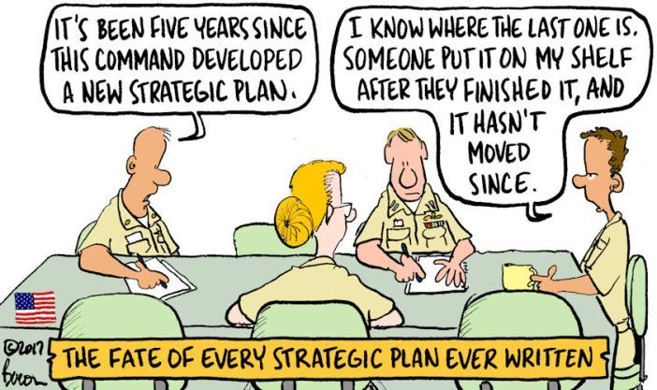
Strategic plans are living documents, not “one and done” activities.

Slide 25
Exercise
Individually, review the prompts and fill in the worksheet for Brown Family Farm – 3 min
1
In groups, use the information you read from the case and use post-its to capture your ideas – 8 min
2
Outline a basic Brown Family Farm Vision, Mission, Objectives, and Strategy – 4 min
3

