Slide 1

Navigating Farm Succession as a Business First Farm
David Mayo mayod@ecu.edu

Slide 2

Agenda
Understand Succession as a Driver of Farm Success and Innovation
Understand Business First vs Family First farms
Assess Farm Succession Readiness

Slide 3
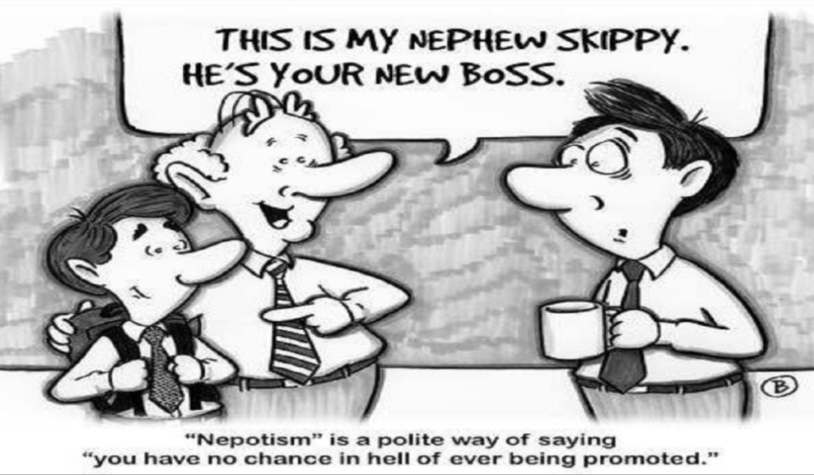
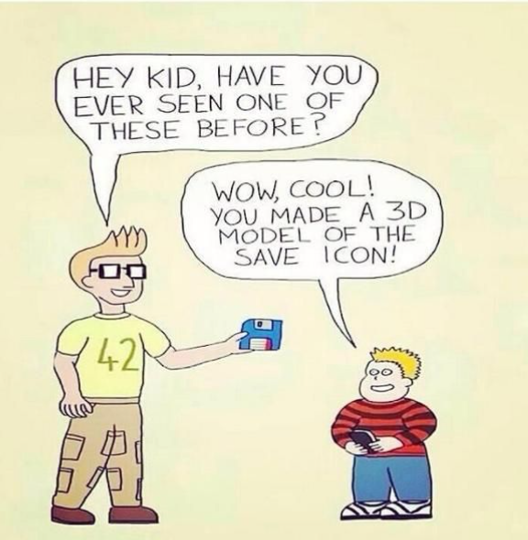
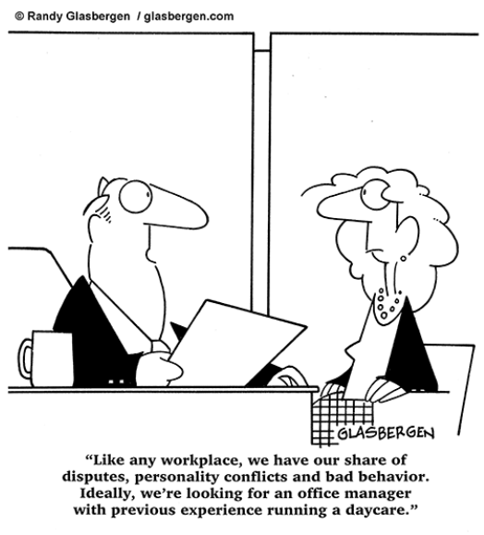
What are common perceptions of generational transfer?

Slide 4

Family Firm Outperformance
Family Businesses Outperform
+5.62% annual returns (stock price )
Small global outperformance
More than 6% total outperformance for USA in small firms
More families involved (and more cofounders) translate to higher performance

Slide 5

Why do Family Firms Outperform?
Why do Family Businesses Outperform
Generational transfer as a driver of:
Patience
Stewardship
Alignment of goals with the leader and long-term success
Innovation

Slide 6
Effective control of the organization is transferred in farms and businesses that are “Business First”
Position and title are earned not given.
Clear pathways to positions for family must be given
Receiving some level of ownership or financial benefit may be a birthright, but organizational control must be earned
Becoming business first will take a level of organization and formality

Slide 7
Check the family first statements that are true for Brown Family Farm
The farm only promotes leaders from the family
There is a strong emotional attachment to the land/farm
Hierarchy is based on age/seniority
The oldest son is expected to lead the farm
The farm money is the same as family money (assets are purchased for family members by the farm)
Pay is not based on performance
There is no annual performance evaluation
Family members are paid about the same
Children have a job if they want one regardless of skill
Conflict is avoided

Slide 8
Check the business first statements that are true for Brown Family Farm
Leadership is awarded by performance
Job descriptions are documented for positions on the farm
Leadership development plans are formalized for family members
Family members receive compensation and distributions (vs writing checks from the business as needed)
There is a non-family member that is higher paid than a family member
There is a family employment policy
The best candidate is hired for each position regardless of family status
There are regular leadership meetings
Job performance is evaluated and communicated
Shares are transferred between generations before death as a reward or incentive

Slide 9
Family First
Business First

Slide 10
Implications
If you want family succession… mold leaders
Formalize processes throughout the farm
Inventory and understand generational skillsets
Succession isn’t a moment it’s a process, transition ownership and responsibilities over time

Slide 11
