Slide 1

Brown Family Restructure 2026
AgEdge Management, LLC.
Z

Slide 2
Securing the Future of Brown Family Farms
Vision Statement:
To become a regional leader in diversified crop production and packing excellence while creating long-term financial security for our family and community.
Mission Statement:
Brown Family Farms produces high-quality crops through disciplined management, strategic growth, and operational excellence, positioning our farm as a regional leader in agriculture and packing.
BP

Slide 3
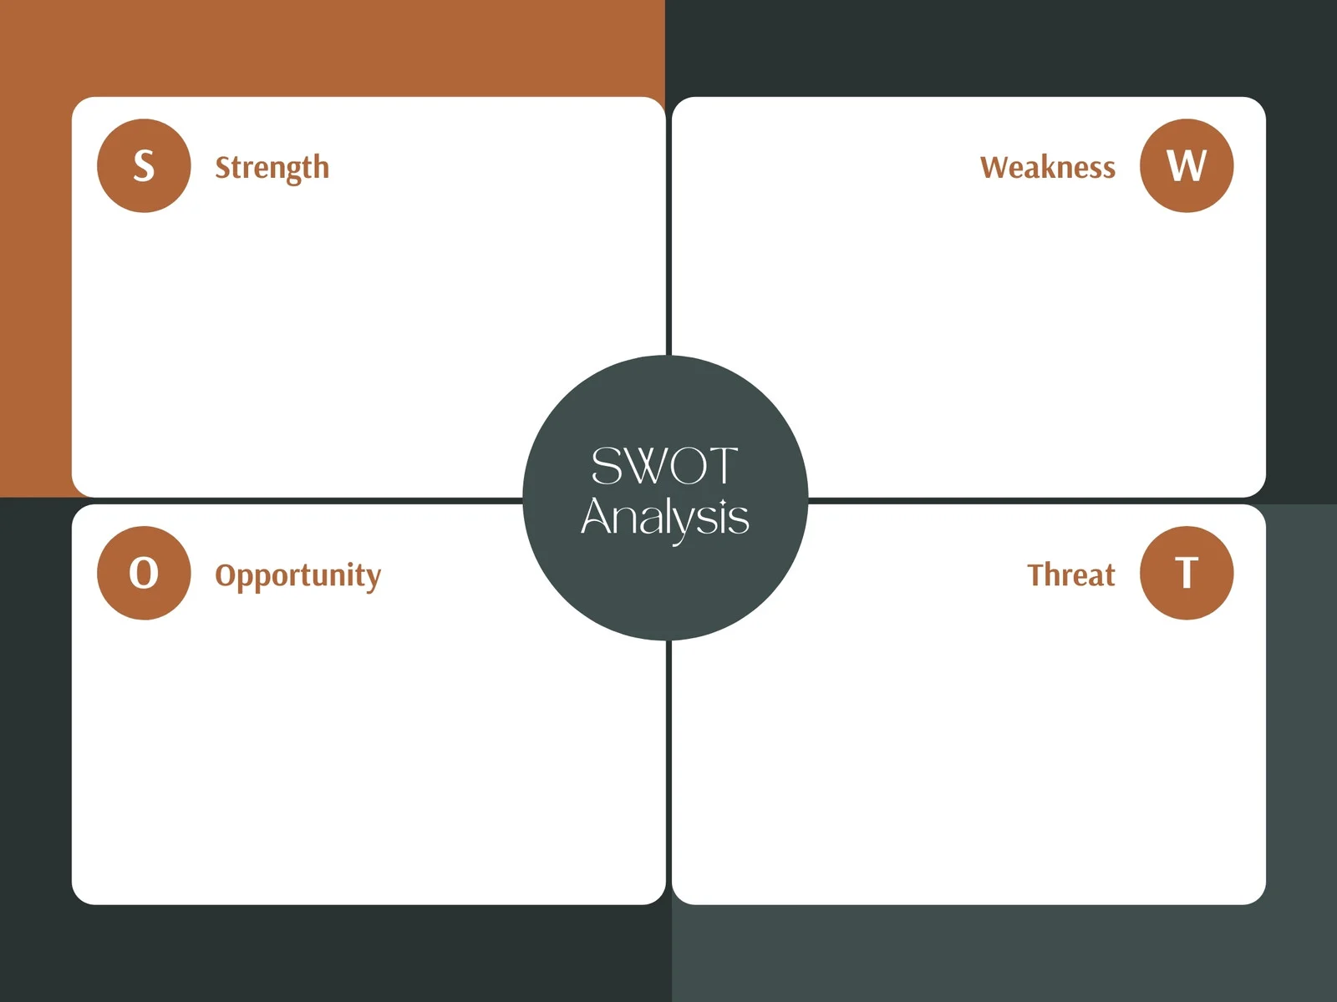
SWOT Analysis
Some owned land
Family Experience
Own Packing Line
Crop Diversity
Strong Equity and Working Capital
Lack of organization, family first
No target market
Tech gaps
Weak financial analysis per crop
Reactive decision making
Equipment liquidation and reinvestment
Marketing strategy and branding, business first
Packing advancement
Volatile commodity markets
Community competitors
Succession uncertainty
Exit of family employees
R

Slide 4
Why Change is Necessary
Crop input vs. ROI through enterprise budgets
No defined target markets
Overlapping roles with family, with succession not formulated
Further retirement planning
Need for value added products
BD

Slide 5
What Brown Family Farms looks like in 5-10 years
Defined enterprise profitability
Strategic crop mix
Modern technology with driven decision making
Clear family governance
Profitable packing line
Family employees in fair farm roles
Funded retirement plans for Kent and Vicky as well as all full-time employees
D

Slide 6
The Restructure Plan-Financial
Equipment sale and reallocation
New business model through Brine & Vine, LLC.
Old farmhouse transitioning to store front and offering custom gardens in high density residential areas
Approved for USDA grant for $200,000 for Value Added Producer Grant for packing line updates and small batch pickling facility with a 1:1 match
Sell of Fred Best Cattle
Z

Slide 7
Enterprise Analysis of Crops
Each crop will be re analyzed and distributed through target markets.
Corn and Tobacco will be under price taking markets.
The family has recently been advised that Kroger will be increasing shipping through the port in Savannah, GA. We aim t0 drive their new fresh produce and pickle business through this distribution system through strategic partnership. All cucumbers, squash and sweetpotatoes not used by Brine and Vine will travel through this distribution channel under contract.
This business was created to venture into new consumer markets and use labor on the farm cut by their declining tobacco contract.
There is a partnership established with NC State, UGA, and Clemson for Brown Family Farms to provide Ball Park in shell peanuts for baseball and football home game events through Severn Peanut/Hampton Farms.
All non marketable foods are under contract with Misfit Market.
BP

Slide 8
Crop Production Report
Crop | Operating Cost | Yield | Acres | Amount Produced
Corn | $900 | 225 | 600 | 135,000 bushels
Tobacco | $4,145 | 2400 | 135 | 324,000 lbs.
SweetPotatoes | $4,500 | 500 | 1000 | 500,000 boxes
Peanuts | $1,500 | 4500 | 1000 | 4.5 mil lbs.
Cukes | $1,800 | 700 | 865 | 605,500 boxes
Squash | $3,109 | 1000 | 300 | 300,000 boxes
BD

Slide 9
Crop Revenues
Crop | Unit Price | Gross Profit | Net
Corn | $5.12/bushel | $691,200 | $488,700
Tobacco | $2.32/lb. | $751,680 | $192,105
SweetPotaoes Kroger | $26/b0x, 474,839 boxes | $12,345,814
SweetPotatoes Misfit | $8/box, 24,992 boxes | $199,936
SweetPotatoes B&V | $26/box, 169 boxes | $4,394 | SP Total $8,165,144
Peanuts Severen | $0.27/lb. | $1,215,000 | $214,000
Cukes Kroger | $18/box, 120,680 | $2,172,240
Cukes Misfit | $7/b0x, 30,245 boxes | $211,715
Cukes B&V | $18/box, 454,575 boxes | $8,182,350 | Cuke Total $10,055,105
Squash Kroger | $16/b0x, 284,753 boxes | $4,556,048
Squash Misfit | $7/box, 14,987 boxes | $104,909
Squash B&V | $16/box, 260 boxes | $4,160 | Sq Total $3,732,417
BP

Slide 10
Total Brown Family Farms
Line Item | Cost | Total
Crop Revenue | $22,847,471
John Salary & .05% bonus | ($174,237)
Katie Salary & $3000 bonus | ($48,000)
Issac Salary & $3000 bonus | ($53,000)
Kent and Vicky .025% retirement | ($114,237)
H2A Workers | ($2,340,000)
Insurance Expense | ($230,000)
Equipment Expense | ($330,567)
Employee Retirement | ($8,257)
Roberts Banking Commission | ($25,000)
Farm Hand | ($45,000)
 |  | $19,479,173
R

Slide 11
Equipment Sale and Reallocation
Asset Sold | Sales Price | Asset Purchased | Cost
2021 Combine | $359,274 | Peanut Combine (2) | $600,000
Peanut Combine | $135,000 | Peanut Digger (2) | $120,000
Peanut Combine | $20,000 | Irrigation Reel (4) | $72,000
Peanut Equip | $22,159 | Dump Cart | $60,000
 |  | Lifter | $15,000
Total Sell | $536,433 | Total Bought | $867,000
Total Difference: $330,567 paid out of increased revenue
D

Slide 12
Brine & Vine Revenue
Product | Cost | Sell Price | Units/yr | Revenue
Rdy to boil pnuts | $1.60/bag | $10/bag | 1560 bags | $13,104
Boiled Peanuts | $2.50/bag | $15/bag | 1560 bags | $19,500
Sweetpotatoes | $1.60/bag | $10/bag | 1350 bags | $11,340
Squash | $1.90/bag | $10/bag | 1040 bags | $8,424
Cucumbers | $1.70/bag | $10/bag | 1040 bags | $8,632
Pickles Store Front | $2.95/jar | $6.40/jar | 4368 jars | $15,070
Pickles Kroger | $2.95/jar | $7.50/jar | 6,053,160 | $27,541,878
Casserole Kiosk | $9/casserole | $18/casserole | 6,240 casseroles | $56,160
Ice Cream | $.60/scoop | $4.50/scoop | 32100 scoops | $125,190
Glass Sodas | $1.40/bottle | $3/bottle | 32100 sodas | $51,360
Garden Subscriptions | $350/garden | $950/garden | 60 gardens | $35,400
2026 Projections
BP

Slide 13
Total Brine & Vine, LLC
Line Item | Cost | Total
Merchandise Sold | $27,886,058
Mary Beth Salary & Bonus | ($55,000)
Marketing Intern | ($30,000)
H2A Pickling Workers | ($585,000)
Insurance | ($150,000)
Anne pickle bonus to supplement packing | ($25,000)
Supplies | ($34,500)
Farm stand renovations | ($300,000)
USDA 1:1 match | ($200,000)
Garden subscription trucks (5) | ($300,000)
Employee Retirement | ($2,400)
Packing and storage sheds | ($400,000)
 |  | $25,804,158
BD

Slide 14
Retirement Planning and Moving Forward for Employees
Sell of Fred Best Cattle
Land is going half and half to Vicky and her sister Susie Good
The cattle and machinery will be a 5-way split inheritance for the grandchildren
All sales will have the choice to go into investment accounts
Kent and Vicky now have a supplemental established retirement income stream
All full-time employees will receive access to a Roth IRA with a 50 cent on the dollar match up to 3%. (ex. Employee 6%, BFF & subsidiaries 3%)
Annual performance reviews will be put in place for all employees
D

Slide 15
Succession Planning
Upon the retirement of Kent and Vicky, John will move into his leadership role on the farm as president with a voting share on the board, with this promotion his wife will be required to agree to a postnuptial agreement t0 protect the farm.
Katie will move into a full-time record keeping and technology advancement role going forward. She will be the secretary of the board with a non-voting share.
Anne will move into a full-time position and run their packing line. She will be paid through Brown Family Packing and receive a pickle bonus through Brine & Vine and when married, will be required to have a prenuptial agreement. She will be the vice president of the board with a voting share.
MaryBeth will move into a full-time role managing Brine & Vine and handling all of the marketing out of that business and when married, will be required to have a prenuptial agreement. Anne will also receive a voting share on the board.
Fred Best’s right-hand man, Issac will move over to help John as Assistant Farm Manager.
Z

