Slide 1

Customer Relationships and Channels

Slide 2
The Customer Relationships Building Block
Describes the types of relationships a company establishes with specific Customer Segments
Driven by the following motivations:
Customer acquisition
Customer retention
Boosting sales/upselling

Slide 3
Categories of Relationships
(may co-exist in a company’s relationship with a particular Customer Segment)
Dedicated personal assistance/Advisory (crop consultant)
Automated service (algorithms)
Community exchange (online forum for shared learning)
Co-creation/Collaborative (crowdsourcing design ideas)
Self-service (tech driven, empower customers with online portals)
Transactional (selling commodities)
Subscription (monthly produce box)
Assured quality (warranty/guarantee)

Slide 4

What kind of relationship do our customers expect?
Which relationships have we established?
Which relationships do we want to establish?
Which relationships work?
How costly are the relationships?

Slide 5
Exercise
What Relationships do the Brown Family Farm customers want?
Brainstorm on your worksheet individually
Share your ideas with your group and rank the top ideas

Slide 6
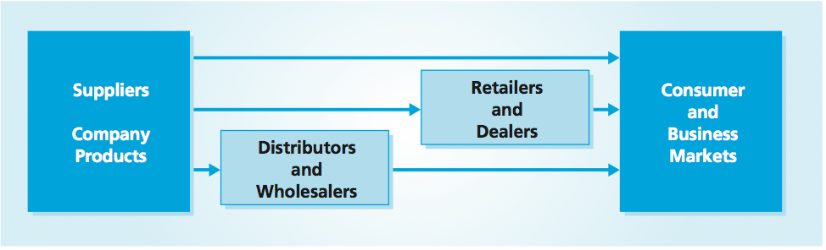
Channels
Image source: Roger J. Best, Market-based Management
Notes:
Companies (suppliers) need a value proposition for both end-user customers and channel partners. Like end-user customers, channel intermediaries must have a good reason to buy and market a company’s products.
■ Sales Growth — A company should emphasize the level of demand for its products or services and the investment that the company will continue to make in order to stimulate demand and grow channel partners’ sales.
■ Profitability — A company should show prospective intermediaries the margins, contributions, utilization of overhead, and net profitability that offering the company’s products or services will deliver. The company could augment an intermediary’s profitability by funding activities carried out by the channel member (such as placing items on display and emphasizing them in advertising) or offering rewards for performance (such as achieving volume thresholds and reaching a specific segment of the market).
■ Return on Capital — A company should demonstrate how the productivity of the channel member’s investments in inventory, working capital, and fixed assets will improve by engaging with the supplier. For example, a fast-selling product will accelerate inventory turnover, increasing the productivity of the intermediary’s warehouse, shelf space, and web site.
■ Brand Leverage — A company should show how an association with it will empower the channel member’s own brand or allow it to “borrow” or leverage the supplier’s brand. Small dealers and retailers, for example, could place the company’s authorized-reseller emblems on their printed materials and in their premises to demonstrate credibility to customers.

Slide 7
The Channels Building Block
Describes how a company communicates with and reaches its customer segments to deliver a value proposition.
Communication, distribution, and sales channels create the interface with customers.
Channels are touch points and play an important role in the customer experience.
Source: StrategyzerAG

Slide 8
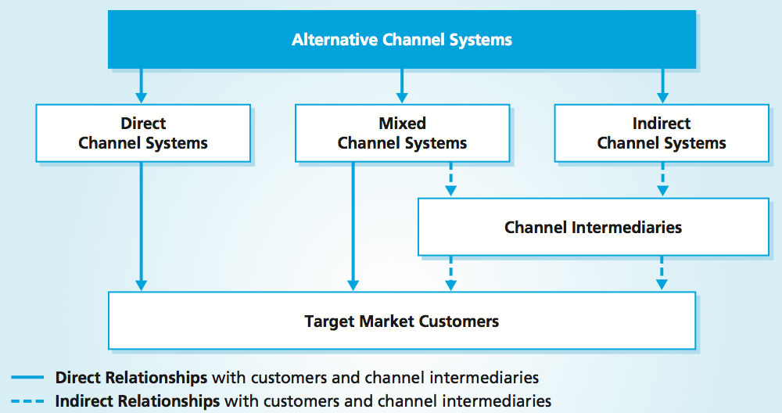
Types of Channels
Channel Types
Direct: business retains product ownership until delivery
Indirect: intermediaries take ownership of product
Mixed : combination of direct and indirect channels
Channel Partners
Source: Roger J. Best, Market-based Management
Notes:
Direct Channel Systems use one or more direct channels to reach customers, with the business interfacing with customers at all contact points and retaining ownership (title) of the product until delivery.
Indirect Channel Systems use one or more indirect channels, with the channel intermediaries taking ownership of the product and interfacing with customers at all customer contact points.
Mixed Channel Systems use a combination of direct and indirect channels. A business reaches, sells to, and services some customers directly but has channel intermediaries perform these functions for other customers, or a business and its intermediaries separately interface with the same customers at different contact points

Slide 9
Five Channel Phases
Awareness
Raise awareness among customers about a company’s products and services
Evaluation
Help customers evaluate a company’s Value Proposition
Purchase
Allow customers to purchase specific products and services
Delivery
Delivers a value proposition to the customer
After Sales
Provide post-purchase customer support
Source: StrategyzerAG

Slide 10
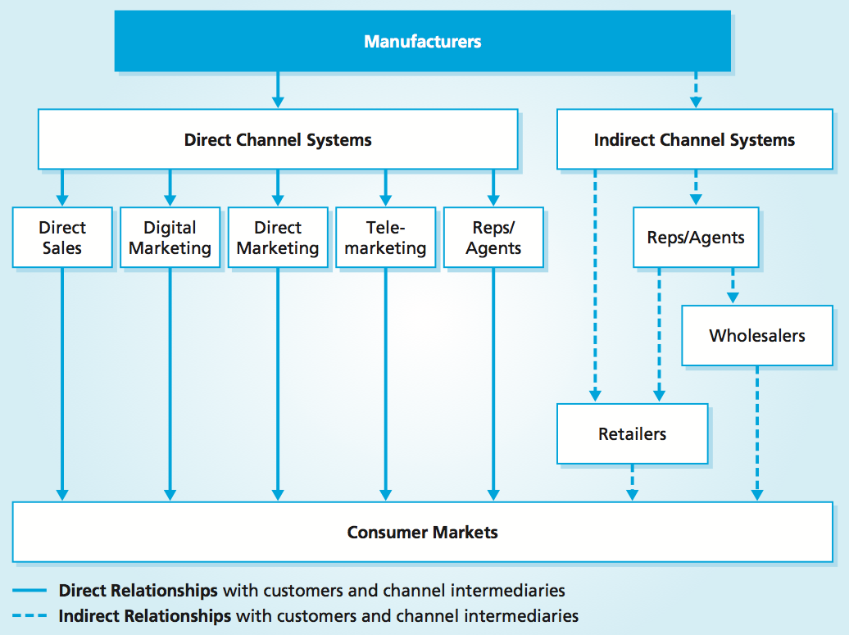
Channels and Direct Marketing Alternatives
Brokers
Source: Roger J. Best, Market-based Management
Notes:
Although a direct sales force offers the best opportunity for sales communication and customer interaction, the cost of direct customer sales contact is high and increasing.

Slide 11

Through which Channels do our Customer Segments want to be reached?
How are we reaching them now?
How are our Channels integrated?
Which ones work best?
Which ones are most cost-efficient?
How are we integrating them with customer routines?

Slide 12
Exercise
What channels does the Brown Family Farm need to reach its customers?
Brainstorm on your worksheet individually
Share your ideas with your group and rank the top ideas

