Slide 1

Presentation Title
Presentation Subtitle

Slide 2
About Brown Family Farms:
Mission Statement:
To pursue growth, innovation, and operational excellence in modern agriculture—producing premium crops, capturing greater market value, and building a scalable, multi‑enterprise farm business that strengthens our family legacy and rewards those who work alongside us.
Vision Statement:
To transform Brown Family Farms from a traditional price‑taking operation into a vertically integrated, market‑driven agricultural leader—recognized for strategic expansion, value‑added production, and multi‑generational wealth creation.

Slide 3
Current Headwinds:
Generational Farm Ownership Transfer
  Secure Retirement for Kent and Vikki
  Formalize Business Organization and Responsibilities
Future Financial Sustainability
  Through New Ventures
Inheritance from Fred Best – Vikki Best Father
  Brown Family Farms Portion
  Susie Good Family Portion

Slide 4
Brown Family Farms Position:
Business Valuation
BFF Market Net Worth: $5,947,198
Kent & Vicky Ownership (66.6%): ≈ $3,960,834
John Ownership (33.3%) ≈ $1,980,415
Brown Packing (60%): ≈ $780,000
John Ownership (40%) ≈ $520,000
Financial Strength Indicators
• 2025 EBITDA: ≈ $1.7M
• Working Capital: ≈ $1.2M
• Strong term debt coverage

Slide 5
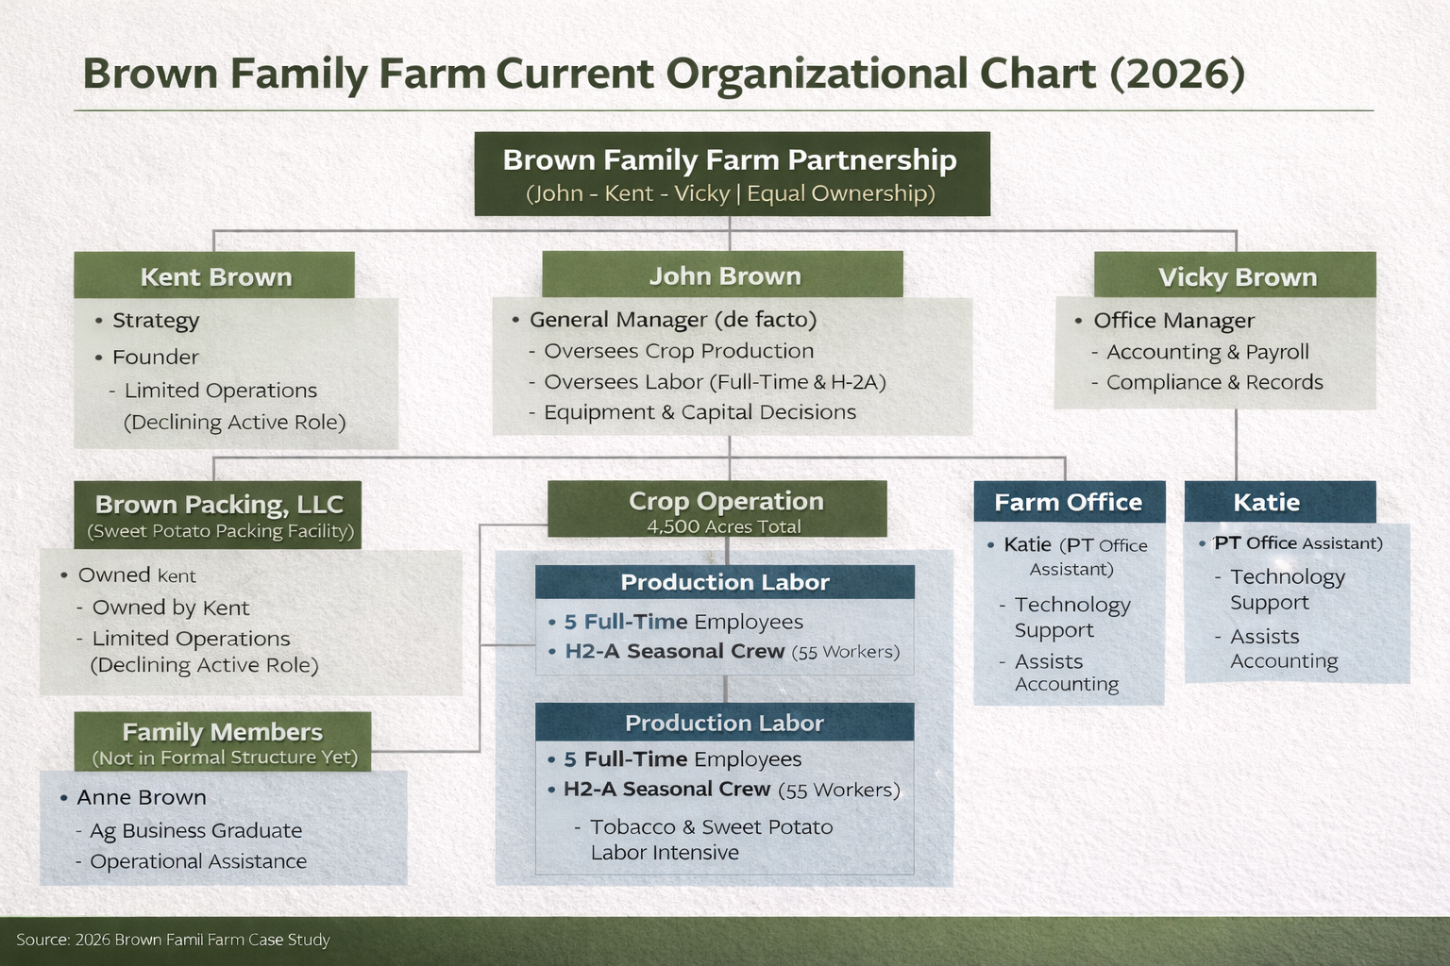
Current Brown Family Farm:

Slide 6
Value Proposition:
Diversifying into several new markets while adding value to our commodities based on demand trends while reducing input costs. Focusing on reducing the number crop production enterprises and engaging in value added marketing to the most financially efficient crops produced with historical and documented knowledge of production. To ensure generational success. For customer and Family.

Slide 7
Problem:
Commodity and Vegetable farmers are plagued with the problem of being price takers. All the while having limited opportunities to manage cost. These problems coupled with generational ownership transfer.

Slide 8
Opportunity:
Divest from the least financially efficient crops and invest in current crop production that are financially efficient. Engage in Value Added processes for “Identity Preserved” corn and soybeans. Add value to sweet potatoes by changing form marketed.
Focus on current production methods and redefining marketing plan.

Slide 9
Products:
Maintain current squash and cucumber production
  Projected EBITDA Eff. of 31% and %36 respectively
Decrease Tobacco acreage due to contracted lbs. decreasing.
  Unforeseen decrease but required due to contracted pounds limitations.

Slide 10
Product:
Transition Corn and Soybean Production to Identity Preserved varieties:
  Livestock Feed
  Ground Corn Products
Sweet Potato acreage increase due to profitability and to support new processing enterprise
  Dehydrated Sweet Potato Treats
  Able to increase acres due to Tobacco contract limitations, utilizes workers.

Slide 11
Market Opportunity:
MAHA improvement
Post-COVID local food and food story movement
Geographic proximity to city centers

Slide 12
Marketing Opportunity:

Slide 13
Phase 1 – Identity Preserved Grain
Costs (Annual) | Revenue (Annual)
Extra herbicide program – $25,000 | Non‑GMO corn premiums – $145,000
Testing & certification – $8,500 | Non‑GMO soybean premiums – $50,000
Seed documentation – $6,000
Segregated trucking – $10,000
Bin cleaning labor – $9,000
Admin & records – $5,000
Net Annual Gain | ≈ $124,000

Slide 14
Phase 2 – Feed Mill 1000t
($121,000)
Phase 3 – Private Label Line 150t
($54,700)
Costs (Annual) | Revenue (Annual)
Grain inputs – $177,971 | Bulk feed - $340,000
Minerals- $32,500
Operating Expenses- $46,000
Net Annual Gain | ≈ $73,029
Costs (Annual) | Revenue (Annual)
Operating Cost - $25,600 | Bagged feed sales – $90,000
Net Annual Gain | ≈ $64,400

Slide 15
Phase 4 Sweet Potato Treats
($655,500)
Costs (Annual) | Revenue (Annual)
Utilities - $22,000 | Wholesale treat sales $1,518,750
Labor – $153,000
Packaging - $129,000
Culls -$50,000
Insurance Maintenance $100,000
Net Annual Gain | ≈ $1,518,750

Slide 16
Business Model:
Price Premiums
Diversified Production and Marketing
Lower Input Costs – Seed – While Increasing value
Minimize Reliance on Government Payments
Utilize USDA Value Added Grant to minimize start up cost.

Slide 17
Traction:
Year 1-2 - Identity Transformation
  Convert all Corn and Soybean Production to Identity Preserved
  Establish Contracts with Regional Grain Merchandisers.
  Customer Recruitment – Palmetto Grain Brokers, Scoular, Perdue Agri-businesses
Year 2-3 – Soybean Roasting
  Begin continuous Soybean Roasting
  Provide Whole Roasted Soybeans for livestock feed
  Customer Recruitment – Feedstock for Livestock Producers

Slide 18
Traction:
Year 3-5 Feed mill Implementation
  Install required equipment for feed mill operations.
  Divert 10-20% of grain production to livestock feed.
  Customer Recruitment – Feed and Seed stores and Livestock Producers
Year 4-6 Dehydrated Sweet Potato Treats
  Use packing Shed culls – From Brown Family Farms and existing farmer customers
  Install necessary equipment i.e. dryer, mill and slicer.
  Customer Recruitment – Pet food and Food ingredient markets

Slide 19
Competition:
Direct Competition
    Regional Row Crop Farmers (IP and Non-IP)
    Larger Mid-west IP growers
Indirect Competition
    Organic growers
    Feed Alternatives
Wins
    Large acreage
    Infrastructure and Production in Place
    Vertical Integration Potential

Slide 20
New Horizons, Growth, and Transitions:

Slide 21
Proposed Brown Family Farm Transition:
Consultant Recommended Transition Plan Summary
• Proceed with structured 10-year seller-financed equity redemption.
• Maintain annual transition payments near $300,000.
• Keep term debt coverage above 110%.
• Protect working capital sufficiency above 20%.
• Monitor EBITDA quarterly against transition capacity.
• Avoid new term leverage during buyout period.
• Gradually reduce family living withdrawals post-transition.
• Maintain equity-to-asset ratio above 65%.
• Stress-test annually at -15% and -30% EBITDA levels.
• Include protective financial covenants in agreement.
• Shift governance authority with ownership thresholds.
• Sunset advisory compensation by Year 5.
• Revisit valuation formula every 3 years.
• Align estate planning with ownership transition.
• Maintain disciplined capital expenditure planning.

Slide 22
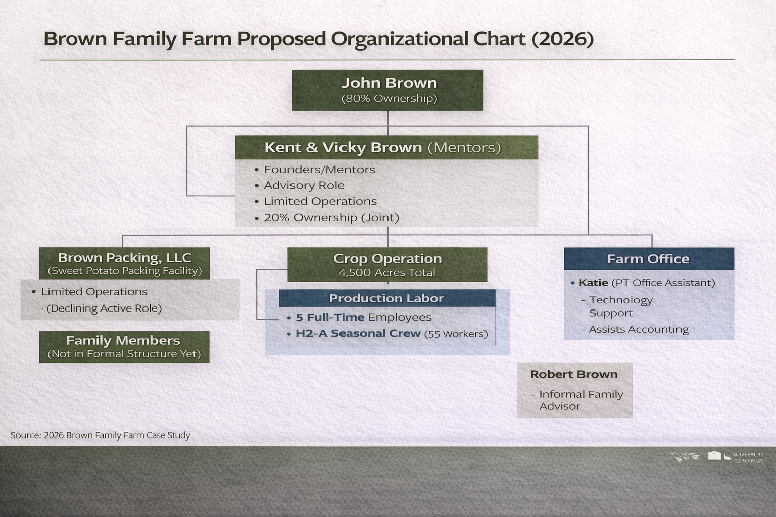
Proposed Brown Family Farm:

Slide 23
Best Farms Options:
Susie and Vikki will split land and timber 50/50
Complete Sell Out
Current Market Value
Current and Intermediate Valuation $1,381,544
Each grandkid receives $276,308
Good buys out Brown
Current Market Value
$1,105,235 to Brown Grandkids
Year 1 - $55,261 per Brown
Year 2-8 - $57,364 per year per Brown kid inc. interest

Slide 24

Thank You
Bethany Pugh, President & CEO
Cornerstone AG LLC

Slide 25
Phase 7 – Branded Products
Costs (Annual) | Revenue (Annual)
Marketing – $18,000 | Retail & dealer sales – $323,000
Labels & packaging design – $12,000
Trade shows – $15,000
Broker commissions – $40,000
Customer service – $38,000
Net Annual Gain | ≈ $200,000

