Slide 1
Next Generation Tobacco Products…Implications for Growers
Dr. Blake Brown
Hugh C. Kiger Professor
Agriculture & Resource Economics
College of Agriculture & Life Sciences

Slide 2
November 25, 2013 Equity Research: A Vaping State Of Mind - E-Cig Company Fireside Chats
“We reiterate our Overweight rating on the tobacco sector as we are increasingly optimistic on e-cigs.”
Wells Fargo Securities

Slide 3
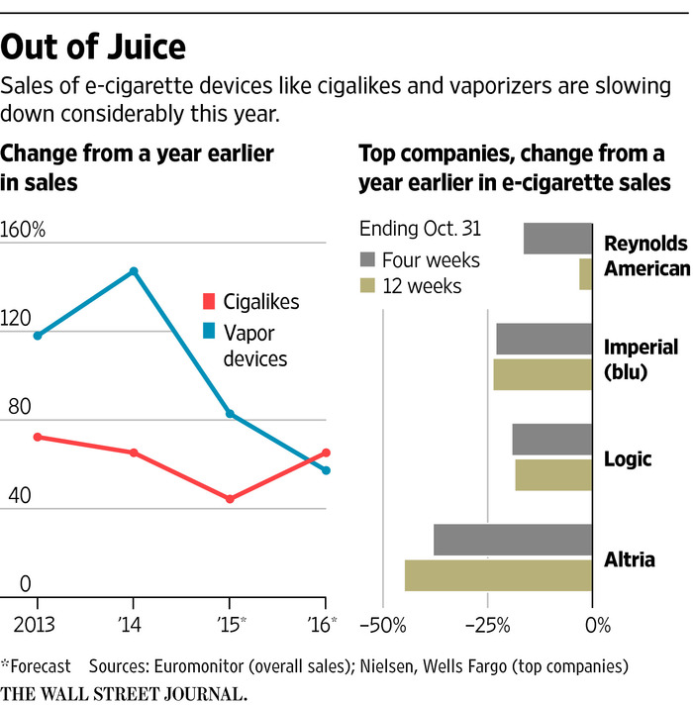
November 17, 2015

Slide 4
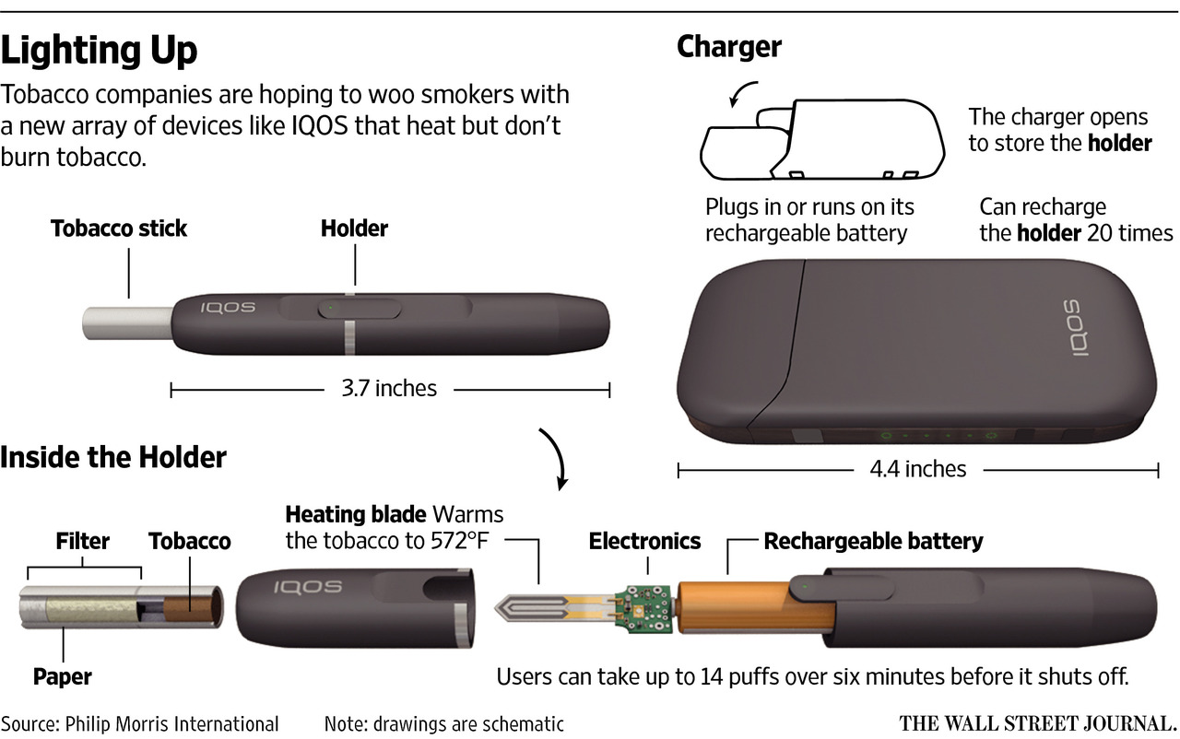
iQOS

Slide 5
Current and Future Trends in Cigarette Manufacturing
The progress of next-generation products is key for new plants
Next-generation products continue to make strong progress. The single greatest driver in diluting the combustible cigarette’s leading position in the world of tobacco is vapour products and in particular the emergence of heated tobacco. In 2016, vapour products as a whole (encompassing closed and open liquid nicotine vaping systems) and heated tobacco grew at 34% in constant price terms to reach USD12.3 billion. E-cigarette products in the form of closed or open systems accounted for USD10.2 billion with heated tobacco (largely accounted for by Japan) representing a further USD2.1 billion. The whole category is forecast to grow to USD34 billion by 2021.
Euromonitor’s TB17 system provides strong evidence not only for the growth of vapour products but also for drastic changes in the balance of consumption within the vapour segment. In 2014, open vaping systems accounted for 71% of category value with closed systems taking the remaining 29%. In 2016, the balance had changed with open vaping systems falling to 59%, closed systems accounting for 24% and heated tobacco for 17%. Forecast data suggests that by 2021 heated tobacco will be the single largest vapour category with 45% (USD15.4 billion).
Euromonitor International, Sept 2017

Slide 6
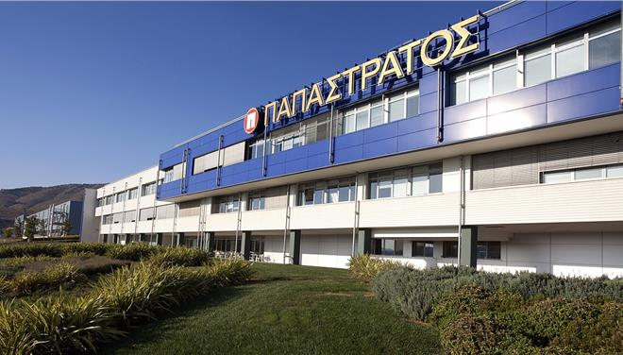
Current and Future Trends in Cigarette Manufacturing
Building capacity for next-generation products: PMI leading the way
PMI has undertaken a plethora of activities in recent years. The company’s vision of designing a smoke- free future is at the heart of all strategic decisions and newest factory-related announcements. PMI envisions the future of tobacco through its portfolio of next-generation products but the star performer is without a doubt the heat not burn device IQOS. PMI is aiming to have total annual installed capacity of 100 billion heat sticks by the end of 2018. This currently represents 12% of PMI’s total cigarette shipments. The production of Heets is in fact very similar to the existing production process of conventional combustible cigarettes. The adaptation of existing technology in this context can play a key role in the transition.
PMI Factory Investments Related to Next-generation Products
Location | Action | Invested (million) | Start date | Capacity | Focus
Bologna region, Italy (2 factories) | New factories | EUR500 +EUR500 | 2014 and 2016 | Currently 30 billion heat sticks | Heets for IQOS
Aspropyrgos, Greece | Upgrade | EUR300 | Jan 2018 | 20 billion heat sticks | Heets for IQOS
Dresden, Germany | New factory | USD320 | Early 2019 |  | Heets for IQOS
Otopeni, Romania | Upgrade | EUR490 | 2020 |  | Heets for IQOS
Italian PM at Bologna inauguration
Euromonitor International, Sept 2017
PMI Papastratos plant in Greece

Slide 7
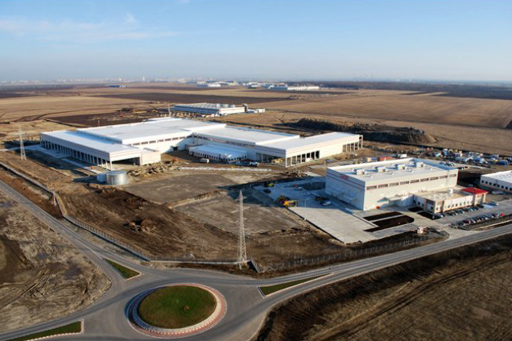
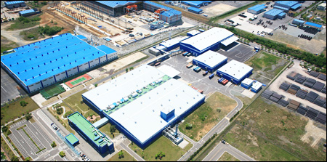
Current and Future Trends in Cigarette Manufacturing
Preparing for next-gen products: BAT and JTI are also taking action
Although PMI is clearly the leader in embracing next-generation products, other big tobacco multinationals are also investing heavily in their own alternative devices capabilities.
In late 2016, BAT announced that it will turn its factory in Ploiesti, Romania into its second largest factory in Europe. The total 5-year investment is expected to reach EUR1 billion. Along with the factory’s role as an export hub, ie half of Romanian production is exported to 35 countries around the world, BAT will start producing glo iFuse Neopods for its next-generation heated tobacco product. Other BAT factories that will receive noticeable upgrades to accommodate the production of glo are located in South Korea and Russia. The Korean factory investment amounts to GBP138.7 million. One of the main goals of this restructuring is to turn the plant into a global hub for exporting Neosticks for glo.
JTI is the other key global player embracing next-generation vapour devices. JTI’s answer to IQOS and glo is Ploom TECH. Since Ploom was released, the popularity of the device has soared immensely. Currently, JTI is unable to keep up with the demand. Recent news suggests that the company will invest about USD481 million in factories in Japan and China. The ultimate goal of the company is to increase production capacity tenfold in the course of the next year. JTI also works on Ploom in Trier, Germany, where the company owns a state-of-the-art research and development centre.
BAT’s facility in Romania
BAT’s facility in South Korea
JTI’s facility in Trier, Germany
Euromonitor International, Sept 2017

Slide 8
BAT Strategy (source: Wells Fargo)
Focus on multi-category Next Generation Products (NGP)
Heat-not-burn: multiple products
Vapor technology: multiple products
BAT plans to submit a Substantial Equivalence application to FDA for Glo (HNB product)
Reynolds filed a Substantial Equivalence to FDA application for an improved version of Eclipse
Strong growth and dominance in American Snuff Market

Slide 9
FDA REGULATION:
Modified Risk Tobacco Products
MRTP Applications Currently Under Scientific Review
Product/ Company | Comment Period Closes | Regulations.gov Docket # | TPSAC Meeting Date/Info
IQOS system with Marlboro Heatsticks/Philip Morris Products S.A. | TBD** | FDA-2017-D-3001 | January 24-25, 2018
* Due to the large size of the Philip Morris Products S.A. MRTP applications, FDA will post the application documents in batches on a rolling basis as they are redacted in accordance with applicable laws.

Slide 10
What do we know about the leaf needs for iQOS?
High quality leaf...but what “high quality” means is not well defined
Consistent quality…how can we make “quality” more consistent?
Strict adherence to GAP
Leaf quantity per stick will be 1/3-1/2 that of combustibles by weight
Leaf in the Heet stick is highly processed

Slide 11
Who is in the best position to service this new market?
“larger commercial growers” – major HNB manufacturer
Growers who can exert more control over growing and curing
Computerized curing
Hand harvest for higher quality
GAP compliant
What can be done to exert more control over the growing process?
Italy, US, maybe Brazil
Probably flue-cured growers
But will buyers be willing to pay for higher costs?

Slide 12
US Flue-Cured Exports and Domestic Disappearance

Slide 13
Projected 2025 Use of US flue-cured (FC) tobacco for Combustible Cigarettes and Heat-not-burn products (HNB) in the US
Assumes HNB products have 30% market share by 2025 Assumes HNB products contain 49% by weight of the amount of tobacco as contained in combustible cigarettes

Slide 14
Projected 2025 Use of US flue-cured (FC) tobacco for Combustible Cigarettes and Heat-not-burn products (HNB) for exports to the EU28 and Switzerland
Assumes HNB products have 30% market share by 2025 Assumes HNB products contain 49% by weight of the amount of tobacco as contained in combustible cigarettes

Slide 15
Take Aways….
HNB requires a consistently high quality tobacco which gives US growers a competitive advantage over most global producers
HNB requires only 1/3-1/2 the quantity of tobacco required by combustibles
30% market share HNB in the US cigarette market could imply up to 15% less tobacco required from US producers for US cigarettes
The proportion of US tobacco used in HNB products would have to double to offset the decline in the total quantity of tobacco needed for HNB relative to Combustibles…for Europe and the US
But a tilt toward HNB in the developing world could increase exports of US tobacco to the developing world

