Slide 1

Looking at Food Safety from Many Perspectives
Beth Bland Oleson
Georgia Fruit & Vegetable Growers Assoc.
February 24, 2020

Slide 2
Overview
Where did food safety come from?
Food safety from different perspectives
What now?

Slide 3
Presentation has original content as well as content from other presentations…
Why reinvent the wheel?

Slide 4
In the produce industry, it all started in a land far, far away…

Slide 5

Notes:
In 1998, the US-FDA released a Guide to Minimize Microbial Food Safety Hazards for Fresh Fruits and Vegetables.
The Guide represents the first major effort to define GAPs for growers and handlers of fresh produce.
You should study it in detail. The “Seven Principles” defined therein are based on common sense and are easy to understand.

Slide 6
GAPs
Good Agricultural Practices
  Recommendations, Not Regulation
  FDA, October 1998
  Recommends we be aware of potential contaminations and manage operations as to minimize potential risks
  Microbial, chemical and physical hazards.
  Came about due to large, nationwide foodborne illness outbreaks related to produce

Slide 7
Learn the Lingo
GAP – Good Agricultural Practices
  Requirements & guidelines for production of safe crops
  Primarily used in the field
GMP – Good Manufacturing Practices
  Primarily used in the packing facility
BMP – Best Management Practices
  Synonymous with GAPs but can also refer to postharvest operations
HACCP – Hazard Analysis Critical Control Points
  Primarily used in processing
SOP – Sanitation Standard Operating Procedure
  Written directions…What you are gonna do, how you are gonna do it, and who’s gonna do it

Slide 8
GAP - Food Safety Audits Were Born
Market started asking for food safety plans and audits
  1999 – 2010 – General GAP audits were KING
  Food safety guided by market, not regulatory agencies
  Drawback for us…..Did not see huge changes in outbreaks
  Operations with food safety audits were still be implicated in nationwide outbreaks

Slide 9
Don’t Look Ethel! But it was too late…GFSI
General GAP audits were easy but GOOD and focused on FOOD SAFETY…so if we add more it should be better, right?
2010: Global Food Safety Initiative made it’s way over to the US
  European concept – any audit scheme with GFSI benchmark accepted by large group of buyers
  Walmart was on the Board of Directors

Slide 10
GFSI cont’d
2011: Customized food safety programs, paperwork
  Very in depth
  Heavy focus on sustainability, social accountability
  Huge shift in food safety program design and application on farms and packing facilities
  Drawback for us…..Did not see huge changes in outbreaks
  Operations with food safety audits were still be implicated in nationwide outbreaks

Slide 11
So what do we do with or approach food safety in our operations?
The perspective around food safety is variable across the produce industry
Different Perspectives
of Food Safety
Impact Your Operations Differently

Slide 12
Market – Buyers/Shippers
Perspective

Slide 13
Market: Reduce Liability
“Protect at all costs”
  Market requires suppliers to sign affidavits, liability insurance, etc.
  Most require audits for ALL commodities and all packing processes (wet/dry)
  What’s your operation’s response?
FSMA should level the playing field…Market will always trump regulatory requirements
  The Market raises the bar frequently

Slide 14
Market: Marketing Tool
Food safety is not a marketing tool….but tell that to the marketing team
One brand against another
One region against another

Slide 15
Market: YOUR Buyer
Most buyers are good at relationships and buying… NOT FOOD SAFETY
  Organizational objective pushed down
  Limited knowledge and lingo
Problem for the grower: Start a relationship with a buyer, receive regular payments, THEN ask for food safety audit certificate, That’s when Beth gets a frantic phone call…Beth’s Theory

Slide 16
Market: Dept of Quality and Safety
Quality and Safety Teams are good at science, risk, and metrics…not necessarily supply chain management
  Creating the organizational objective being pushed to the buyer
  Engaged at national industry level (PMA, United Fresh)
  They are good at finding problems and saying “NO” and not helping with mediation of any supplier issues
  Sometimes need educating regarding on farm practices
  Also doing supply chain verification audits…which is another audit

Slide 17
Ask a Question with a Question
Are you being asked for a specific BRAND of food safety audit?
  PrimusGFS - Global GAP
  USDA - SQF
  Harmonized GAP - Any food safety scheme will do
What will be the SCOPE of your audit?
  Field - Packing Facility
  Harvest - All of the Above

Slide 18
Push Back is an Option
Food safety audit certifications are expensive and time consuming
Multiple buyers asking for different certification bodies
Push back and educate on what you are doing

Slide 19
Industry Organizations
Perspective

Slide 20
Associations and Organizations
“If you aren't part of the decision making table, you will likely get left out, or worse yet, get served on the menu” -- Unknown
  Associations/organizations are the voice of their membership
  Lots of meetings with each other, with members, with regulatory organizations, with the marketplace
  United Fresh, PMA, Western Growers, GFVGA, FFVA, North Carolina Farm Bureau, Carolina Stewardship Committee, Texas International Produce Association, Canadian Produce Marketing Association, National Sustainable Ag Coalition, Northwest Horticultural Council, LGMA, Depts of Ag, Land Grant Univ., etc.

Slide 21
Associations and Organizations
Most produce related associations/orgs are working to represent the grower/packer/shipper
Help educate/push back FDA, buyers

Slide 22
Drawback to Niche Food Safety Efforts
Buyers and producers want defined metrics
When commodity specific organizations “draw a line in the sand” with a defined metric, it will most likely be adopted by the marketplace and be pushed as an industry practice
  Leafy Greens Marketing Agreement – Water metrics
  Take Home: Keep your eyes/ears open

Slide 23
Association and Organizations
Be part of the solution
Be engaged
Share your story, concerns, needs, wants

Slide 24
Regulatory: Rule Making
Perspective

Slide 25
Regulatory Orgs Run by Humans
Overall focus is to produce safe food
Many current regulatory burdens originated with “good intentions”
  Smart, well-meaning people who want to help…but don’t understand the ultimate outcome on a farm or packing facility
Line gets blurry when organizational leaders have different agendas…and leadership seems to change a lot

Slide 26
Notes:
In 1998, the US-FDA released a Guide to Minimize Microbial Food Safety Hazards for Fresh Fruits and Vegetables.
The Guide represents the first major effort to define GAPs for growers and handlers of fresh produce.
You should study it in detail. The “Seven Principles” defined therein are based on common sense and are easy to understand.

Slide 27
1998: Focus - Minimize Risk
Focus on risk reduction, not risk elimination.
“Current technologies cannot eliminate all potential food safety hazards associated with fresh produce that will be eaten raw.”
Guide to Minimize Microbial Food
Safety Hazards for Fresh Fruits and Vegetables

Slide 28
2013 Focus - Reduce or Eliminate Risk
Letter to Cantaloupe Industry on Produce Safety (Feb 2013)
“Due to our [FDA] observations at cantaloupe packinghouses, we urge the cantaloupe industry to review its current operations in the context of our guidance…
We further encourage the industry to seek other information…pertaining to pathogen reduction or elimination on fresh produce…”

Slide 29
1998 Focus - Minimize Risk
Focus on risk reduction, not risk elimination.
“Current technologies cannot eliminate all potential food safety hazards associated with fresh produce that will be eaten raw.”
Guide to Minimize Microbial Food
Safety Hazards for Fresh Fruits and Vegetables
TECHNOLOGIES HAVE NOT CHANGED

Slide 30
FSMA:
Regulatory Update
Jennifer McEntire, Ph.D.
VP Food Safety & Technology
jmcentire@unitedfresh.org

Slide 31
FSMA
Food Safety Modernization Act
  A law in the United States (not a rule)
  Written by Congress (not US FDA- Food and Drug Administration)
  Requires FDA to write rules based on the law, do studies, etc.
  Biggest change to US food safety system in decades

Slide 32
New Law Updates Authority and Tools
2011 – FSMA
(Prevention, Risk Analysis)
1938 – Food, Drug, and
Cosmetic Act
(Reactionary)
1906 – Pure Food and
Drug
(Focus on Sanitation)
Keith R. Schneider (keiths29@ufl.edu) - Univ of Florida
Notes:
Around the turn of the 20th century, the focus was on sanitation.
Even with the reforms of the 1930s, our efforts focused more on reacting to problems in the marketplace.
The historic FSMA is aimed at transforming our food safety efforts toward prevention and based on risk analysis.

Slide 33
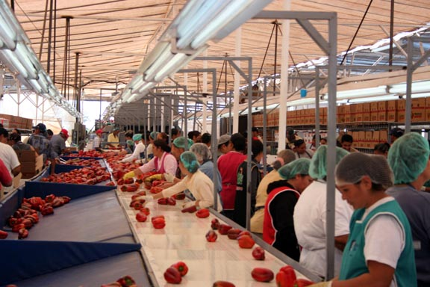
Prevention – The Cornerstone
Comprehensive preventive controls for food and feed facilities
  Sounds like HACCP
Produce safety standards
  GAPs will no longer be guidance only
International standards
  Particularly with adulteration
Transportation issues
Keith R. Schneider (keiths29@ufl.edu) - Univ of Florida

Slide 34
Food Safety Modernization Act
New authorities, responsibilities for FDA
  Mandated inspection frequency - prescribed depending on risk
  Mandatory recall authority
  Expanded records access, more to come
  New facility registration requirements
  New detention authority
  New authority to withdraw registration
  New requirements for Reportable Food Registry

Slide 35
Other Provisions in the Act
Impact on food importers
  Importer defined as owner at the border
  Importers required to verify that food products are grown/manufactured in accordance with relevant FDA regulations
  FDA authority to require certification of imported foods, if based on risk
    FDA may allow 3rd party certification of imports
  FDA may refuse entry if foreign facility or country denies access to inspection
  Requires FDA to develop voluntary program for expedited review

Slide 36
The Big 7 Rules
Produce Safety Rule
Preventive Controls- Human Food
Preventive Controls- Animal Food
Foreign Supplier Verification Programs
  Importers must comply, not foreign suppliers
Accredited 3rd Party Certification
Sanitary Transportation
Intentional Adulteration

Slide 37
Produce Safety Rule
“Standards for the Growing, Harvesting, Packing and Holding of Produce for Human Consumption”
Applies to “covered produce” that is generally consumed raw
  “exhaustive list” of rarely consumed raw
Addresses microbiological hazards only (not chemical or physical hazards)
Requires someone trained to Produce Safety Alliance curriculum (or equivalent)

Slide 38
Produce Safety Rule
  Agricultural water that contacts produce (irrigation, crop chemicals, washing) or food contact surfaces (including hands)
  Domesticated and wild animals and their excreta that may come into contact with produce
  Biological soil amendment of animal origin (manure) that may reasonably come into contact with produce
  Training and Health and hygiene of workers that contact produce (harvesters, sorters, packers)
  Equipment, tools, buildings and sanitation (tools, utensils, containers, equipment)
  Growing, harvesting, packing, and holding activities that may reasonably be a source of contamination

Slide 43
-Does the primary production farm “own” the packing operation?
-Is most packed produce from the primary production farm?
Secondary Activities Farm
Facility
Farm
Packinghouse
Stay Tuned!

Slide 44
Farm vs Registered Facility
Produce Safety Rule
  PSA
Sanitation GMPs
No traceability requirement
Mostly state inspectors
No mandatory recall authority
Exempt from Sanitary Transport rule
Preventive Controls
  PCQI
Must consider Listeria
Bioterrorism Act recordkeeping reqs
Mostly FDA inspectors
Mandatory recall authority
Sanitary Transport rule applies
Everyone must produce safe food

Slide 45
It Could Have Been Worse…
Mandatory microbiological testing of raw materials, finished product
Mandatory environmental monitoring for pathogens
Mandatory supplier approval and verification program

Slide 46
Implementation Update
Larger farms (>$500K produce sales) compliance: January 2018
Small farms (<$250K-$500K produce sales) compliance: January 2019
  State Dept Ag/ Health will do most inspections
  FDA Produce Safety Network can also inspect
Ag water subpart is on hold

Slide 47
Resources
www.fda.gov/fsma
  Summaries and full versions of each rule (multiple languages)
  Guidance and other notices
  Technical Assistance Network
www.unitedfresh.org/food-safety/food-safety-modernization-act/
www.unitedfresh.org/fsma-faqs
www.Fspca.net
https://producesafetyalliance.cornell.edu/

Slide 48
Regulatory:
Assessment / Sampling
Perspective

Slide 49
FDA Inspection, Environmental Sampling and Sample Collection Cantaloupe Packinghouse Assignment
Summer 2013

Slide 50
2013
“FDA Inspection, Environmental Sampling and Sample Collection Cantaloupe Packinghouse Assignment”
  Issued to determine current cantaloupe packinghouse practices and
  To gather baseline data on the prevalence of Listeria monocytogenes in the environment of these packing houses and how that relates to incoming and outgoing cantaloupes

Slide 51
2013 or 2019…Same
The 2013 Cantaloupe Assignment for Lm
  On Farms and Packing Facilities
2018/2019 Romaine Lettuce Assignment for E. coli
  Started in POST HARVEST coolers…industry uprising…moved sampling to field
2019/2020 General Surveillance for Norovirus and Cyclospora
  Consumer retail stores

Slide 52
2013 FDA’s Purposes - 1
Assess and document current practices in packing facilities through out the industry
Discover the extent of knowledge and adoption of FDA guidance and other industry guidance
Are producers aware of previous outbreaks and have they looked at their practice and adjusted anything based on what was found
Prevalence of Listeria monocytogenes within packing houses
  Common handling practices?
  Dry vs Wet packed?
  Food contact surfaces, equipment, other vehicles on which L.mono is likely to be found?

Slide 53
2013 FDA’s Purposes - 2
Info will be used to support a risk assessment of L.mono relative to the handling of cantaloupe
Develop updated industry guidance
Guide research with the intent of evaluating common handling practices
Frame regulatory inspection and compliance strategies used in the future

Slide 54
2013 Implementation
FDA District office will reach out to State Department of Ag and invite to attend inspection
  No more than 4 people will be allowed on a visit
48 hour prior notice by FDA
Notice call will inform packer of scope of the inspection
Only cover packing operations
  They will NOT be going out to the field or field harvest operations

Slide 55
2013 The Low Down
Samples will be pulled from:
  Incoming product from the field
  Packed product at the end of the packing line
  Ready to ship from the cooler
  Environmental samples
Approximately 50-100 samples will be pulled
Retail customers have sent letters emphasizing TEST AND HOLD
  Do not send produce lots from which FDA has taken any samples until a clear report is provided by FDA

Slide 56
Be Ready
Produce Lots are separated by a “clean break”
  Clean Break is when cleaning/sanitation occurs
  Verify with environmental samples
DOCUMENT ALL CLEAN BREAKS
Have written SOPs (Standard Operating Procedures) for all cleaning and sanitizing procedures and a Cleaning Schedule
  Follow your SOPs or
  Edit your SOPs to reflect your reality
Have MSDS (Material Safety Data Sheets) for all chemicals used in your packing facility
Have Guidance documents in hand

Slide 57
Current Day Guidance…
  Draft Guidance for Industry: Guide to Minimize Food Safety Hazards of Fresh-cut Produce (Comment period open until April 2019)
  Guidance for Industry: Standards for the Growing, Harvesting, Packing, and Holding of Produce for Human Consumption: What You Need to Know About the FDA Regulation - Small Entity Compliance Guide
  Guide to Minimize Microbial Food Safety Hazards of Tomatoes
  Guide to Minimize Microbial Food Safety Hazards of Melons
  Guide to Minimize Microbial Food Safety Hazards of Leafy Greens
  Guide to Minimize Microbial Food Safety Hazards of Onions
  Guide to Minimize Microbial Food Safety Hazards of Mushrooms
  Guide to Minimize Microbial Food Safety Hazards of Cantaloupe (multiple)
  Guide to Minimize Microbial Food Safety Hazards of Watermelon

Slide 58
Get Ready NOW
After PRE-SEASON cleaning and sanitation
  Conduct microbial sampling through out your facility
  Take on the TV show, CSI – go on a swab-a-thon
It’s much better to know you have a problem and FIX IT BEFORE produce is introduced

Slide 59
Audit / Auditor
Perspective

Slide 60
Auditor
Normal person with highs and lows
But, they have authority to judge/score based on some degree of interpretation and perspective the audit scheme
  Warning: Can lead to pontification aka consulting…slippery slope
Their Purpose is to determine compliance with the audit schemes based on what they observe
  This has gotten tighter due to Jensen Farms

Slide 61
Personal Liability for Auditors
NEW with the Jensen Bro Farms- Cantaloupe – Listeria Suit:
“PrimusLabs was negligent in auditing their cantaloupe fields and packing facility in July 2011, shortly before their cantaloupe was linked to a 28-state outbreak of Listeria that was ultimately found responsible for 33 deaths and a miscarriage. It also sickened about 150 people. Jensen was given a score of 96 percent and a ‘superior’ rating at the conclusion of the audit.”
The 2011 auditor, Mr. Dilorio, failed to observe, or properly downscore or consider, multiple conditions or practices that were in violation of Primus’s own audit standards applicable to cantaloupe packing houses, industry standards, and relevant FDA industry guidance”
https://www.foodsafetynews.com/2013/10/jensen-brothers-sue-primus-over-third-party-audit-they-say-was-faulty/

Slide 62
Auditor
The audit begins as soon as they drive up
  Looking for signage, direction, organization, physical appearance of the operation
  Continues with their interaction with office personnel
    How are they greeted? Are they asked to sign in? Are they directed to review the visitors policy? ETC.

Slide 63
Auditor
Some auditors will purposefully leave on watches, jewelry, etc. as a “test”
They are expected to follow YOUR visitor and hygiene rules.
Do not leave auditors alone. Always escort them.
Like any evaluation/audit, a good operator will manage the auditor

Slide 64
Insider Trading
Auditors love organization!
  Signs, Signs and more Signs
    Directional signs for visitors, shipping, office, etc.
    Bathroom signs to wash hands, to put toilet paper in the toilet, not to use the field or woods
    Authorization/Warning Signs
    Color coded signs for cleaning equipment
    No eating/drinking/tobacco signs around facility

Slide 65
Insider Trading
Auditors love organization!
  Label all trash container “Trash” in English and any other primary language spoken in the operation
  Includes trash cans, boxes, bins, etc.
  Keep EVERYTHING off the ground.
        Boxes
        Packaging
        Stickers
        Brooms, Mops, Shovels – hang or in drums
        PRODUCE

Slide 66
Insider Trading
Auditors love organization!
  Draw lines on the floors with yellow paint to delineate barriers
  Sign-In Logs
  Visitor Name Tags
  Get to know any special field and/or packing practices for your commodity(s) and region
    Florida Tomato Food Safety Initiative
    Leafy Green Food Safety Initiative

Slide 67
School’s In
Training is KEY.
  All workers, supervisors, etc. must undergo training
    Health & Hygiene
    Sanitation of the packing line
    Pesticide Application
    Fork lift safety
  Most auditing firms want ON GOING training
    http://ohioline.osu.edu/atts/modules.html
    Gemplers Tailgate Training – www.gemplers.com

Slide 68
Tips
Farms and ON FARM PACKING FACILTIES do not need to register as a FDA Food Facility (BioTerrorism Act)
  Registered Food Facilities will be audited under Preventive Controls Rule
  Even if a food safety audit asks the question
  The Registration number is confidential and should not be given to an auditor or written on an audit report

Slide 69
Manage the Audit
An Audit is a snap shot in time
Good auditor can differentiate between a systemic/entrenched issue verses rare occurrence
If a problem occurs, SOPs and the way it’s handled will be factored into scoring

Slide 70
Manage the Audit
Know your audit questions
  Some auditors will ask leading questions
  If you open the “information” door, they can step in
  Answer the question and stop talking

Slide 71
Grower/Packer &
Food Liability
Perspective

Slide 72
Question:
Regarding liability and prosecution…
Does there have to be intentional contamination or gross neglect that causes contamination?
Does there have to be knowledge of any type of contamination factors?

Slide 73
Highlights from News Reel
Peanut Corporation of America (PCA): Salmonella outbreak (2008)
  Peanut butter paste
Jensen Brothers Farm: Listeria monocytogenes outbreak (2011)
  Cantaloupe
Quality Egg: Salmonella outbreak (2010)
  Eggs
ConAgra: Salmonella (2006­–2007)
  Peanut butter / Sylvester, GA
Blue Bell: Listeria monocytogenes (2010–2015)
  Ice cream
Chipotle Mexican Grill: Norovirus (2015, 2017, 2019)
  Sick restaurant employees

Slide 74
Jensen Brothers
Family farm
Cantaloupe growers, packers, shippers
2011 Listeria monocytogenes outbreak
  33 people killed
  147 hospitalized
  Covered 28 states
Brothers were shocked and saddened by the deaths…pleading guilty in court did not imply any intentional wrongdoing or knowledge that the cantaloupes were contaminated.
PrimusAudits food safety auditor gave their farm a "superior" rating just before the outbreak
Auditor’s “consultation” was they did not have to use chlorine in the rinse step.
The Jensens were charged with introducing adulterated food into interstate commerce. At the time, the FDA said the rare move was intended to send a message to food producers.
https://www.nydailynews.com/life-style/health/cantaloupe-farmers-plead-guilty-listeria-case-article-1.1492591

Slide 75
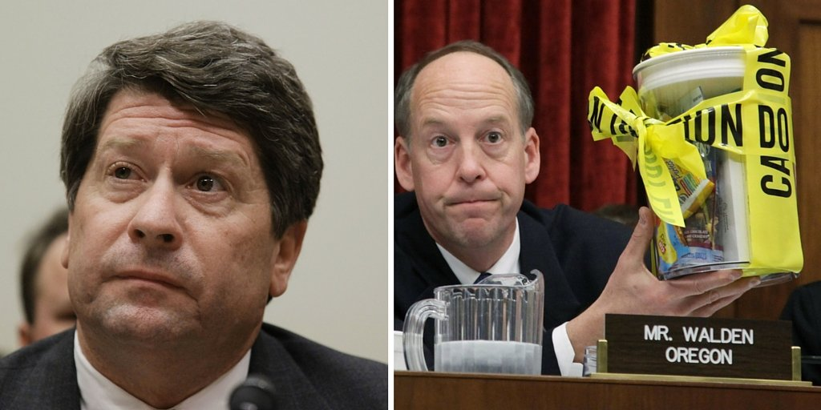
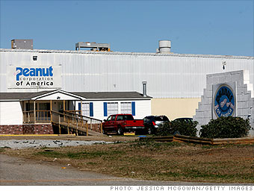
Peanut Corporation of America
Recall of bulk peanut butter and peanut paste products
3,913 products recalled from over 350 companies

Slide 76
Why were these outbreaks different?
Jenson Farms
Peanut Corporation of America
147 illnesses
33 deaths (22%)
1 miscarriage
~714 illnesses
9 deaths (~.01%)
5 years probation
100 hours community service
6 months home detention
$150,000 each in restitution
28 years prison (CEO)
20 years prison (Broker)
5 years in prison (QC manager)
Pathogen
Intention

Slide 77
Why were these outbreaks different?
Jenson Farms
Peanut Corporation of America
96% Primus Audit
Clean facility
Failed own final product tests, but shipped product anyway
Rodent/bird droppings, cockroaches, leaky roof
Genuinely thought they were doing the right thing
“Just ship it”

Slide 78
Jenson Farms
Peanut Corporation of America
Listeria monocytogenes
No knowledge of contamination
An EM program may have prevented this outbreak
Salmonella enterica serovar Typhimurium
Had knowledge of contamination
Had product monitoring program, ignored results

Slide 79
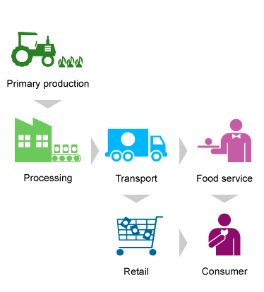
Who is affected by these outbreaks?
Produce supply chain icons…
Photo Credit: https://www.aihw.gov.au/reports/food-nutrition/australia-s-food-and-nutrition-2012-in-brief/contents/in-brief

Slide 80

Produce Supply Chain… in real life

Slide 81
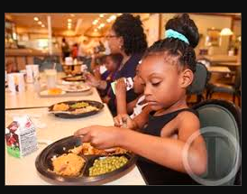
Produce Supply Chain… in real life

Slide 82

Produce Supply Chain… in real life

Slide 83

Produce Supply Chain… in real life

Slide 84

Produce Supply Chain… in real life

Slide 85
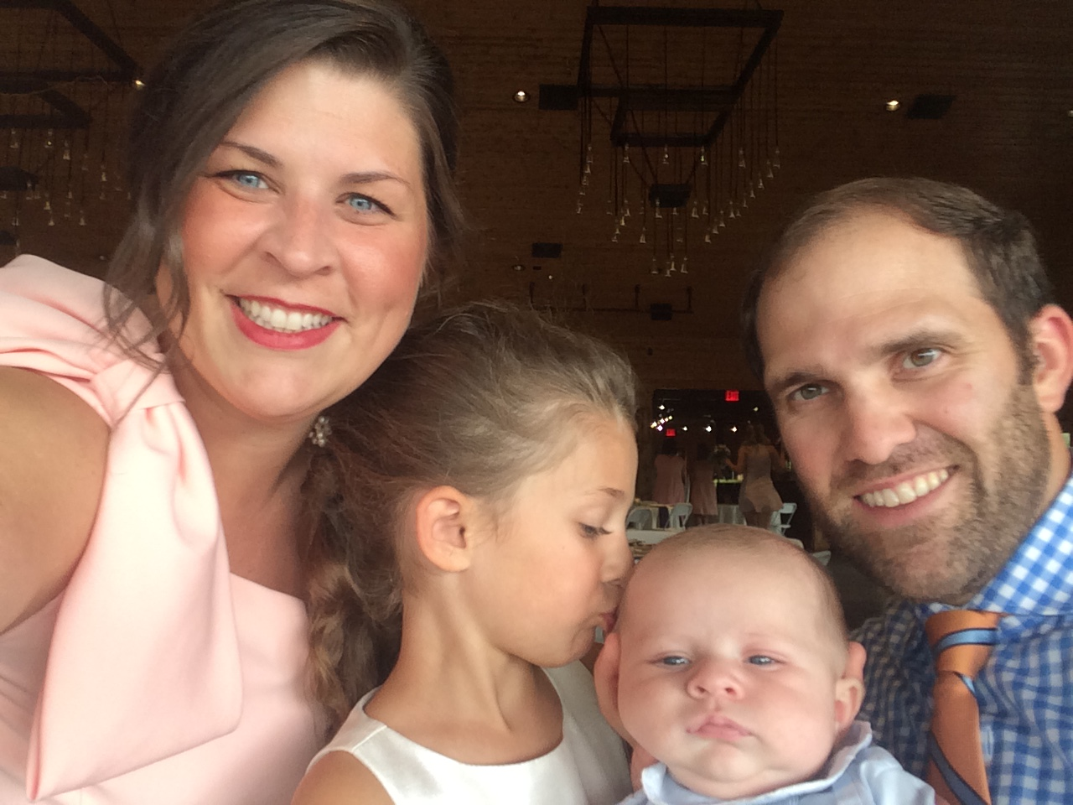
Produce Supply Chain… in real life

Slide 86
Question:
Regarding liability and prosecution…
Does there have to be intentional contamination or gross neglect that causes contamination?
Does there have to be knowledge of any type of contamination factors?

Slide 87
Consequences of FD&C Act Violations:
Criminal Liability
United States v. Park, 421 U.S. 658 (1975)
A.K.A The Park Doctrine
In 1975, the Park Doctrine solidified FDA’s authority to criminally charge corporate executives and high-level managers.
The Supreme Court upheld the conviction of the president of a major grocery chain who was found to be criminally liable for unsanitary conditions existing in a company distribution center, notwithstanding the argument that he had delegated the responsibility for maintaining the cleanliness of the site to his subordinates.
The Supreme Court concluded that if a company ships adulterated food, the management of that company can be charged, even if they have no direct knowledge or intent.
https://www.foodqualityandsafety.com/article/park-doctrine-food-companies-prosecution/

Slide 88
Consequences of FD&C Act Violations:
Criminal Liability
United States v. Park, 421 U.S. 658 (1975)
A.K.A The Park Doctrine
Under this standard, a food industry executive or QA manager can be sentenced to prison if he or she is aware of a circumstance or condition within his or her facility that could lead to a foodborne illness and fails to take action to correct it.
If charged with this type of misdemeanor, the executive could be sentenced to up to a year in prison and a $250,000 fine for each count.
On a case-by-case basis, FDA will consider the individual’s position within the company, his or her relationship to the violation, and whether in fact he or she was in a position (or had the authority) to correct the violation.
The government is demonstrating that it intends to use criminal sanctions to create a deterrent and compel compliance.
https://www.foodqualityandsafety.com/article/park-doctrine-food-companies-prosecution/

Slide 89
Consequences of FD&C Act Violations:
Criminal Liability
United States v. Dotterweich, 320 U.S. 277, 281 (1943)
FDCA “dispenses with the conventional requirement for criminal conduct awareness of some wrongdoing.”
The Dotterweich case, decided by the U.S. Supreme Court in 1943, established that corporate officers could be prosecuted for violating the FD&C Act, regardless of any knowledge or awareness of the violation.
Joseph Dotterweich was the president of Buffalo Pharmacal Company, Inc. Buffalo’s business involved purchasing bulk drugs, repackaging them, and selling them under its own label.
Unbeknownst to Dotterweich, the company received a batch of adulterated drugs, which it subsequently repackaged and shipped into commerce. Dotterweich had no idea the products—which were guaranteed by the manufacturer—were adulterated. Nonetheless, Dotterweich and Buffalo were criminally charged for violating the FD&C Act.
https://www.foodqualityandsafety.com/article/park-doctrine-food-companies-prosecution/

Slide 90
Consequences of FD&C Act Violations:
Criminal Liability
United States v. Dotterweich, 320 U.S. 277, 281 (1943)
Determined to prove his innocence, and apparently that of his company, Dotterweich took the case all the way to trial. Despite the supplier guarantee and Dotterweich’s lack of knowledge regarding the adulteration, the jury found him guilty.
Dotterweich appealed his conviction, and the case eventually reached the U.S. Supreme Court. Unfortunately for Dotterweich, the Court upheld his conviction, reasoning that “the only way in which a corporation can act is through the individuals who act on its behalf.”
Perplexingly, the jury found the company not guilty. To find Dotterweich guilty and Buffalo not guilty is illogical, and Dotterweich’s attorneys argued the verdict should be invalidated. The Supreme Court disagreed, holding “Whether the jury’s verdict was the result of carelessness or compromise or a belief that the responsible individual should suffer the penalty…is immaterial. Juries may indulge in precisely such motives or vagaries.” There is an important lesson here: Letting a jury decide your case is very risky. Juries are manifestly unpredictable, and even when a verdict is seemingly unjust, courts will rarely overturn it.”
https://www.foodqualityandsafety.com/article/park-doctrine-food-companies-prosecution/

Slide 91
FDA Cites Park Doctrine in a Different Context
FSMA 2011 – FDA new authorities
2013 FDA sent letters to food company DID NOT cite the typical Park doctrine for the usual theory of strict liability for company officials or even as a clear threat to prosecute individuals. Instead, the letters appeared to cite Park and Dotterweich to make a point about vicarious liability.
  Vicarious liability: a situation where someone is held responsible for the actions or omissions of another person. In a workplace context, an employer can be liable for the acts or omissions of its employees, provided it can be shown that they took place in the course of their employment.
http://www.fdalawblog.net/2013/05/fda-cites-park-doctrine-in-a-different-context/
https://www.acas.org.uk/index.aspx?articleid=3715

Slide 92
2016
The Criminal Offensive Begins
FDA intends to pursue criminal investigations against any food company executives or quality assurance (QA) managers involved in cases in which a link is made between a positive sample collected by the agency from a food facility or product and a foodborne illness.
FDA and the U.S. Department of Justice announced they will be working together to aggressively enforce food safety laws, including the Food, Drug and Cosmetic Act.
“When it comes to food safety, we (public) have to rely on the companies who manufacture and distribute food to ensure that the food we buy is safe,” Benjamin C. Mizer, principal deputy assistant attorney
https://foodsafetytech.com/column/the-criminal-offensive-begins/

Slide 93
Grower/Packer/Shipper
Perspective

Slide 94
The Cost of Business
Food safety is no longer “just something you have to do to pacify the buyer”
Food safety is now an intracule part of the farm/packing operation

Slide 95
Farmer Perspective
Just tell me what to do Ms Beth
Most operations just want to know what they have to do to be in compliance…it’s not political

Slide 96
Food Safety 101
Food safety training is not just for the employees
Example is set from top down
  Great example is Titan Farms
  Create a line item in the farm budget
  Hire and train a good employee to oversee the program

Slide 97
What is a Grower to do?
Know your food safety program
Making friends with State Department of Agriculture
Active with PMA and United Fresh Produce Assn
Regular Communication with FDA staff
Regular Communication with U.S. Congressmen
  They want to hear from the farmers, not association staff
Workshops and Trainings
Hire a good consultant

Slide 98
Not all Audits are Created Equally…
Local, non-accredited 3rd party audit:
  GA GAP Food Safety Program Audit (GAP, Harvest Crew, GMP)
National, accredited 3rd party audits:
  USDA
  PrimusLabs
    Kleenex brand, so ask questions
Internationally accredited 3rd party audits:
  Global Food Safety Initiative (GFSI) benchmarked audit schemes
    PrimusGFS BRC
    GlobalGAP CanadaGAP
    SEVERAL OTHERS….

Slide 99
Employees
Perspective

Slide 100
Food Safety “Director”
Must be a trusted employee
  Food safety director must have access to almost every aspect of the operation
Training, Support, Professional development is key
  Most of the time middle managers did good at their job and have been promoted
  Now managing their peers
  Do they have any supervisory experience, training, support?
  Do they have any experience managing a program?
  Do they understand WHY they are doing what they are doing?

Slide 101
Food Safety Director need to be Empowered
Food safety should have a realistic line item in the budget
  Explain what the budget covers
A food safety program and professional is one of the best “liability insurance” items available to an operation.
  It’s not a revenue suck
Food Safety Committee should include people from all areas of the operations
  Understand how food safety impacts each area and why and how to improve both food safety AND operations
Include food safety professionals with facility/equipment redesign, reflow, upgrades, etc.

Slide 102
Food Safety Employees
Most operations’ total future (from a safety standpoint) rest in the hands of the “motely crew” that wants overtime
Some of the most valuable employees in the operation and often the last on the totem pole
Food safety employees (doing the cleaning/sanitation) should be managed like an inverted pyramid
  1 Train 3 Review
  2 Supervise 4 Pay adequately

Slide 103
Culture Change for Employees
Food safety is not a marketing gimmick but use the food safety team to help make the sale
Train employees as to WHY they are doing WHAT they are doing
Annual training is required but annual is minimal
RE-Training should be ongoing and regular and applicable
Sometime you have to make an example

Slide 104
SUMMARY

Slide 105
Be Active and Be Ready
Make changes to management practices as needed.
Keep good records of all production practices.
Teach employees the importance of prevention strategies and provide proper facilities.
Update your plan regularly.
If you don’t document an action, it’s as if it never happened.

Slide 106
Perspective
Take things…
One step at a time
One question at a time
One SOP at a time

Slide 107

Questions?
Beth Bland Oleson, boleson@asginfo.net, (706) 845-8200
Director of Food Safety & Education
Georgia Fruit and Vegetable Growers Association
www.gfvga.org
Produce Food Safety Services
Providing customized food safety consulting and education, tailored to produce operations nationwide
www.producefoodsafetyservices.com

