Slide 1
HR Loose Ends

Slide 3
Checking Job Values Payscale.com

Slide 4
Job Posting Sites
Us.jobrapido.com
https://www.hansenagriplacement.com

Slide 5
Internships: Intern toolkit on the portal
Create a job description
Define expectations
Advertise:
Local community college or technical school
Universities (advertise at internship fairs, job fairs, or websites)
Ag Extension Office
High School: FBLA programs

Slide 6
Drug Testing
Give notice
If random, keep it random and give proper notice (state laws vary)
Post Accident: be careful not to discourage accident reporting

Slide 7
Benefit Options
https://www.peoplekeep.com/blog/top-5-small-business-health-insurance-options-in-2020
https://www.samaritanministries.org/
Health share organization . If interested contact Sharon for a referral network name.

Slide 8
Let’s review
10 years in the future
Values
Beliefs

Slide 9
Leading Self: Knowing your Value System
Your Values
Does this value define me?
Is this who I am at my best?
Does it reflect who I am vs who I want to be?
Have I made sacrifices to maintain this value?
Is this a value that I use to make hard decisions?
Does this value bring me joy?
Faith
Respect & Authenticity
Team work

Slide 10
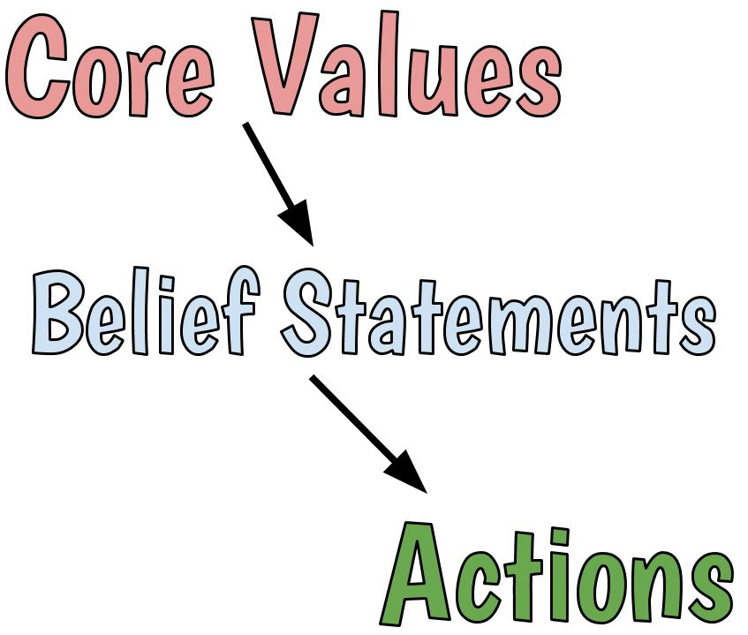

Slide 12
Beliefs Get in the Way
Use the Cards at the table:
Identify the Beliefs that no longer serve you well
What will you do about 1?

Slide 13
What’s next?
Sticky conversation?
Boundaries: “no, but”, “
Yes, and”
Committing to your values:
If you value something, and your calendar isn’t in agreement,
Commit to do something about it

Slide 14
Homework
Keep dreaming your next 10 years
Start the process of your sticky conversation
Report back in Charleston
Complete the Change Style survey
SHARK Tank! Goals, jobs to be done, people, conversations tackled

