Slide 1
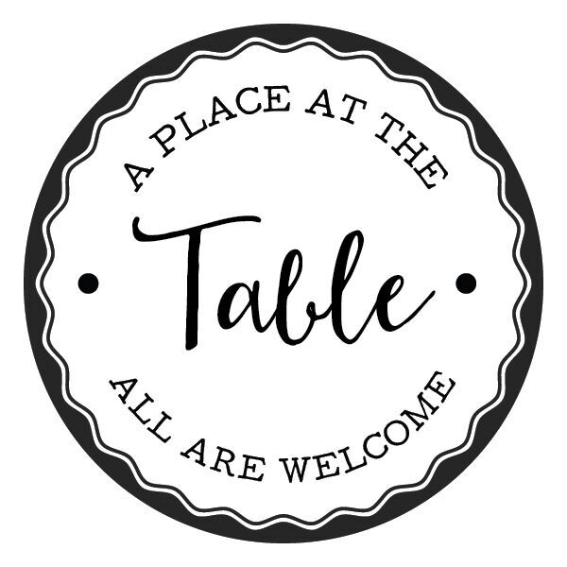
Notes:
Close your eyes. I’d like to invite you to picture a kitchen. Maybe it is your kitchen at home or your dream kitchen that your best friend has. What does it look like? What does it smell like?
Now, I’d like to invite you to picture and think about another kind of kitchen: a soup kitchen.
It’s suddenly a different image, right?
Open your eyes

Slide 2
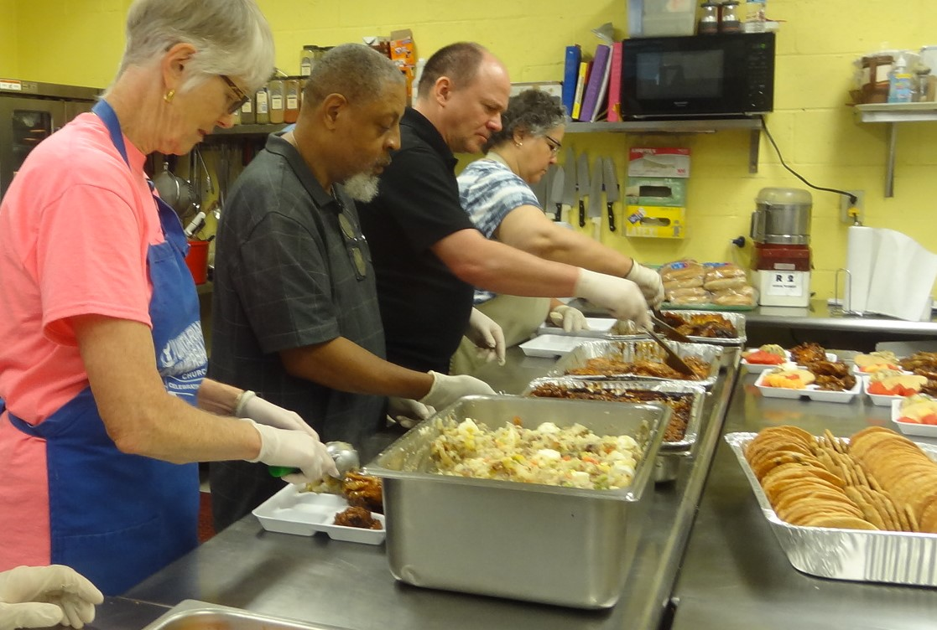
Notes:
Was it something like this? (slide of typical soup kitchen)
If it was—that is okay. It was certainly my idea of a soup kitchen when I was volunteering at one in my hometown as a child. My twin sister, Mom, and I went there often. Not because we were food in-secure, but because my mom wanted to teach us two about serving others.
We would drive downtown, walk in to the soup kitchen, Nancy-the woman in charge) would give us a few different canned goods or items to prepare for the lunch a few hours later. At 11, we would put gloves on fill the plates.
I grew up ‘serving’ there.
And it was through this experience, that II began to notice things, as only a child can.
One thing that always struck me as strange was how I would ‘serve’ this food. I call it “prison style”, we were literally on the opposite side of the counter from them, scooping out whatever food item was on the line that day. Some days pork, some days chicken, on really “good” days, the diners would get a combination of both.
It wasn’t like any dining experience I had at the time - not even my elementary or middle school cafeteria’s felt his way. At the soup kitchen there was an actual barrier in between me and this kid who looked just like me.
After we served the food, my group would not sit and eat. We had done our “Service”, so we’d clean up and talk about where we were going to lunch. We ended up at our favorite Mexican place a lot.
But sitting there with the lunch I loved (often chips and salsa), I’d still have the diners at the soup kitchen in the back of my mind. Something didn’t feel right.

Slide 3
Notes:
Years went by, I transitioned to college.
--App vs. NCSU
--NCSU (international relations degree)- wanted to travel
--& and began to volunteer for day shelter.
--graduated and thought I would again go away…
--but stayed and fell even more in love with people at the shelter
--eating in soup kitchens
STARTED LEARNING MORE ABOUT HUNGER

Slide 4
1 in 7 people are food insecure
1 in 5 children are hungry
-Food Bank of CENC
Notes:
STORY OF JOHN
1 in 7 people are food insecure in our county.
That is 1 in 7 people in your row in front of you. Think about that.
To make it worse, 1 in 5 children are hungry.
That is a lot of people and
I began to take people out for meals. We would go anywhere they wanted to go. We ended up at buffet restaurants a lot.
I had a friend named John, who happened to be experiencing homelessness at the time. John had lost his job in a restaurant because the restaurant shut down. He couldn’t find another one at the time, so he couldn’t pay his light bill. Then he couldn’t pay his rent. He had no one to call to crash on the couch while he got it all together. John ended up at the shelter.
It was John’s birthday, so we went out to dinner. We were at a buffet restaurant that I loved (they had a chocolate fountain). I asked John why he always wanted us to go to this particular restaurant. He said, “Maggie, I am hungry and need food, but I also have dignity here. I am seen. When in poverty, I feel invisible a lot. Here, multiple layers of people greet me. People at the door open the door and say hello, the people at the register ask how I am doing. The servers come around and ask how my food is and if I need a refill. I also have choice. I can choose what I want today. Some days I want a salad because I am feeling greens and some days I want a waffle because some days we just want a waffle, right? I don’t have to just take whatever is available.
Mic drop. Powerful stuff.
I understood and knew I needed to do something about it. I needed to soup kitchen 2.0 this town.

Slide 5
Notes:
Soup kitchens could be this instead.
So we opened APATT the next day and all was well right?
48 months later (yes..48), I opened A Place at the Table, our town’s first and state’s second pay-what-you-can café. In opening A Place at the Table, we joined 60 pay-what-you-can cafes, that are operating across the US.
With 1 million restaurants in the US. We would be the 61st pay-what-you-can one.
In 2014 after visiting the soup kitchen, I knew something had to change.
-researched everything from ___, found OWEE and FARM (mentors)
-incorporation
-build a vision team that turned board
-filled out nonprofit paperwork—kne w we had to be a nonprofit
-held our first fundraiser (disaster)

Slide 6
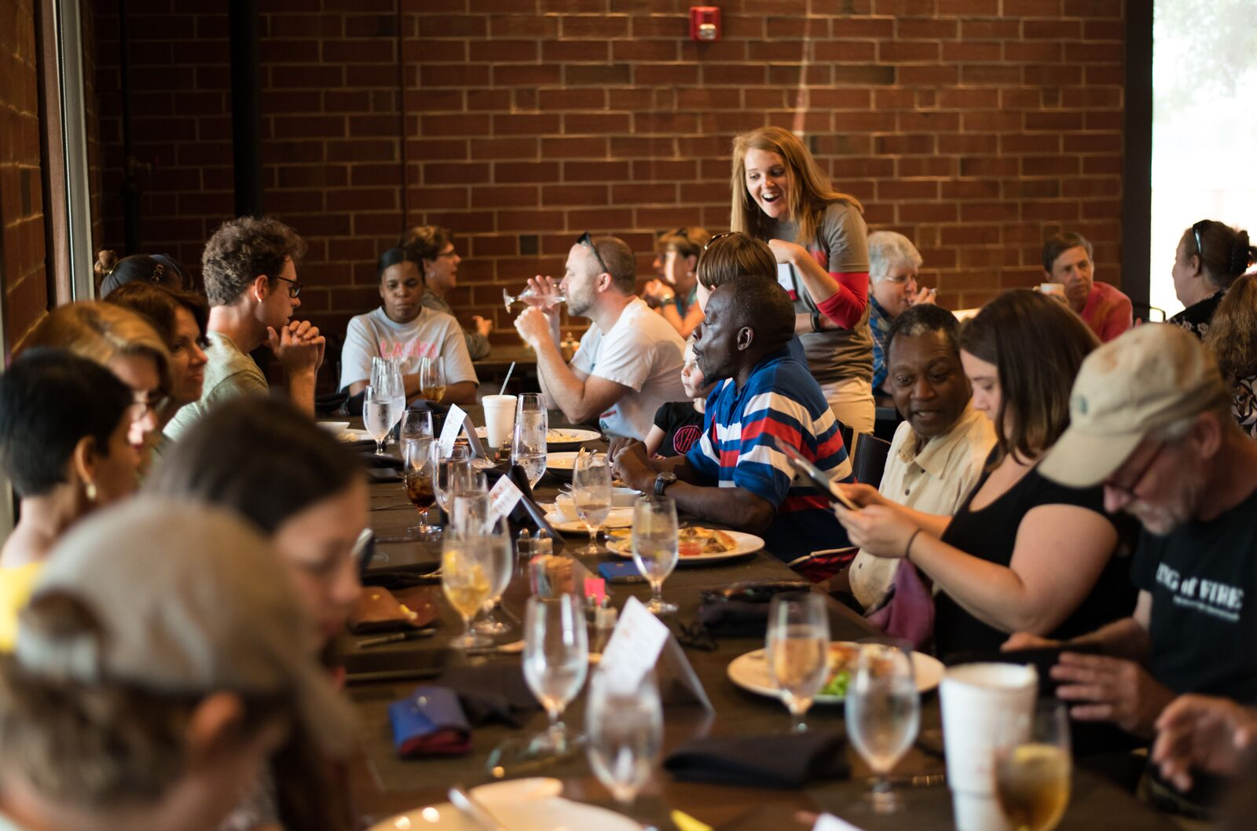
Notes:
-held popups every month to live out the mission
-searched for a space for years and years (landlords turned us down)
-one day, York Properties called..
In January of 2018, we opened APATT

Slide 7
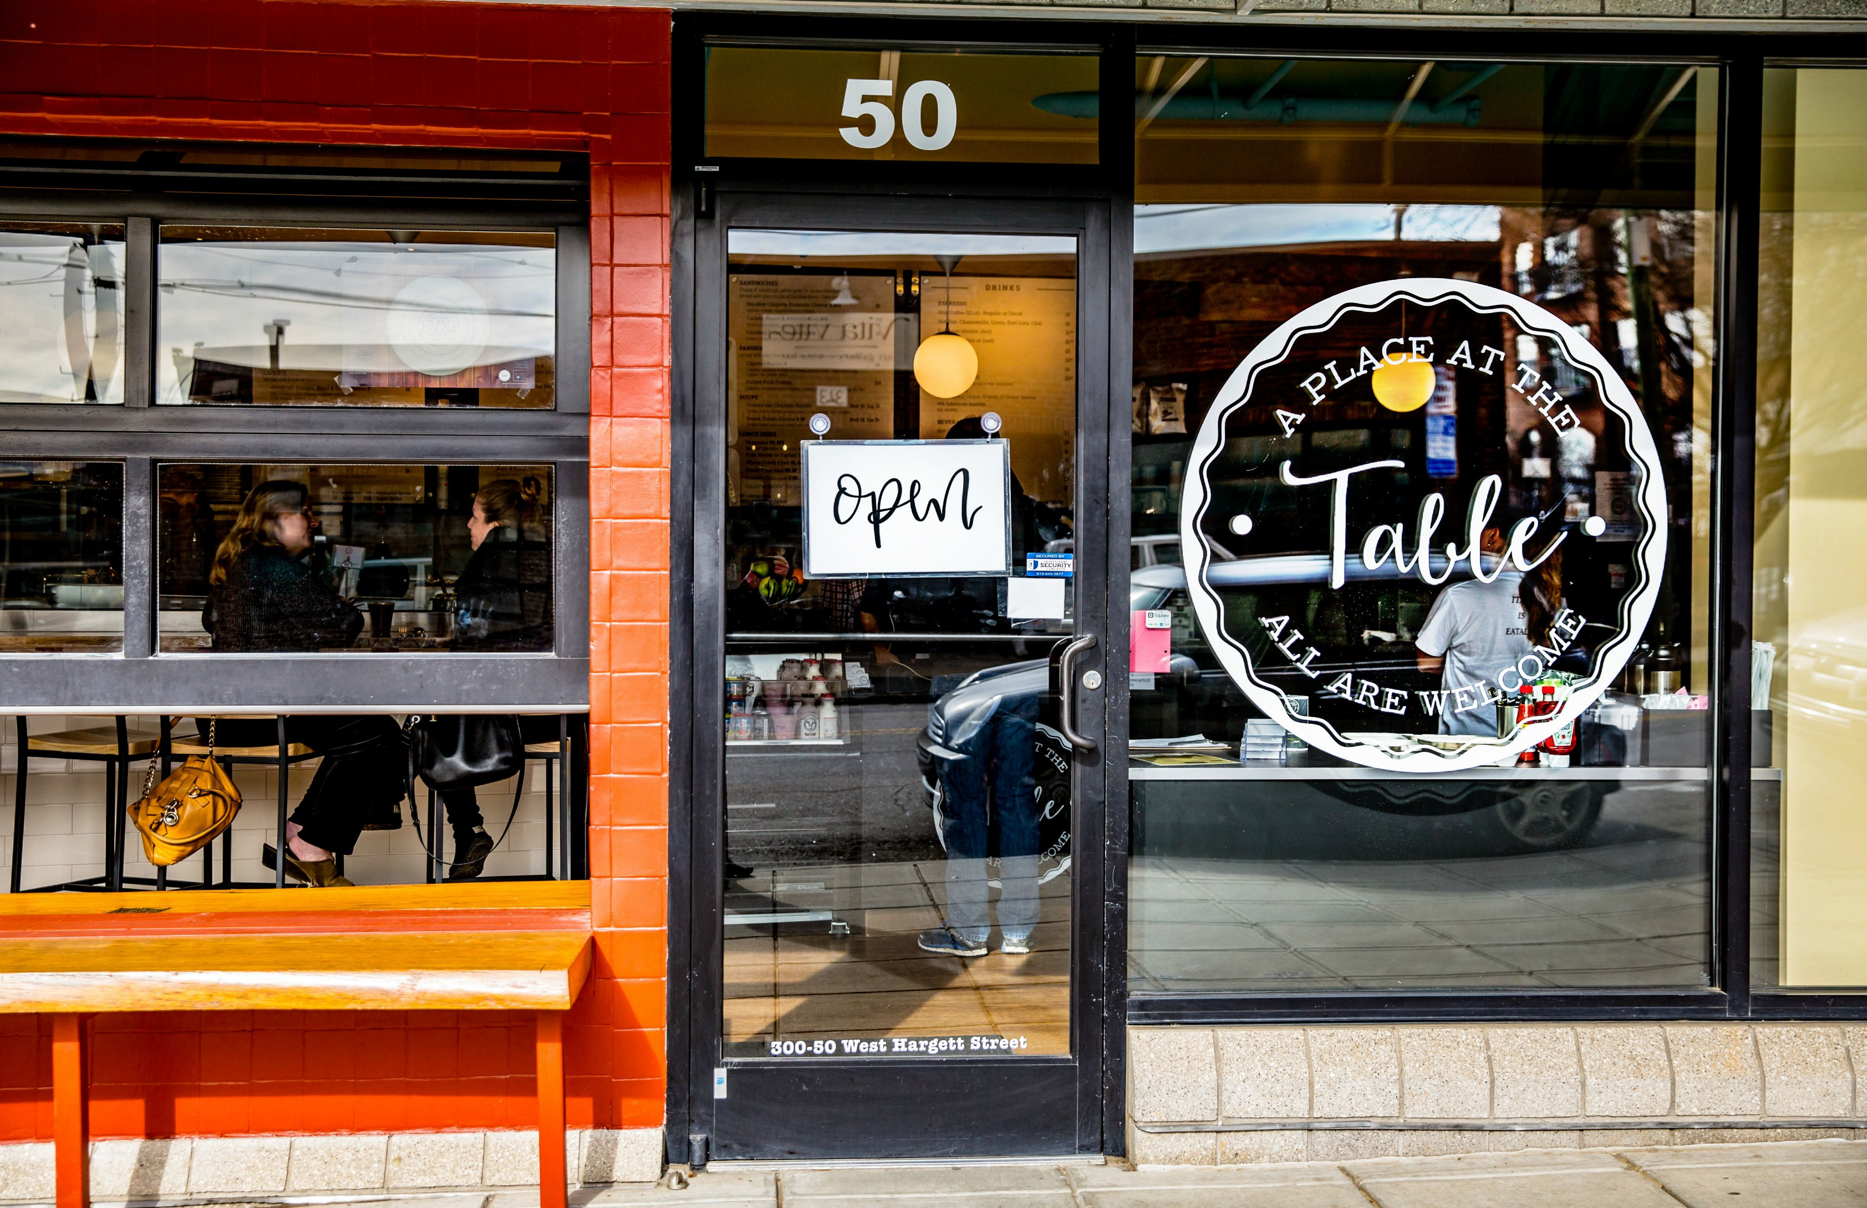
Notes:
STORY OF APATT
So what is a pay-what-you-can café?
I now invite you to walk in this front door with me.
You see a regular restaurant, like most of us go to anyway if weve the opportunity and can afford a meal. You see a menu full of breakfast and lunch items. You smell bacon or hot scones in the oven. You see lots of smiles and good music rolling. You see big photos on the wall with friendly faces.
You truly don’t know we are a nonprofit until you see a few different interesting explainer signs or kind people with volunteer nametags.
Once you order your food, the person behind the register with the volunteer nametag says, “Your suggested price is..would you like to pay that price, less, or volunteer for your meal?”
Suggested pricing means just that. You can choose to pay that, pay more and pay it forward for someone else who cannot afford to pay for their meal, pay less because some weeks are just harder than others and all you can do is pay $5 for your meal, or pay by volunteering with us.
Our mission is to provide community and good food for all regardless of means.
There is a reason community is first in our mission statement.
Isn’t life better when we are in community?
We do this in multiple ways.
We eat together. We have large community tables where people can share meals and come together from all different walks of life.
We volunteer together. We have over 80 volunteers a day. These 80 are either volunteering for their meal or had signed up to volunteer. The cool part is you don’t know who is volunteering for their meal and who signed up. People are doing dishes together, running food, serving refills, and again doing it together…..
We are a hand up vs hand out. We see 40-60 people a day volunteering for their meal. They want to volunteer.
We all want to be a part of something bigger than ourselves. At Table, we all feel a part of it, no matter where we come from.

Slide 8
Notes:
Let me tell you a story about my friend Deno:
Deno has a great story. He started coming to the cafe in January of 2018, right when we opened. I have no idea how he found out about us, but he began coming every day. He did not say a word, at all. He would walk in, eat his food, then volunteer for his meal (mostly do dishes for hours—sometimes all day, just because he wanted to). As the months went on, he began to come out of the dishroom more, as many of us do—boy is that tiring, and he wanted to be a food runner. He didn’t say much, but he began to interact more. After a few months of that you could not shut the guy up! The news came out to do a story and we asked him to interview, he talked for 30 minutes about Table…not sure what he said, but he at least was raving on! Deno shows up every day, sometimes wet from the rain, sometimes freezing cold when the temperature drops, but he shows up bright eyed and ready to see how his Table family is.
All of us, Deno, you, and me, have dignity and all of us belong. We welcome every single person in no matter who you are, where you came from. You are seen, heard, and welcomed. You are in and you have a place at the table.

Slide 9
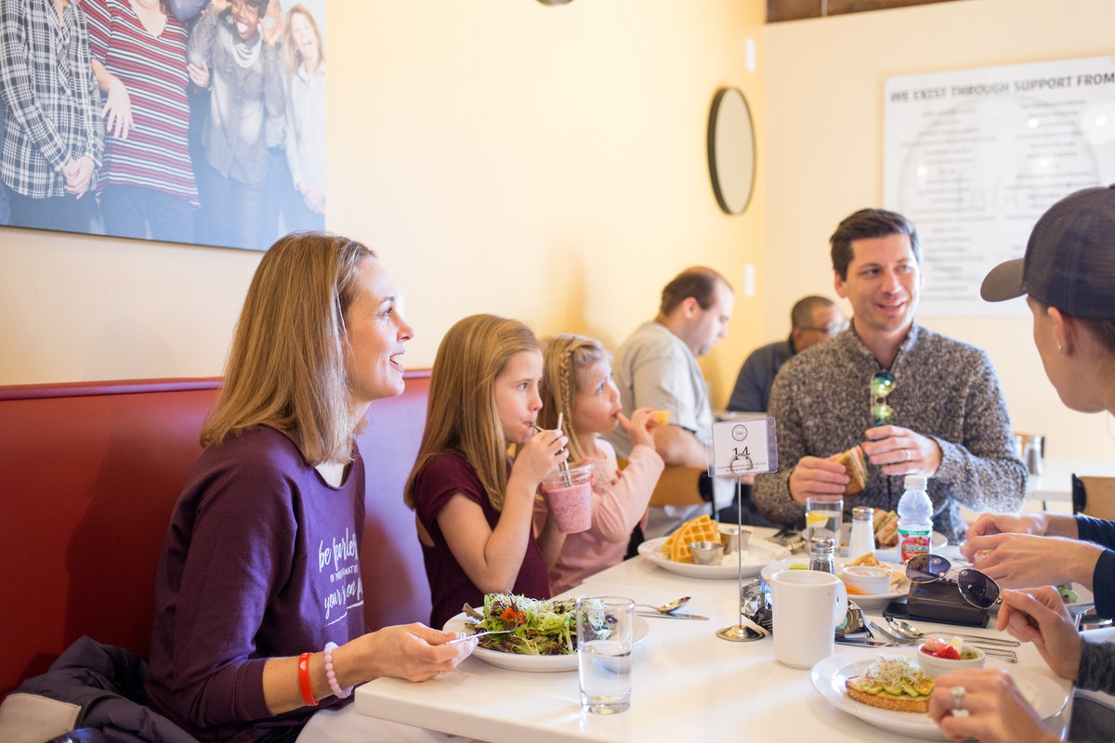
Notes:
I want to tell you another story of how this not soup kitchen impacts our community.
We had a family come in a few months ago. They didn't know the concept. Liz, our POS person at this shift, heard them talking about how it was going to be one of their only meals out in the next couple months. They walked up, put their order in, and she gave them the options of pay. They said, "What? I don't get it. Pay less than 30?" She explained further and the parents starting crying. The dad said, "I lost my job and we are on her assistant teaching pay's income right now. And are you serious, I can get a side salad with my sandwich?" The mom said, "Honey, I told you we were meant to come here today." They paid less and thanked abundantly.
Y’alll, we are changing up the soup kitchen model for all the Denos, all the families who may just have $15 to pay for their families meal, for you, and for me. All of us have community, dignity, and choice. Three things in life that we all need and all deserve.

Slide 10
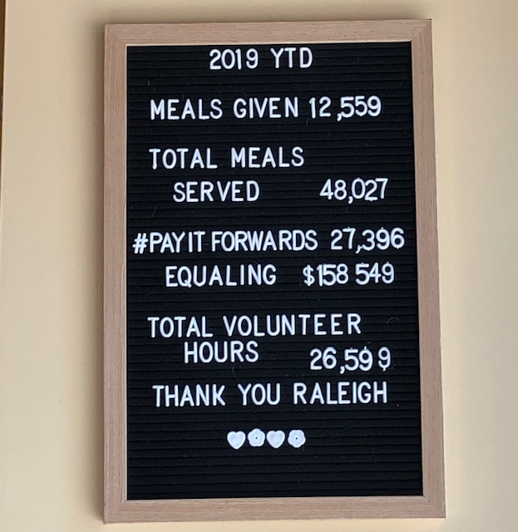
Notes:
AND IT IS WORKING
AND WE ARE EXPANDING—

Slide 11
You can do it too!
Notes:
How can you change your life by doing just one thing?
I knew the answer wasn’t just another feeding ministry or soup kitchen, I knew it wasn’t a regular restaurant…you have to find what your community needs.
Trust me, if I can do it—you can.
Questions?

