Slide 1
Tending the Human Resources
Tips to keep you out of the ditch!
Sharon Justice

Slide 2
Kahoot.it

Slide 3
Handbooks Survey Says…………..
A. We don’t have one in writing | 31%
B. We have a basic document that has a few key items | 15%
C. We have a comprehensive document | 8%
D. We have one in the works | 23%
E We may need some help in figuring out what we need | 23%

Slide 4
What’s the Purpose of A Handbook

Slide 5
If you put it in writing, you must adhere. If you have any question about consistently following a written policy don’t put it in writing

Slide 6
Employee Handbooks Purpose?
Minimum
Pay process
Minimal Workplace Rules
Intermediate
Disciplinary process
Comprehensive
Policies, programs, expectations, etc.

Slide 7
You make your handbook serve your needs
Payroll issues?
Workplace rule violations?
Poor Performance?
Define how pay is processed and when
Define each workplace rule and how it should be followed and what the range of repercussion can be if violated
Define acceptable performance standards and range of consequences if not achieved

Slide 8
What is employment at Will?
Employers can release any employee at any time for any reason without reason, explanation or warning
Employee can quit at any time for any reason

Slide 9
Preserving Employment at Will
State Employment at Will Policy
Add a disclaimer that the handbook, (code of conduct or any other written policies or documents) does not create an express or implied contract between the company and the employee
Put it in clear writing, bold, color, front page—anywhere so it can’t be missed by a disgruntled employee

Slide 10
Avoiding Unemployment
Paid:
Not Paid
Misconduct
Deliberate or disregard for standards of behavior that have been clearly communicated in writing or orally
Carelessness, violence, theft,
A host of other DOCUMENTED performance violations Resignation
Layoffs
Terminations not related to misconduct or policy violations
Notes:
At the next level is the case of rules violation. The rhythm of a
strong rules violation case includes publication of the rule, acknowledgement by the employee,
violation, warning, another violation, termination.

Slide 11
How to avoid paying unemployment?
Employee handbook that outlines:
Policies
Attendance
Drug and Alcohol policy
Performance
Disciplinary process
Documentation of misconduct
Be specific
Document the dates
Create a written record of the violation, warning, violation, termination

Slide 12
Do you have a Corrective Action Policy?
This Photo by Unknown Author is licensed under CC BY-NC

Slide 13
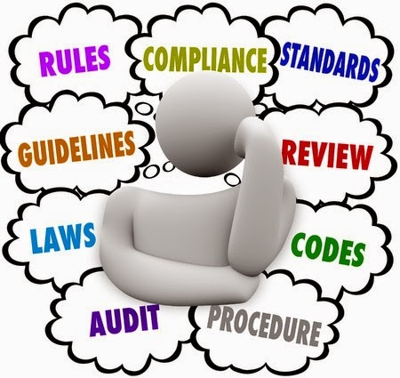
Verbal
First phase to address behavior issues.
Written
Address continued failure to perform. Delivered as formal written document Usually follows a verbal warning
Final written warning or Suspension
Termination
. May be unpaid suspension to allow investigation
Usually follows a written warning, but may be used for situations that require immediate action due to safety, theft, etc.
Usually follows others
Can be immediate
Policy Documented
Performance documented

Slide 14
What does the Brown Family need in their handbook?

