Slide 1
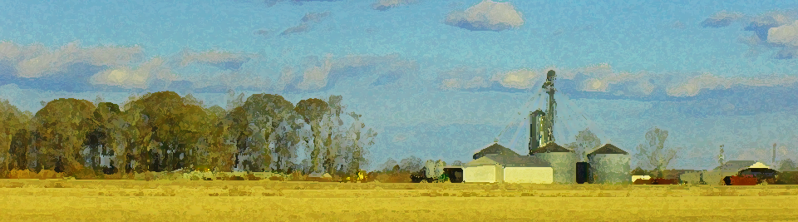
Growers Legal Update
Agricultural Law and Policy
Andrew Branan, JD
Extension Assistant Professor
Department of Agriculture and Resource Economics
North Carolina State University
rabrana2@ncsu.edu

Slide 2
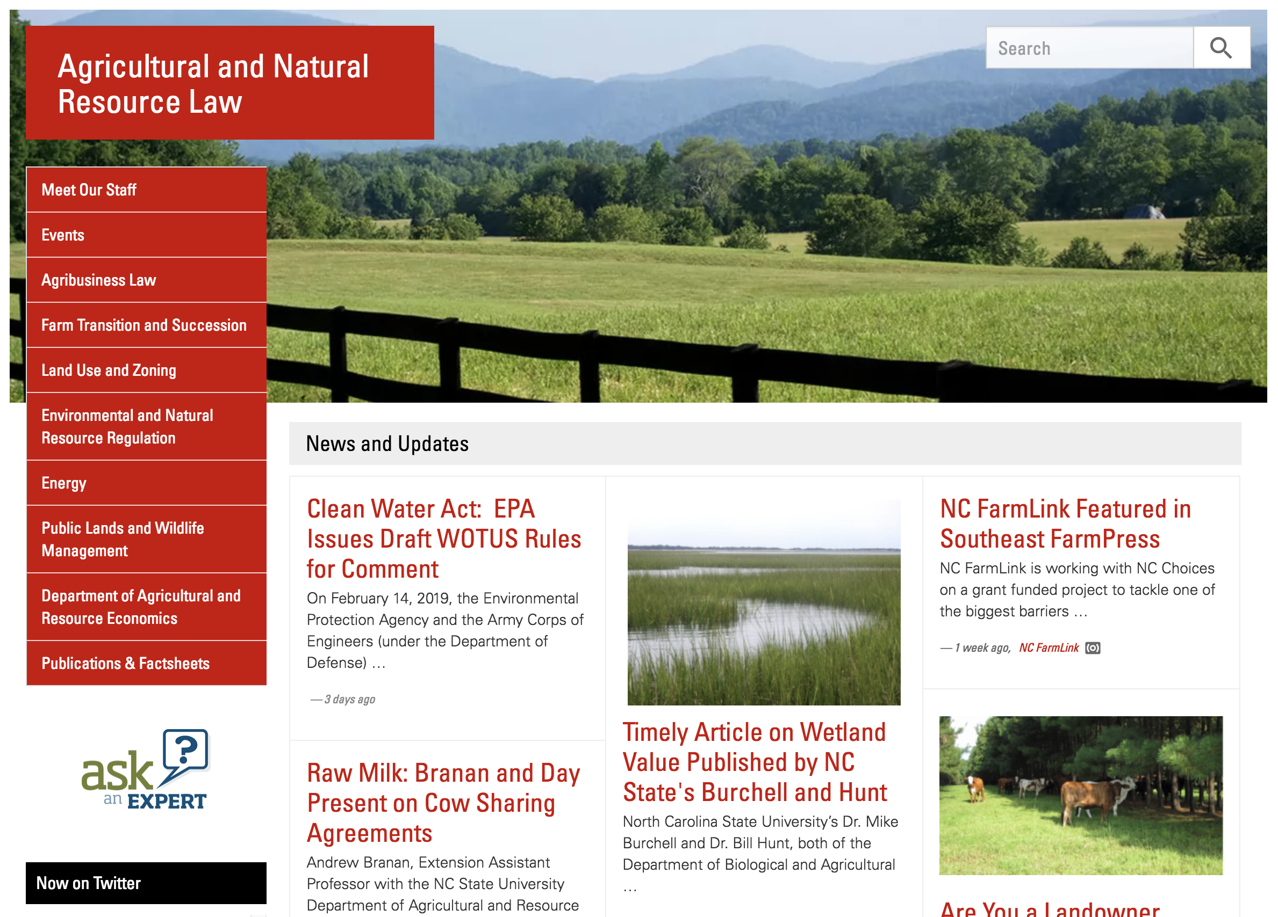
https://farmlaw.ces.ncsu.edu/

Slide 3
NC Agricultural Mediation Program – Farm Bill expansion
Created under Agricultural Credit Act of 1987 (born of 80’s farm crisis)
Mediation: dispute resolution by 3d party neutral
  Collaborative agreement, not focused on winning
Program reauthorized under Farm Bill, provides grant funding for ag mediation as free service
  Run in NC by NC Agricultural Mediation Program (housed at Western Carolina University)
Existing: adverse letter rulings, wetlands determinations, conservation program compliance
2018 Farm Bill expanded list of ”issues” a farm mediation program may mediate, now includes
  Landowner/farmer disputes (leases)
  Equipment leases
  “farm transition” (including partition)
  Organic certification loss
  Right to Farm (neighbor disputes)
  “Other” as state agriculture department determines
    Examples: Easements, water rights, environmental compliance, etc.

Slide 4
This Lawyer’s Background
Member of the Virginia State Bar (1992) and North Carolina State Bar (2003)
Non-profit work in agriculture
  American Farmland Trust
  NC Farm Transition Network
Private (Farm) Law Practice (2010 - 2018)
NCSU Agricultural and Resource Economics (2018)
  70% Extension appointment
  30% Teaching (Environmental and Agriculture Law)

Slide 5
The Role of Legal Counsel
Training and experience with various regulations and who enforces them and when
Experience with liability exposure and allocation in disputes between people, and the factors that led to their resolution
Can apply lessons from work for previous clients, where things have worked and more importantly, where they haven’t
  An exercise in prospective defense against conjured scenarios
    An exercise in cost v. presence of risk and probability
  Lawyers don’t get it right every time, and sometimes the legal work – though it brings piece of mind – simply wasn’t tested by circumstances that would have exposed its gaps
  A witness to what’s at stake in various circumstances

Slide 6
The “Big Picture” (Pres. Obama)
“Agriculture Law” and “Environmental Law” are somewhat intertwined when it comes to farm ownership and operation
Obama Administration implemented a more expansive interpretation of federal policy (as expressed by Congress) in response to increasing scientific understanding of how substances impact our health
  Increased understanding of hydrological science
  History of scientific study of health impacts of ‘substances’
  History of scientific study on carbon impacts in our atmosphere

Slide 7
“The Big Picture” (Pres. Trump)
New Presidential Administration (Trump) somewhat reactive to impacts of regulation on the economy
”Across the Board” reversal of Obama-era policy
Many “Rollback” efforts have been delayed in federal court on procedural grounds (e.g. APA, NEPA and ESA)
Change Factor: Federal judiciary is more conservative?
  Two new Supreme Court Justices (Gorsuch and Kavanaugh)
    GOP confirmed: 5 (CJ Roberts, J. Thomas, J. Alito, J. Gorsuch, J. Kavanaugh
    Dem confirmed: 4 (J. Ginsburg, J. Breyer, J. Sotomayor, J. Kagan
  Kennedy retirement, loss of ‘swing’ vote?

Slide 8
Obama vs. Trump
Supreme Court
  Justice Sotomayor (2009)
  Justice Kagan (2002)
  Judge Garland nominated
Circuit COA
  30 by Jan 1, 2012
  55 total by Jan, 2016
District Courts
  130 by Jan 1, 2012
  268 total by July 2016
Supreme Court
  Justice Gorsuch (2017)
  Justice Kavanaugh (2018)
  Next?
Circuit COA
  50 by October 2019
  Next term?
District Courts
  133 by March 2019
  22 nominated or pending

Slide 9
N.C. Legislature and Courts
(all elected)
Senate
  29 GOP
  21 Dem
House
  65 GOP
  55 Dem
NC Court of Appeals (15 Judges)
  7 GOP
  8 Dem
NC Supreme Court (7 Justices)
  1 GOP
  6 Dem

Slide 10
Todays Topics
North Carolina’s agricultural policy as expressed in annual “Farm Acts”
Smithfield Murphy-Brown Lawsuit: Anatomy of a Nuisance Suit (and legislative response)
Example regulatory “roll backs” impacting agriculture
  Navigable Waters Rule
Updates on Ag Gag, Trespass, Zoning

Slide 11
“Agriculture” Defined in State Law
§ 106-581.1. Agriculture defined.
For purposes of this Article, the terms "agriculture", "agricultural", and "farming" refer to all of the following:
(1) The cultivation of soil for production and harvesting of crops, including but not limited to fruits, vegetables, sod, flowers and ornamental plants.
(2) The planting and production of trees and timber.
(3) Dairying and the raising, management, care, and training of livestock, including horses, bees, poultry, and other animals for individual and public use, consumption, and marketing.
(4) Aquaculture as defined in G.S. 106-758.
(5) The operation, management, conservation, improvement, and maintenance of a farm and the structures and buildings on the farm, including building and structure repair, replacement, expansion, and construction incident to the farming operation.
(6) When performed on the farm, "agriculture", "agricultural", and "farming" also include the marketing and selling of agricultural products, agritourism, the storage and use of materials for agricultural purposes, packing, treating, processing, sorting, storage, and other activities performed to add value to crops, livestock, and agricultural items produced on a farm, and similar activities incident to the operation of a farm.

Slide 12
Liability vs. Regulation
The concept of liability has been developed over hundreds of years in English Common law
  Concept of “tort law” (tort comes from the Latin “torquere,” to twist, “tortus”, twisted, wrested aside)
  Broadly means the wrong one does to another
  Concerns the redress of wrongs between individual parties, where one party is injured or loses property through the “negligence” of another
The concept of regulation comes form our governments’ (federal, state, local) use of its “Police Power”: the obligation we place upon it to protect the general health and welfare of ”we the people”
  Reserving of course certain individual rights guaranteed in US and State Constitutions

Slide 13
Liability vs. Regulation
Liability
  Redress of and compensation for an injury when you owed another person a duty not to injure them
    Food safety – sickness from raw or value-added product traced to you
    Personal injury (driving a tractor down the road)
    Personal injury when you invite someone to your farm
Regulation
  Has been informed by ‘tort law’ over the centuries, we know how injuries generally occur, so we ask the government to protect us
  Eliminate common injury for which no financial redress (other party has no money) – the power to stop you backed up by criminal penalty
  Taxation: collect sales and property tax
  Zoning: regulating proximity of incompatible land uses
  Food Safety: ensuring foods are prepared safely to prevent illness
  Environmental regulation: clean water and air to prevent disease
    Natural Resource Conservation – public good vs. private property right

Slide 14
Liability v. Regulation
Liability = responsible to make an injured party “whole”
(must pay)
Regulation = out of compliance
(must stop operating)

Slide 15
2019 NC “Farm Act” Provisions
(not yet law)
Hemp
  Smokeable hemp banned (“I fought the law…”) (June 1, 2020)
  Applicants must be Qualifying Farmer (have Farm Tax Certificate [or Conditional])*
PUV disqualification notice requirement
Abandoned utility right of ways (separate statue) § 62-193. Disposition of certain unused utility easements.
  Landowner may extinguish if no construction within 20 years of grant, pays utility fair market value of the easement
  File complaint with NC Utilities Commission
  If landowner and utility cannot agree to value, then Clerk of Court appoints commissioners (as in taking valuation)
Confidentiality of Soil and Water gathered info from farms (on conservation applications)
No Clean Water Management TF money if have EQIP money
No Updates to Right to Farm law

Slide 16
Bona Fide Farm Status - Zoning
Exemption from County zoning restrictions
Not an exemption from NC Building Code requirements
  New statute all but requires issuing permit for all farm buildings
Safe Harbors NCGS §153A-340
  A farm sales tax exemption certificate issued by the Department of Revenue.
  A copy of the property tax listing showing that the property is eligible for participation in the present use value program pursuant to G.S. 105-277.3.
  A copy of the farm owner's or operator's Schedule F from the owner's or operator's most recent federal income tax return.
  A forest management plan
FSA Farm Numbers no longer qualify

Slide 17
NC Farm Act Bona Fide Farm Expansion
Bona Fide Farm zoning exemption changes
  Response to Harnett County case (Jeffries v. Harnett Co.)
  Hunting, fishing, shooting sports, equestrian now considered agritourism
    Shooting range requires NC WRC site evaluation
    Agritourism = bona fide farm
  Structures exempt on shooting farms in counties < 110,000 population
Catering from BFF exempt from county or municipal permitting (still must comply with health code)
Roadside signage
  BFF may erect signage within normal 660 foot buffer from edge of interstate or primary highway RW
  Sign not bigger than 3 feet long on any side
  Located on owned or leased BFF

Slide 18
Nuisance Scenario
Scenario: Plan to take a loan to build a chicken house, neighbor objects, threatens to sue
Must unreasonably interfere with neighbor’s use and quiet enjoyment
New Right to Farm standing requirements:
  Is neighbor legal possessor of property? (owner or signed tenant)
  Will neighbor have been there when the poultry houses are built?
  Does the neighbor live within one-half mile of the new poultry houses? (as opposed to ½ mile from boundary)
Is building a chicken house a fundamental change in the land use?

Slide 19


Common Law Nuisance, Generally
In general, nuisance is “that activity which arises from unreasonable, unwarranted or unlawful use by a person of his own property, working obstruction or injury to the right of another, or to the public, and producing such material annoyance, inconvenience and discomfort that law will presume resulting damage”, Black’s Law Dictionary (7th ed.)

Slide 20
Common Law Nuisance:
The Logic Model
General Rule, from Rest. (2nd) of Torts, § 822:
“One is subject to liability for a private nuisance if, but only if, his conduct is a legal cause of an invasion of another's interest in the private use and enjoyment of land, and the invasion is either
  intentional and unreasonable, or
  unintentional and otherwise actionable under the rules controlling liability for negligent or reckless conduct, or for abnormally dangerous conditions or activities.”
§ 826. Unreasonableness of Intentional Invasion
§ 827. Gravity of Harm--Factors Involved
§ 828. Utility of Conduct--Factors Involved
§ 829. Gravity vs. Utility--Conduct Malicious Or Indecent
§ 831. Gravity vs. Utility--Conduct Unsuited to Locality

Slide 21
Fundamental Challenge re Nuisance Litigation
Public understanding of where bacon comes from?
  There is no system to replace this system
  Hard to imagine ecological damage from sufficient “pasture pork” to meet current demand
  Does this feature into nuisance liability “balance” theory?
Right to Farm laws are increasingly being challenged on constitutional “property rights” deprivation
  Does the NC RTF (as amended) statute strike enough balance?
  Iowa RTF statute held unconstitutional “as applied” (Gacke v. Pork Xtra, L.L.C.)

Slide 22
Murphy-Brown Cases and Right to Farm
26 cases (540 plaintiffs)
  5 verdicts
  Remainder stayed pending appeal
4th Circuit Appeal
  Briefs filed (including Farm Bureau amicus)
  Arguments heard Friday January 31, 2020
Issues on Appeal:
  Punitive damages: did the trial judge err as a matter of law in allowing award of punitive damages?
  Right to Farm: does it apply retroactively?
  Exclusion of defense expert witness on odors and other evidentiary rulings

Slide 23
Farm Nuisance Litigation Generally
Nuisance litigation tends to reflect the types of agriculture prevalent in the state.
  WI cranberry bogs (water quality, flooding)
  LA sugar cane fields (burning)
  NC swine operations
  New England wedding barns (noise, traffic)
Animal ag nuisance tends to get the headlines because of the potential impact
Very difficult to measure the impact of the RTF statutes from across the country
In early American trespass and nuisance cases, farmers were often the plaintiffs (against municipal water treatment)

Slide 24
General RTF Protection Triggers
3 Basic types of triggers
  Farm existed first (i.e. “Coming to the Nuisance”)
    Feature of NC law
  Some states have designated agriculture zones and only operations in the zone receive protection
    Not a feature of NC law
    However statutory ban on local swine zoning (Craig v. Chatham Co.)
  Many states say that if a farm has been in continuous operation substantially unchanged, then it receives protection (statute of repose)
    Feature of NC law

Slide 25
New Right to Farm (§106-701)
(all must apply)
(1) The plaintiff is a legal possessor of the real property affected by the conditions alleged to be a nuisance.
(2) The real property affected by the conditions alleged to be a nuisance is located within one half-mile of the source of the activity or structure alleged to be a nuisance.
(3) The action is filed within one year of the establishment of the agricultural or forestry operation or within one year of the operation undergoing a fundamental change.

Slide 26
“Fundamental Change” is not:
A change in ownership or size.
An interruption of farming for a period of no more than three years.
Participation in a government-sponsored agricultural program.
Employment of new technology.
A change in the type of agricultural or forestry product produced.
  Grazing cattle to poultry house?
  Forestry harvest cleared for poultry house?

Slide 27
Nuisance Damages (§106-702)
measured by the reduction in the fair market value of the plaintiff's property caused by the nuisance, but not to exceed the fair market value of the property
(new) “A plaintiff may not recover punitive damages … from an agricultural or forestry operation that has not been subject to a criminal conviction or a civil enforcement action* taken by a State or federal environmental regulatory agency pursuant to a notice of violation for the conduct alleged to be the source of the nuisance within the three years prior to the first act on which the nuisance action is based.”

Slide 28
Attorneys Fees
(f) In a nuisance action against an agricultural or forestry operation, the court shall award costs and expenses, including reasonable attorneys' fees, to:
  (1) The agricultural or forestry operation when the court finds the operation was not a nuisance and the nuisance action was frivolous or malicious; or
  (2) The plaintiff when the court finds the agricultural or forestry operation was a nuisance and the operation asserted an affirmative defense in the nuisance action that was frivolous and malicious.

Slide 29
4th Circuit Appeal
Oral arguments scheduled for January 28-31(ish)
Argument for retroactive application of 2018 changes to Right to Farm law
  Some precedent for “clarifying” laws
Other issues:
  Whether damages are appropriate remedy
  Judges ruling on evidentiary issues
    Odor expert testimony
    Denial of juror farm visit
Decision will likely not serve as precedent for North Carolina state law on Right to Farm

Slide 30
Rural Empowerment Association for Community Help et al v. State of North Carolina, et al (19 CVS 8198)
On June 19, 2019, three non-profit groups filed a state constitutional challenge (in Wake County) to the 2017 & 2018 right to farm amendments
Claims include:
  Illegal “special law”
  Deprived plaintiffs members of property rights
  Violates right to jury trial to judge nuisance elements
Status?

Slide 31
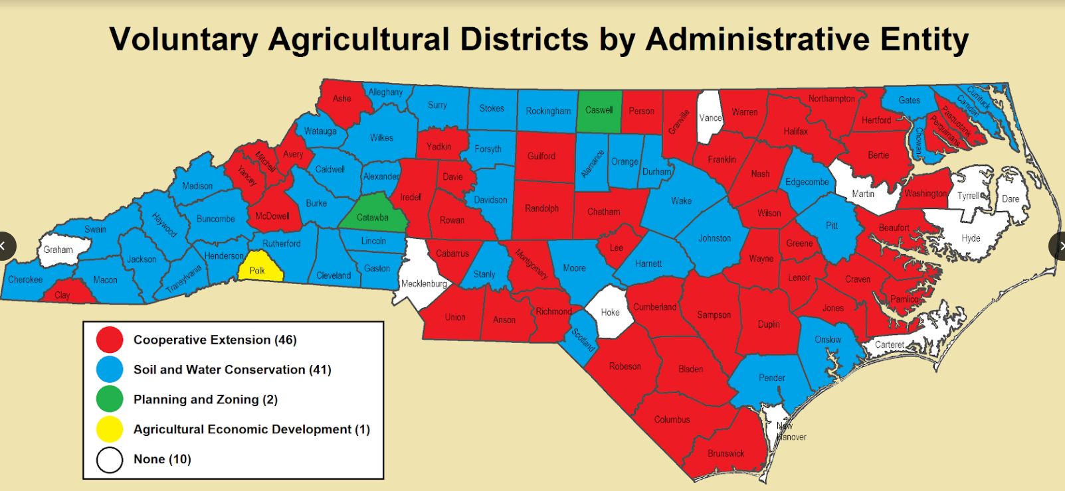
Voluntary Agricultural District update
Voluntary program, non-binding, get signage
Counties must provide a land records warning (in chain of title, GIS, etc.) to warn of proximity to farms enrolled in the program
  1000 feet poultry, swine or dairy
  600 feet of qualifying farm
  ½ mile from VAD

Slide 32
Regulatory “Roll Backs”
Systematic reversal of regulations promulgated by the Environmental Protection Agency during Obama Administration
Many targeted at protecting extraction economy
  Relaxation of carbon, methane, mercury standards
  Opening up public lands for extraction (e.g. OCS NC)
  Ag: Relaxation of pesticide and worker safety regulations; repeal of GIPSA rule
Early efforts held in check by federal courts, failure of new Administration to follow Administrative Procedures Act and National Environmental Policy Act

Slide 33
APA and NEPA
Administrative Procedures Act (5 U.S.C. §501 et seq.)
  Passed 1947
  Defined process by which Agencies promulgate rules to implement federal statutes
  Court reviews agency action to determine whether “arbitrary and capricious”
National Environmental Policy Act (42 U.S.C. §4321 et seq.)
  Passed 1970
  Requires government to consider environmental consequences of federal projects
  Defined process of assessment and disclosure
  Don’t have to choose best, just disclose consideration of impacts of alternatives

Slide 34
Waters of the United States (WOTUS) Repeal of 2015 Rule
Fundamental tension between Clean Water Act jurisdiction (federal) and state jurisdiction over waterways (and what you can discharge to them)
  If not WOTUS, no federal jurisdiction (state must regulate)
  Theoretically, state may enforce stricter standards
February 28, 2017 EO
Proposed Rules in line with Rapanos v. US decision (2006): wetlands adjacent or direct surface connection to navigable waters
Revised rules revoke 2015 final rules
Relevance:
  fill of wetlands, ditches, etc. require permit
  Discharge of pollution (point source) requires NPDES permit
December 23, 2019 effective date of Final rules

Slide 35
Scenarios
Landowner wishes to deepen a wetland area into a pond for irrigation or livestock
Landowner wishes to fill in a wet area on property for crop production
Landowner wishes to divert established ditching on property
Landowner wishes to “un-dam” an existing pond
Must landowner apply for a CWA §404 permit?

Slide 36
Waters of the United States (“WOTUS”)
The term WOTUS refers to the jurisdiction limit of the Army Corps of Engineers over dominion of water on your land
The “outer limits of Congress’ commerce power” (40 FR 37144)
Clean Water Act (FWPCA): “The objective of this chapter is to restore and maintain the chemical, physical, and biological integrity of the Nation’s waters” (33 U.S. Code §1251(a))
  Defined by Army Corps as that which affects domestic and foreign commerce
  40 C.F.R. §122.2 (Army Corps of Engineers Rules)

Slide 37
WOTUS History
“The term “navigable waters” means the waters of the United States, including the territorial seas.” 32 U.S.C. §1362(7)
Previous focus was the “navigable in fact” jurisdiction of Rivers and Harbors Act of 1899
In 1972, expansion of jurisdiction to achieve CWA directive that “due regard shall be given to the improvements which are necessary to conserve such waters for the protection and propagation of fish and aquatic life and wildlife, recreational purposes, and the withdrawal of such waters for public water supply, agricultural, industrial, and other purposes.” 33 U.S.C. §1252(a)

Slide 38
“Waters of the United States” (WOTUS) Terms
The term WOTUS refers to the jurisdiction limit of the Army Corps of Engineers
“Navigable in Fact” – waterways used in ordinary condition as as highways for commerce
Ephemeral əˈfem(ə)rəl (adj.). Lasting for a very short time
  “An ephemeral channel”
Intermittent in(t)ərˈmitnt (adj.). Occurring at irregular intervals; not continuous or steady.
  “An intermittent stream”
Nexusˈneksəs/ (n.) A connection or series of connections linking two or more things
  “The nexus between a wetland and a navigable waterway”

Slide 39
WOTUS Litigation History - Wetlands
U.S. v. Riverside Bayview Homes, Inc. 474 U.S. 121 (1985)
  Wetlands that “actually abutted” traditional navigable waters
  Corps expands enforcement to sewers and arroyos
Solid Waste Agency of Northern Cook County v. Army Corps of Engineers, 531 U.S. 159 (2001) (SWANCC)
  WOTUS does not extend to isolated ponds
  Does not overrule Riverside Bayview

Slide 40
Rapanos v. EPA 547 U.S. 715 (2006) to Current
Two holdings (4-1-4)
  Plurality (Roberts, Scalia, Thomas, Alito
  Concurrence (Kennedy): significant nexus test
Lower Courts continue to follow Kennedy holding, under obscure SCOTUS ruling requiring lower courts to follow narrowest holding where no clear majority
EPA promulgates WOTUS rules in 2015
Current Presidential Administration proposes revised rules, eliminate EPA veto of 404 permits

Slide 41
Review 2015 Rules:
8 Categories of Jurisdictional Waters
Traditional navigable waters
Interstate waters
Territorial Seas
Impoundments of jurisdictional waters
Tributaries
Adjacent
Isolated wetlands (5 types)
Waters within 100 year flood plain
  4000 ft from traditional navigable water
“Jurisdictional by Rule”= no additional analysis required
“Case by Case basis”= significant nexus (Kennedy concurrence)

Slide 42
Case by Case “Similarly Situated” Nexus to Downstream Water Quality
Five types of isolated wetlands
  Prairie potholes
  Carolina and Delmarva bays
  Pocosins (Algonquin for “swamp on a hill”)
  western vernal pools in California
  Texas coastal prairie wetlands
“similarly situated” analysis is conducted where it is determined that there is a likelihood that there are waters that function together to affect downstream water integrity

Slide 43
Current Events
November 2017: EPA and ACOE issue rule delaying 2015 WOTUS rule for 2 years
February 2018: several District Court cases filed challenging stay
Various District Court cases re-commence around the country (Texas, OK, GA, ND) challenging 2015 rule
EPA and ACOE try to stay litigation (ND case denied)
GA District Court delays WOTUS rule (including NC)
SC District Court invalidates 2 year delay rule

Slide 44
Finalized “Navigable Water Rule” Highlights
Wetlands must have “direct hydrologic surface connection” to traditional water (continuous surface)
Wetlands physically separated from other waters of the United States by upland or by dikes, barriers, or similar structures and also lacking a direct hydrologic surface connection to such waters are not adjacent
Ditches are generally proposed not to be “waters of the United States” unless
  functioning as traditional navigable waters
  constructed in a tributary and also satisfy the conditions of the proposed “tributary” definition
  constructed in an adjacent wetland and also satisfy the conditions of the proposed “tributary” definition.
Tributaries do not include surface features that flow only in direct response to precipitation, such as ephemeral flows, dry washes, arroyos, and similar features
  Perennial means year round
  Intermittent means continuous flow at certain times in a ”typical” year
Groundwater is not WOTUS

Slide 45
Definitions
“typical year” – precip and other ‘climate variables’ are within normal range based on rolling 30 year period
”perennial” – continuous surface flow
“intermittent” – flows only in direct response to rainfall
“ephemeral” – predictable flows in a year (not just in response to rainfall)
“adjacent wetlands” – abuts or is connected to traditional navigable water
  May be separated by berms, bank, dike or dune
  Separated by artificial berm, dike etc. if have a direct hydrologic connection through e.g. culvert or flood gate
“waste treatment system” – lagoons and retention ponds

Slide 46
Endangered Species Act Finalized Rules
Land fauna administered by U.S. Fish and Wildlife Service (Dept. of Interior); Sea fauna by Marine Fisheries (NOAA)
Relevance:
  landowner dominion over land considered critical habitat for threatened or endangered species (e.g. red cockaded woodpecker)
  Pipeline and other permitted ”takings” projects requiring ESA impact analysis
General “rollback” of environmental regulation under current presidential administration
Federal Register highlights
  Removes climate change from consideration (redefines “foreseeable future”)
  Allows agency to consider “economic impacts” of listing determinations for ‘transparency’ (increase political pressure?)
  “threatened” species no longer given automatic protection (must each go through administrative rulemaking process [APA])
  Reduction in requirement of inter-agency consultation
Effective September 26, 2019

Slide 47
ANIMAL ACTIVISM – “Ag Gag” law
Creates a civil right of action for private employers
North Carolina Property Protection Act, N.C.G.S. 99E-2(b)
  Employee enters non-public space of employment to remove or capture “data, paper, records, or any other documents and uses the information to breach the person's duty of loyalty to the employer”
  “records images or sound occurring within an employer's premises”
  “placing on the employer's premises an unattended camera or electronic surveillance device”
  Commits “An act that substantially interferes with the ownership or possession of real property”
Under challenge in PETA v. Stein (before federal Middle District NC, 1:16-cv-00025-TDS-JEP )
  4th Circuit has granted standing to PETA et al in ”pre-enforcement challenge” to First Amendment rights

Slide 48
Drone Law
Any person who is the subject of unwarranted surveillance, or whose photograph is taken in violation of the provisions of this section, shall have a civil cause of action
  If you hear a drone you think is trying to take evidence on your property, go outside and make sure it is taking a picture of you!
In lieu of actual damages, the person whose photograph is taken may elect to recover five thousand dollars ($5,000) for each photograph or video that is published or otherwise disseminated, as well as reasonable costs and attorneys' fees and injunctive or other relief as determined by the court.

Slide 49
Drone Law (§15A-300.1)
Surveillance of real property prohibited without consent of owner or lessee (§15A-300.1[b][1][b])
May not photograph an individual, without the individual's consent, for the purpose of publishing or otherwise publicly disseminating the photograph.
  Does not apply to newsgathering, newsworthy events, or events or places to which the general public is invited
Maximum height: 400 feet
Permit for commercial operation
18 U.S.C. 32 prohibits destruction of aircraft
Cannot use to hunt or fish or interfere with taking of wildlife

Slide 50
Bona Fide Farm Status - Zoning
Exemption from County zoning restrictions
Not an exemption from NC Building Code requirements
Safe Harbors NCGS §153A-340
  A farm sales tax exemption certificate issued by the Department of Revenue.
  A copy of the property tax listing showing that the property is eligible for participation in the present use value program pursuant to G.S. 105-277.3.
  A copy of the farm owner's or operator's Schedule F from the owner's or operator's most recent federal income tax return.
  A forest management plan
FSA Farm Numbers no longer qualify

Slide 51
Bona Fide Farm - Agritourism
A building or structure that is used for agritourism is a bona fide farm purpose if the building or structure is located on a property that (i) is owned by a person who holds a qualifying farmer sales tax exemption certificate from the Department of Revenue pursuant to G.S. 105-164.13E(a) or (ii) is enrolled in the present-use value program pursuant to G.S. 105-277.3. Failure to maintain the requirements of this subsection for a period of three years after the date the building or structure was originally classified as a bona fide purpose pursuant to this subdivision shall subject the building or structure to applicable zoning and development regulation ordinances adopted by a county pursuant to subsection (a) of this section in effect on the date the property no longer meets the requirements of this subsection.
For purposes of this section, "agritourism" means any activity carried out on a farm or ranch that allows members of the general public, for recreational, entertainment, or educational purposes, to view or enjoy rural activities, including farming, ranching, historic, cultural, harvest-your-own activities, or natural activities and attractions. A building or structure used for agritourism includes any building or structure used for public or private events, including, but not limited to, weddings, receptions, meetings, demonstrations of farm activities, meals, and other events that are taking place on the farm because of its farm or rural setting.

Slide 52
Trespass Generally
§38B-2. General rule. A possessor of land, including an owner, lessee, or other occupant, does not owe a duty of care to a trespasser and is not subject to liability for any injury to a trespasser.
§38B-3. Exceptions
  Intentional harm = “willful or wanton”
    Example: thin wire across field entrance (to repel ATV)
    May use reasonable force to repel a crime
  Harm to Children (<14) (attractive nuisance doctrine)
    reason to know that children were likely to trespass and
    owner knew of unreasonable risk of serious bodily injury or death and
    child did not appreciate the risk and
    utility to the possessor of maintaining the condition and the burden of eliminating the danger were slight as compared with the risk discover the condition or realize the risk involved and
    possessor failed to exercise reasonable care to eliminate the danger or otherwise protect the injured child.

Slide 53
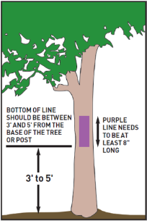
Landowner Protection Act
Prior to 2011, WRC had to get warrant to arrest trespasser
NCGS §14-159.6 (outlines proof of permission)
  Class 2 Misdemeanor for “willful” trespass
  Class 1 Misdemeanor for pine straw trespass
  Must produce written permission when confronted by Wildlife Resources Commission officer or sheriff/deputy sheriff
  HUNT CLUB
    Must produce hunt club membership card, and
    Written permission
NCGS §14-159.7 (marking)
  Signs not less than 120 square inches
  Not more than 200 yards apart
  May paint Purple Mark
    Vertical line 8 inches long
    3 feet above ground
    100 yards apart
Source: NC WRC

Slide 54
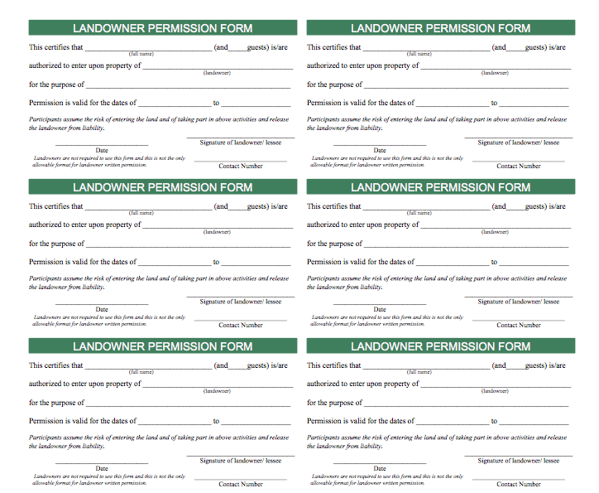
Wallet Size Card

Slide 55
Timber Trespass
N.C.G.S.§14-128. Willfull injury to trees is Class 1 Misdemeanor
  NCDOT gets pass in RW
NCGS §1-539.1
  Injured landowner entitled to double stumpage of timber cut (cutting and burning)
  Need a good boundary survey (mark boundary trees)
  Timber harvester entitled to reimbursement from landowner who misrepresents property lines
Hamby v. Thurman Timber Company (July 2018)
  Contractor trespass not attributable to buyer (without more evidence)

Slide 56
THANKS FOR INVITING ME!
Robert “Andrew” Branan
Extension Assistant Professor
Department of Agriculture and Resource Economics
North Carolina State University
Campus Box 8109
4336 Nelson Hall
Raleigh, NC 27695
rabrana2@ncsu.edu
919 515 4670

